Slide 1
CS427: Software Engineering I
Components and Reuse

Slide 2
Today’s goal
What are reusable components?
When should we reuse components vs. build our own?
How do we design with component reuse in mind?
How do we design with/for reuse?

Slide 3
Commercial off-the-shelf (COTS)
History
60’s: compilers, OS, accounting apps, IBM
70’s: numerical libraries, other apps (payroll, manufacturing, etc.)
80’s: GUI libraries, Unix, Microsoft
90’s: CORBA, COM, VB, Office, Internet, Java, SAP, Oracle, PeopleSoft
2000’s: XML, EJB, SOAP, .NET, Ajax, SOA
2010’s: SaaS (Software as a Service)

Slide 4
COTS
Standard applications need
Standard OS
Standard way of customizing them
Standard way of connecting them to other software

Slide 5
Customizing COTS
Programming languages
COBOL, FORTRAN, C, VB, Java…
Scripting languages
sh, VB, perl, Lua, Python, Ruby…
APIs
DLL, CORBA, COM, SOAP…
Data formats
Unix streams, RDBMS, XML, JSON…

Slide 6
Importance of standards
Need a large user base
To make it likely that the component that you need has been developed
To give enough potential customers for a component that you are developing

Slide 7
Standards for interfacing
Unix: All components have the same interface, stream of ASCII characters
Ada, Smalltalk, Java: Use some programming language to define custom data types and use it to write components and clients that use the components

Slide 8
Standards for interfacing
Older standards
CORBA: Use IDL (interface description language) to define the interface of component. Generate code from IDL
COM: Component has many interfaces. There is a binary standard for interfaces. DCOM is distributed
.NET/JVM: Standard run-time allows languages to interoperate

Slide 9
CORBA
Developed by OMG (www.omg.org)
Language independent, object-oriented
Define interface with IDL
Generate proxies for clients, skeleton for servers
Components on different machines
Complete standard includes many standard interfaces

Slide 10
COM
Developed by Microsoft
An interface is an array of function pointers
Clients refer to objects by their interfaces
The first operation of any interface is QueryInterface(I); returns a pointer to the interface named I if the object has one

Slide 11
WWW as a component system
One server can reuse services from other servers by embedding links in pages
Google Maps
Amazon
PayPal
XML – data standard – let other servers read data more easily
SOAP – send commands in XML
JSON – another data standard
REST – URL specifies the command

Slide 12
Browser as a component system
Web browsers – core C/C++, dynamism with JavaScript
Extensions
JavaScript that gets loaded later
Monkey patching
JavaScript is standardized
Each browser defines its own interfaces, implementation

Slide 13
What is component-based design?
Designing an application by breaking it into components
Designing an application by building it from existing components
Designing components
Designing reusable components
Designing reusable interfaces

Slide 14
Implications of component reuse
Must change architecture
Based on components
Usually changes specification
Eliminate features that are too expensive
Changes detailed design and implementation
Wrapping components and gluing them

Slide 15
Reusing components
Add component early
Use it in early iteration
Adjust design to fit component
Add component late
Refactor to replace old code
Design set before component

Slide 16
Component architectures
Some architectures based on components
Active Server Pages (ASP), Microsoft Transaction Server (MTS)
JavaBeans, Servlets
Eclipse plugins
Jenkins plugins

Slide 17
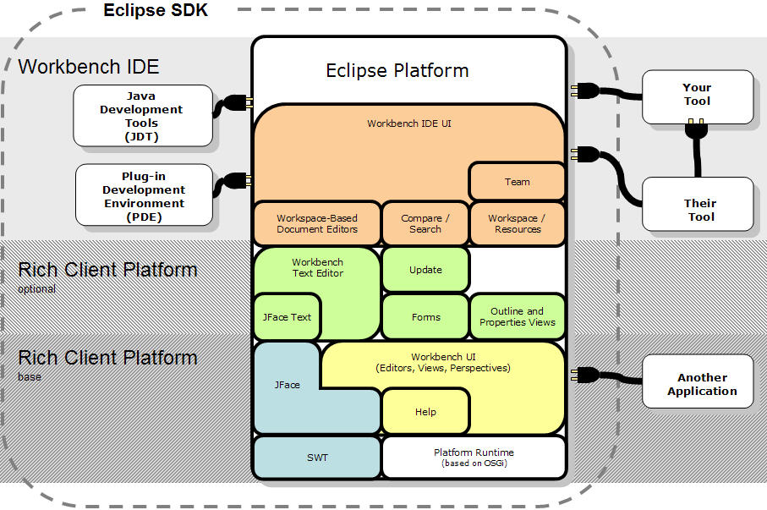
Don’t worry about the details

Slide 18
Reuse approaches
Components
Frameworks
Domain-specific software architectures
Product-line architectures

Slide 19
Group Discussion
Get into 2 or 3 person groups and discuss your answers for the following questions
What reusable components did you reuse in your past software development (including but not limited to K development)? What are the component forms?
What reusable components do you wish/want to develop based on existing code portions (including but not limited to the K code base)? What are the component forms?

Slide 20
Economics
Reuse software when the benefits are greater than the cost
Reuse software when
The cost with reuse < cost without reuse
Reuse benefit metric
CostNoReuse(S) - CostWithReuse(S)
CostNoReuse(S)
Rb(S) =

Slide 21
Cost savings
Cost savings =
cost without reuse
- costs associated with reuse
- cost of software as delivered

Slide 22
Costs of reuse
Royalties and licenses
Training
Support and enhancement of components
Domain analysis and modeling
Increased documentation for reuse
Reuse repository

Slide 23
Costs of reuse
Reusing free software is not free
Reusing software has risks
Reusing software can increase quality, decrease time-to-market
Are the benefits worth the costs?

Slide 24
Summary of economics of reuse
Reusing software has many benefits
Must watch to make sure the benefits are worth the costs
Don’t do too much at once
Have someone responsible

Slide 25
Costs of reusable software
Reusable software is more expensive than non-reusable software
Must reuse it many times to pay off
COTS sells for small fraction of cost of development
Can only sell to part of market
COTS requires a big market

Slide 26
Results of costs
Make sure the benefits are large before you start to develop reusable software
Internal reuse is less expensive than developing COTS
Best to develop for internal use, then internal reuse, then to sell to others

Slide 27
Internal reuse vs. COTS
COTS requires marketing
To learn what people need
To let people know what you have
COTS requires training program
COTS requires very good documentation

Slide 28
Frameworks
Frameworks = Components + Patterns
Reading on Wiki
Build reusable pieces of software
What is the difference between a pattern, a framework, and a component?
How is a framework different from a library?

Slide 29
Design with reuse
Little reuse
Design as normal
Check design for pieces that might be reused
Much reuse
Domain analysis
Select architecture with components
Reuse components designed for architecture
Consider rewriting new components to make them reusable

Slide 30
Many technologies
Software as a service / service-oriented
Domain specific languages
Object-oriented frameworks
Components
Libraries

Slide 31
Design for reuse
Software that isn’t tested doesn’t work
Software that hasn’t been reused isn’t reusable
Reusable software is developed by iteration

Slide 32
Domain analysis
Look at the entire problem domain
Read text books
Collect and categorize problems
Make a model for everything in the domain

Slide 33
Domain engineering
Build software that helps to build applications in the problem domain
Class libraries (frameworks)
Little languages
Table driven applications
Specialized modeling tools

Slide 34
Build applications
Applications are a test for components
Will show weaknesses
Fixing weaknesses requires changing the components
Changing components breaks applications

Slide 35
Iterative approach to making reusable software
Develop version for one customer, making software simple, modular, and easy to change
Develop version for another customer, refactoring to keep software simple. Make the first customer use the same version
Develop version for yet another customer, ...

Slide 36
The Rule of Three
Eventually (customer 4, 5, maybe 6) you will need little customization for the next customer
Your software is now reusable
Further reuse will result in more changes, but not many

Slide 37
Benefits of iterative approach
Cost is spread out, income comes in quickly
Teaches you the domain, prevents costly mistakes
Must know how to refactor
Can be traumatic for the first customer
Lots of changes
Give special attention to first customer

Slide 38
Reusable software is expensive
Must be implemented several times
Requires better documentation
Often requires training programs
Only try to develop reusable software if you are going to use it many times

