Slide 1
CS427: Software Engineering I
Design Patterns

Slide 2
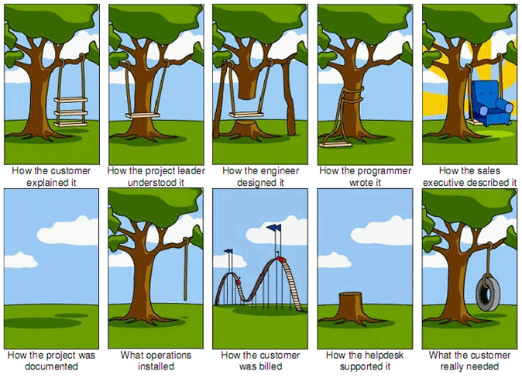
Team regular meetings are important: Communicate; be in synch; be useful

Slide 3
Today’s goals
What are design patterns?
Some examples (to be continued)
When to use the Observer pattern?
When to use the Composite pattern?
When to use the Interpreter pattern?

Slide 4
Design patterns
Experts build up a set of techniques
“Best practices” - good enough practices
Patterns
Recurring arrangements of elements
Documenting expertise
A good excuse to describe something that doesn’t fall into standard categories (algorithm, data structure)

Slide 5
Patterns caveats
Techniques used by experts
Not magic
Require practice
Become part of vocabulary

Slide 6
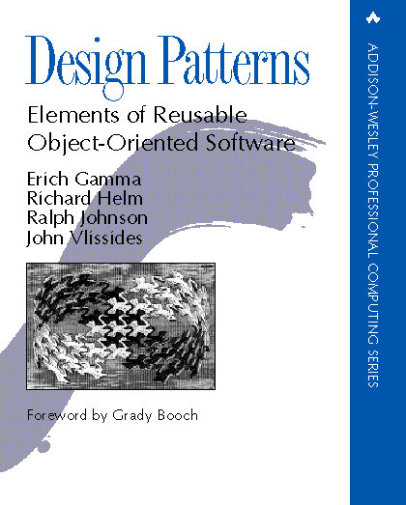
GoF book (the “dictionary”)
“Design Patterns: …” by Gamma, Helm, Johnson, Vlissides (Addison-Wesley 1995)
23 object-oriented patterns in 3 groups
We will cover a subset in detail
Wikipedia page from reading summarizes all
Learn at least one more

Slide 7
GoF creational patterns
Abstract factory
Builder
Factory method
Prototype
Singleton

Slide 8
GoF structural patterns
Adapter
Bridge
Composite
Decorator
Façade
Flyweight
Proxy

Slide 9
GoF behavioral patterns
Chain of responsibility
Command
Interpreter
Iterator
Mediator
Memento
Observer
State
Strategy
Template method
Visitor

Slide 10
OO design patterns
OO programming techniques
Small group of objects
Reusable design, not reusable code
Not tied to language, need not be Java
Can lead to more reusable code

Slide 11
Elements of description
Pattern Name and Classification
Intent
Also Known As
Motivation (Forces)
Applicability
Structure
Participants
Collaboration
Consequences
Implementation
Sample Code
Known Uses
Related Patterns

Slide 12
Example 1: Observer pattern
Intent: Define a one-to-many dependency between objects so that when one object changes state, all its dependents are notified and updated automatically
Example: Graphics system - moving box causes connecting lines to move
Question: which object is observing which here?

Slide 13
Observer
Observable - class
Observer - interface
observers/dependents
*
Observer
update
Subject
addDependent removeDependent notify
endPoint
LineFigure
update
RectangleFigure

Slide 14
Observer Pattern - Participants
Subject
Has a collection of observers
Methods for adding/removing an observer
Observer
An updating interface for objects that gets notified of changes in a subject
ConcreteSubject
Stores state of interest to observers
Sends notification when state changes
ConcreteObserver
Implements updating interface

Slide 15
Using Observer
Decide whether object is Subject, Observer, or both
Subjects must call notify() when they change state
Observers must define update()
Observers must register with Subjects
What are the arguments of notify() and update()?

Slide 16
Listeners related to observers
Example: Java GUI (Swing)
EventSource is a subject
EventListener is an observer
Many kinds of EventListeners, each with their own interface
ActionListener: actionPerformed(ActionEvent)
ComponentListener: componentResized(ComponentEvent), componentMoved(ComponentEvent), componentShown(ComponentEvent), componentHidden(ComponentEvent)

Slide 17
Another example from Java
interface Observer {
We can have additional hasChanged method for Observerable
void update (Observable sub, Object arg)
}
Java terminology for Subject.
class Observable {
…
}
public void attach(Observer o) {}
public void detach(Observer o) {}
Sometimes names
addListener
removeListener
notifyListeners
Instead of
attach
detach
notify
public void notify (Object arg) {}
public boolean hasChanged() {}
Sometimes we can omit the argument of notify if the information to be passed to the observers has been stored in the Observable object

Slide 18
Observers and dependence
If package A depends on package B then you can’t run the tests for A unless you also have B (or some mock of B)
“A depends on B” means you can’t use A unless you have B
“Package A depends on package B” means that something in A depends on something in B

Slide 19
Cycles of dependence
If package A depends on package B then package B should NOT depend on package A
If classes C and D both depend on each other, put them in the same package

Slide 20
Eliminating dependence
The Observer pattern eliminates some dependence
Suppose that “FBIAgent” is an observer of “Mobster”. Mobster is a subclass of Model, so it can have observers. Class FBIAgent probably depends on class Mobster, but Mobster does not depend on FBIAgent.

Slide 21
Example FBIAgent
Subject
addDependent: removeDependent: changed:
*
Observer
update:
Mobster
robBank
driveCar
FBIAgent
update:

Slide 22
Example 2: Composite
Context:
Developing OO software
Problem:
Complex part-whole hierarchy has lots of similar classes
Example: book, chapter, section, paragraph
What’s the example from MPs?

Slide 23
Forces
Simplicity -- treat composition of parts like a part
Power -- create new kind of part by composing existing ones
Safety -- no special cases, treat everything the same

Slide 24
Composite
Idea: make abstract "component" class
Alternative 1: every component has a (possibly empty) set of components
Problem: many components have no components
*
Component
Children
Chapter
...
Paragraph

Slide 25
Composite pattern
Composite and Component have exact same interface
enumerating children
Component has empty iterator
only Composite adds or removes children
Component
*
container
children:
Leaf
Composite

Slide 26
Two design alternatives for Part-of
:
Component doesn’t know what it is a part of
Component can be in many composite
Component can be accessed only through composite
Component knows what it is a part of
Component can be in only one composite
Component can be accessed directly

Slide 27
Part-of
Rules when component knows its single composite
A is a part of B if and only if B is the composite of A
Duplicating information is dangerous!
Problem: how to ensure that pointers from components to composite and composite to components are consistent

Slide 28
Ensuring consistency
The public operations on components and composites are:
Composite can enumerate components
Component knows its container
Add/remove a component to/from the composite
The operation to add a component to a composite updates the container of the component
There should be no other way to change the container of a component

Slide 29
addChild() in Composite
public void addChild(Component child) {
ensureCapacity(); childArray[numChildren++] = child; child.parent = this;
}

Slide 30
Book example
*
DocumentComponent
Paragraph
Composite
Section
Chapter
Book

Slide 31
A book
Book
Chapter
Section
Paragraph
Paragraph
Section
Paragraph
Chapter
Section
Paragraph

Slide 32
Composite in MP4
Component = ? Which type ?
Composite = ? Which type ?
Leaf = ? Which type ?
Answer this as exam practice

