Slide 1
CS427: Software Engineering I
Testing Mistakes
Bug Advocacy
Debugging

Slide 2
Today’s goals
Recall project’s objectives
What are some common testing mistakes?
How to fight for (having) your bugs (fixed)?
Basic debugging notions
Debugging K Demo
By Daejun Park

Slide 3
Class project: Objectives
Get a sense of what it’s like to work on a large-sized software project as a team
Teach you a new set of skills
How to navigate through large pieces of code written by others?
How to figure out which parts are relevant or not relevant?
How to understand a large piece just enough to be able to add a new feature?

Slide 4
Classic Testing Mistakes

Slide 5
Classic testing mistakes (1) Category: Role of Testing
Testing team (alone) is responsible for insuring quality
Purpose of testing is to find bugs
Usability problems not considered bugs
Reporting bugs without putting in context
Starting testing too late

Slide 6
Classic testing mistakes (2) Category: Planning Testing Effort
Test plans biased towards functional testing
Underemphasize configuration testing
Put stress and load testing off to the last minute
Not testing documentation
Not testing installation procedures
Overreliance on beta testing
Marketing vs. testing
Finishing one testing task before starting another
Failing to correctly identify risky areas
Sticking stubbornly to the test plan

Slide 7
Classic testing mistakes (3) Category: Personnel Issues
Using testing as a job for new programmers
Recruiting testers from failed programmers
Testers who are not domain experts
Testing team that lacks diversity
Physical developers / testers separation
Programmers can't test their own code
Then can, but not always motivated
This is changing

Slide 8
Class Exercise
What qualities should a good tester have?
…

Slide 9
Qualities of a good tester
Methodical and systematic
Tactful and diplomatic (but firm, too)
Skeptical; wants concrete evidence
Notice and pursue odd details
Good written/verbal skills (bug explanation)
Willingness to change code, experiment

Slide 10
Classic testing mistakes (4) Category: Tester at Work
Focusing on running, not designing tests
Not reviewing tests
Being too specific about test input
Not noticing ‘oddities’
Tests understandable only by their owners
Testing only through the user interface
Attempting to automate all tests
Poor bug reporting
Using GUI capture tools
Expecting regression tests find new bugs

Slide 11
Exploratory testing
Looking for new bugs
Try things programmers don’t think of
Illegal values
Very long inputs
Usually manual
Automated – generate all combinations

Slide 12
Bug advocacy
How to “sell” your bugs

Slide 13
Bug advocacy
How to write better bug reports?
Useful much more broadly than just bugs
How to ask questions on Piazza?
How to do persuasive writing in general?
Slides from Cem Kaner and James Bach http://www.testingeducation.org/BBST/bugadvocacy/BugAdvocacy2008.pdf
We listed on Wiki what exact slides you need to read for the exam
You’re encouraged to read/skim all the slides

Slide 14
Debugging

Slide 15
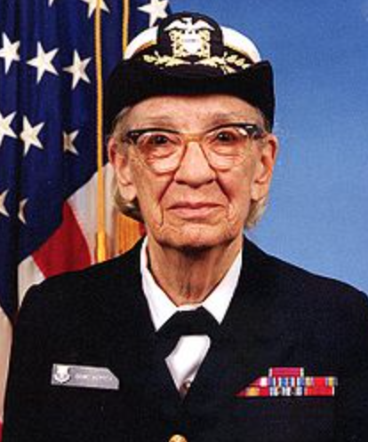
“Debugging”
Find out why a program is not functioning as intended
Grace Hopper was the first person to use the word bug to describe a computer glitch
[https://en.wikipedia.org/wiki/Grace_Hopper]

Slide 16
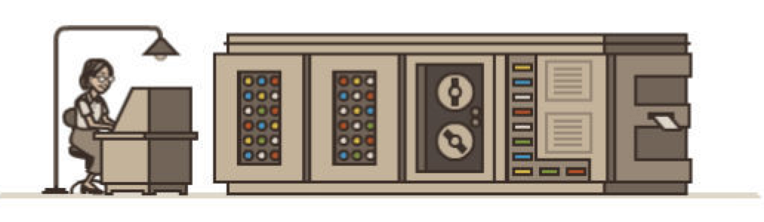
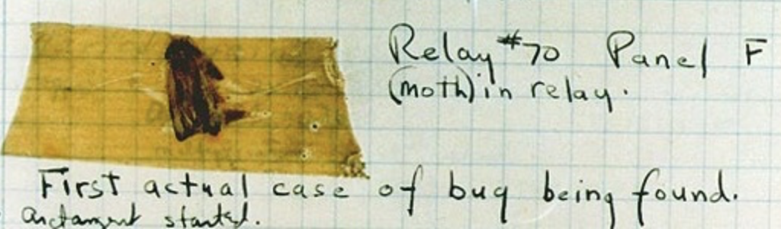
“Debugging”
finding an actual moth in the computer
[http://www.wired.com/2013/12/googles-doodle-honors-grace-hopper-and-entomology/]

Slide 17
Debugging vs. Testing
What’s the difference?
How would you describe it in terms of failures and faults?

Slide 18
Debugging
Purpose of testing is to find failure
Failure: symptom – observe wrong result
Produces bug reports, tests that fail
Purpose of debugging is find / correct fault
Fault / bug: cause – mistake in the code
Produces changes to the code

Slide 19
The Debugging Process
Reproduce failure (write automated test)
Find and understand cause
Fix the bug
Add test case to regression suite

Slide 20
1) Reproduce failure
Clarify symptom (simplify input), create “minimal” test
Find small, repeatable test case that produces the failure
Write automated test
May take effort, but helps identify the defect and gives you a regression test

Slide 21
2) Find and understand cause
Rubber duck debugging
Tracing
Backtracking
Cause elimination

Slide 22
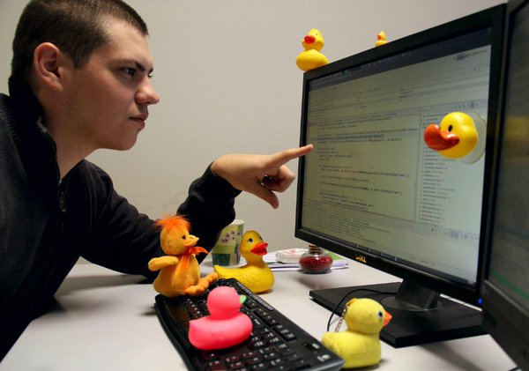
Rubber duck debugging
Explain the problem to a friend who love to listen to you (or just to a rubber duck)
[https://pbs.twimg.com/media/B75vnDaIgAAXGDV.jpg:large]

Slide 23
Tracing
Watch execution of program
Determine when it goes wrong
Print statements
Single stepping in debugger
Log or trace execution (e.g., log4j)
Breakpoints (conditional breakpoints)
Assertions / watchpoints

Slide 24
Backtracking
Determine a failure
Find fault by backing up to first failure
Repeatedly run program with new print statements
What could have caused this? Put in print statements to test each possibility.
Remove unneeded print/trace statements

Slide 25
Cause elimination
What could cause this bug?
List all possibilities
Check each one:
By examining program
By performing experiments (tracing)
Requires knowledge of system and the errors that people make

Slide 26
3) Fix bug & 4) Add test case
After checking the bug, make sure that it does not occur elsewhere
Add the test case to the regression suite
Is this failure fixed? Are any other new failures introduced?

Slide 27
Debugging expertise
Expert debuggers know the system model
Can imagine how the system executes
Can perform mental experiments
Know their limits
They know kinds of errors people make
Not closing a file
Not initializing an object correctly
Sending message to wrong object

Slide 28
Error catalog
Testing and debugging depend on knowing common errors
Other people make the same kinds of mistakes that you do
So, learn the kinds of mistakes people make (see Testing Catalog in readings)

Slide 29
Time Spent for Debugging
Coding (50%)
Debugging(50%)
A survey by Rogue Wave Software [http://bretthard.in/2013/06/developers-spend-half-their-time-fixing-bugs/]
How to decrease the time spent for debugging:
Find defects in earlier stages
During unit tests
During integration tests
During production (much harder to debug / fix)

Slide 30
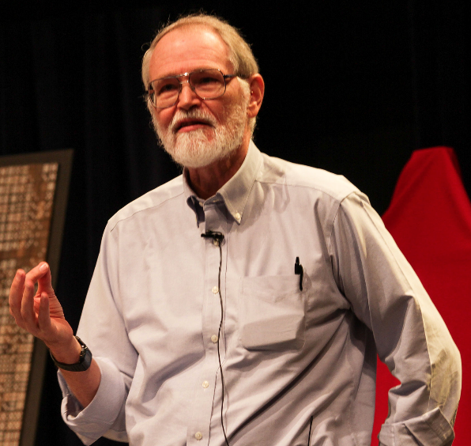
Maintain High Code quality
Maintain high code quality
Continuous integration
Code reviews
Reduce cyclomatic complexity
Emphasize simplicity (delete unnecessary code)
“Debugging is twice as hard as writing the code in the first place. Therefore, if you write the code as cleverly as possible, you are, by definition, not smart enough to debug it.” Brian Kernighan
[http://tinyurl.com/p5wg245]

Slide 31

Debugging K DEMO by Daejun Park

Slide 32
Assertions
Statements about a program’s execution that are either true or false
Variable is an integer between 1 and 10
Variable is not null
v1 < v2
Different than assertions in testing
Reduce time spent for debugging
Errors can be detected close to when/where they occur
Easier to track down the source of a bug

Slide 33
Assertions in Java
New Java statement since version 1.4
assert exp1;
assert exp1: exp2;
If exp1 is false, throw an exception and give it exp2 as an argument
Assertions in unit tests are completely different (assertEquals, assertTrue)

Slide 34
Assertions in Java
public int pop() {
assert !isEmpty() : "Stack is empty";
return stack[--num];
}
public int abs(int number) {
if (number < 0) {
number *= -1;
}
assert number >= 0;
return number;
}

Slide 35
Types of Assertions
Checkpoint (like above)
Pre-conditions
Post-conditions
Invariants

Slide 36
Pre- and post-conditions
Some functions only work under certain conditions
Precondition: assertion that must be true before a function is executed in order for it to work
Postcondition: assertion that is true after a function

Slide 37
Invariants
Invariant is an assertion that should be always true
Class invariant - a precondition and a postcondition of every method in the class
Loop invariant - an assertion that is true before the loop, after the loop, and every time through the loop

Slide 38
Example: What is the Class Invariant?
class ValueRange { int lower = Math.minInt(); int upper = Math.maxInt(); void setLower(int i) { if (i < upper) lower = i; } void setUpper(int i) { if (i > lower) upper = i; } }

Slide 39
Example: Pre-condition, Post-condition, and Invariant?
int n;
// precondition: ???
int s=0;
while(n > 0) {
// invariant: ???
s = s + n;
n = n - 1;
}
// postcondition: ???

Slide 40
Example: Pre-condition, Post-condition, and Invariant?
int n;
// precondition: n == N & N > 0
int s=0;
while(n > 0) {
// invariant: s == sumFrom(n+1,N)
s = s + n;
n = n - 1;
}
// postcondition: s == sumFrom(1,N)

Slide 41
Assertions as programming tool
Execute assertions during testing and debugging
Do not execute assertions in production code
In JVM
-ea[:<packagename>...|:<classname>]
-enableassertions[:<packagename>...|:<classname>]
-da[:<packagename>...|:<classname>]
-disableassertions[:<packagename>...|:<classname>]

Slide 42
Assertions as programming tool
Write preconditions for procedures
Don’t write postconditions; write unit tests
Write assertions
To match original specifications
For places that errors occur
Where you need them during debugging

Slide 43
Summary
Finding bugs is only half the battle
Write assertions incrementally
Write tests incrementally
Write code incrementally

