Slide 1

Working with cPanel, SQL and PHP Programming
Project Track 1
Khuram Shahzad
02/13/2017
CS 411 Spring 2017

Slide 2
Project Track 1
cPanel
PHP Programming
Mobile App Development

Slide 3
Important Note
Since this is a DB course, our focus is on databases.
So, learning how to do hands-on SQL programming is very important.
We do not restrict what tools students can use, the tools must not mask interactions with databases.
For example, PHP does not mask the interactions with databases as students still need to construct actual SQL commands.
On the other hand, tools such as Hibernate and Linq are not allowed.

Slide 4

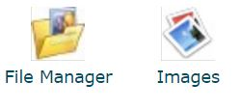
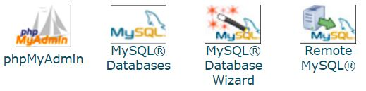

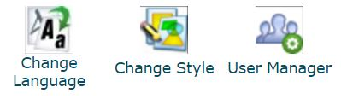
cPanel

Slide 5
How to access cPanel
Go to the Tools and Resources Page
https://wiki.illinois.edu/wiki/display/cs411sp17/Technical+Resources+for+Project+Track+1
Follow the instructions carefully to create an account
Personal account:
Your personal web hosting account is created automatically the first time you login to (if your EWS account is active):
https://webhost.engr.illinois.edu
Once your are logged in, your personal URL will be
http://netid.web.engr.illinois.edu

Slide 6
How to access cPanel
Group account:
Visit the following URL and fill out the form
https://my.engr.illinois.edu/getcpanel (~15 Minutes time for an account creation)
Group URL (YourGroupName must be 9-14 characters long)
http://YourGroupName.web.engr.illinois.edu
You will need personal account to login into the group account

Slide 7


How to access cPanel
https://webhost.engr.illinois.edu

Slide 8
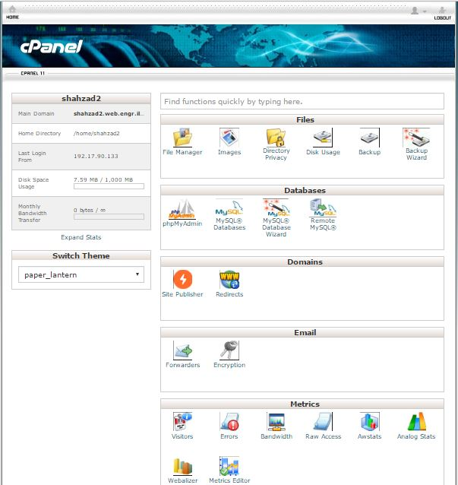
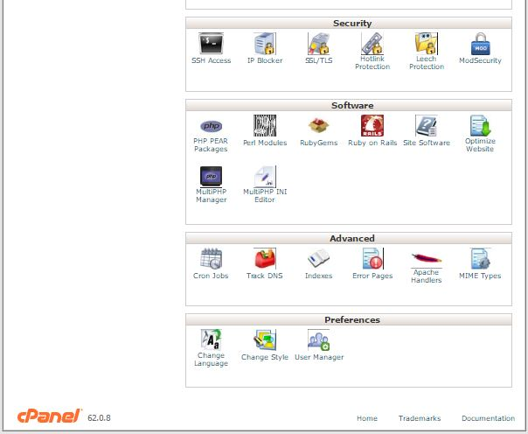
Personal Account Preview

Slide 9
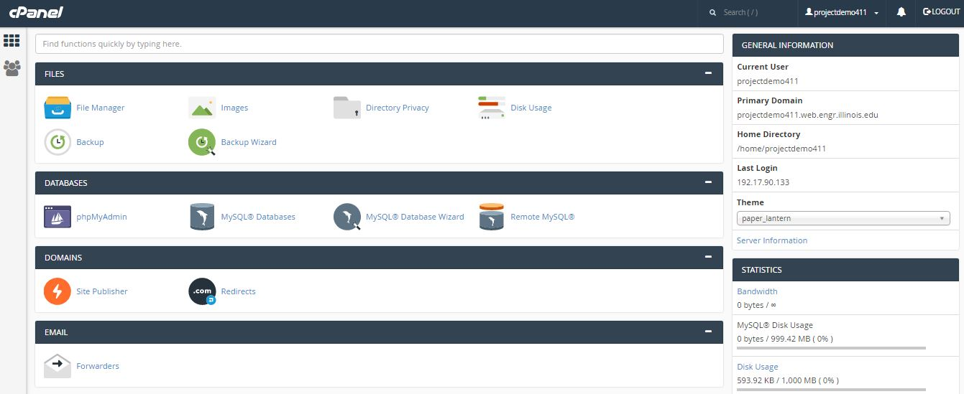
Group Account Preview

Slide 10
Tools inside cPanel
MySQL ® Databases
phpMyAdmin
File Manager
PHP/HTML

Slide 11
Interactive Session Files
Download the Project Demo Files from the following link:
https://wiki.illinois.edu/wiki/display/cs411sp17/Team0
Unzip the folder and you should have the following files:
Index.html
search_genes.php
Gene.csv
arabidop1.png
projectdemo411_cs411.sql

Slide 12
Tools inside cPanel
MySQL ® Databases
phpMyAdmin
File Manager
PHP/HTML

Slide 13
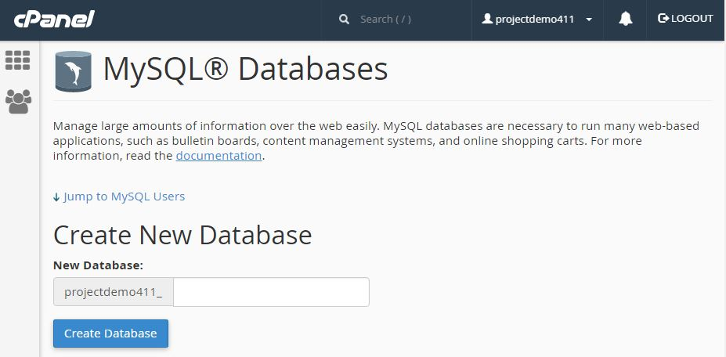
MySQL ® Databases
Create a database named “cs411”

Slide 14
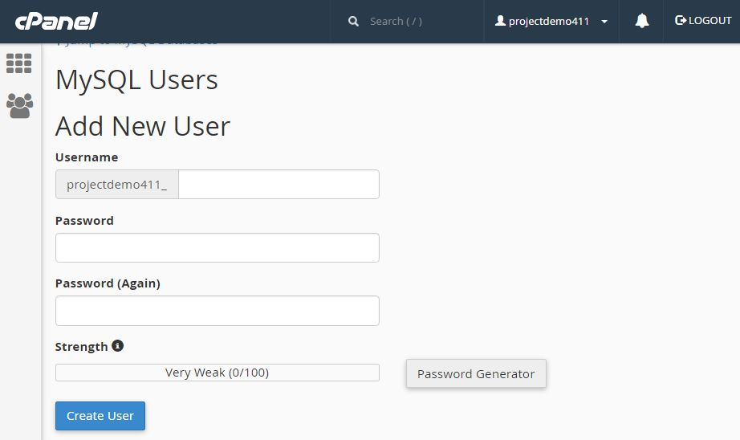
MySQL ® Databases
Add a new user “cs411” and password “cs411”

Slide 15
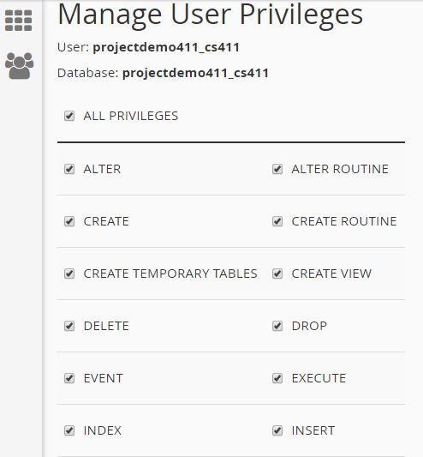
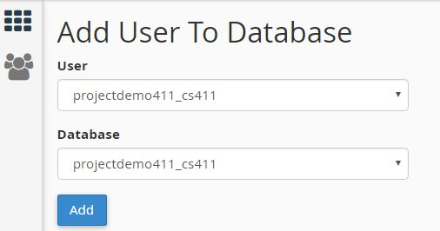
MySQL ® Databases
Add user to your database &
Check all privileges

Slide 16
Tools inside cPanel
MySQL ® Databases
phpMyAdmin
File Manager
PHP/HTML

Slide 17
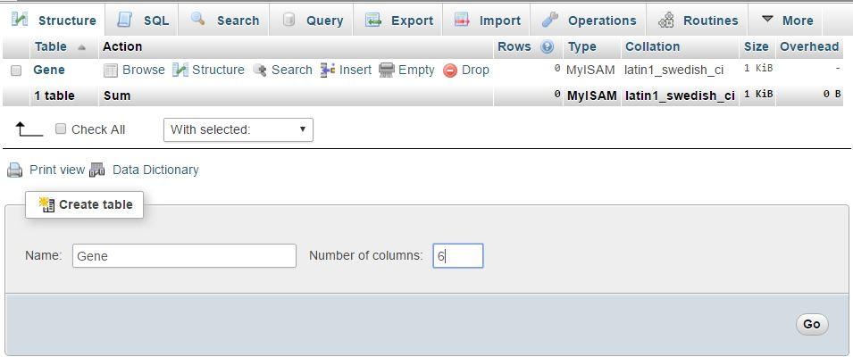
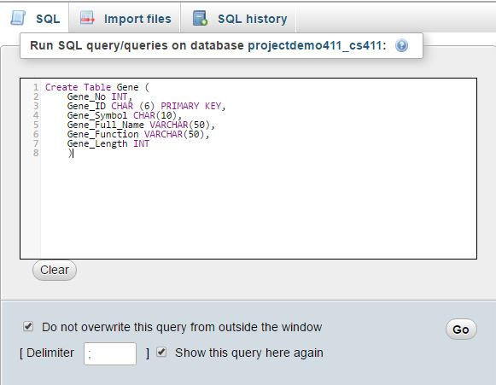
phpMyAdmin
INT
CHAR
VARCHAR(N)
TEXT
BOOLEAN (true, false, unknown)
FLOAT or REAL
DECIMAL (m,n)
DATE
TIME
Two ways to create a table
Structure
SQL

Slide 18
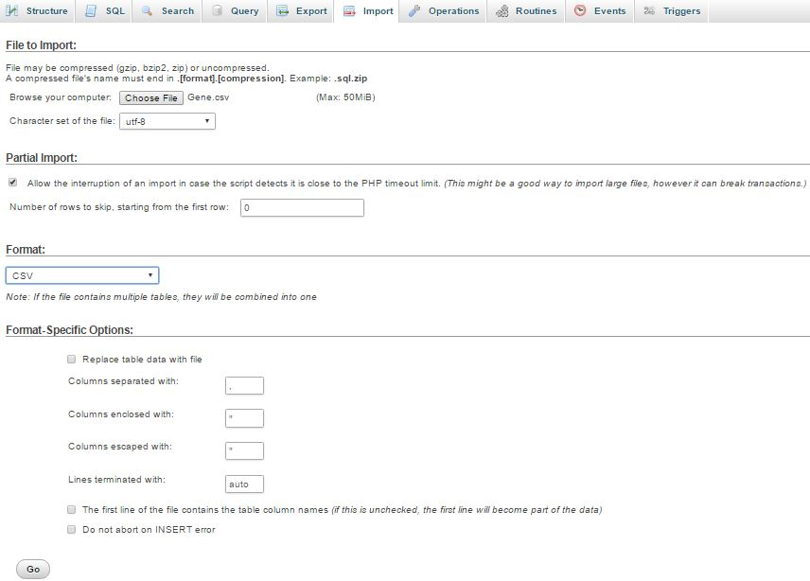
phpMyAdmin
Input Data
Several methods
User Input
Crawl
Import using CSV files

Slide 19
Tools inside cPanel
MySQL ® Databases
phpMyAdmin
File Manager
PHP/HTML

Slide 20
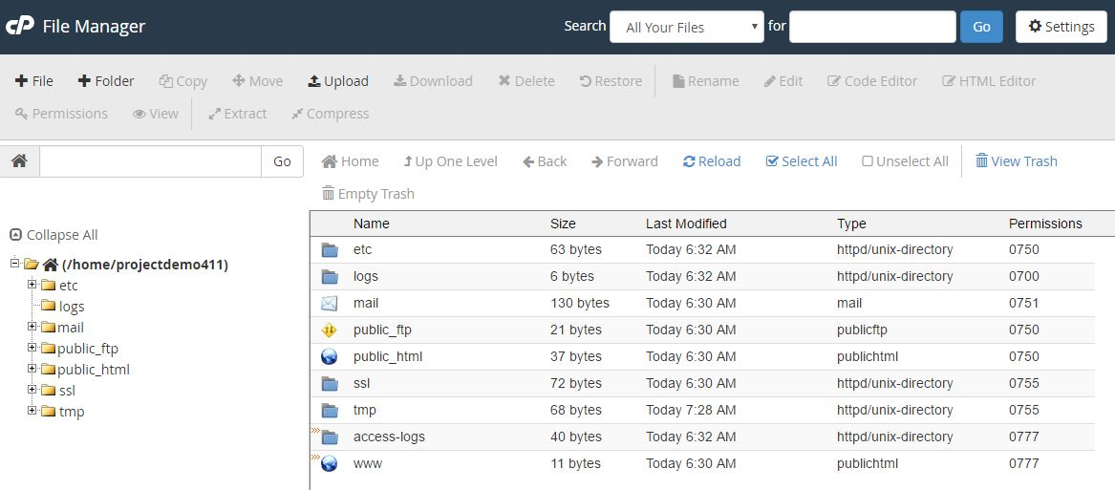
File Manager

Slide 21
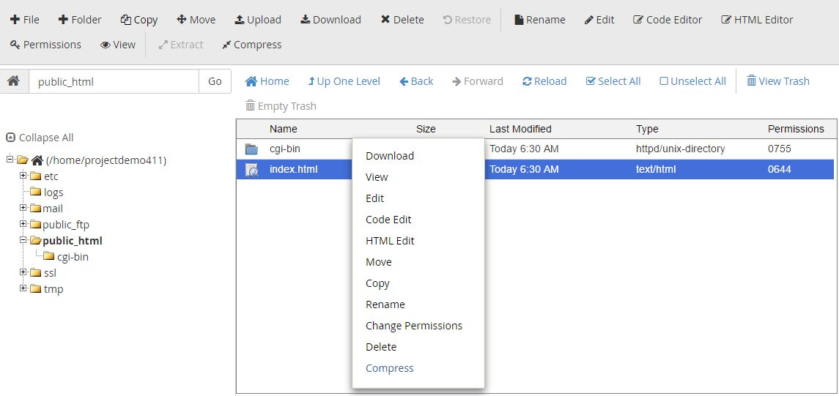
File Manager

Slide 22
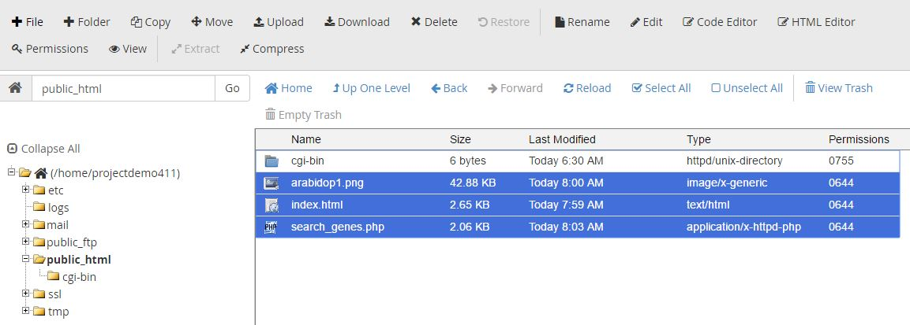
File Manager

Slide 23
File Manager
Connecting to a Database
localhost: ‘webhost.engr.illinois.edu’,
username: ‘projectdemo411_cs411’,
password: ‘cs411’,
----------------------------------------------------
$link = mysql_connect('webhost.engr.illinois.edu', 'projectdemo411_cs411', 'cs411');
if (!$link) {
die('Could not connect: ' . mysql_error());
}
mysql_select_db('projectdemo411_cs411');
.
.
mysql_close($link);

Slide 24
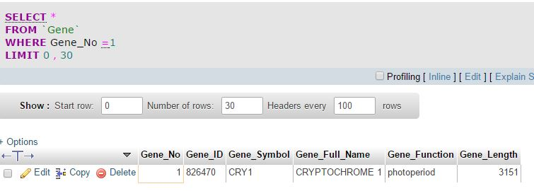
SQL COMMANDS
Execute different SQL Commands in phpMyAdmin

Slide 25
Creating Web Pages
PHP/HTML
Now we know that our database is ready!
Its time to make our schema as a functional unit by creating server side and client side scripting
Scripting ...
Client-Side Scripting (HTML, Javascript...)
Server-Side Scripting (PHP, Django, JSP...)
https://wiki.illinois.edu/wiki/display/cs411sp17/Tools+and+Resources

Slide 26
PHP/HTML
HTML
Hyper Text Markup Language (HTML)
It is not a programming language, rather it is a markup language
It uses markup tags e.g.,
<html> your text</html>.
Check the file “index.html” provided.

Slide 27
PHP/HTML
PHP
PHP (recursive acronym for PHP: Hypertext Preprocessor)
It is a server side scripting language
<?php Your text… ?>
Can also be embedded inside html
<html>
<? Php
Echo “Hello World”;
?>
</html>
Check the file “search_genes.php” provided.

Slide 28
URL Access
http://shahzad2.web.engr.illinois.edu/
http://projectdemo411.web.engr.illinois.edu/

Slide 29
Mobile App Development
Basic Intro

Slide 30


Mobile App Development
Different types of Mobile application development platforms
Most commonly used ones are
iOS
(Objective-C)
Android
(Java based)

Slide 31
Mobile App Development
iOS (initially iPhone OS)
The language used to develop software for iOS is Objective-C.
general-purpose, OOP language that adds Smalltalk-style messaging to the C
The iOS SDK is the software development kit that allows application programs to utilize classes and frameworks provided by the SDK.
Xcode is the integrated development environment (IDE) for iOS programming.

Slide 32
Mobile App Development
MVC is the basic paradigm of iOS programming
Model
It is responsible to manage the data; it stores and retrieves entities used by an application, usually from a database.
View
It is responsible to display the data provided by the model in a specific format.
Controller
It handles the model and view layers to work together. The controller receives a request from the client, invokes the model to perform the requested operations and sends the data to the View. The view formats the data to be presented to the user, in a web application as an html output.

Slide 33
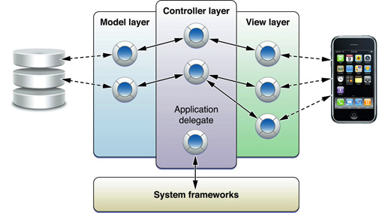
Mobile App Development
Notes:
https://developer.apple.com/library/ios/documentation/general/conceptual/CocoaEncyclopedia/Introduction/Introduction.html

Slide 34
Mobile App Development
References
http://www.tutorialspoint.com/ios/
http://www.appcoda.com/hello-world-build-your-first-iphone-app/
http://www.appcoda.com/hello-world-app-using-xcode-5-xib/
https://developer.apple.com/library/ios/documentation/general/conceptual/CocoaEncyclopedia/Introduction/Introduction.html

Slide 35

Mobile App Development
Android
An operating system based on the Linux kernel
Initially developed for touchscreen mobile devices such as smartphones and tablet computers.
Android SDK is required for the app development.
ADT plugin for Eclipse (if you use the Eclipse IDE).

Slide 36
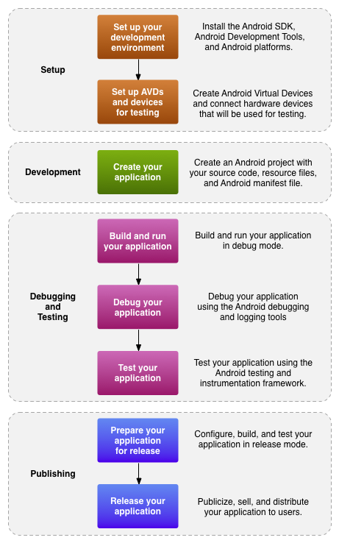
General Workflow for Android applications.

Slide 37
Mobile App Development
Reference
https://developer.android.com/training/basics/firstapp/index.html

Slide 38
Project Track 1
Stage 0: Group Formation: Feb 6, 2017
Stage 1: Functional Description and ER Design (Feb 20)
Stage 2: Development Plan (Feb 27)
Stage 3: Setup Development Environment (March 01)
Stage 4: Initial Demo + Advanced SQL Queries (March 13-15, Before spring breaks)
Stage 5: Final Demo and Report (April 17-19)

Slide 39
Project Track 2
Stage 0: Survey Teams Formation: Feb 6, 2017
Stage 1: Survey Proposal Submission(Feb 27)
Stage 2: Survey Final Draft Submission (April 20)

Slide 40
Thanks
&
Good luck for your Projects

