Slide 1
CS411 Database Systems
01: Introduction
Aditya Parameswaran

Slide 2
Welcome to CS411
Web site:
https://wiki.cites.illinois.edu/wiki/display/cs411sp17/
or http://tiny.cc/411sp17
Announcements, syllabus, policies, schedule, …
Please read the class syllabus, policies, and lecture schedule (very tentative)

Slide 3
Teaching Staff: TAs
Aditi Adhikari (Homework/Exams, Online section)
Pramod Srinivasan (Homework/Exams)
Vipul Venkataraman (Homework/Exams)
Khuram Shahzad (Project, 4 Credit Section)
Joey Cao (Project)

Slide 4
Teaching Staff
Aditya Parameswaran
Assistant Professor of Computer Science
twitter: @adityagp
web: data-people.cs.illinois.edu
Research interests:
Interactive (“Human-in-the-loop”) Data Analytics
SecondFirst time I’m teaching this class!
Bound to be hiccups…
We’ll figure it out as we go along.

Slide 5
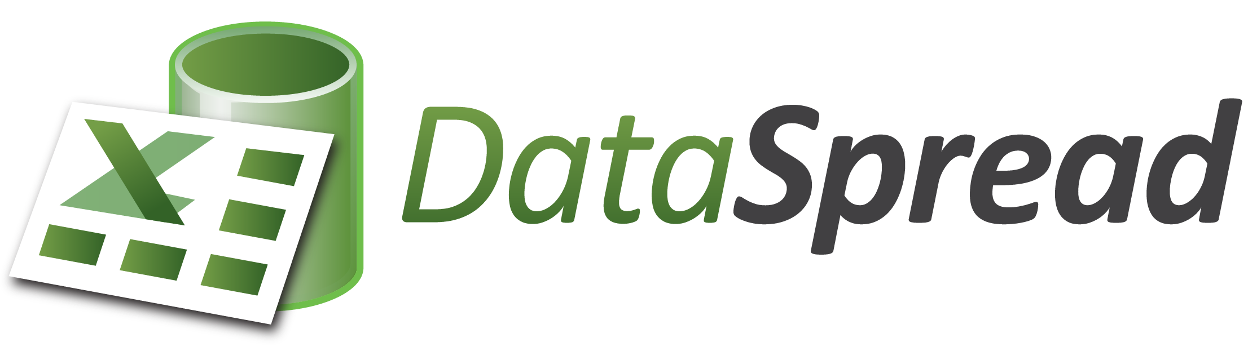


Interactive Data Analytics
That is: interacting with “BIG DATA”
Data Manipulation
Data Visualization
Data Collaboration

Slide 6
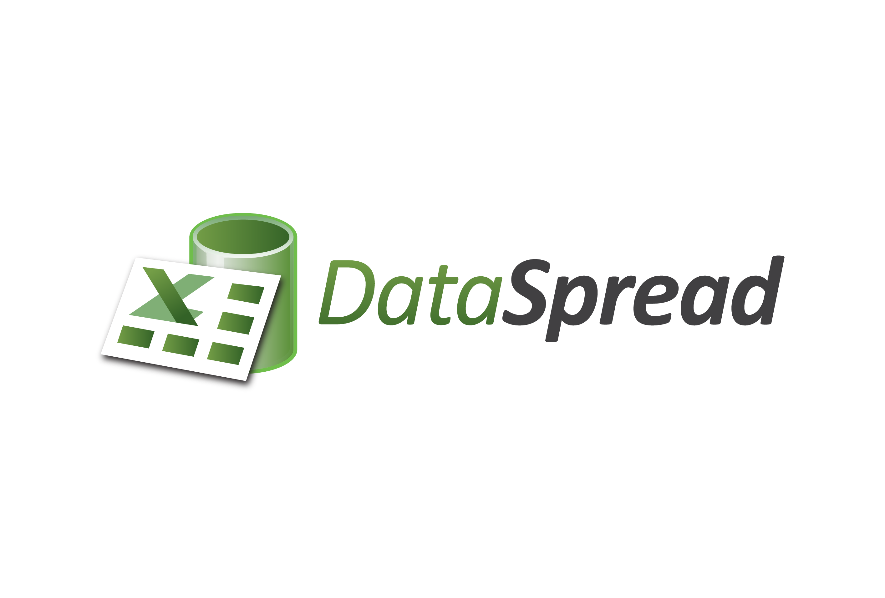
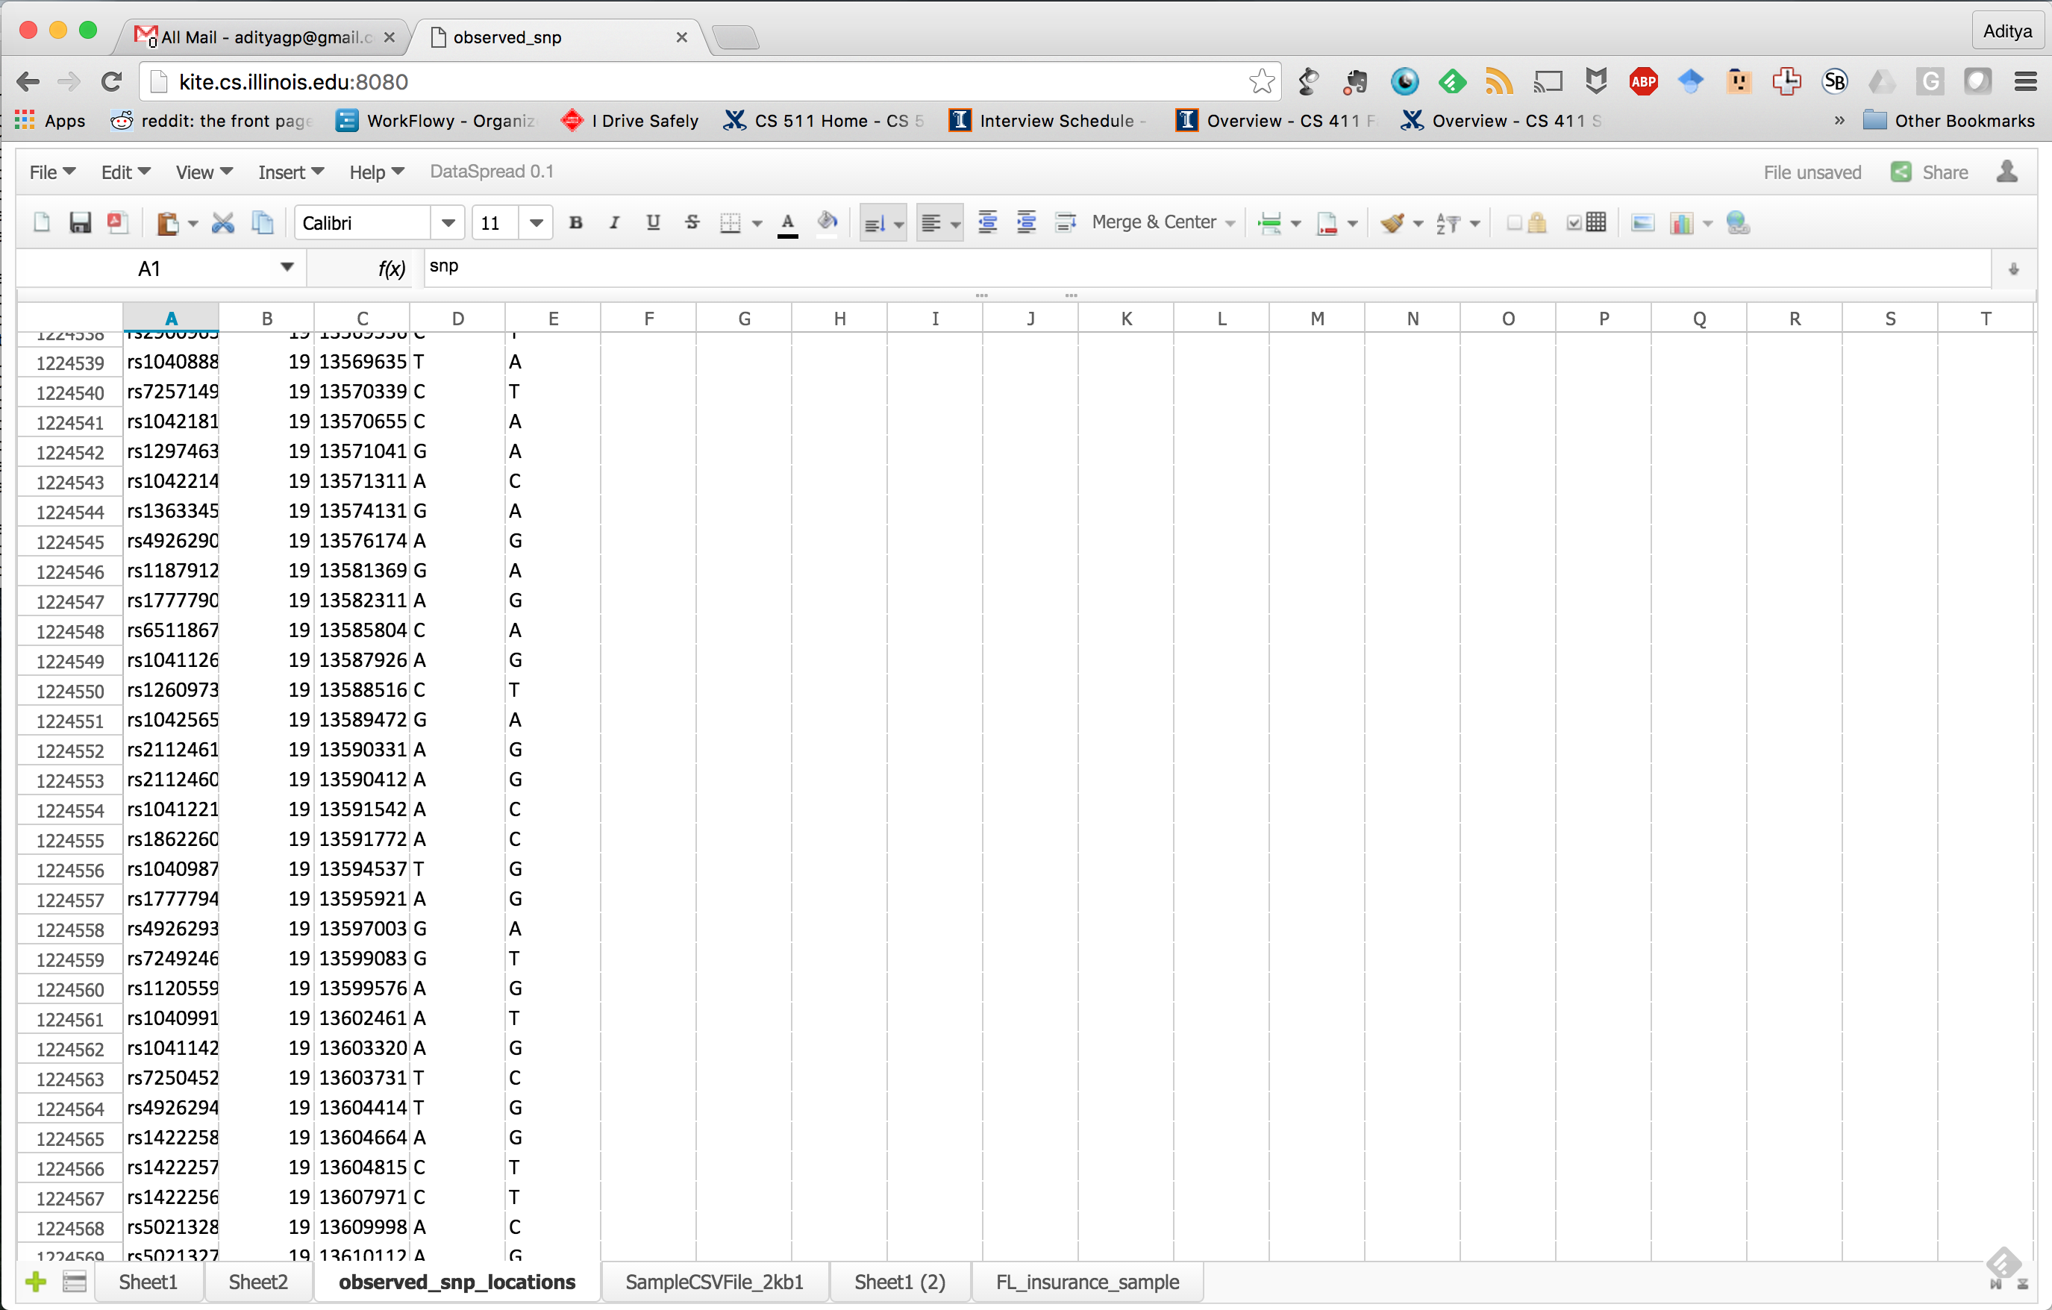
Data Manipulation to the People
Spreadsheets suck:
Can’t scale
Can’t express sophisticated operations
Can we bring spreadsheets to the big data era?
1224560

Slide 7
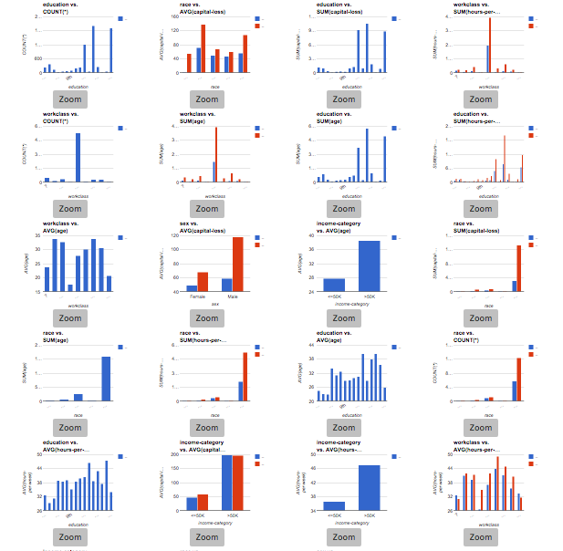
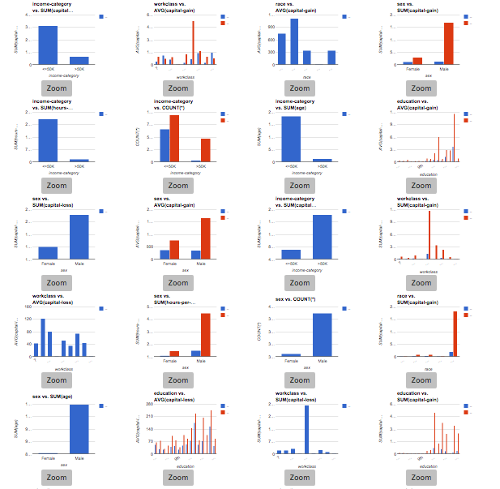
Data Visualizations to the People
Too much data = too many visualizations!
Often boils down to looking at each pertinent one until desired insights are found.

Slide 8
Overview

Slide 9
Coming back to the course ...

Slide 10
CS411: All about “Databases”
DBMS (Data Base Management System) = Database Systems = Databases
System to manage, maintain, query, interact with, transact with data.
More loosely, database systems are used for “data management”

Slide 11
CS411 Goals: Two Perspectives of DBMS
User perspective
how to use a database system?
conceptual data modeling, the relational and other data models, database schema design, relational algebra, and the SQL query language.
Systems perspective
how to design and implement a database system?
data representation, indexing, query optimization and processing, transaction processing, concurrency control, and crash recovery
NOT COMPLETE: very high-level view of implementation; CS511
Notes:
analogy: deciding on data structures and their details, for a software project.

Slide 12
Prerequisites
Must have data structure and algorithms background
CS 225 or equivalent assumed
Good programming skills
Project will require lots of programming
Need C++, Java, Python, or PHP … to communicate w/ the DB
Your project group picks the language
We cannot help with detailed debugging for your language (i.e., pick wisely)

Slide 13
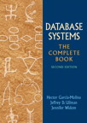
Textbook
Textbook:
Database Systems: The Complete Book, 2/e, by Hector Garcia-Molina, Jeffrey D. Ullman, and Jennifer D. Widom
All readings will come from this book.
(Looks intimidating, but it’s not very dense…)
Good references:
Database Management Systems, by Raghu Ramakrishnan an Johannes Gehrke, McGraw-Hill
Database System Concepts, by Abraham Silberschatz, Henry F. Korth, and S. Sudarshan, McGraw Hill

Slide 14
Course Format
For all students
two 75-min lectures / week
5 assignments planned
project (significant)
Several stages
a midterm (in class) and a final exam (may be in class)
Cheat sheet allowed
Graduate students: 4 credits option
write a survey paper

Slide 15
Lectures
Lecture slides will be posted shortly before the lecture
Are meant to complement the text
Last year’s slides are already up (our slides will be similar)
Lectures are important for guiding your reading of textbook (and will be covered in exams and homeworks)
so please attend lectures or watch videos regularly

Slide 16
Homework Assignments
Mostly paper-based, some light programming
Submit through Compass.
No late homework will be accepted
Late = missing
OK to submit partial work
See details on course web page

Slide 17
Project
Build a Web-based Database-driven Application
select an database application that needs a database
design and build it from start to finish
your choice of topic:
useful, realistic, database-driven, web-based, fun!
Easy strategy to pick projects: pick your favorite web company, re-implement a tiny version of it!
A tiny Amazon: managing and selling inventories of books
A tiny Facebook: keeping track of all your posts, likes, and friendships
A tiny AirBnB: matching home-owners to visitors
Hopefully you’ll take away the fact that all web-based companies (or all companies) require databases at their core.

Slide 18
Project
Team work (3-4): not lower!
Significant amount of programming (we will provide 3 tutorials)
Will be done in stages
you will submit some work at the end of each stage
You will show a demo at the end of the semester

Slide 19
Project Groups
Project will be done in group of 3-4 students
learn how to work in a group: valuable skills
may also use project group as study partners
fulfills your curricular requirements for project-based activities!
Try to form groups as soon as possible
can start by posting requests on piazza
especially important for online students
There will be a deadline soon for forming groups
if you have not formed groups by then
we will help assign you to groups
Grading:
all members receive same grade
if someone drops out, the rest pick up the work (sorry!)

Slide 20
Four Credit Version
Only for Graduate students
Read and summarize the literature on a specific topic
This time, selected from a small list of topics
Submit a survey report + presentation

Slide 21
Exams
Midterm and final
Midterm in class; final may also be in class.
Check dates and make sure that you have no conflict!
Will post these in a few days
generally no makeup exams unless exceptional cases (see policy page)

Slide 22
Tentative Grading Breakdown
Homework: 25%
Project: 30%
Midterm: 20%
Final: 25%
For 4 Credit students: 90% = the total of everything above, 10% = Survey Project

Slide 23
IMPORTANT: Communications and Contacting the Staff

Slide 24
Communications: From us to you
Website: “Announcements” page
Piazza:
Signup link: piazza.com/illinois/spring2017/cs411
vitally important!
make sure to check it regularly for questions/clarifications
announcements will appear here and the course website
Enable “notifications”

Slide 25
Communications: From You to Us
We’re a LARGE class (200ish) students.
If you have a question/problem
talk to people in your group first
post your question on piazza
if it is of a sensitive nature, post your question privately to piazza
if it is pertinent only to one TA, and of a sensitive nature, then email the TA
if it is sensitive & not easily conveyed electronically, then go to office hours to talk to TA or instructor
(I get 100+ emails a day and I often take weeks to respond to email ☹ so unless you have a sensitive matter that no one else can address … very very rare)

Slide 26
Piazza
Designed for you and your peers
to communicate and help one another
please do not post solutions
TAs will monitor relatively regularly and try their best to help with your questions
But don’t expect responses in <24 hours.
There will be many questions
May not be able to answer all of them timely manner
Don’t wait until the last minute to ask!
Not good for more complex questions -- come to office hours or email TA

Slide 27
Piazza: Incentivizing Participation
Since it’s hard for us to be present 24x7 on Piazza, we want to incentivize the students who diligently answer other’s questions
Up to 3% bonus credit for participation

Slide 28
Office Hours
For any complex questions and clarifications
Team has office hours six times a week, at least one each day of the week.
Mine: right after class on Monday
See course website for schedule

Slide 29
IMPORTANT: Registration Questions
I get 2-3 emails a day about registration/wait-list questions.
I do not handle any registration requests – completely handled by the CS Academic office.
See: tiny.cc/411faq first
Then follow communication guidelines

Slide 30
Onto databases now!

Slide 31
Task: Build a Banking System from Scratch
Goal: Manage customers, accounts, joint accounts, transfers, transactions, interest rates.
Let’s say I implement this system using C++ or Java, without using a database
Think like a designer: what aspects do we need to worry about?

Slide 32
Aspects to worry about
Deal with lots of data
Be fast
Don’t lose information
Allow multiple users
Stay consistent
Easy to use

Slide 33
The Database Approach
Abstract out all of the data management functionality into a separate layer
Many applications can access it
Turns out this “separate layer” keeps turning up in many many many scenarios
Makes sense to abstract it out
E-banking application
Teller application
Cell phone application
DBMS

Slide 34
Database Management System (DBMS)?
System for providing EFFICIENT, CONVENIENT, and SAFE, MULTI-USER storage of and access to MASSIVE amounts of PERSISTENT data

Slide 35
Example: Banking system
System for providing EFFICIENT, CONVENIENT, and SAFE, MULTI-USER storage of and access to MASSIVE amounts of PERSISTENT data
Data = information on accounts, customers, balances, current interest rates, transaction histories, etc.
MASSIVE:
many TBs at a minimum for big banks, more if keep history of all transactions,
even more if keep images of checks -> Far too big for memory

Slide 36
Example: Banking system
System for providing EFFICIENT, CONVENIENT, and SAFE, MULTI-USER storage of and access to MASSIVE amounts of PERSISTENT data
PERSISTENT: data outlives programs that operate on it, even on
system shutdown
power failure
So simply can’t store these things in memory, we have to rely on stable storage (disk, flash)

Slide 37
MULTI-USER Access
System for providing EFFICIENT, CONVENIENT, and SAFE, MULTI-USER storage of and access to MASSIVE amounts of PERSISTENT data
MULTI-USER: many people/programs accessing same database, or even same data, simultaneously -> Need controls
Alice @ ATM1: withdraw $100 from account #002
get balance from database;
if balance >= 100
then balance := balance – 100; // dispense cash
update balance in database;
Bob @ ATM2: withdraw $50 from account #002
get balance from database;
if balance >= 50
then balance := balance - 50; // dispense cash
update balance in database;
Initial balance = 100. What’s the ideal case? What could go wrong?
Notes:
Good cases: either bob or alice are able to withdraw but not both
Bad cases: interleaving of transactions, withdrawing more than what’s there in the account

Slide 38
DBMS: More Requirements
System for providing EFFICIENT, CONVENIENT, and SAFE, MULTI-USER storage of and access to MASSIVE amounts of PERSISTENT data
SAFE:
from system failures. E.g., money should not disappear or appear from the account, due to a power failure!
Bob @ ATM2: withdraw $50 from account #002
get balance from database;
if balance >= 50
then balance := balance - 50; // dispense cash
update balance in database;
from malicious users
Power failure right here

Slide 39
DBMS: More Requirements
System for providing EFFICIENT, CONVENIENT, and SAFE, MULTI-USER storage of and access to MASSIVE amounts of PERSISTENT data
CONVENIENT:
simple commands to debit account, get balance, write statement, transfer funds, etc.
also unpredicted queries should be easy
shouldn’t require complex 100s of lines of code
EFFICIENT:
don't search all files in order to get balance of one account, get all accounts with low balances, get large transactions, etc.

Slide 40
Why Direct Implementation Won’t Work / is Super Hard
Early DBMS evolved from file systems
Provided storage of MASSIVE amounts of PERSISTENT data, to some extent
SAFE?
when system crashes, no guarantees on how program may behave: we may lose data
EFFICIENT?
Does not intrinsically support fast access to data whose location in file is not known: will need to write custom code

Slide 41
Why Direct Implementation Won’t Work
CONVENIENT?
need to write a new C++/Java program for every new query
small changes to structure entails changing file formats; need to rewrite virtually all applications
MULTI-USER ACCESS?
limited protection
need to worry about interfering with other users

Slide 42
That’s why the notion of DBMS was invented!

Slide 43
DBMS: A Software System
Buy, install, set up for particular application or applications
Major vendors:
Oracle
IBM (DB2)
Microsoft (SQL Server, Access)
Sybase
Open source:
Postgres
MySQL
Sqlite
All are "relational” DBMS

Slide 44
DBMS Examples
Most familiar use: many Web sites rely heavily on DBMS's
And many non-Web examples

Slide 45
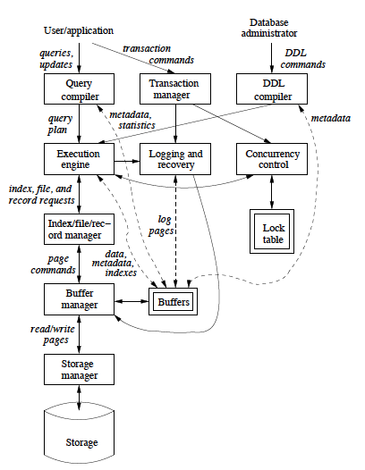
DBMS Architecture
Pretty complex piece of software!!

Slide 46
Data Model and Schemas
Defining the data model of the database:
conceptual structuring of data stored in database
E.g., data is set of records, each with student-ID, name, address, courses, photo
E.g., data is graph where nodes represent cities, edges represent airline routes
Schema versus data
schema describes how data is to be structured, defined at set-up time, rarely changes (also called "metadata")
data is actual "instance" of database, changes rapidly

Slide 47
DDL and DML
Data definition language (DDL)
commands for setting up schema of database
Data manipulation language (DML)
Commands to manipulate data in database:
RETRIEVE, INSERT, DELETE, MODIFY
Also called "query language"
Common relational language for both: SQL
(Structured Query Language)

Slide 48
People / Roles
DBMS application designer
set up schema, loads data, …
Primarily DDL
DBMS user: queries/modifies data
Primarily DML
DBMS administrator
user management, performance tuning, …
DBMS implementer: builds systems

Slide 49
First ½ Topics: User Perspective
Entity-Relationship Model
Relational Model
Relational Database Design
Relational Algebra
SQL and DBMS Functionalities:
SQL Programming
Queries and Updates
Indexes and Views
Constraints and Triggers

Slide 50
Second ½ Topics: System Perspective
Storage and Representation
Indexing
Query Execution and Optimization
Transaction Management

Slide 51
How to Get the Most out of CS411?
Read and think before/after class
readings are there for a reason
discuss assignments w/ others but write your own solution!
Use lectures as a guide
a roadmap for what’s important
lectures are starting points– they do not cover everything you should read

Slide 52
Questions?

