Slide 1
Chapter 6
Normalization of Database Tables

Slide 2
Learning Objectives
In this chapter, students will learn:
What normalization is and what role it plays in the database design process
About the normal forms 1NF, 2NF, 3NF, BCNF, and 4NF
How normal forms can be transformed from lower normal forms to higher normal forms
That normalization and ER modeling are used concurrently to produce a good database design
That some situations require denormalization to generate information efficiently

Slide 3
Normalization
Evaluating and correcting table structures to minimize data redundancies
Reduces data anomalies
Assigns attributes to tables based on determination
Normal forms
First normal form (1NF)
Second normal form (2NF)
Third normal form (3NF)

Slide 4
Normalization
Structural point of view of normal forms
Higher normal forms are better than lower normal forms
Properly designed 3NF structures meet the requirement of fourth normal form (4NF)
Denormalization: Produces a lower normal form
Results in increased performance and greater data redundancy

Slide 5
Need for Normalization
Used while designing a new database structure
Analyzes the relationship among the attributes within each entity
Determines if the structure can be improved
Improves the existing data structure and creates an appropriate database design

Slide 6
Normalization Process
Objective is to ensure that each table conforms to the concept of well-formed relations
Each table represents a single subject
No data item will be unnecessarily stored in more than one table
All nonprime attributes in a table are dependent on the primary key
Each table is void of insertion, update, and deletion anomalies

Slide 7
Normalization Process
Ensures that all tables are in at least 3NF
Higher forms are not likely to be encountered in business environment
Works one relation at a time
Starts by:
Identifying the dependencies of a relation (table)
Progressively breaking the relation into new set of relations

Slide 8
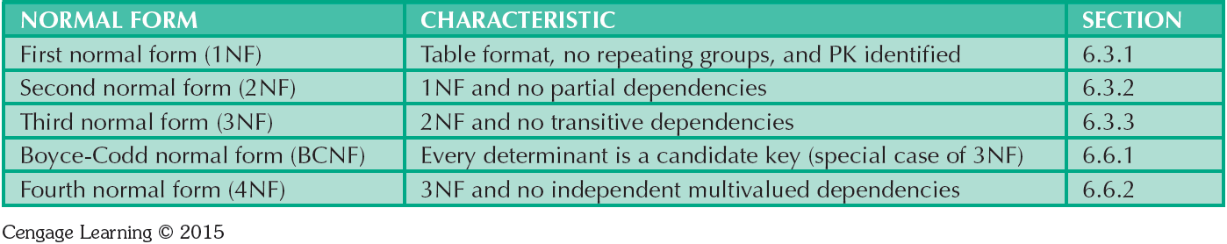
Table 6.2 - Normal Forms

Slide 9
Functional Dependence Concepts
Concept | Definition
Functional dependence | The attribute B is functionally dependent on the attribute A if each value of A determines one and only one value of B.
Functional dependence (Generalized definition) | Attribute A determines attribute B if all of the rows in the table that agree in value for attribute A also agree in value for attribute B.
Fully functional dependence (composite key) | If attribute B is functionally dependent on a composite key A but not on any Subset of that composite key, the attribute B is fully functionally dependent on A.

Slide 10
Types of Functional Dependencies
Partial dependency: Functional dependence in which the determinant is only part of the primary key
Assumption - One candidate key
Straight forward
Easy to identify
Transitive dependency: An attribute functionally depends on another nonkey attribute

Slide 11
Conversion to First Normal Form
Repeating group: Group of multiple entries of same type can exist for any single key attribute occurrence
Existence proves the presence of data redundancies
Enable reducing data redundancies
Steps
Eliminate the repeating groups
Identify the primary key
Identify all dependencies

Slide 12
Conversion to First Normal Form
Dependency diagram: Depicts all dependencies found within given table structure
Helps to get an overview of all relationships among table’s attributes
Makes it less likely that an important dependency will be overlooked

Slide 13
Conversion to First Normal Form
1NF describes tabular format in which:
All key attributes are defined
There are no repeating groups in the table
All attributes are dependent on the primary key
All relational tables satisfy 1NF requirements
Some tables contain partial dependencies
Subject to data redundancies and various anomalies

Slide 14
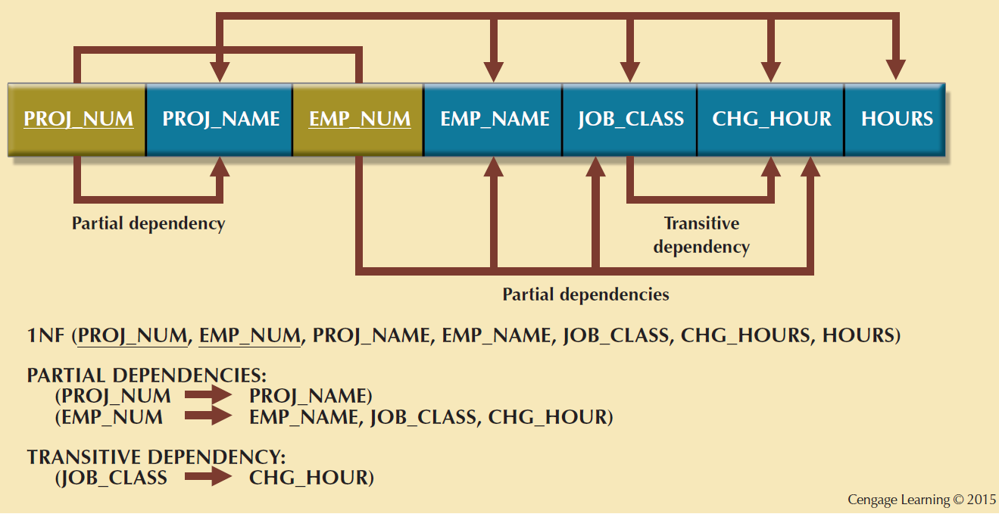
Figure 6.3 - First Normal Form (1NF) Dependency Diagram

Slide 15
Conversion to Second Normal Form
Steps
Make new tables to eliminate partial dependencies
Reassign corresponding dependent attributes
Table is in 2NF when it:
Is in 1NF
Includes no partial dependencies

Slide 16
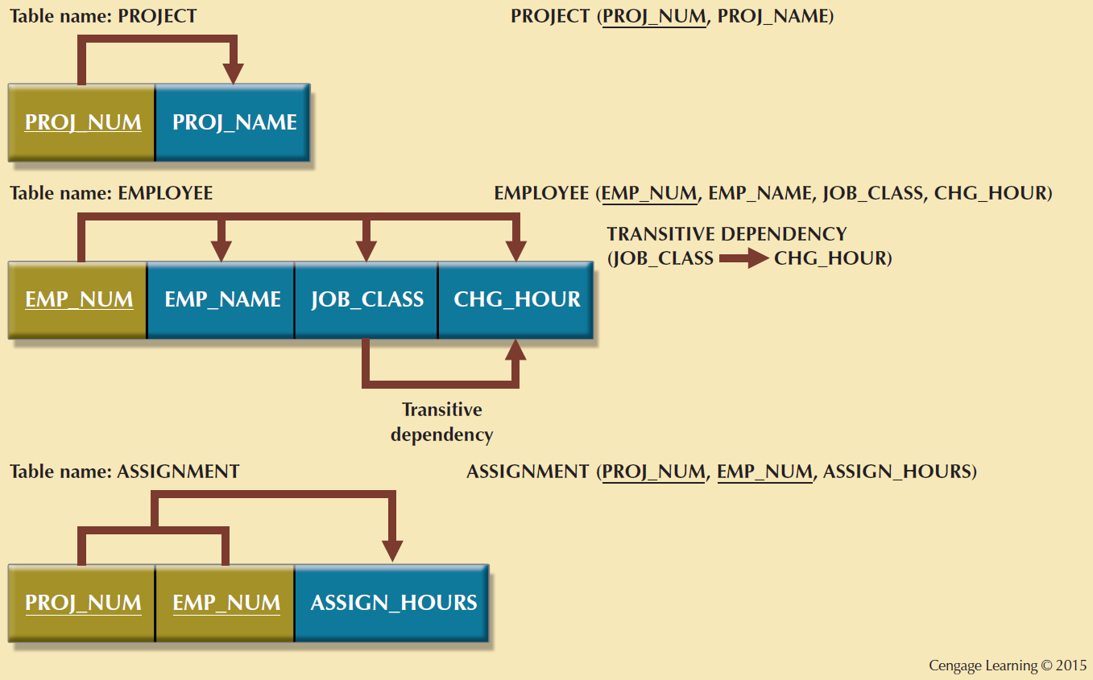
Figure 6.4 - Second Normal Form (2NF) Conversion Results

Slide 17
Conversion to Third Normal Form
Steps
Make new tables to eliminate transitive dependencies
Determinant: Any attribute whose value determines other values within a row
Reassign corresponding dependent attributes
Table is in 3NF when it:
Is in 2NF
Contains no transitive dependencies

Slide 18
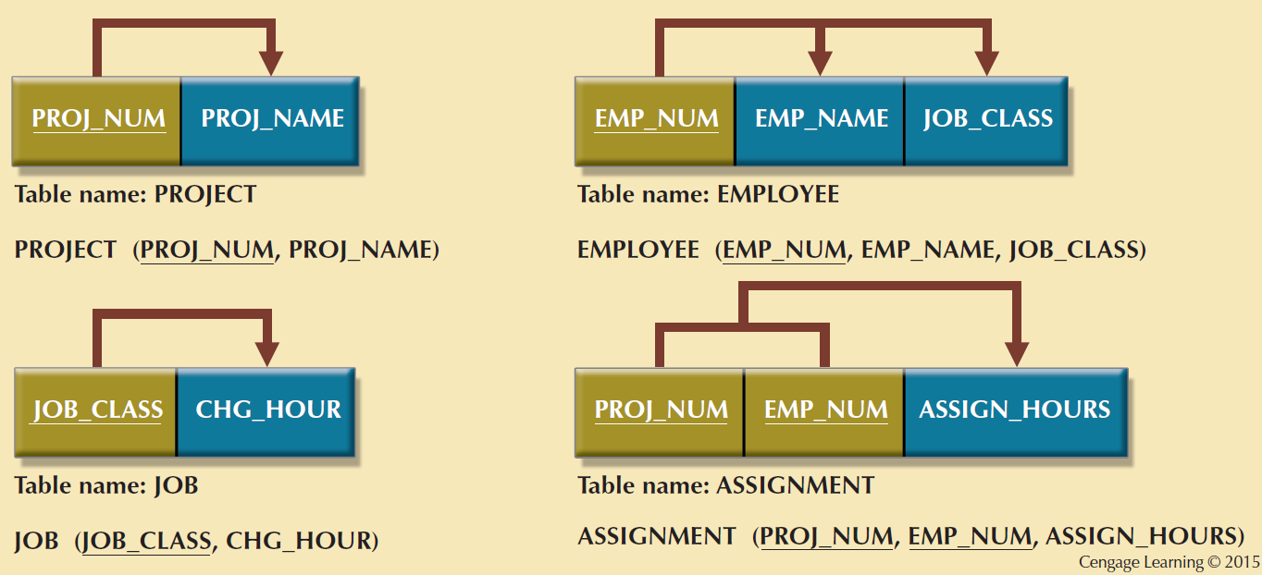
Figure 6.5 - Third Normal Form (3NF) Conversion Results

Slide 19
Requirements for Good Normalized Set of Tables
Evaluate PK assignments and naming conventions
Refine attribute atomicity
Atomic attribute: Cannot be further subdivided
Atomicity: Characteristic of an atomic attribute
Identify new attributes and new relationships
Refine primary keys as required for data granularity
Granularity: Level of detail represented by the values stored in a table’s row
Maintain historical accuracy and evaluate using derived attributes

Slide 20
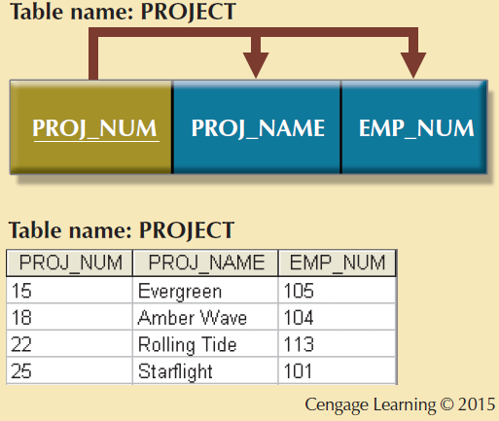
Figure 6.6 - The Completed Database

Slide 21
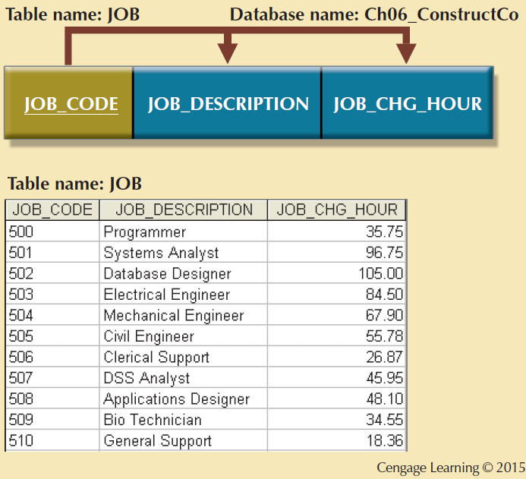
Figure 6.6 - The Completed Database

Slide 22
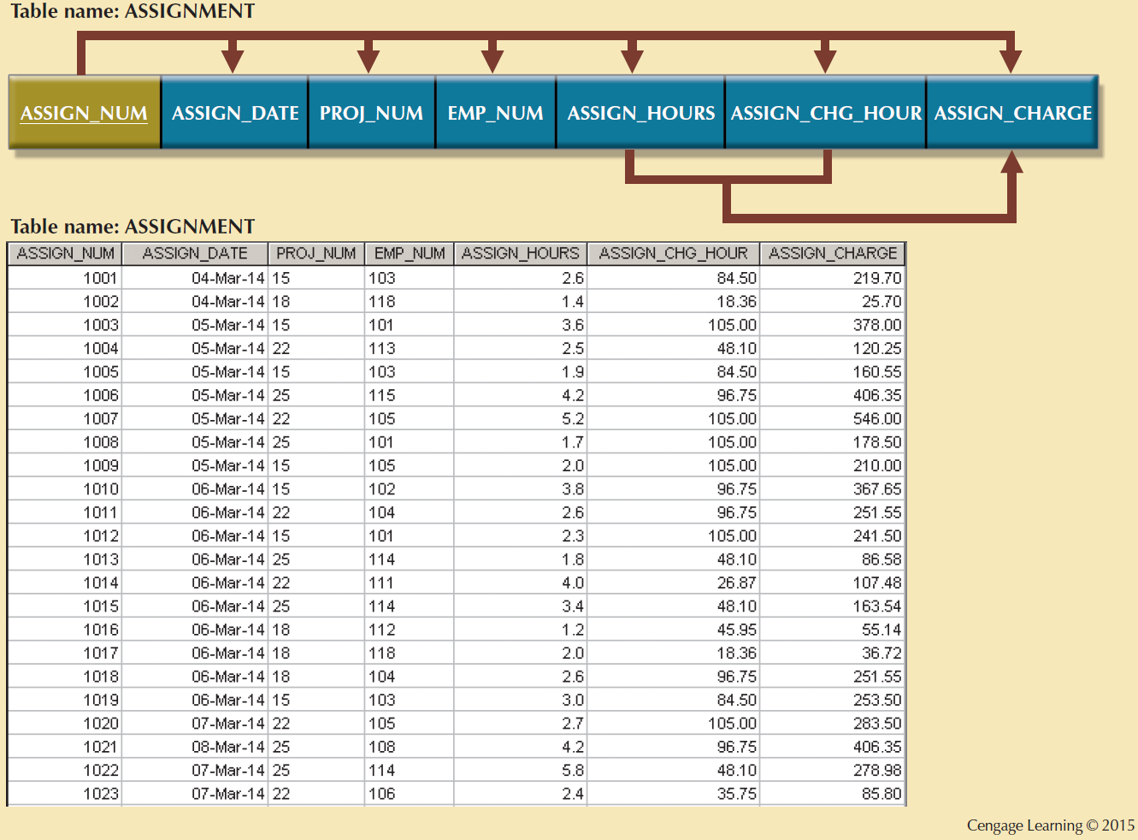
Figure 6.6 - The Completed Database

Slide 23
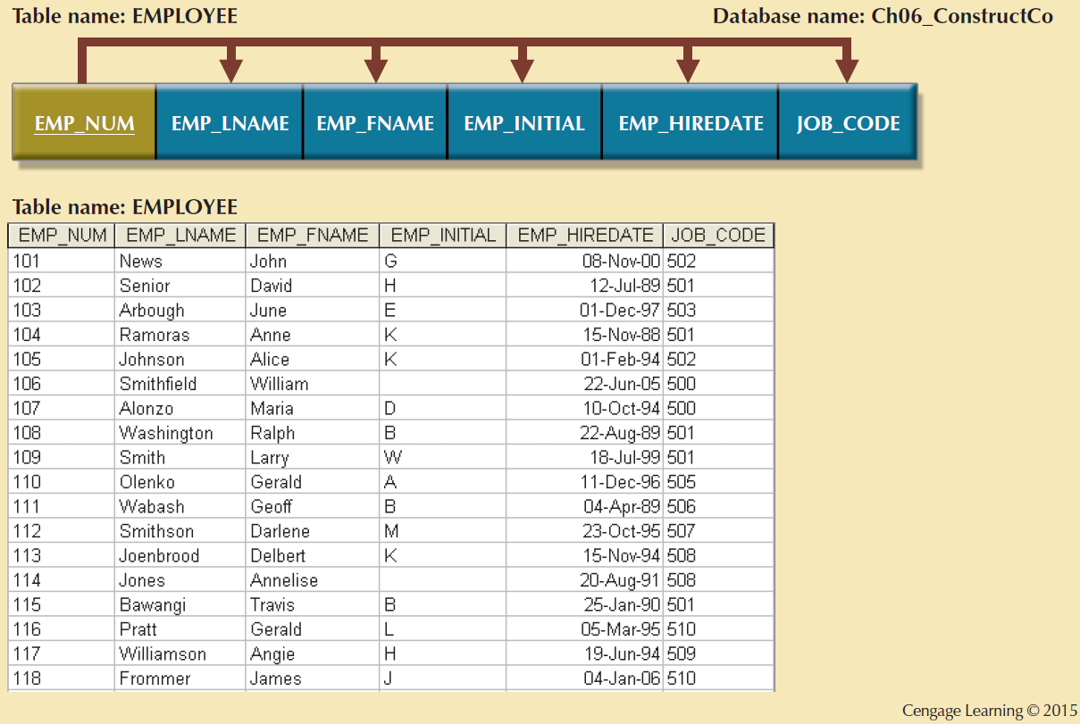
Figure 6.6 - The Completed Database

Slide 24
Surrogate Keys
Used by designers when the primary key is considered to be unsuitable
System-defined attribute
Created an managed via the DBMS
Have a numeric value which is automatically incremented for each new row

Slide 25
The Boyce-Codd Normal Form (BCNF)
Every determinant in the table should be a candidate key
Candidate key - Same characteristics as primary key but not chosen to be the primary key
Equivalent to 3NF when the table contains only one candidate key
Violated only when the table contains more than one candidate key
Considered to be a special case of 3NF

Slide 26
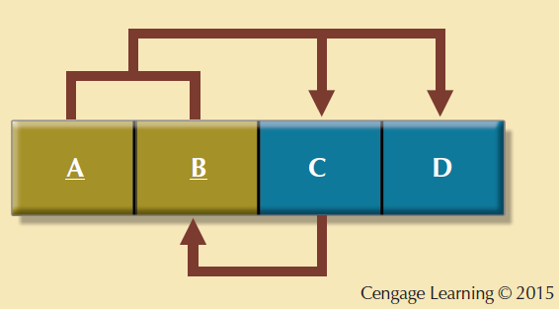
Figure 6.7 - A Table That is in 3NF and not in BCNF

Slide 27
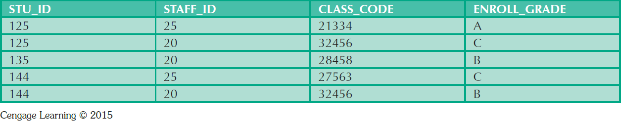
Table 6.5 - Sample Data for a BCNF Conversion

Slide 28
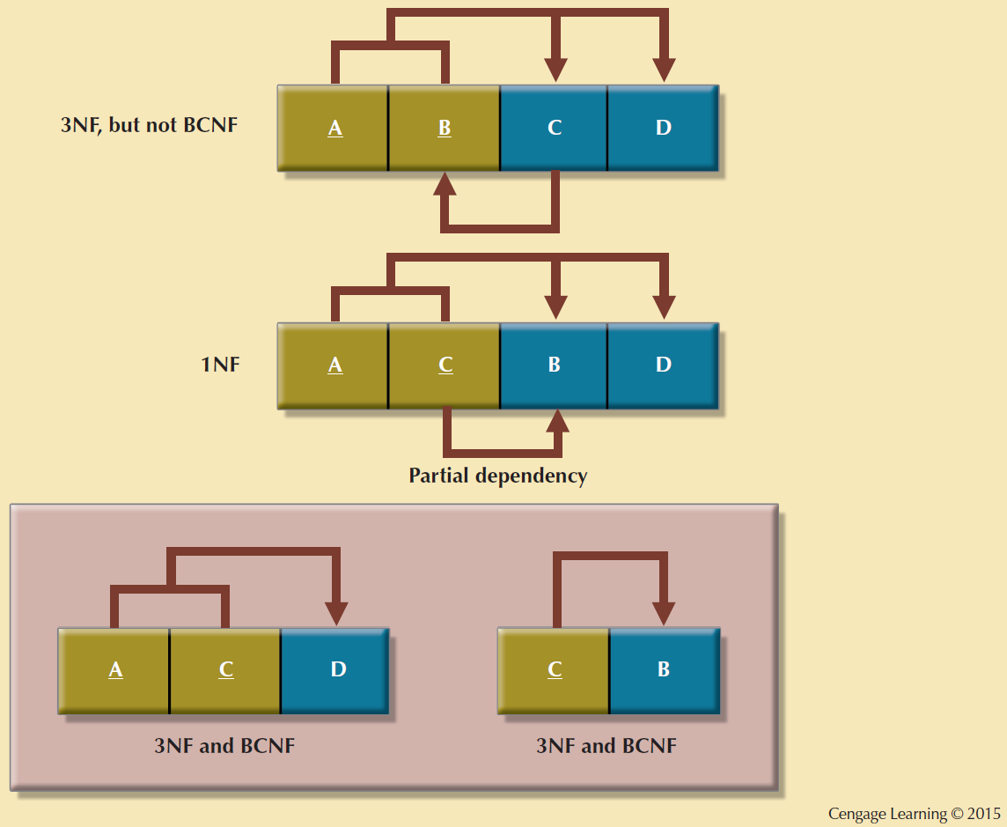
Figure 6.8 - Decomposition to BCNF

Slide 29
Fourth Normal Form (4NF)
Table is in 4NF when it:
Is in 3NF
Has no multivalued dependencies
Rules
All attributes must be dependent on the primary key, but they must be independent of each other
No row may contain two or more multivalued facts about an entity

Slide 30
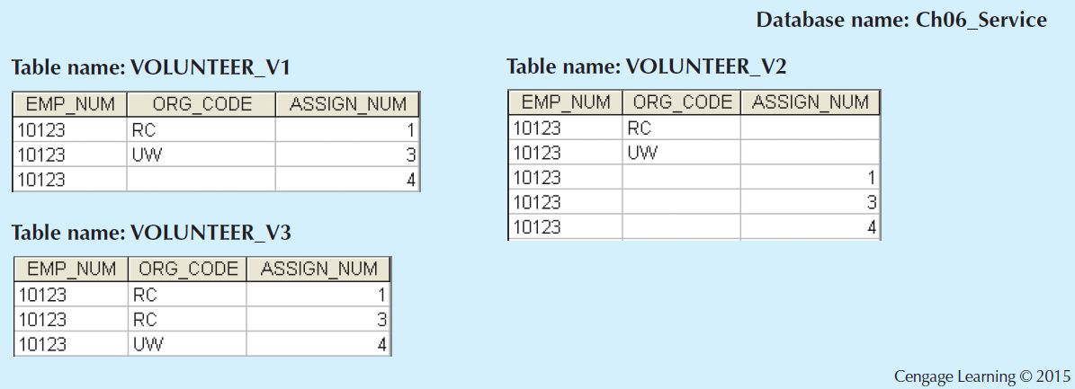
Figure 6.10 - Tables with Multivalued Dependencies

Slide 31
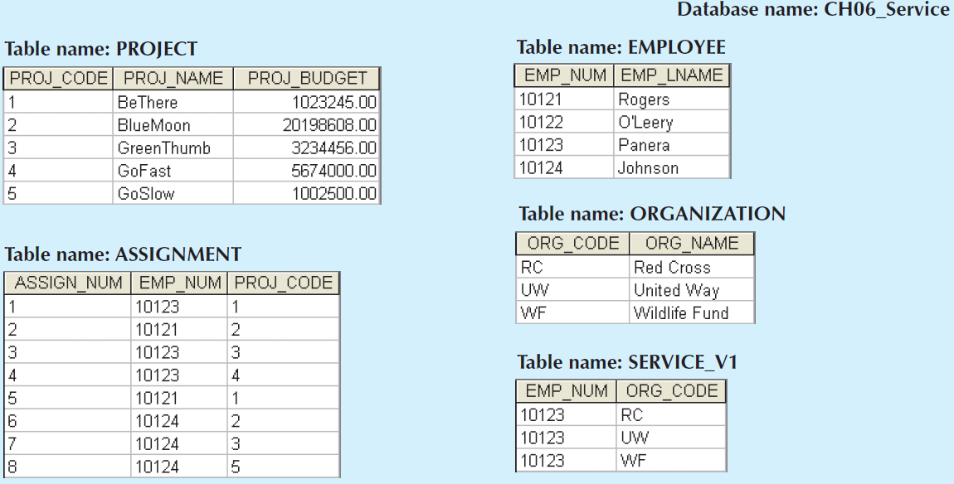
Figure 6.11 - A Set of Tables in 4NF
Cengage Learning © 2015

Slide 32
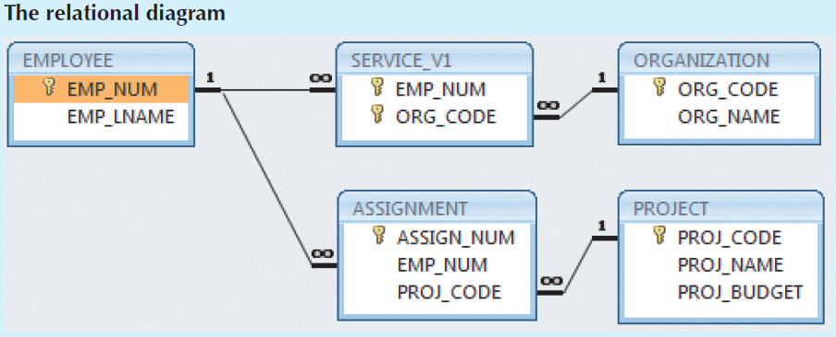
Figure 6.11 - A Set of Tables in 4NF
Cengage Learning © 2015

Slide 33
Normalization and Database Design
Normalization should be part of the design process
Proposed entities must meet required the normal form before table structures are created
Principles and normalization procedures to be understood to redesign and modify databases
ERD is created through an iterative process
Normalization focuses on the characteristics of specific entities

Slide 34
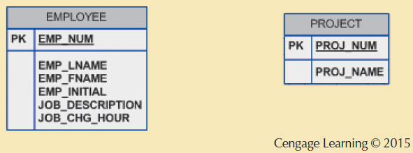
Figure 6.12 - Initial Contracting Company ERD

Slide 35
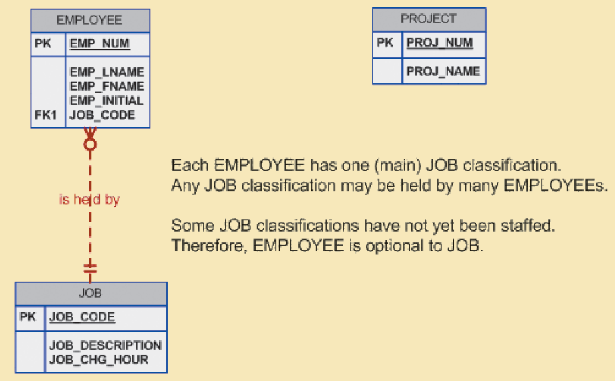
Figure 6.13 - Modified Contracting Company ERD
Cengage Learning © 2015

Slide 36
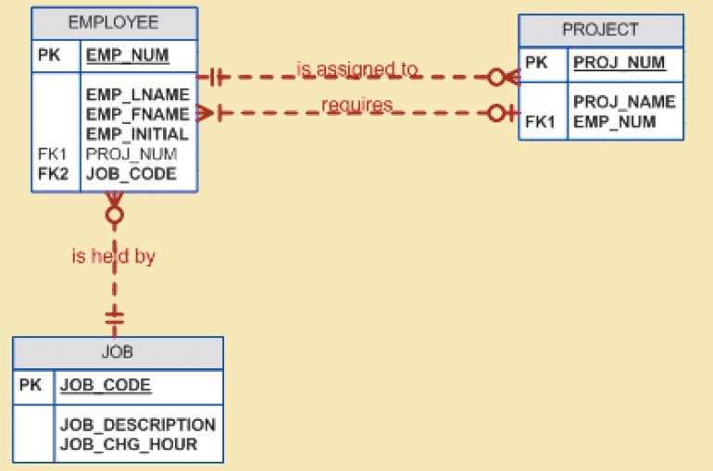
Figure 6.14 - Incorrect M:N Relationship Representation
Cengage Learning © 2015

Slide 37
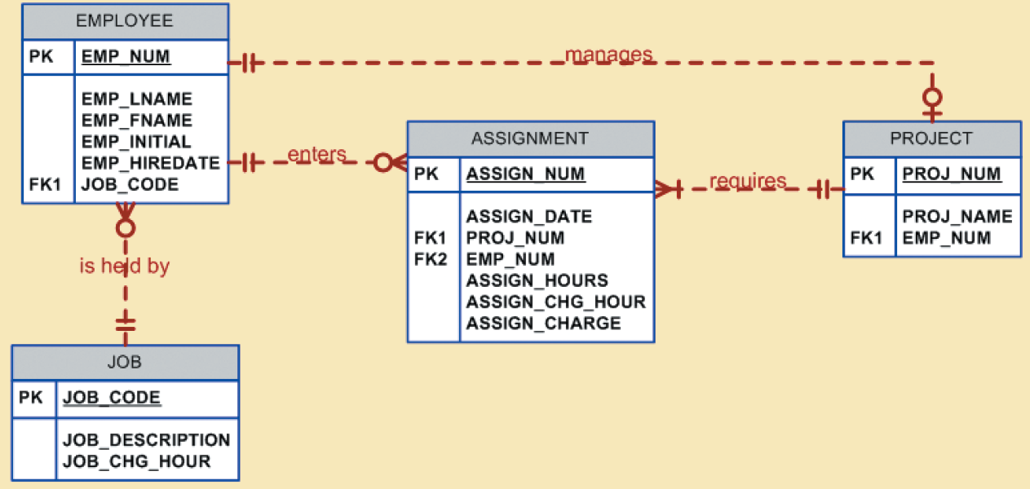
Figure 6.15 - Final Contracting Company ERD
Cengage Learning © 2015

Slide 38
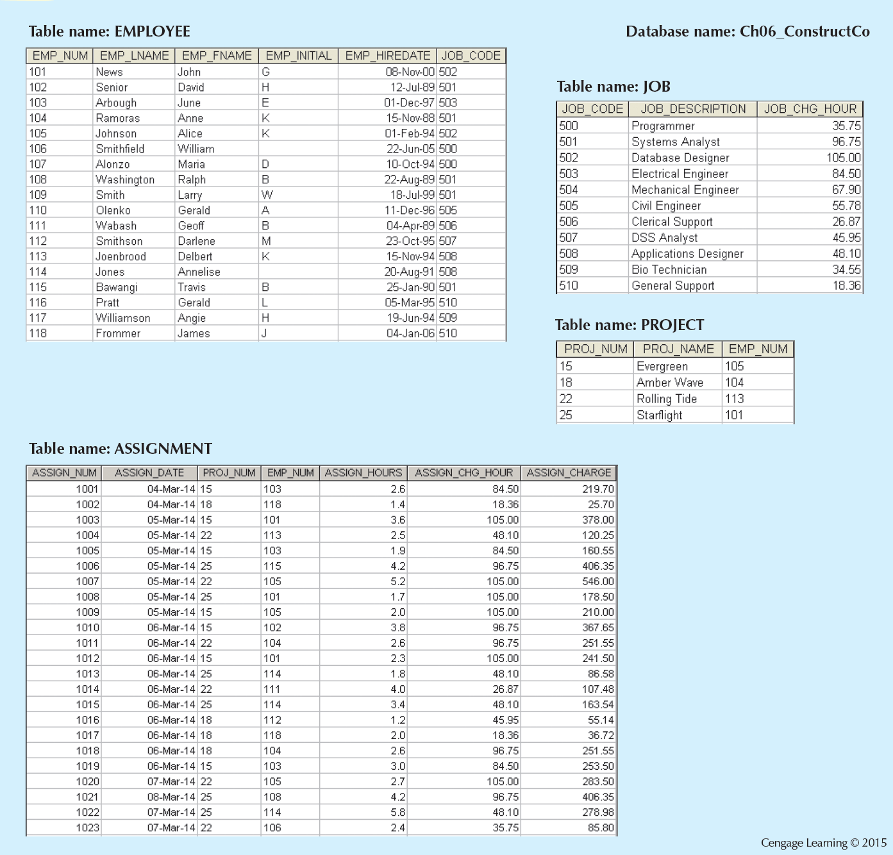
Figure 6.16 - The Implemented Database

Slide 39
Denormalization
Design goals
Creation of normalized relations
Processing requirements and speed
Number of database tables expands when tables are decomposed to conform to normalization requirements
Joining a larger number of tables:
Takes additional input/output (I/O) operations and processing logic
Reduces system speed

Slide 40
Denormalization
Defects in unnormalized tables
Data updates are less efficient because tables are larger
Indexing is more cumbersome
No simple strategies for creating virtual tables known as views

Slide 41
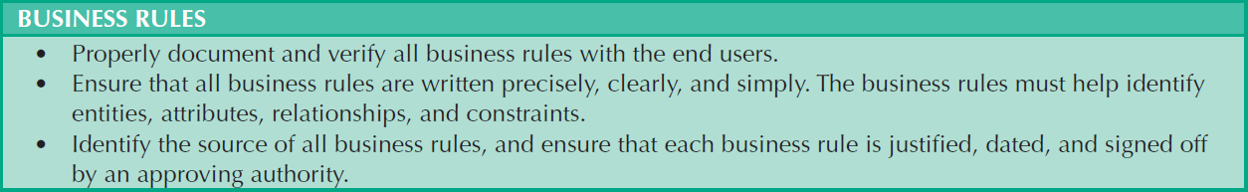
Table 6.7 - Data-Modeling Checklist
Cengage Learning © 2015

Slide 42
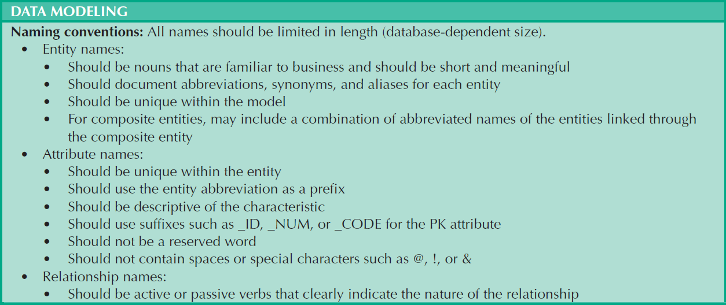
Table 6.7 - Data-Modeling Checklist
Cengage Learning © 2015

Slide 43
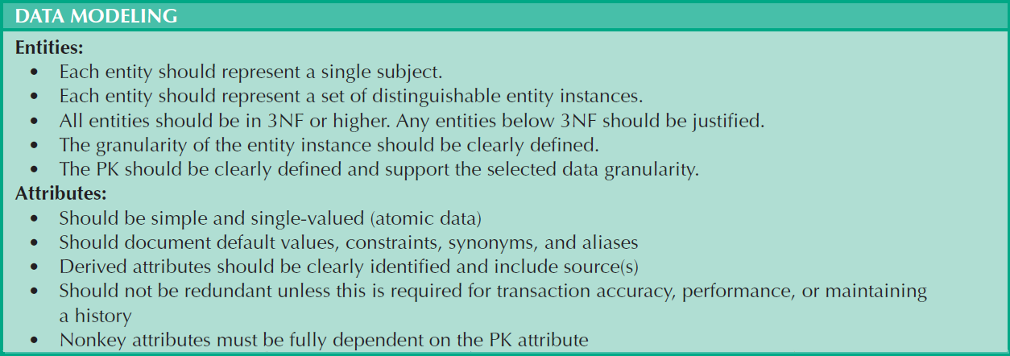
Table 6.7 - Data-Modeling Checklist
Cengage Learning © 2015

Slide 44
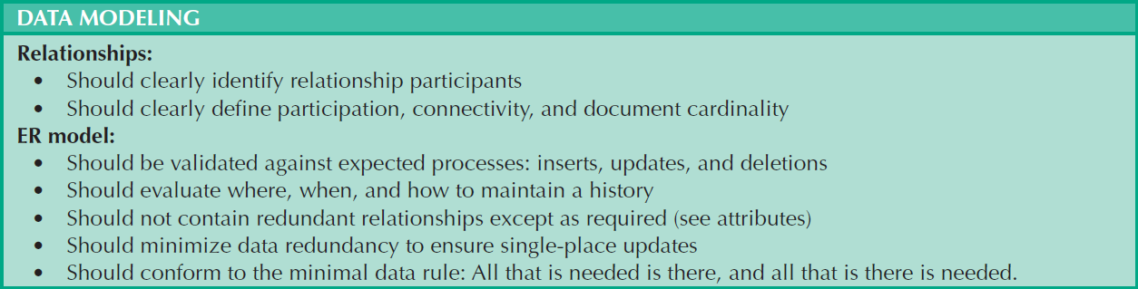
Table 6.7 - Data-Modeling Checklist
Cengage Learning © 2015

