Slide 1
Chapter 7
Introduction to Structured Query Language (SQL)

Slide 2
Learning Objectives
In this chapter, you will learn:
The basic commands and functions of SQL
How to use SQL for data administration (to create tables and indexes)
How to use SQL for data manipulation (to add, modify, delete, and retrieve data)
How to use SQL to query a database for useful information

Slide 3
Structured Query Language (SQL)
Categories of SQL function
Data definition language (DDL)
Data manipulation language (DML)
Nonprocedural language with basic command vocabulary set of less than 100 words
Differences in SQL dialects are minor

Slide 4
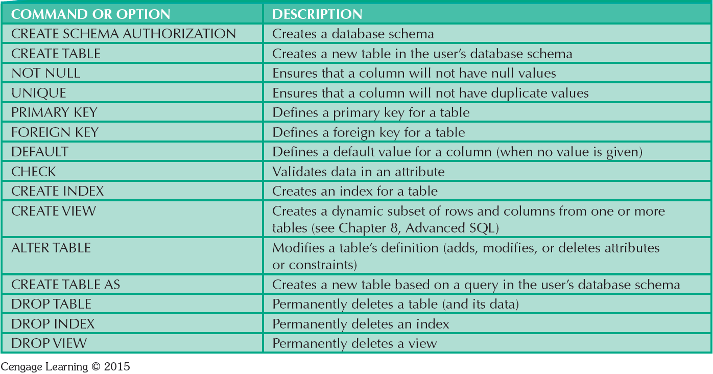
Table 7.1 - SQL Data Definition Command

Slide 5
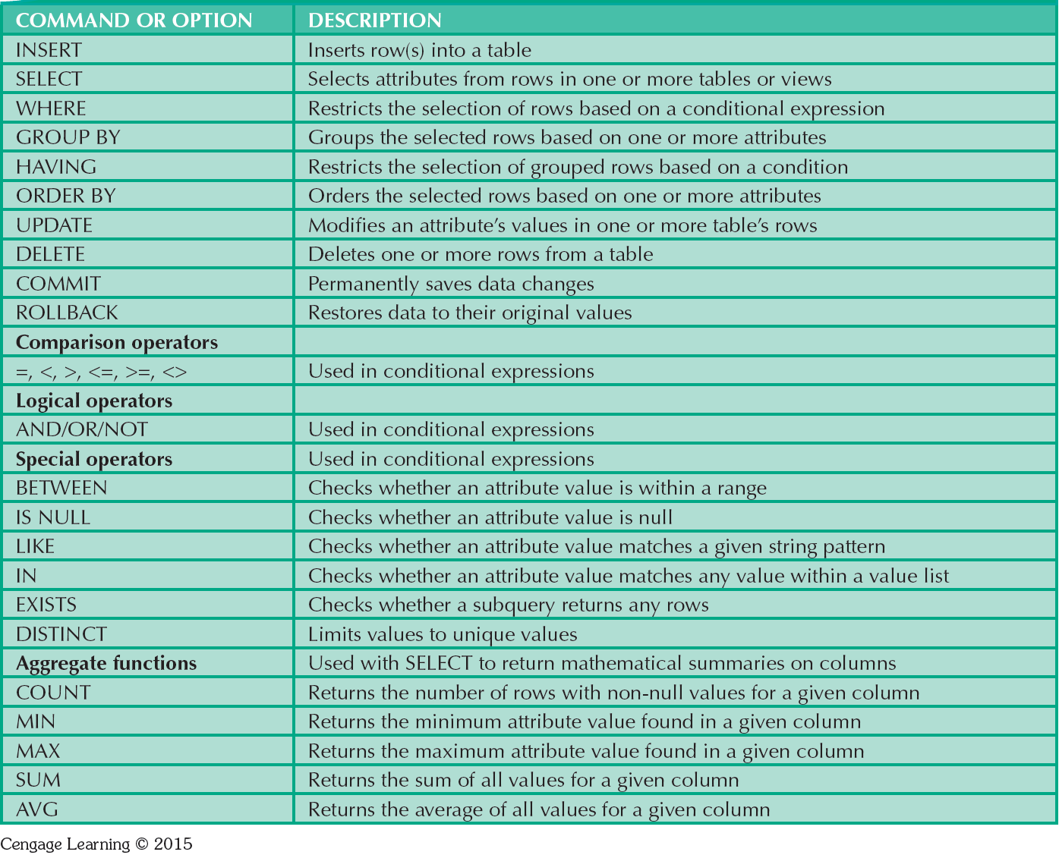
Table 7.2 - SQL Data Manipulation Commands

Slide 6
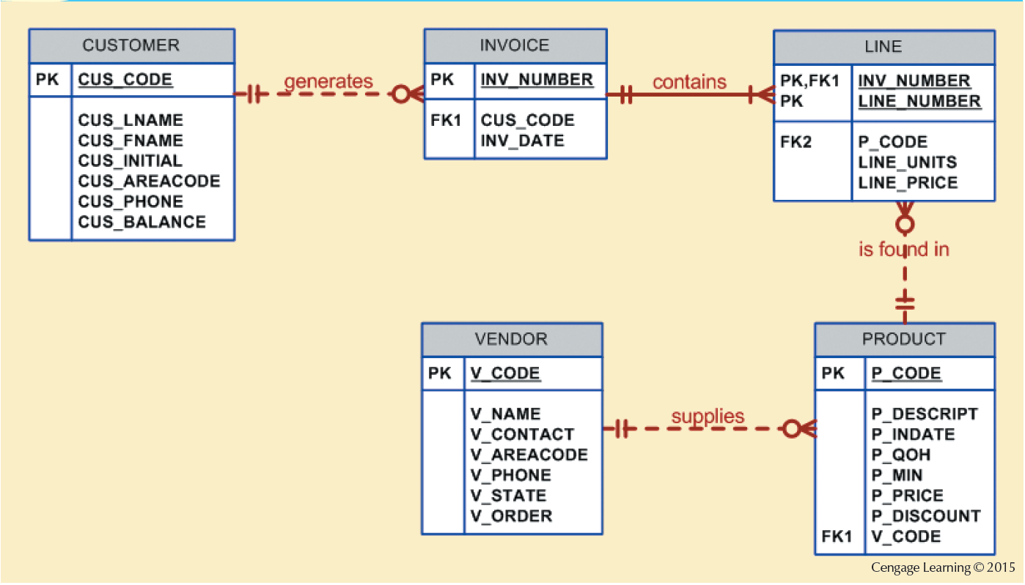
Figure 7.1 - The Database Model

Slide 7
Tasks to be Completed Before Using a New RDBMS
Create database structure
RDBMS creates physical files that will hold database
Differs from one RDBMS to another
Authentication: Process DBMS uses to verify that only registered users access the data
Required for the creation tables
User should log on to RDBMS using user ID and password created by database administrator

Slide 8
The Database Schema
Logical group of database objects related to each other
Command
CREATE SCHEMA AUTHORIZATION {creator};
Seldom used directly

Slide 9
Common SQL Data Types
Numeric
NUMBER(L,D) or NUMERIC(L,D)
Character
CHAR(L)
VARCHAR(L) or VARCHAR2(L)
Date
DATE

Slide 10
Creating Table Structures
Use one line per column (attribute) definition
Use spaces to line up attribute characteristics and constraints
Table and attribute names are capitalized
Features of table creating command sequence
NOT NULL specification
UNIQUE specification
Syntax to create table
CREATE TABLE tablename();

Slide 11
Primary Key and Foreign Key
Primary key attributes contain both a NOT NULL and a UNIQUE specification
RDBMS will automatically enforce referential integrity for foreign keys
Command sequence ends with semicolon
ANSI SQL allows use of following clauses to cover CASCADE, SET NULL, or SET DEFAULT
ON DELETE and ON UPDATE

Slide 12
SQL Constraints
NOT NULL
Ensures that column does not accept nulls
UNIQUE
Ensures that all values in column are unique
DEFAULT
Assigns value to attribute when a new row is added to table
CHECK
Validates data when attribute value is entered

Slide 13
SQL Indexes
When primary key is declared, DBMS automatically creates unique index
Composite index:
Is based on two or more attributes
Prevents data duplication
Syntax to create SQL indexes
CREATE INDEX indexname ON tablename();
Syntax to delete an index
DROP INDEX indexname;

Slide 14
Data Manipulation Commands
INSERT: Command to insert data into table
Syntax - INSERT INTO tablename VALUES();
Used to add table rows with NULL and NOT NULL attributes
COMMIT: Command to save changes
Syntax - COMMIT [WORK];
Ensures database update integrity

Slide 15
Data Manipulation Commands
SELECT: Command to list the contents
Syntax - SELECT columnlist FROM tablename;
Wildcard character(*): Substitute for other characters/command
UPDATE: Command to modify data
Syntax - UPDATE tablename SET columnname = expression [, columnname = expression] [WHERE conditionlist];

Slide 16
Data Manipulation Commands
WHERE condition
Specifies the rows to be selected
ROLLBACK: Command to restore the database
Syntax - ROLLBACK;
Undoes the changes since last COMMIT command
DELETE: Command to delete
Syntax - DELETE FROM tablename
[WHERE conditionlist];

Slide 17
Inserting Table Rows with a SELECT Subquery
Syntax
INSERT INTO tablename SELECT columnlist FROM tablename
Used to add multiple rows using another table as source
SELECT command - Acts as a subquery and is executed first
Subquery: Query embedded/nested inside another query

Slide 18
Selecting Rows Using Conditional Restrictions
Following syntax enables to specify which rows to select
SELECT columnlist
FROM tablelist
[WHERE conditionlist];
Used to select partial table contents by placing restrictions on the rows
Optional WHERE clause
Adds conditional restrictions to the SELECT statement

Slide 19
Comparison Operators
Add conditional restrictions on selected table contents
Used on:
Character attributes
Dates

Slide 20
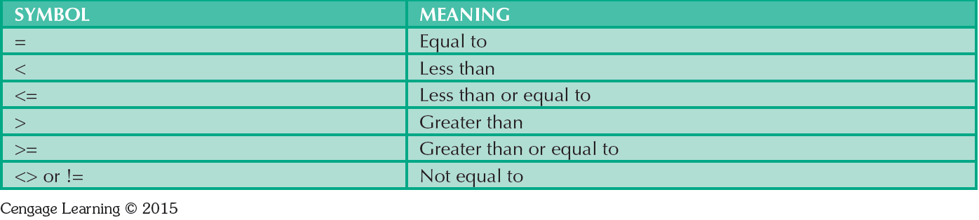
Table 7.6 - Comparison Operators

Slide 21
Comparison Operators: Computed Columns and Column Aliases
SQL accepts any valid expressions/formulas in the computed columns
Alias: Alternate name given to a column or table in any SQL statement to improve the readability
Computed column, an alias, and date arithmetic can be used in a single query

Slide 22
Arithmetic operators
The Rule of Precedence: Establish the order in which computations are completed
Perform:
Operations within parentheses
Power operations
Multiplications and divisions
Additions and subtractions

Slide 23
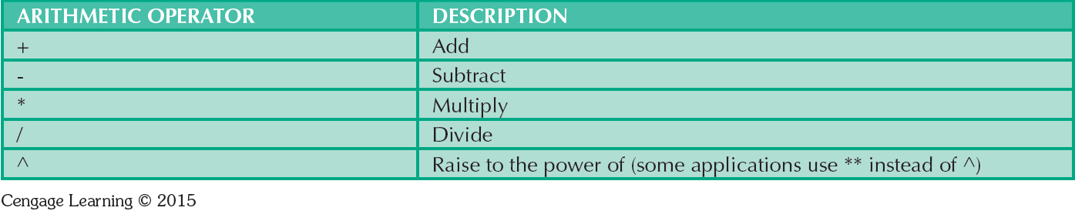
Table 7.7 - The Arithmetic Operators

Slide 24
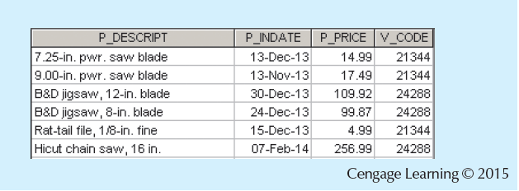
Figure 7.12 - Selected PRODUCT Table Attributes: The logical OR

Slide 25
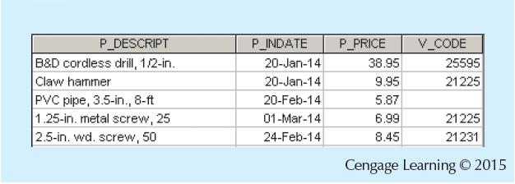
Figure 7.13 - Selected PRODUCT Table Attributes: The Logical AND

Slide 26
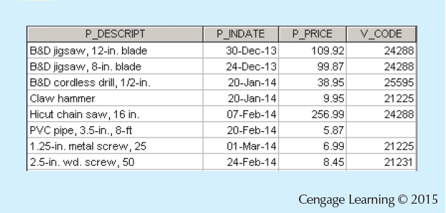
Figure 7.14 - Selected PRODUCT Table Attributes: The Logical AND and OR

Slide 27
Special Operators
BETWEEN
IS NULL
LIKE
IN
EXISTS
Checks whether attribute value is within a range
Checks whether attribute value is null
Checks whether attribute value matches given string pattern
Checks whether attribute value matches any value within a value list
Checks if subquery returns any rows

Slide 28
Advanced Data Definition Commands
ALTER TABLE command: To make changes in the table structure
Keywords use with the command
ADD - Adds a column
MODIFY - Changes column characteristics
DROP - Deletes a column
Used to:
Add table constraints
Remove table constraints

Slide 29
Changing Column’s Data Type
ALTER can be used to change data type
Some RDBMSs do not permit changes to data types unless column is empty
Syntax –
ALTER TABLE tablename MODIFY (columnname(datatype));

Slide 30
Changing Column’s Data Characteristics
Use ALTER to change data characteristics
Changes in column’s characteristics are permitted if changes do not alter the existing data type
Syntax
ALTER TABLE tablename MODIFY (columnname(characterstic));

Slide 31
Adding Column, Dropping Column
Adding a column
Use ALTER and ADD
Do not include the NOT NULL clause for new column
Dropping a column
Use ALTER and DROP
Some RDBMSs impose restrictions on the deletion of an attribute

Slide 32
Advanced Data Updates
UPDATE command updates only data in existing rows
If a relationship is established between entries and existing columns, the relationship can assign values to appropriate slots
Arithmetic operators are useful in data updates
In Oracle, ROLLBACK command undoes changes made by last two UPDATE statements

Slide 33
Copying Parts of Tables
SQL permits copying contents of selected table columns
Data need not be reentered manually into newly created table(s)
Table structure is created
Rows are added to new table using rows from another table

Slide 34
Adding Primary and Foreign Key Designations
ALTER TABLE command
Followed by a keyword that produces the specific change one wants to make
Options include ADD, MODIFY, and DROP
Syntax to add or modify columns
ALTER TABLE tablename
{ADD | MODIFY} ( columnname datatype [ {ADD | MODIFY} columnname datatype] ) ;
ALTER TABLE tablename
ADD constraint [ ADD constraint ] ;

Slide 35
Deleting a Table from the Database
DROP TABLE: Deletes table from database
Syntax - DROP TABLE tablename;
Can drop a table only if it is not the one side of any relationship
RDBMS generates a foreign key integrity violation error message if the table is dropped

Slide 36
Additional SELECT Query Keywords
Logical operators work well in the query environment
SQL provides useful functions that:
Counts
Find minimum and maximum values
Calculate averages
SQL allows user to limit queries to entries:
Having no duplicates
Whose duplicates may be grouped

Slide 37
Ordering a Listing
ORDER BY clause is useful when listing order is important
Syntax - SELECT columnlist
FROM tablelist
[WHERE conditionlist]
[ORDER BY columnlist [ASC | DESC]];
Cascading order sequence: Multilevel ordered sequence
Created by listing several attributes after the ORDER BY clause

Slide 38
Listing Unique Values
DISTINCT clause: Produces list of values that are unique
Syntax - SELECT DISTINCT columnlist
FROM tablelist;
Access places nulls at the top of the list
Oracle places it at the bottom
Placement of nulls does not affect list contents

Slide 39
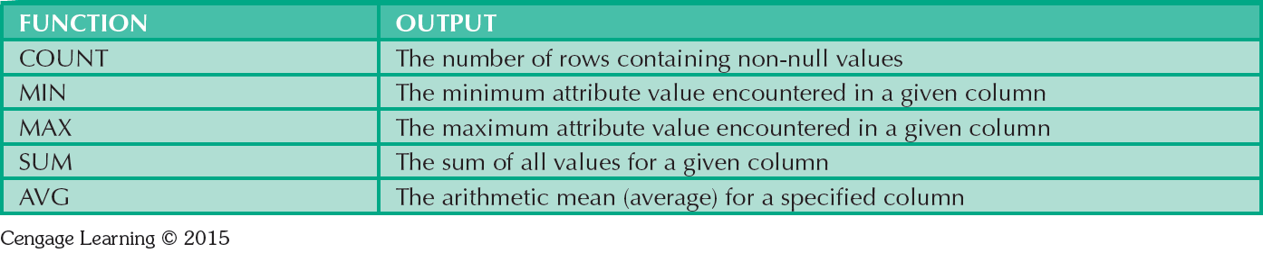
Table 7.8 - Some Basic SQL Aggerate Functions

Slide 40
Grouping Data
Frequency distributions created by GROUP BY clause within SELECT statement
Syntax - SELECT columnlist
FROM tablelist
[WHERE conditionlist]
[GROUP BY columnlist]
[HAVING conditionlist]
[ORDER BY columnlist [ASC | DESC]];

Slide 41
HAVING Clause
Extension of GROUP BY feature
Applied to output of GROUP BY operation
Used in conjunction with GROUP BY clause in second SQL command set
Similar to WHERE clause in SELECT statement

Slide 42
Joining Database Tables
Performed when data are retrieved from more than one table at a time
Equality comparison between foreign key and primary key of related tables
Tables are joined by listing tables in FROM clause of SELECT statement
DBMS creates Cartesian product of every table in the FROM clause

Slide 43
Joining Tables With an Alias
Alias identifies the source table from which data are taken
Any legal table name can be used as alias
Add alias after table name in FROM clause
FROM tablename alias

Slide 44
Recursive Joins
Recursive query: Table is joined to itself using alias
Use aliases to differentiate the table from itself

