Slide 1

NoSQL Data Management: Concepts and Systems
November 8, 2018
BUAN 6320 Database Foundations

Slide 2
History
SQL Databases were dominant for decades
Persistent storage
Standards based
Concurrency Control
Application Integration
ACID
Designed to run on a single big machine
Cloud computing changes that dramatically
Cluster of machines
Large amount of unreliable machines
Distributed System
Schema-free unstructured Big Data

Slide 3
Methods to Run a Database
Virtual Machine Image
Users purchase virtual machine instances to run a database on these
Upload and setup own image with database, or use ready-made images with optimized database installations
E.g. Oracle Database 11g Enterprise Edition image for Amazon EC2 and for Microsoft Azure.
Database as a service (DBaaS)
Using a database without physically launching a virtual machine instance
No configuration or management needed by application owners
E.g. Amazon Web Services provide SimpleDB, Amazon Relational Database Service (RDS), DynamoDB
Managed database hosting
Not offered as a service, but hosted and managed by the cloud database vendor
E.g. Rackspace offers managed hosting for MySQL
TOSCA
Description of Cloud Services as Topology combined with the database stack
Vendor-neutral automatic provisioning and management with OpenTOSCA
Policies to define security requirements of the Cloud Service
Portable and interoperable definition of data security and compliance aspects

Slide 4
Which Data Model?
Relational Databases
Standard SQL database available for Cloud Environments as Virtual Machine Image or as a service depending on the vendor
Not cloud-ready: Difficult to scale
NoSQL databases
Database which is designed for the cloud
Built to serve heavy read/write loads
Good ability to scale up and down
Applications built based on SQL data model require a complete rewrite
E.g. Apache Cassandra, CouchDB and MongoDB

Slide 5
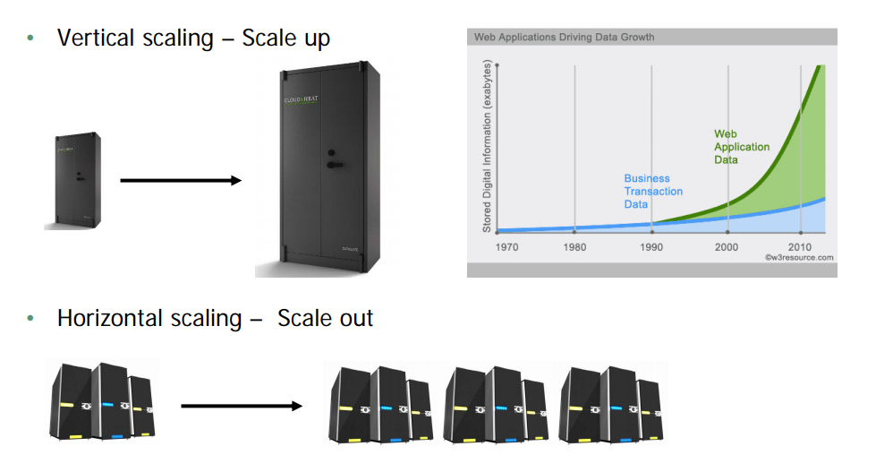
How to scale the data management?

Slide 6
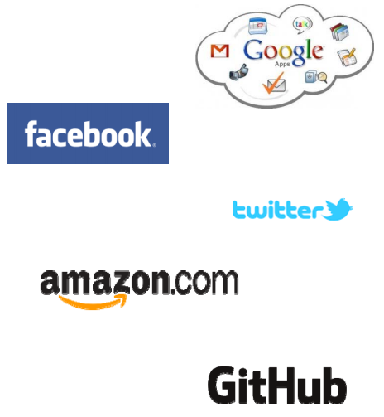
Who Uses NoSQL?
Google – Big Table, Google Apps,
Google Search
Facebook – Social network
Twitter
Amazon – DynamoDB and SimpleDB
CERN
GitHub

Slide 7
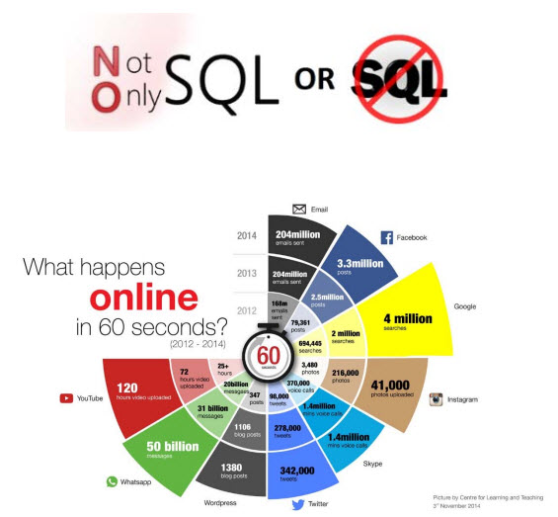
Definition and Goals of NoSQL databases
No formal NoSQL definition available!
Store very large scale data called “Big data”
Typically scale horizontally
Simple query mechanisms
Often designed and set up for
a concrete application
Typical NoSQL characteristics:
Non-relational
Schema-free
Open Source
Simple API
Distributed
Eventual consistency

Slide 8
Non-relational are Schema-free
NoSQL databases generally do not follow the relational model
Do not provide tables with flat fixed-column records
Work with self-contained (hierarchical) aggregates or BLOBs
No need for object-relational mapping and data normalization
No complex and costly features like query languages, query planners, referential integrity, joins, ACID
Most NoSQL databases are schema-free or have relaxed schemas
No need for definition of any sort of schema of the data
Allows heterogeneous structures of data in the same domain

Slide 9
Simple API and Distributed
Often simple interfaces for storage and querying data provided
APIs often allow low-level data manipulation and selection methods
Often no standard based query language is used
Text-based protocols often using HTTP REST with JSON
Web-enabled databases running as internet-facing services
Several NoSQL databases can be executed in a distributed fashion
Providing auto-scaling and fail-over capabilities
Often ACID is sacrificed for scalability and throughput
Often no synchronous replication between distributed nodes is possible, e.g. asynchronous Multi-Master Replication, peer-to-peer, HDFS Replication
Only providing eventual consistency

Slide 10
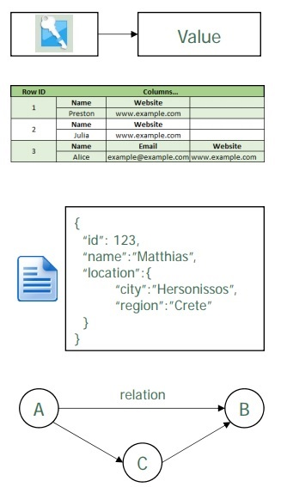
Core Categories of NoSQL Systems
Key-Value Stores
Manage associative arrays
Big hash table
Wide Column Stores
Each storage block contains only data from one column
Read and write is done using columns
(rather than rows – like in SQL)
Document Stores
Store documents consisting of tagged values
Data is a collection of key value pairs
Provides structure and encoding of the managed data
Encoded using XML, JSON, BSON
Schema-free
Graph DB
Network database using graphs with node and edges for storage
Nodes represent entities, edges represent their relationships

Slide 11
SQL and NoSQL Systems
Relational: MySQL, PostgreSQL, SQLite, Firebird, MariaDB, Oracle DB, SQL server, IBM DB2, IBM Informix, Teradata
Key value-stores: Memcachedb, Redis, Riak, Amazon DynamoDB, Voldemort, FoundationDB, leveldb, BangDB, KAI, hamsterdb, Tarantool, Maxtable, HyperDex, Genomu
Column family: Big table, Hbase, hyper table, Cassandra, Apache Accumulo
Document: Mongo DB, Couch DB, Rethink DB, Raven DB, terrastore, Jas DB, Raptor DB, djon DB, EJDB, denso DB, Couchbase
Graph databases: AllegroGraph, Neo4j, OrientDB, InfiniteGraph, graphbase, sparkledb, flockdb, BrightstarDB
Object: ZODB, DB4O, Eloquera, Versant, Objectivity DB, VelocityDB
RDF Stores: Apache Jena, Sesame
Multimodel Databases: arangodb, Datomic, Orient DB, FatDB, AlchemyDB
XML Databases: BaseX, Sedna, eXist
Hierarchical: InterSystems Caché, GT.M

Slide 12
SQL to NoSQL Terminology
SQL Terms/Concepts | MongoDB Terms/Concepts
database | database
table | collection
row | document or BSON document
column | field
index | index
table joins | $lookup, embedded documents
primary key Specify any unique column or column combination as primary key. | primary key In MongoDB, the primary key is automatically set to the _idfield.
aggregation (e.g. group by) | aggregation pipeline See the SQL to Aggregation Mapping Chart.
transactions | transactions TIP For many scenarios, the denormalized data model (embedded documents and arrays) will continue to be optimal for your data and use cases instead of multi-document transactions. That is, for many scenarios, modeling your data appropriately will minimize the need for multi-document transactions.

Slide 13
NoSQL Overview
Introduction to NoSQL
Basic Concepts for NoSQL
CAP-Theorem
Eventual Consistency
Consistent Hashing
MVCC-Protocol
Query Mechanisms for NoSQL
Overview of NoSQL Systems

Slide 14
SQL to NoSQL
The following table presents some database executables and the corresponding MongoDB executables. This table is not meant to be exhaustive.
MongoDB | MySQL | Oracle | MS SQL | DB2
Database Server | mongod | mysqld | MSSQL$SQLEXPRESS | IDS
Database Client | mongo | mysql | SSMS | DB-Access

Slide 15
GENERAL STRUCTURE OF NOSQL DATA
{
_id: ObjectId("509a8fb2f3f4948bd2f983a0"),
user_id: "abc123",
age: 55,
status: 'A'
}

Slide 16
CREATE TABLE
The following table presents the various SQL statements related to table-level actions and the corresponding MongoDB statements.
SQL Schema Statements | MongoDB Schema Statements
CREATE TABLE people ( id MEDIUMINT NOT NULL AUTO_INCREMENT, user_id Varchar(30), age Number, status char(1), PRIMARY KEY (id) ) | Implicitly created on first insertOne() or insertMany()operation. The primary key _id is automatically added if _id field is not specified. db.people.insertOne( { user_id: "abc123", age: 55, status: "A" } ) However, you can also explicitly create a collection: db.createCollection("people")
DROP TABLE people | db.people.drop()

Slide 17
ALTER TABLE ADD COLUMN
SQL Schema Statements | MongoDB Schema Statements
ALTER TABLE people ADD join_date DATETIME | Collections do not describe or enforce the structure of its documents; i.e. there is no structural alteration at the collection level. However, at the document level, updateMany() operations can add fields to existing documents using the $set operator. db.people.updateMany( { }, { $set: { join_date: new Date() } } )

Slide 18
ALTER TABLE DROP COLUMN
SQL Schema Statements | MongoDB Schema Statements
ALTER TABLE people DROP COLUMN join_date | Collections do not describe or enforce the structure of its documents; i.e. there is no structural alteration at the collection level. However, at the document level, updateMany() operations can remove fields from documents using the $unset operator. db.people.updateMany( { }, { $unset: { "join_date": "" } } )

Slide 19
CREATE INDEX
SQL Schema Statements | MongoDB Schema Statements
CREATE INDEX idx_user_id_asc ON people(user_id) | db.people.createIndex( { user_id: 1 })
CREATE INDEX idx_user_id_asc_age_desc ON people(user_id, age DESC) | db.people.createIndex( { user_id: 1, age: -1 })
DROP TABLE people | db.people.drop()

Slide 20
INSERT SQL AND NoSQL
The following table presents the various SQL statements related to inserting records into tables and the corresponding MongoDB statements.
SQL Schema Statements | MongoDB Schema Statements
INSERT INTO people(user_id, age, status) VALUES ("bcd001", 45, "A") | db.people.insertOne( { user_id: "bcd001", age: 45, status: "A" } )

Slide 21
SELECTS
The following table presents the various SQL statements related to reading records from tables and the corresponding MongoDB statements.
NOTE: The find() method always includes the _id field in the returned documents unless specifically excluded through projection. Some of the SQL queries below may include an _id field to reflect this, even if the field is not included in the corresponding find() query.
SQL SELECT Statements | MongoDB find() Statements
SELECT * FROM people | db.people.find()
SELECT id, user_id, status FROM people | db.people.find( { }, { user_id: 1, status: 1 } )

Slide 22
SELECTS, Cont.
SQL Schema Statements | MongoDB Schema Statements
SELECT user_id, status FROM people | db.people.find( { }, { user_id: 1, status: 1, _id: 0 } )
SELECT * FROM people WHERE status = "A" | db.people.find( { status: "A" } )
SELECT user_id, status FROM people WHERE status = "A" | db.people.find( { status: "A" }, { user_id: 1, status: 1, _id: 0 } )

Slide 23
SELECTS, Cont.
SQL Schema Statements | MongoDB Schema Statements
SELECT * FROM people WHERE status != "A" | db.people.find( { status: { $ne: "A" } } )
SELECT * FROM people WHERE status = "A" AND age = 50 | db.people.find( { status: "A", age: 50 } )
SELECT * FROM people WHERE status = "A" OR age = 50 | db.people.find( { $or: [ { status: "A" } , { age: 50 } ] } )
SELECT * FROM people WHERE age > 25 | db.people.find( { age: { $gt: 25 } } )

Slide 24
SELECTS, Cont.
SQL Schema Statements | MongoDB Schema Statements
SELECT * FROM people WHERE age < 25 | db.people.find( { age: { $lt: 25 } } )
SELECT * FROM people WHERE age > 25 AND age <= 50 | db.people.find( { age: { $gt: 25, $lte: 50 } } )
SELECT * FROM people WHERE user_id like "%bc%" | db.people.find( { user_id: /bc/ } ) -or- db.people.find( { user_id: { $regex: /bc/ } } )

Slide 25
SELECTS, Cont.
SQL Schema Statements | MongoDB Schema Statements
SELECT * FROM people WHERE user_id like "bc%" | db.people.find( { user_id: /^bc/ } ) -or- db.people.find( { user_id: { $regex: /^bc/ } } )
SELECT * FROM people WHERE status = "A" ORDER BY user_id ASC | db.people.find( { status: "A" } ).sort( { user_id: 1 } )
SELECT * FROM people WHERE status = "A" ORDER BY user_id DESC | db.people.find( { status: "A" } ).sort( { user_id: -1 } )

Slide 26
SELECTS, Cont.
SQL Schema Statements | MongoDB Schema Statements
SELECT COUNT(*) FROM people | db.people.count() or db.people.find().count()
SELECT COUNT(user_id) FROM people | db.people.count( { user_id: { $exists: true } } ) or db.people.find( { user_id: { $exists: true } } ).count()

Slide 27
SELECTS, Cont.
SQL Schema Statements | MongoDB Schema Statements
SELECT COUNT(*) FROM people WHERE age > 30 | db.people.count( { age: { $gt: 30 } } ) or db.people.find( { age: { $gt: 30 } } ).count()
SELECT DISTINCT(status) FROM people | db.people.aggregate( [ { $group : { _id : "$status" } } ] ) or, for distinct value sets that do not exceed the BSON size limit db.people.distinct( "status" )

Slide 28
SELECTS, Cont.
SQL Schema Statements | MongoDB Schema Statements
SELECT * FROM people LIMIT 1 | db.people.findOne() or db.people.find().limit(1)
SELECT * FROM people LIMIT 5 SKIP 10 | db.people.find().limit(5).skip(10)
EXPLAIN SELECT * FROM people WHERE status = "A" | db.people.find( { status: "A" } ).explain()

Slide 29
Update Records
The following table presents the various SQL statements related to updating existing records in tables and the corresponding MongoDB statements.
SQL Update Statements | MongoDB updateMany() Statements
UPDATE people SET status = "C" WHERE age > 25 | db.people.updateMany( { age: { $gt: 25 } }, { $set: { status: "C" } } )
UPDATE people SET age = age + 3 WHERE status = "A" | db.people.updateMany( { status: "A" } , { $inc: { age: 3 } } )

Slide 30
Delete Records
The following table presents the various SQL statements related to updating existing records in tables and the corresponding MongoDB statements.
SQL Delete Statements | MongoDB deleteMany() Statements
DELETE FROM people WHERE status = "D" | db.people.deleteMany( { status: "D" } )
DELETE FROM people | db.people.deleteMany({})

