Slide 1

NoSQL Data Management: Concepts and Systems
November 15, 2018
BUAN 6320 Database Foundations

Slide 2
NoSQL Overview
Introduction to NoSQL
Basic Concepts for NoSQL
CAP-Theorem
Eventual Consistency
Consistent Hashing
MVCC-Protocol
Query Mechanisms for NoSQL
Overview of NoSQL Systems

Slide 3
We want in a data system
We need a distributed database system having such features:
Fault tolerance
Speed
High availability
Consistency
Scalability
Sustainability

Slide 4
Speed But Deferred-Write
Some statistics about Facebook Search (using Cassandra)
MySQL > 50 GB Data
Writes Average : ~300 ms
Reads Average : ~350 ms
Rewritten with Cassandra > 50 GB Data
Writes Average : 0.12 ms
Reads Average : 15 ms

Slide 5
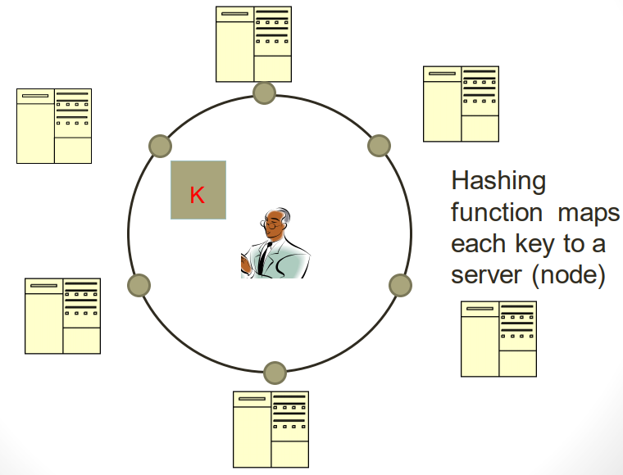
Typical NoSQL Architecture

Slide 6
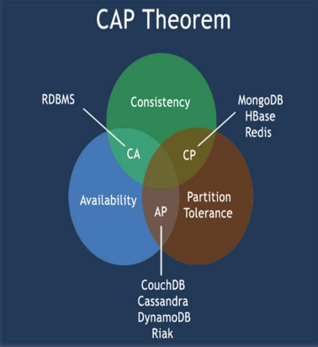
CAP theorem for NoSQL
Impossible for any shared data-system to guarantee all of the three properties, simultaneously.
Consistency-once data is written, all future read requests will contain that data
Availability-the database is always available and responsive
Partition Tolerance-if part of the database is unavailable, other parts are unaffected

Slide 7
CAP theorem for NoSQL
What the CAP theorem really says:
If you cannot limit the number of faults and requests directed to any server and you insist on serving every request then you cannot possibly be provide consistency.
How it is interpreted:
You must always give something up: consistency, availability or tolerance to failure.

Slide 8
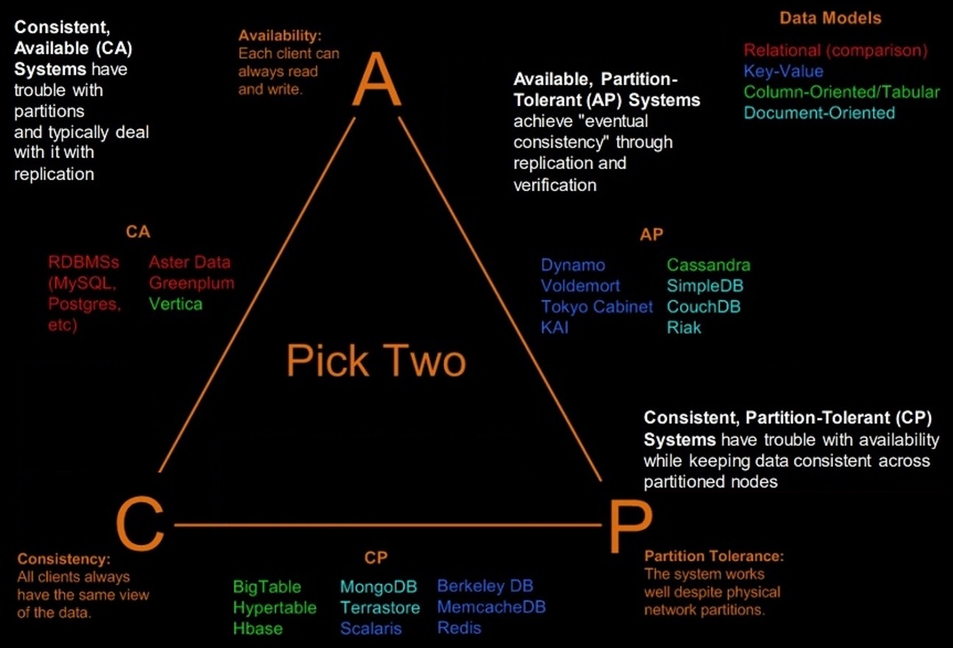
Visual Guide to NoSQL

Slide 9
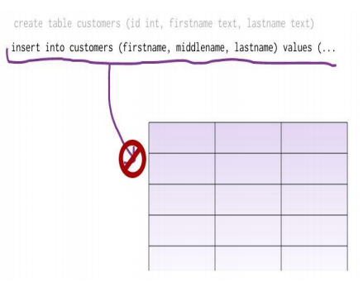
What is a schema data model?
You can’t add a record which does not fit the schema
You need to add NULLs to unused items in a row
We should consider the datatypes. i.e.: you can’t add a string to an integer field
You can’t add multiple items in a field (You should create another table: primary-key, foreign key, joins, normalization, ... !!!)

Slide 10
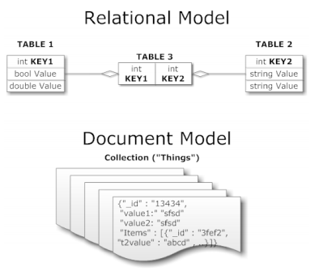
What is a schema-less data model?
There is no schema to consider
There is no unused cell
There is no datatype (implicit)
Most of considerations are done in application layer
We gather all items in an aggregate (document)

Slide 11
Benefits of NoSQL
Elastic Scaling
RDBMS scale up – bigger load , bigger server
NoSQL scale out – distribute data across multiple hosts seamlessly
DBA Specialists
RDBMS require highly trained expert to monitor DB
NoSQL require less management, automatic repair and simpler data models
Big Data
Huge increase in data RDBMS: capacity and constraints of data volumes at its limits
NoSQL designed for big data

Slide 12
Benefits of NoSQL
Flexible data models
Change management to schema for RDBMS have to be carefully managed
NoSQL databases more relaxed in structure of data
Database schema changes do not have to be managed as one complicated change unit
Application already written to address an amorphous schema
Economics
RDBMS rely on expensive proprietary servers to manage data
No SQL: clusters of cheap commodity servers to manage the data and transaction volumes
Cost per gigabyte or transaction/second for NoSQL can be lower than the cost for a RDBMS

Slide 13
Benefits of NoSQL
Support
RDBMS vendors provide a high level of support to clients
Stellar reputation
• NoSQL – are open source projects with startups supporting them
Reputation not yet established
Maturity
RDBMS mature product: means stable and dependable
Also means old no longer cutting edge nor interesting
NoSQL are still implementing their basic feature set

Slide 14
Benefits of NoSQL
Administration
RDBMS administrator well defined role
No SQL’s goal: no administrator necessary however NO SQL still requires effort to maintain
Lack of Expertise
Whole workforce of trained and seasoned RDBMS developers
Still recruiting developers to the NoSQL camp
Analytics and Business Intelligence
RDBMS designed to address this niche
NoSQL designed to meet the needs of an Web 2.0 application - not designed for ad hoc query of the data
Tools are being developed to address this need

Slide 15
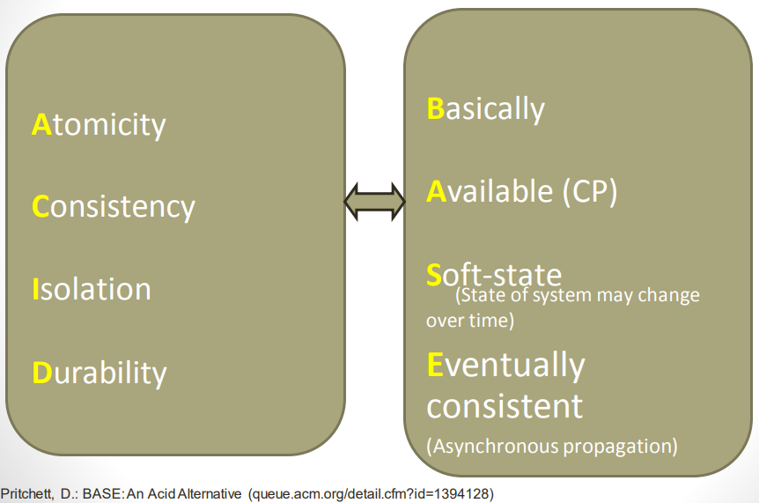
RDBMS ACID to NoSQL BASE

Slide 16
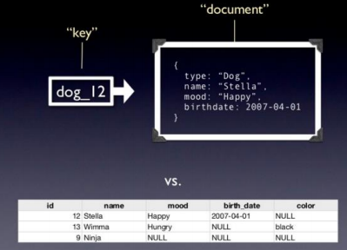
Document based data model
Pair each key with complex data structure known as data structure.
Indexes are done via B-Trees.
Documents can contain many different key-value pairs, or key-array pairs, or even nested documents.

Slide 17
What is MongoDB?
Developed by 10gen founded in 2007
A document-oriented, NoSQL database
- Hash-based, schema-less database
No Data Definition Language
In practice, this means you can store hashes with any keys and values
Keys are a basic data type but in reality stored as strings
Document Identifiers (_id) will be created for each document, field name reserved by system
Application tracks the schema and mapping
Uses BSON format Based on JSON – B stands for Binary
Written in C++ Supports APIs (drivers) in many computer languages, JavaScript, Python, Ruby, Perl, Java, Java Scala, C#, C++, Haskell, Erlang

Slide 18
BSON format
Binary-encoded serialization of JSON-like documents
Zero or more key/value pairs are stored as a single entity
Each entry consists of a field name, a data type, and a value
Large elements in a BSON document are prefixed with a length field to facilitate scanning

Slide 19
Functionality of MongoDB
Dynamic schema - No DDL
Document-based database
Secondary indexes
Query language via an API
Atomic writes and fully-consistent reads
Master-slave replication with automated failover (replica sets)
Built-in horizontal scaling via automated range-based partitioning of data (sharding)
No joins nor transactions

Slide 20
Why use MongoDB?
Simple queries
Functionality provided applicable to most web applications
Easy and fast integration of data
No ERD diagram
Not well suited for heavy and complex transactions systems

Slide 21
Choices made for Design of MongoDB
• Scale horizontally over commodity hardware
• Lots of relatively inexpensive servers
• Keep the functionality that works well in RDBMSs
– Ad hoc queries
– Fully featured indexes
– Secondary indexes
• What doesn’t distribute well in RDBMS?
– Long running multi-row transactions
– Joins (computationally expensive)
– Both artifacts of the relational data model (row x column) 2

Slide 22
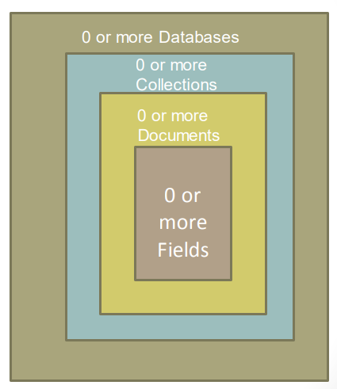
MongoDB: Hierarchical Objects
A MongoDB instance may have zero or more ‘databases’
A database may have zero or more ‘collections’.
A collection may have zero or more ‘documents’.
A document may have one or more ‘fields’.
MongoDB ‘Indexes’ function much like their RDBMS counterparts.

Slide 23
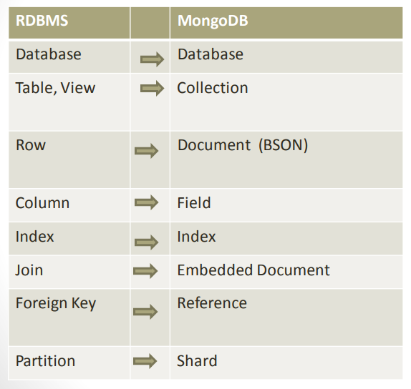
RDBMS Concepts to NoSQL
Collection is not strict about what it Stores
Schema-less
Hierarchy is evident in the design
Embedded Document

Slide 24
MongoDB Processes and Configuration
• Mongod – Database instance
• Mongos - Sharding processes
• Analogous to a database router.
• Processes all requests
• Decides how many and which mongods should receive the query
• Mongos collates the results, and sends it back to the client.
• Mongo – an interactive shell (a client)
- Fully functional JavaScript environment for use with a MongoDB
• You can have one mongos for the whole system no matter how many mongods you have
• OR you can have one local mongos for every client if you wanted to minimize network latency.

Slide 25
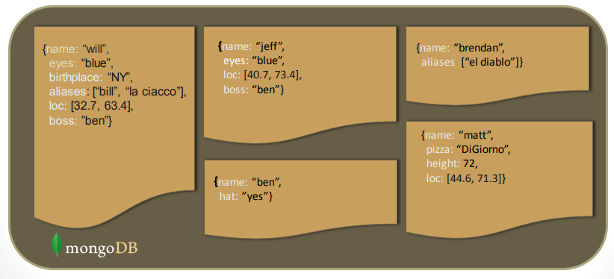
Schema Free
MongoDB does not need any pre-defined data schema
Every document in a collection could have different data
Addresses NULL data fields

Slide 26
JSON Format
Data is in name / value pairs or label / value pairs
A name/value pair consists of a field name followed by a colon, followed by a value
Example: “name”: “R2-D2”
Data is separated by commas
Example: “name”: “R2-D2”, race : “Droid”
Curly braces hold objects
Example: {“name”: “R2-D2”, race : “Droid”, affiliation: “rebels”}
An array is stored in brackets []
Example [ {“name”: “R2-D2”, race : “Droid”, affiliation: “rebels”}, {“name”: “Yoda”, affiliation: “rebels”} ]

Slide 27
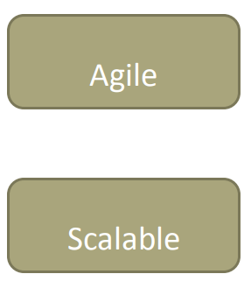
MongoDB Features
• Document-Oriented storage
• Full Index Support
• Replication & High Availability
• Auto-Sharding
• Querying
• Fast In-Place Updates
• Map/Reduce functionality

Slide 28
Sharding of Data
Distributes a single logical database system across a cluster of machines
Uses range-based partitioning to distribute documents based on a specific shard key
Automatically balances the data associated with each shard
Can be turned on and off per collection (table)

Slide 29
Index Functionality
B+ tree indexes
An index is automatically created on the _id field (the primary key)
Users can create other indexes to improve query performance or to enforce Unique values for a particular field
Supports single field index as well as Compound index
Like SQL order of the fields in a compound index matters
If you index a field that holds an array value, MongoDB creates separate index entries for every element of the array
Sparse property of an index ensures that the index only contain entries for documents that have the indexed field. (so ignore records that do not have the field defined)
If an index is both unique and sparse – then the system will reject records that have a duplicate key value but allow records that do not have the indexed field defined

Slide 30
CRUD Operations
Create
db.collection.insert( <document> )
db.collection.save( <document> )
db.collection.update( <query>, <update> , { upsert: true } )
Read
db.collection.find( <query>, <projection> )
db.collection.findOne(<query>, <projection> )
Update
db.collection.update( <query>, <update>, <option> )
Delete
db.collection.remove(<query>, <justOne> )
Collection specifies the collection or the ‘table’ to store the document

Slide 31
Create Operations
Db.collection specifies the collection or the ‘table’ to store the document
db.collection_name.insert( <document> )
Omit the _id field to have MongoDB generate a unique key
Example db.parts.insert( {{type: “screwdriver”, quantity: 15 } )
db.parts.insert({_id: 10, type: “hammer”, quantity: 1 })
db.collection_name.update(<query>, <update> , { upsert: true } )
Will update 1 or more records in a collection satisfying query
db.collection_name.save(<document> )
Updates an existing record or creates a new record

Slide 32
Read Operations
db.collection.find( <query>, <projection> ).cursor modified
Provides functionality similar to the SELECT command
<query> where condition , fields in result set
Example: var PartsCursor = db.parts.find({parts: “hammer”}).limit(5)
Has cursors to handle a result set
Can modify the query to impose limits, skips, and sort orders.
Can specify to return the ‘top’ number of records from the result set
db.collection.findOne( <query>, <projection> )

Slide 33
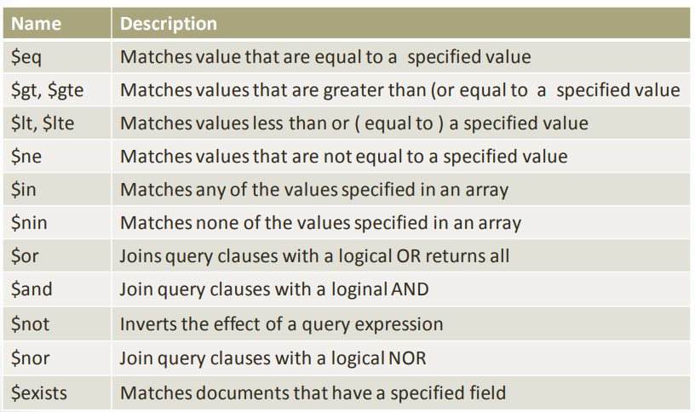
Query Operators

Slide 34
Update Operations
db.collection_name.insert(<document>)
Omit the _id field to have MongoDB generate a unique key
Example db.parts.insert( {{type: “screwdriver”, quantity: 15 } )
db.parts.insert({_id: 10, type: “hammer”, quantity: 1 })
db.collection_name.save(<document> )
Updates an existing record or creates a new record
db.collection_name.update(<query>, <update> , { upsert: true } )
Will update 1 or more records in a collection satisfying query
db.collection_name.findAndModify(<query>, <sort>, <update>, <new>, <field>, <insert>)
Modify existing record(s) – retrieve old or new version of the record

Slide 35
Delete Operations
db.collection_name.remove(<query>,<justone>)
Delete all records from a collection or matching a criterion
<justone> - specifies to delete only 1 record matching the criterion
Example: db.parts.remove(type: /^h/ } ) - remove all parts starting with h
Db.parts.remove() – delete all documents in the parts collections

Slide 36
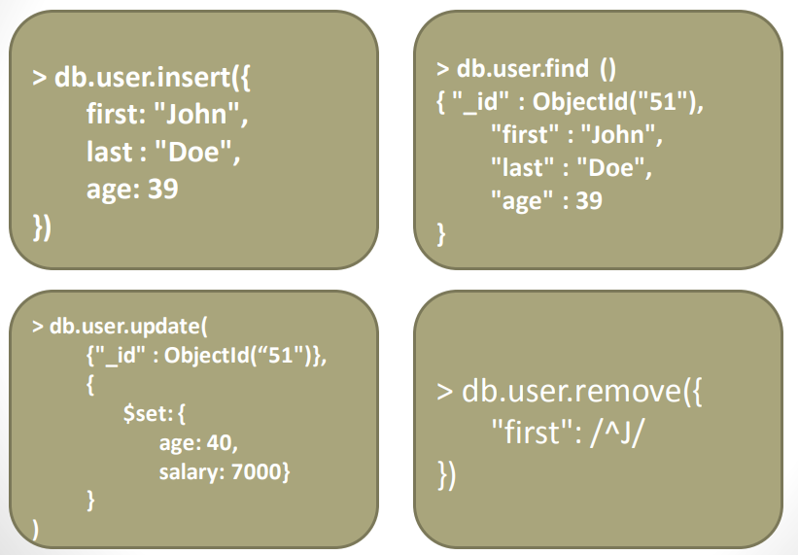
CRUD Examples

Slide 37
Aggregated Functionality
Aggregation framework provides SQL-like aggregation functionality
Pipeline documents from a collection pass through an aggregation pipeline, which transforms these objects as they pass through
Expressions produce output documents based on calculations performed on input documents
Example db.parts.aggregate ( {$group : {_id: type, totalquantity : { $sum: quantity} } } )

Slide 38
Map Reduce Functionality
Performs complex aggregator functions given a collection of keys, value pairs
Must provide at least a map function, reduction function and a name of the result set
db.collection.mapReduce( <mapfunction>,<reducefunction>, { out: <collection>, query: <document>, sort: <document>, limit: <number>, finalize: <function>, scope: <document>, jsMode: <boolean>, verbose: <boolean>} )
More description of map reduce next lecture

Slide 39
Indexes: High Performance Read
Typically used for frequently used queries
Necessary when the total size of the documents exceeds the amount of available RAM.
Defined on the collection level
Can be defined on 1 or more fields
Composite index (SQL) -> Compound index (MongoDB)
B-tree index
Only 1 index can be used by the query optimizer when retrieving data
Index covers a query - match the query conditions and return the results using only the index;
Use index to provide the results.

Slide 40
Replication of data
Ensures redundancy, backup, and automatic failover
Recovery manager in the RDMS
Replication occurs through groups of servers known as replica sets
Primary set – set of servers that client tasks direct updates to
Secondary set – set of servers used for duplication of data
At the most can have 12 replica sets
Many different properties can be associated with a secondary set i.e. secondary-only, hidden delayed, arbiters, non-voting
If the primary set fails the secondary sets ‘vote’ to elect the new primary set

Slide 41
Consistency of Data
All read operations issued to the primary of a replica set are consistent with the last write operation
Reads to a primary have strict consistency
Reads reflect the latest changes to the data
Reads to a secondary have eventual consistency
Updates propagate gradually
If clients permit reads from secondary sets – then client may read a previous state of the database
Failure occurs before the secondary nodes are updated
System identifies when a rollback needs to occur
Users are responsible for manually applying rollback changes

Slide 42
When and When Not to use NoSQL
When / Why?
When traditional RDBMS model is too restrictive (flexible schema)
When ACID support is not “really” needed
Object-to-Relational (O/R) impedance
Because RDBMS is neither distributed nor scalable by nature
Logging data from distributed sources
Storing Events / temporal data
Temporary Data (Shopping Carts / Wish Lists / Session Data)
Data which requires flexible schema
Polyglot Persistence i.e. best data store depending on nature of data
When Not?
Financial Data
Data requiring strict ACID compliance
Business Critical Data

