Slide 1
Dr. Avanti Sethi
OPRE 6301-003/006/009
Statistics and Data Analysis
Fall of 2018

Slide 2
eLearning / Blackboard
Syllabus
Class notes
Quizzes
Homework assignment
Announcements
Emails (Put 6301 somewhere – anywhere - in the email)

Slide 3
Assessment
Assessment | Tests | On-line Quizzes | Excel Homework | Total
Weight | 80% | 10% | 10% | 100%
The tests will be at the testing center
Points | Weight | Event | Time | (Updated) Available |  | (Updated) Finish by |  | Chapters
100 | 26.00% | Test 1 | 150 Min | Mon 10-01 | 9:00 AM | Tue 10-02 | 9:30 PM | Ch 1-4, 6, 7, 16-17
100 | 26.00% | Test 2 | 150 Min | Thu 11-01 | 9:00 AM | Sat 11-03 | 1:00 PM | Ch 5, 8, 9, 10
100 | 26.00% | Test 3 | 150 Min | Thu 12-06 | 9:00 AM | Sat 12-08 | 6:00 PM | Ch 11-15
Reserve your seat ASAP. Extremely Important.

Slide 4
Quiz / Homework
Points | Weight | Event | Time | Available |  | Finish by |  | Chapters
36 | 3.96% | Quiz Set 1 | No Limit | Mon 08-27 | 1:00 PM | Tue 09-25 | 8:00 AM | Ch 4, 6, 7
36 | 3.96% | Quiz Set 2 | No Limit | Mon 09-24 | 1:00 PM | Mon 10-29 | 8:00 AM | Ch 5, 8, 9, 10
28 | 3.08% | Quiz Set 3 | No Limit | Mon 10-29 | 1:00 PM | Mon 12-03 | 8:00 AM | Ch 11, 12, 14, 15
20 | 2.20% | HW 1 | No Limit | Mon 08-27 | 1:00 PM | Tue 09-11 | 11:59 PM | Ch 2-4
25 | 2.75% | HW 2 | No Limit | Mon 09-03 | 1:00 PM | Tue 09-25 | 11:59 PM | Ch 7, 16-17
25 | 2.75% | HW 3 | No Limit | Mon 10-01 | 1:00 PM | Tue 10-30 | 11:59 PM | Ch 8-10
30 | 3.30% | HW 4 | No Limit | Mon 11-05 | 1:00 PM | Tue 12-04 | 11:59 PM | Ch 13, 14, 15

Slide 5
Quizzes
Purpose is to learn the material and be ready for the tests
Better if you work in a group.
Multiple attempts are allowed.
Scores = best of all attempts
Some questions (numbers) will change with each attempt
Must be submitted by the due date
Must follow the Test / Quiz guidelines
See your rights and wrongs after the deadline is over
Average score is typically 90% or higher
Quizzes constitute 10% of the course

Slide 6
Homework
Purpose is to learn to use Excel in solving stat problems
Excel Add-in Data Analysis will be used
You must work on your own
Must use Excel functions only
Must submit via eLearning before the due date. Do not email
Average score is typically 90% or higher
Windows / Mac system both are fine
HW constitutes 10% of the course

Slide 7
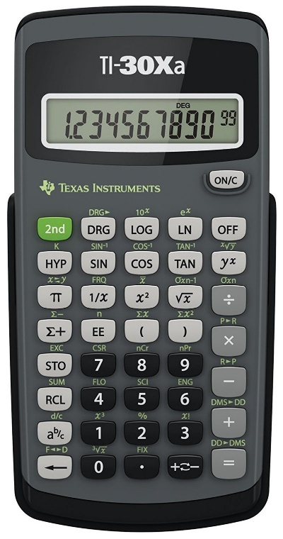
Test
At the UTD testing center
Must reserve your spot at least 2 weeks in advance. DO ASAP
No jackets, cell phones, paper, food, etc. allowed
A 5” x 8” (half paper) cheat sheet allowed. Written both sides
Use either the testing center calculator TI 30-X IIS or your TI-30Xa
Follow the quiz guidelines in answering the questions
Testing center will provide scratch paper and probability tables
If any problems at the testing center, ask them to call me
Reserve for this test ::: OPRE 6301-003/006/009- Test
Do not switch classes on a random basis

