Slide 1

Graphs and Samples
Chapters 2 and 3

Slide 2
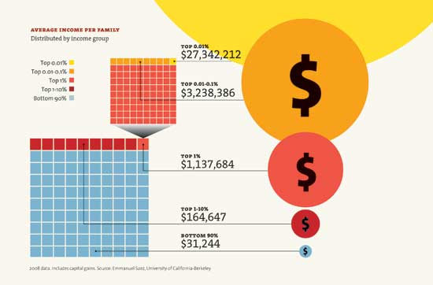
From Yahoo.Com April 2011

Slide 3
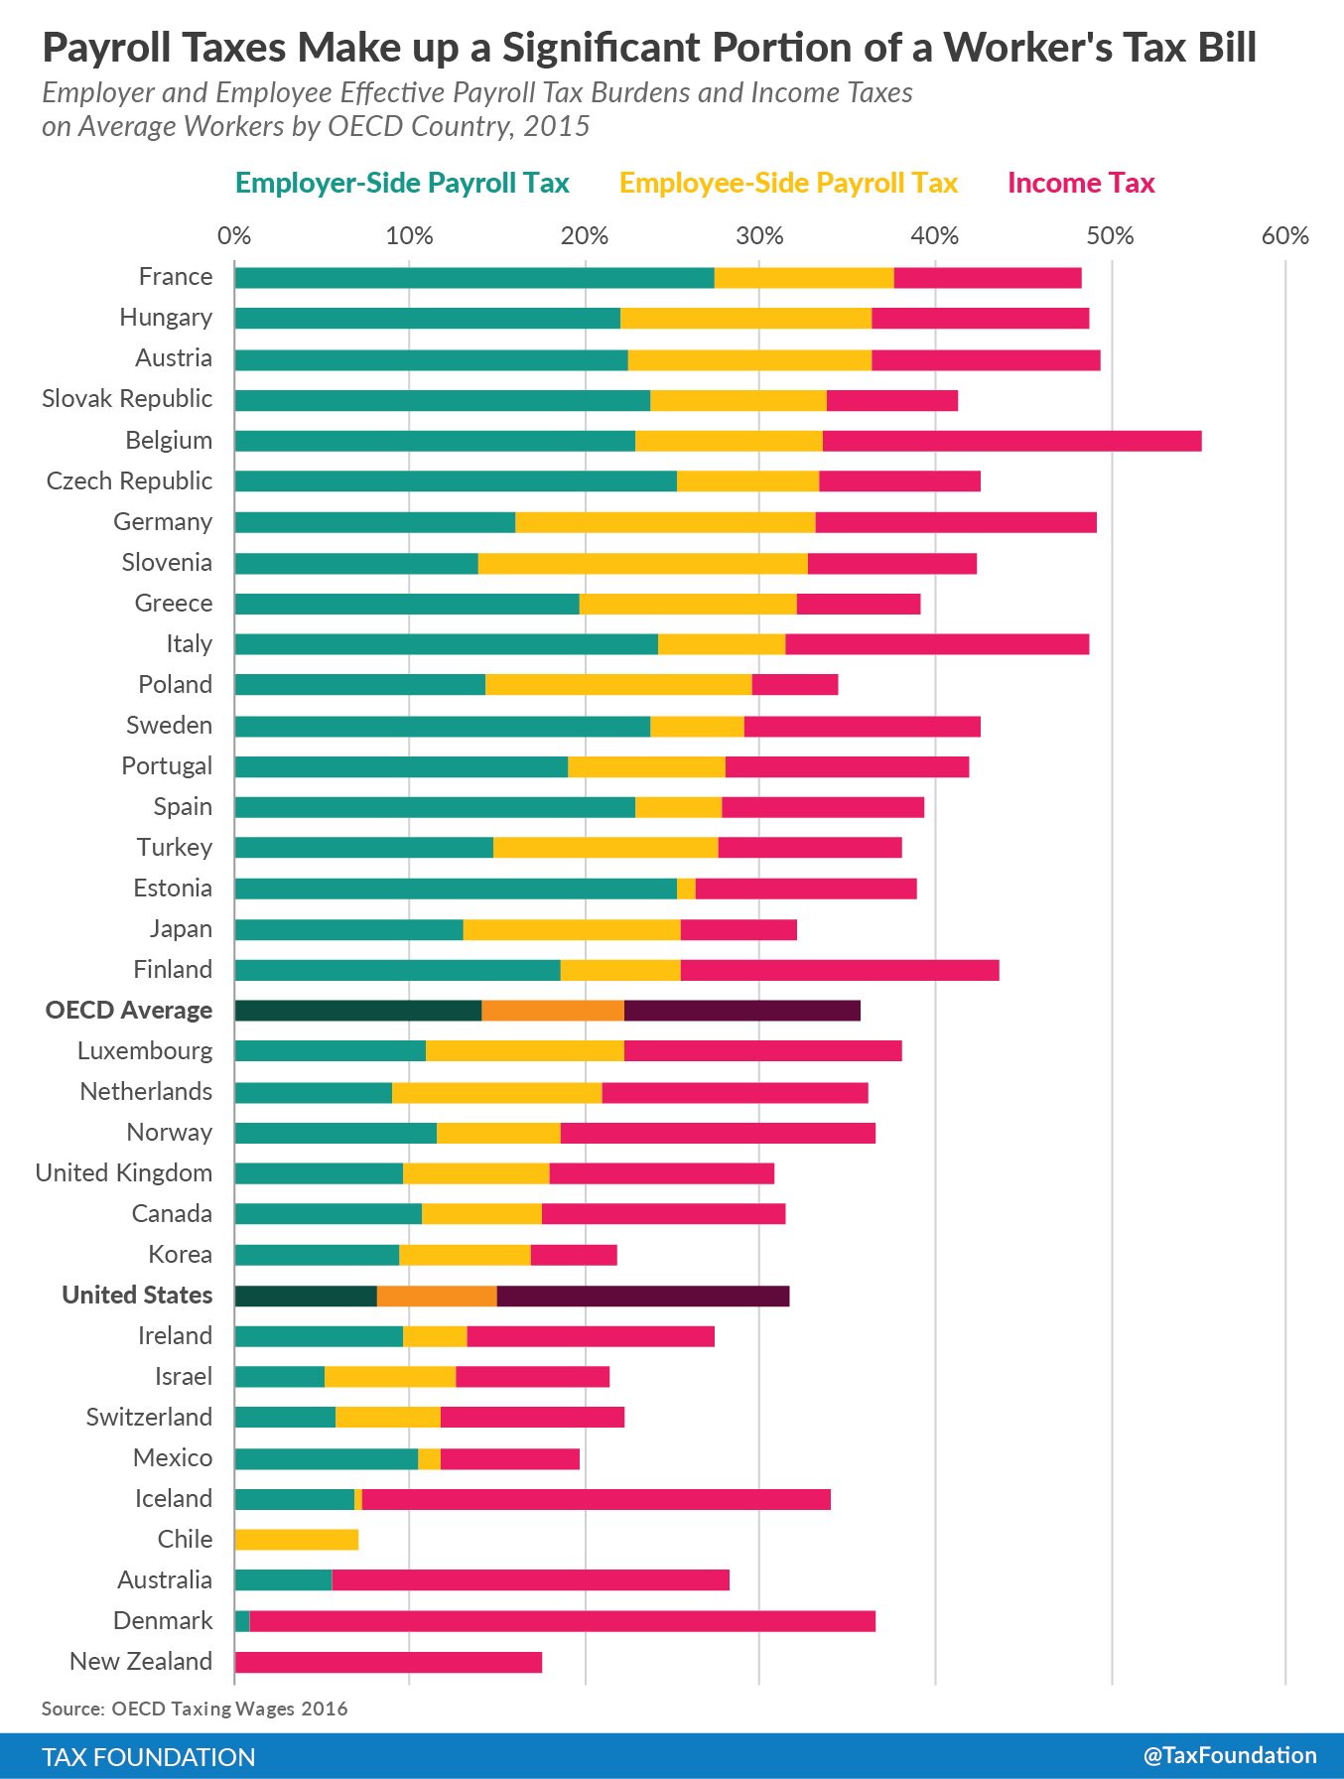
France had the highest combined payroll tax burden of 37.8 percent. This is followed by Hungary with a payroll tax burden of 36.6 percent, and Austria with a payroll tax burden of 36.4 percent. These three countries’ payroll tax burdens alone are greater than the total tax burden on laborers in the United States.
The countries with the lowest combined payroll tax burdens were Australia (5.6 percent), Denmark (.8 percent), and New Zealand (0 percent). New Zealand is the only country that does not levy a payroll tax on the average worker.
Denmark has low payroll taxes, its government still places a relatively high tax burden on average workers through higher individual income taxes (an effective rate of 35.8 percent).

Slide 4
Example: Who drinks what?
1. Budweiser Light
2. Busch Light
3. Coors Light
4. Michelob Light
5. Miller Lite
6. Natural Light
7. Other brand
A random sample of 285 graduating students was asked to report which of the following is their favorite light beer. The responses were recorded using the above codes.
2.4

Slide 5
Who drinks what?
2.5

Slide 6
Frequency & Relative Frequency Distributions
2.6

Slide 7
Nominal Data (Frequency)
Bar Charts are often used to display frequencies…
2.7

Slide 8
Nominal Data (Relative Frequency)
Pie Charts show relative frequencies…
2.8

Slide 9
Frequency Distributions for datasets
A frequency distribution is a compact summary of data, expressed as a table, graph, or function.
The data is gathered into bins or cells, defined by class intervals.
The number of classes, multiplied by the class interval, should exceed the range of the data. The square root of the sample size is a guide.
The boundaries of the class intervals should be convenient values, as should the class width.

Slide 10
Example: Alloy Strength
To illustrate the construction of a stem-and-leaf diagram, consider the alloy compressive strength data in.

Slide 11
Frequency Distribution Table
Frequency Distribution for the compression data
Considerations:
Range = 245 – 76 = 169
Sqrt(80) = 8.9
Trial class width = 18.9
Decisions:
Number of classes = 9
Class width = 20
Range of classes = 20 * 9 = 180
Starting point = 70

Slide 12
Histograms
A histogram is a visual display of a frequency distribution, similar to a bar chart or a stem-and-leaf diagram.
Steps to construct a histogram with equal bin widths:
Label the bin boundaries on the horizontal scale.
Mark & label the vertical scale with the frequencies or relative frequencies.
Above each bin, draw a rectangle whose height is equal to the frequency corresponding to that bin.

Slide 13
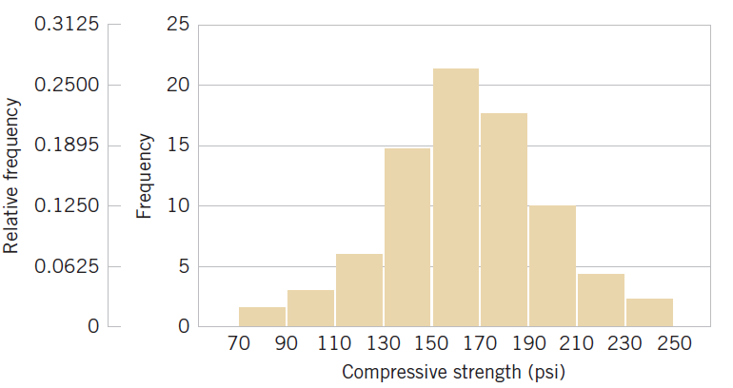
Histogram of the Compressive Data
Histogram of compressive strength of 80 aluminum-lithium alloy specimens. Note these features – (1) horizontal scale bin boundaries & labels with units, (2) vertical scale measurements and labels, (3) histogram title at top or in legend.

Slide 14
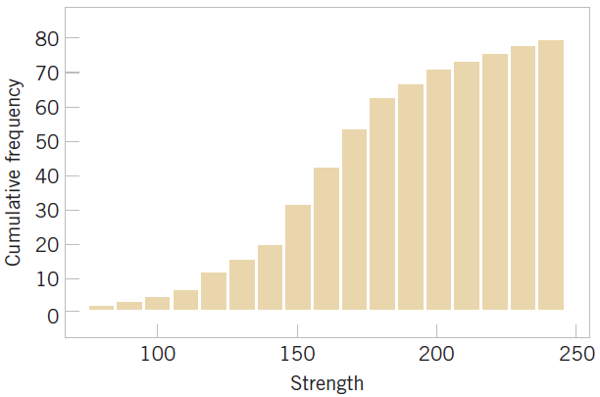
Cumulative Frequency Plot
Cumulative histogram of compressive strength of 80 aluminum-lithium alloy specimens. Comment: Easy to see cumulative probabilities, hard to see distribution shape.

Slide 15
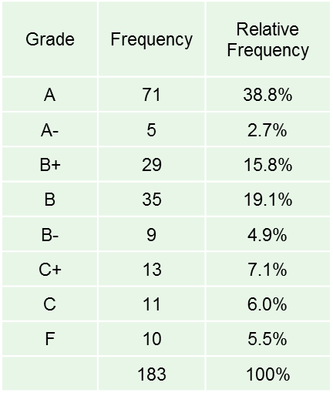
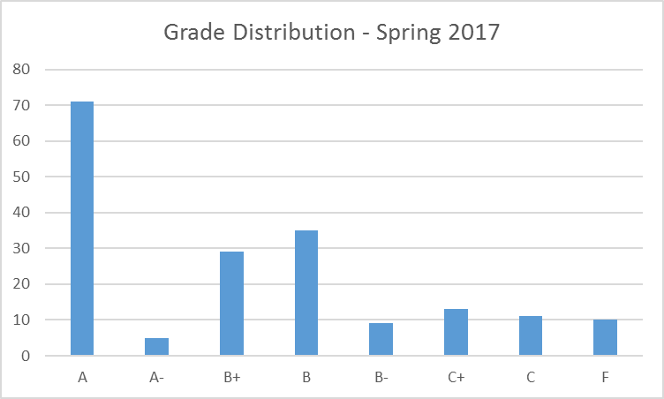
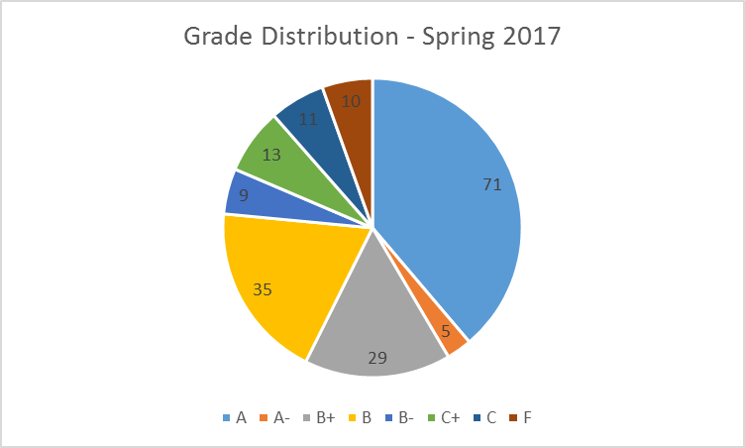
Frequency / Relative Frequency
OPRE 6301

Slide 16
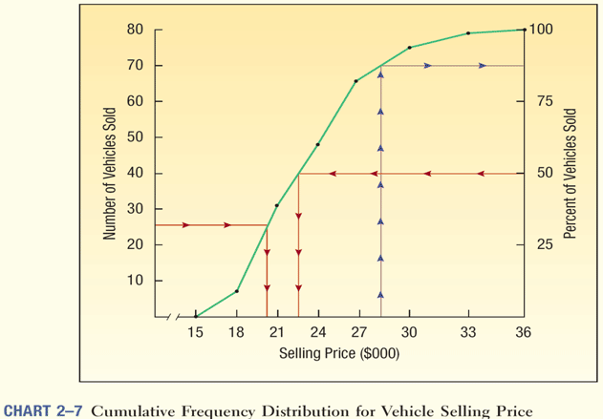
Ogive: Cumulative Frequency Distribution Graph

Slide 17
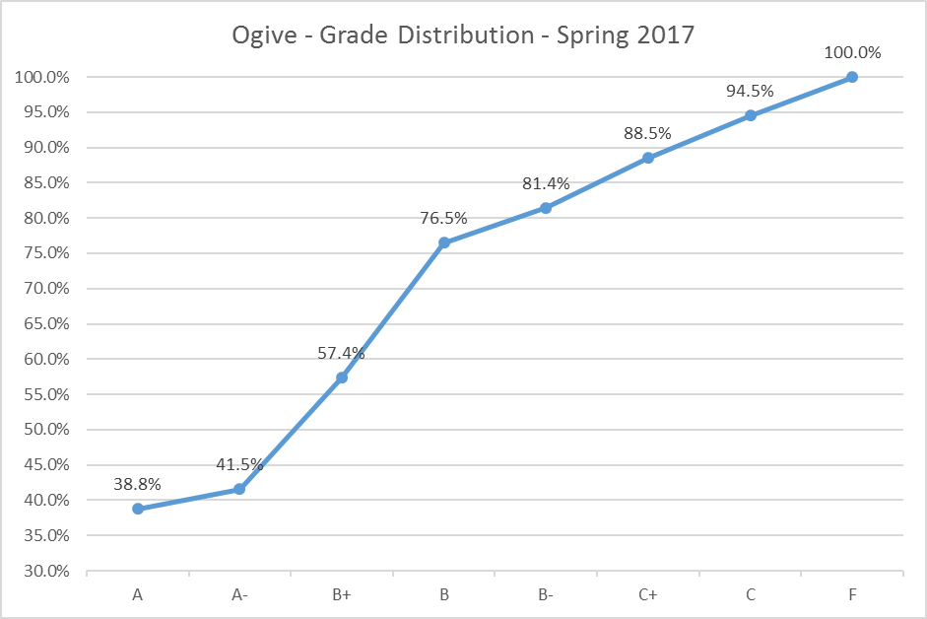
Cumulative Frequency Distribution Graph

Slide 18
Histograms - Symmetric
Left tail is the mirror image of the right tail. The skewness of such symmetric graphs is zero. Median, Mean, and Modes are the same.
Examples: heights or weights of people
.35
Skewness = 0
.30
.25
.20
Relative Frequency
.15
.10
.05
0

Slide 19
Histograms – Left Skewed
A longer tail to the left (negatively skewed)
Example: Test scores. Typically, median is higher than mean.
.35
Skewness = -.31
.30
.25
.20
Relative Frequency
.15
.10
.05
0

Slide 20

Histograms – Right Skewed
A Longer tail to the right (Positively skewed)
Example: housing prices or income. Typically, the mean is higher than the median.
.35
Skewness = .31
.30
.25
.20
Relative Frequency
.15
.10
.05
0

Slide 21
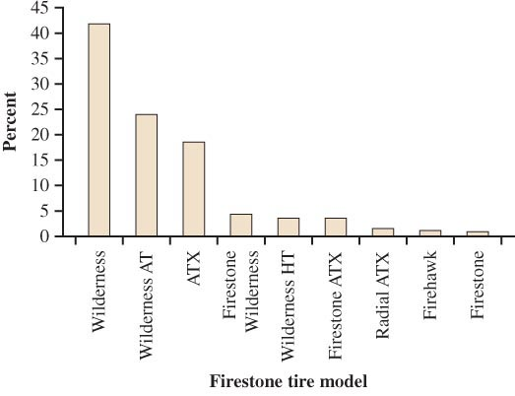
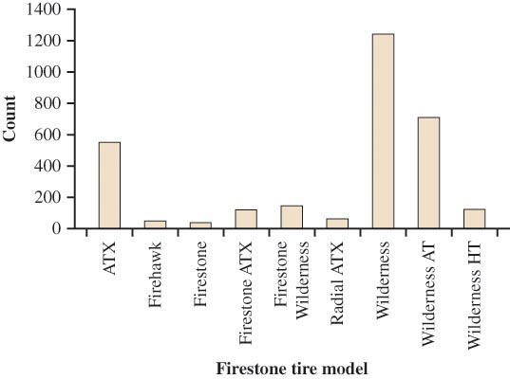
Accidents involving Firestone tire models
Bar graph sorted by rank (Called Pareto Chart)
→ Easy to analyze
Sorted alphabetically
→ Much less useful

Slide 22
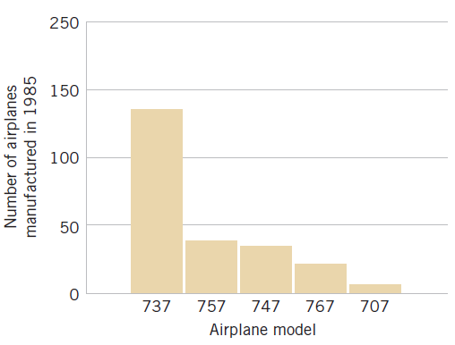
Categorical Data Histogram
Airplane production in 1985. (Source: Boeing Company) Comment: Illustrates nominal data in spite of the numerical names, categories are shown at the bin’s midpoint, a Pareto chart since the categories are in decreasing order.

Slide 23
Stem & Leaf Display…
Stem Leaf 0 0000000000111112222223333345555556666666778888999999 1 000001111233333334455555667889999 2 0000111112344666778999 3 001335589 4 124445589 5 33566 6 3458 7 022224556789 8 334457889999 9 00112222233344555999 10 001344446699 11 124557889
Thus, we still have access to our original data point’s value!

Slide 24
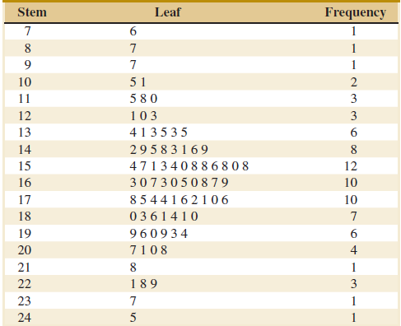
Stem-and-leaf Display
To illustrate the construction of a stem-and-leaf diagram, consider the alloy compressive strength data in.
From the display (leaves are unordered), we can say that the center is about 155 and most data is between 110 and 200.

Slide 25
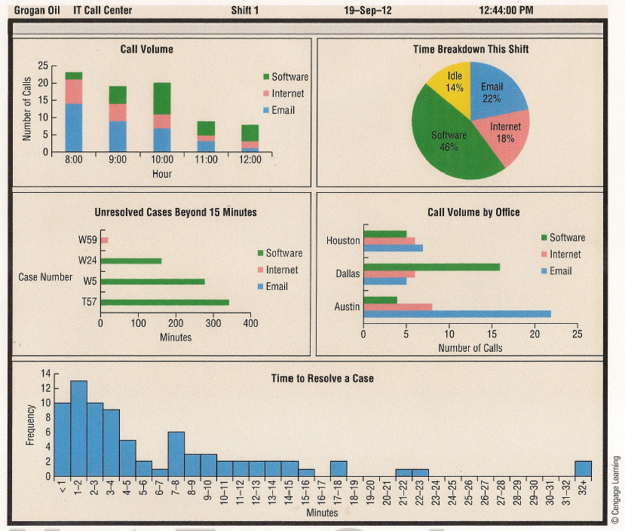
Data Dashboard Example

Slide 26
Relation between two variables
Scatterplot

Slide 27
Scatter Diagram
A Positive Relationship
y
x

Slide 28
Scatter Diagram
A Negative Relationship
y
x

Slide 29
Scatter Diagram
No Apparent Relationship
y
x

Slide 30
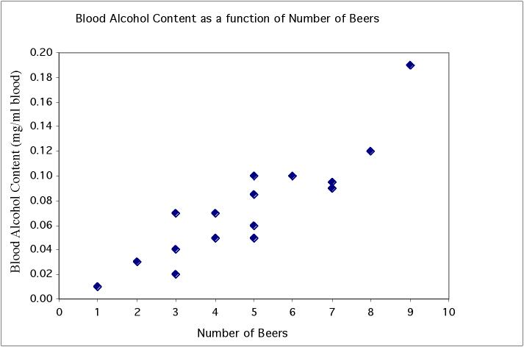
Scatterplot: Beer vs Blood Alcohol Level
Student | Beers | BAC
1 | 5 | 0.1
2 | 2 | 0.03
3 | 9 | 0.19
6 | 7 | 0.095
7 | 3 | 0.07
9 | 3 | 0.02
11 | 4 | 0.07
13 | 5 | 0.085
4 | 8 | 0.12
5 | 3 | 0.04
8 | 5 | 0.06
10 | 5 | 0.05
12 | 6 | 0.1
14 | 7 | 0.09
15 | 1 | 0.01
16 | 4 | 0.05
Notes:
Quantitative data - have two pieces of data per individual and wonder if there is an association between them. Very important in biology, as we not only want to describe individuals but also understand various things about them. Here for example we plot BAC vs number of beers. Can clearly see that there is a pattern to the data. When you drink more beers you generally have a higher BAC. Dots are arranged in pretty straight line - a linear relationship. And since when one goes up, the other does too, it is a positive linear relationship. Also see that

Slide 31
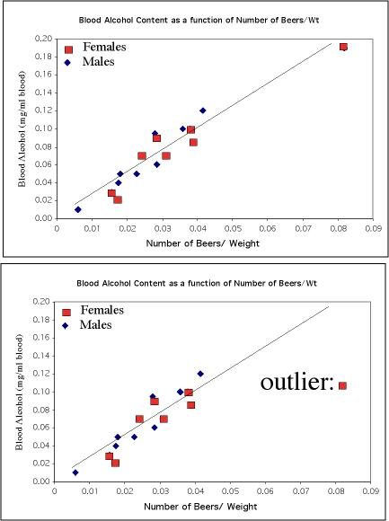
Outliers
Not an outlier:
The upper right-hand point here is not an outlier of the relationship—It is what you would expect for this many beers given the linear relationship between beers/weight and blood alcohol.
This point is not in line with the
others, so it is an outlier of the relationship.

Slide 32
Graphing the Relationship between 2 Nominal Variables
There are only a few telephone
bills in the middle range.

Slide 33
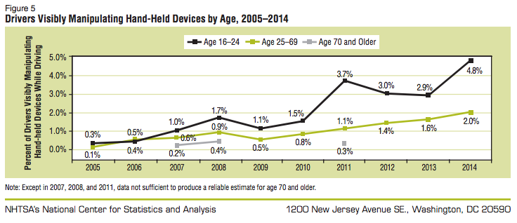
Time Series
9 people are killed and over 1,000 more are injured every day in car accidents that involve a distracted driver.
3,179 people were fatally injured in car accidents involving a distracted driver in 2014.
Distracted Driving accounted for 10% of all motor vehicle fatalities in 2014.

Slide 34
Graphical Excellence…
Graphical Excellence is achieved when…
large data sets are presented concisely and coherently.
the message being presented by the chart is clear.
the comparison of two or more variables is aided.
the substance of the data, not the form of the graph is prominent.
there is no distortion of the data and findings.

Slide 35
Graphical Misrepresentations of Data
What can make a graph misleading, confusing, or deceptive.
Notes:
35

Slide 36
Eight Common Methods for Making a Graph Misleading
1. Graphing/selecting an inappropriate statistic.
2. Omitting the zero on the relevant scale.
3. Manipulating the scale.
4. Using two dimensions (area) to emphasize
a one-dimensional difference.
5. Careless combination of categories in a bar
graph.
6. Inaccuracy in relative lengths of bars in a bar
graph.
7. Biased distortion or embellishment.
8. Unclear labeling.
Notes:
36

