Slide 1
Chapter Four
Numerical Descriptive Techniques

Slide 2
Numerical Descriptive Techniques…
Measures of Central Location
Mean, Median, Mode
Measures of Variability
Range, Standard Deviation, Variance, Coefficient of Variation
Measures of Relative Standing
Percentiles, Quartiles
Measures of Linear Relationship
Covariance, Correlation, Determination, Least Squares Line

Slide 3

Notation…
When referring to the number of observations in a population, we use uppercase letter N
When referring to the number of observations in a sample, we use lower case letter n
The arithmetic mean for a population is denoted with Greek letter “mu”: µ
The arithmetic mean for a sample is denoted with an “x-bar”:

Slide 4
Measures of Central Location…
The median is calculated by placing all the observations in order; the observation that falls in the middle is the median.
Data: {0, 7, 12, 5, 14, 8, 0, 9, 22} N=9 (odd)
Sort them bottom to top, find the middle:
0 0 5 7 8 9 12 14 22
Data: {0, 7, 12, 5, 14, 8, 0, 9, 22, 33} N=10 (even)
Sort them bottom to top, the middle is the
simple average between 8 & 9:
0 0 5 7 8 9 12 14 22 33
median = (8+9)÷2 = 8.5
Sample and population medians are computed the same way.

Slide 5
Mean, Median, Mode: Which Is Best?
With three measures from which to choose, which one should we use?
The mean is generally our first selection. However, there are several circumstances when the median is better.
The mode is seldom the best measure of central location.
One advantage the median holds is that it not as sensitive to extreme values as is the mean.

Slide 6
Mean or Median?
In 2016, the median home price of a Plano house is $301,000. The median list price per square foot in Plano is $134, which is higher than the Dallas-Fort Worth Metro average of $120
The 2016 median household income in Plano is $83,000
https://www.realtor.com/local/Plano_TX

Slide 7
Geometric Mean
The arithmetic mean is the single most popular and useful
measure of central location.
However, there is another circumstance where neither the
mean nor the median is the best measure.
When the variable is a growth rate or rate of change, such as
the value of an investment over periods of time, we need
another measure.
This will become apparent from the following illustration.

Slide 8
Geometric Mean
Let R_{i} denote the rate of return (in decimal form) in period i
(i = 1, 2, …, n). The geometric mean R_{g} of the returns is
defined such that
Solving for R_{g} we produce the following formula.
Question: If your investment gained 6.4% the 1st year, but you lost 2.1% the 2nd year, what was your average return over the two years?

Slide 9
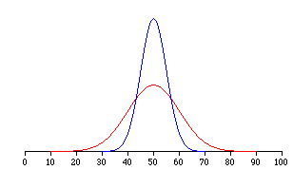
Measures of Variability…
Measures of central location fail to tell the whole story about the distribution; that is, how much are the observations spread out around the mean value?
For example, two sets of class grades are shown. The mean (=50) is the same in each case…
But, the red class has greater variability than the blue class.

Slide 10
Range…
The range is the simplest measure of variability, calculated as:
Range = Largest observation – Smallest observation
E.g.
Data: {4, 4, 4, 4, 50} Range = 46
Data: {4, 8, 15, 24, 39, 50} Range = 46
The range is the same in both cases,
but the data sets have very different distributions…

Slide 11


Variance…
Variance and its related measure, standard deviation, are arguably the most important statistics. Used to measure variability, they also play a vital role in almost all statistical inference procedures.
Population variance is denoted by
(Lower case Greek letter “sigma” squared)
Sample variance is denoted by
(Lower case “S” squared)

Slide 12


Variance…
The variance of a population is:
The variance of a sample is:
population mean
population size
sample mean
Note: The denominator is sample size (n) minus one !

Slide 13

Degrees of Freedom
The sample variance is calculated with the quantity n-1.
This quantity is called the “degrees of freedom”.
Origin of the term:
There are n deviations from x-bar in the sample.
The sum of the deviations is zero.
n-1 of the observations can be freely determined, but the n^{th} observation is fixed to maintain the zero sum.

Slide 14


Standard Deviation…
The standard deviation is simply the square root of the variance, thus:
Population standard deviation:
Sample standard deviation:

Slide 15
Measures of Variation
Smallest
Largest
Data A
Mean = 15.5
S = 3.338
11 12 13 14 15 16 17 18 19 20 21
Data B
Mean = 15.5
S = 0.926
11 12 13 14 15 16 17 18 19 20 21
Data C
Mean = 15.5
S = 4.570
11 12 13 14 15 16 17 18 19 20 21

Slide 16
Interpreting Standard Deviation…
The standard deviation can be used to compare the variability of several distributions and make a statement about the general shape of a distribution. If the histogram is bell shaped, we can use the Empirical Rule, which states:
Approximately 68% of all observations fall within one standard deviation of the mean.
Approximately 95% of all observations fall within two standard deviations of the mean.
Approximately 99.7% of all observations fall within three standard deviations of the mean.

Slide 17
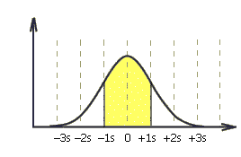
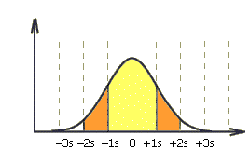

The Empirical Rule…
Approximately 68% of all observations fall
within one standard deviation of the mean.
Approximately 95% of all observations fall
within two standard deviations of the mean.
Approximately 99.7% of all observations fall
within three standard deviations of the mean.

Slide 18
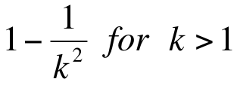
Chebysheff’s Theorem…
A more general interpretation of the standard deviation is derived from Chebysheff’s Theorem, which applies to all shapes of histograms (not just bell shaped).
The proportion of observations in any sample that lie
within k standard deviations of the mean is at least:
For k=2 (say), the theorem states that at least 3/4 of all observations lie within 2 standard deviations of the mean. This is a “lower bound” compared to Empirical Rule’s approximation (95%).

Slide 19
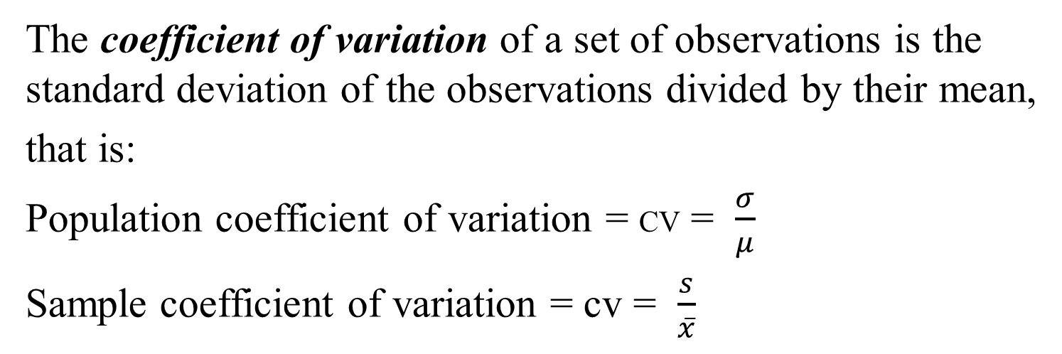
Coefficient of Variation…
The coefficient of variation of a set of observations is the standard deviation of the observations divided by their mean,
that is:
Population coefficient of variation = CV = $\frac{σ}{μ}$
Sample coefficient of variation = cv = $\frac{s}{\overline{x}}$
Remarks
Allows comparison of populations with significantly different mean values
Distributions with Cv < 1 could be as considered low-variance
Distributions with Cv > 1 could be considered as high-variance

Slide 20
Analysis of Shape
Skewness
Kurtosis

Slide 21
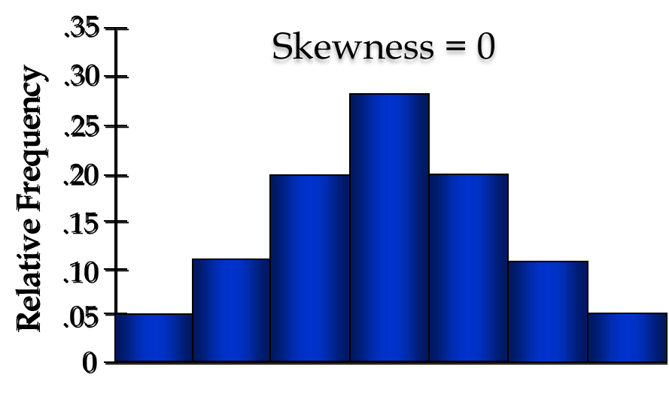
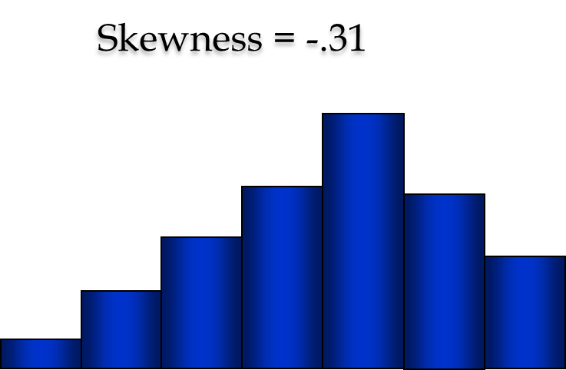
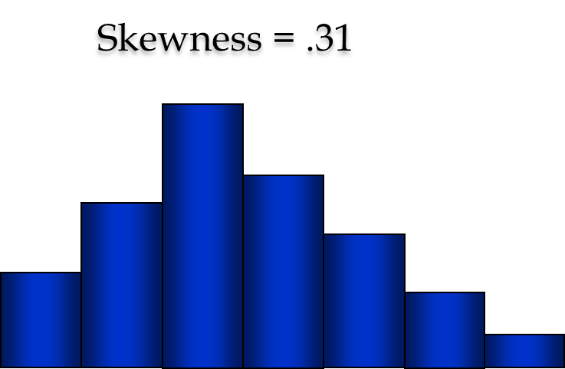
Skewness
Skewness determines the asymmetry of the distribution of a random variable. It’s not always easy to guess skewness by simply looking at the graph as the length of the tail and it’s fat-ness can influence the skewness.
Skewness = 0: Symmetry around the mean
Skewness < 0: Skewed to the left
Skewness > 0: Skewed to the right
In Excel, use SKEW function.

Slide 22
Kurtosis
Kurtosis measures the “weights” of tails relative to the center. Thus, a distribution with bigger tails tends to have a higher Kurtosis then the distribution with shorter tails.
Kurtosis is measured with reference to Normal distribution. A distribution which has significant data outside the 3 sigma limits will have a higher measurement. T-distribution with smaller degrees of freedom falls in this category. On the contrary, Uniform distribution which has no tails will have a low Kurtosis.
Excel function = KURT

Slide 23
Measures of Relative Standing & Box Plots
Measures of relative standing are designed to provide information about the position of particular values relative to the entire data set.
Percentile: the P^{th} percentile is the value for which P percent are less than that value and (100-P)% are greater than that value.
Suppose you scored in the 60th percentile on the GMAT, that means 60% of the other scores were below yours, while 40% of scores were above yours.

Slide 24
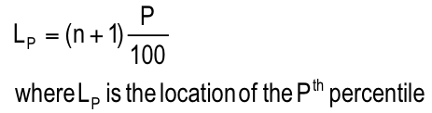
Location of Percentiles…
The following formula allows us to approximate the location of any percentile:
Note: We’ll not use this formula. We’ll simply take the average of the two relevant numbers to find the proper percentile. Pay attention to class discussion / quiz problems.

Slide 25
Location of Percentiles (our way)
Find the 25th, 50th, and 75th percentile of the following numbers.
55 49 43 45 34 23 89 30
First we sort these 8 numbers
23 30 34 43 45 49 55 89
25th percentile mean 8 x .25 = 2 below and 6 above our number.
25th Percentile = average of 30 and 34 = 32.
50th Percentile = average of 43 and 45 = 44.
75th Percentile = average of 49 and 55 = 52.

Slide 26
Quartiles…
We have special names for the 25th, 50th, and 75th percentiles, namely quartiles.
The first or lower quartile is labeled Q₁ = 25th percentile.
The second quartile, Q₂ = 50th percentile (which is also the median).
The third or upper quartile, Q₃ = 75th percentile.

Slide 27
5-number Summary
It includes
The smallest number
The 1st quartile
The 2nd quartile
The 3rd quartile
The largest number
Thus, S, Q1, Q2, Q3, L will be a 5-number summary. This is used in creating box plots.
{45, 60, 73, 90, 123}
{ S, Q1, Q2, Q3, L}

Slide 28
Interquartile Range…
The quartiles can be used to create another measure of variability, the interquartile range, which is defined as follows:
IQR ::: Interquartile Range = Q₃ – Q₁
The interquartile range measures the spread of the middle 50% of the observations.
Large values of this statistic mean that the 1st and 3rd quartiles are far apart indicating a high level of variability.
Impact of outlier data:
IQR is not affected
Range is directly affected.

Slide 29
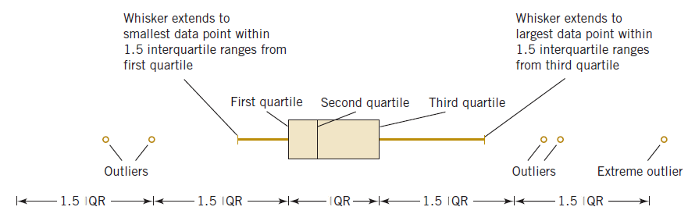
Box Plot
A box plot is a graphical summary of data that is
based on a five-number summary. It is a graphical
display showing center, spread, shape, and outliers.
Box plots provide another way to identify outliers.

Slide 30
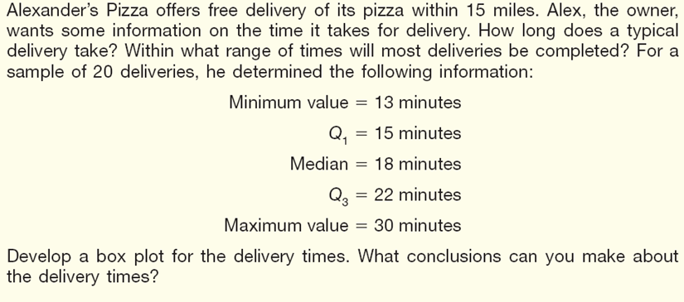
Boxplot - Example

Slide 31
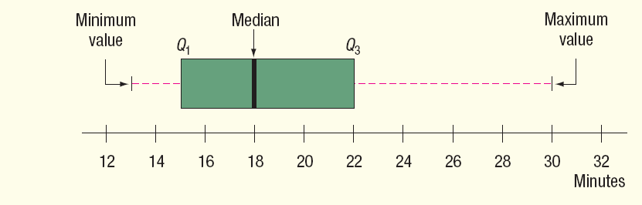
Boxplot Example
Step1: Create an appropriate scale along the horizontal axis.
Step 2: Draw a box that starts at Q1 (15 minutes) and ends at Q3 (22
minutes). Inside the box we place a vertical line to represent the median (18 minutes).
Step 3: Extend horizontal lines from the box out to the minimum value (13
minutes) and the maximum value (30 minutes).

Slide 32
Box Plots…
The box plot is a technique that graphs five statistics (5-number summary):
• the minimum and maximum observations, and
• the first, second, and third quartiles.
Whisker
Whisker (1.5*(Q₃–Q₁))
The lines extending to the left and right are called whiskers. Any points that lie outside the whiskers are called outliers. The whiskers extend outward to the smaller of 1.5 times the interquartile range or to the most extreme point that is not an outlier.

Slide 33
BoxPlot
Find the 25th, 50th, and 75th percentile of the following numbers.
55 49 43 45 34 23 89 30
5-number summary: 23, 32 , 44, 52, 89
IQR = Q3 – Q1 = 52 – 32 = 20

Slide 34
Example 4.15
A large number of fast-food restaurants with drive-through windows offering drivers and their passengers the advantages of quick service. To measure how good the service is, an organization called QSR planned a study wherein the amount of time taken by a sample of drive-through customers at each of five restaurants was recorded. Compare the five sets of data using a box plot and interpret the results.
Dataset Xm04-15

Slide 35
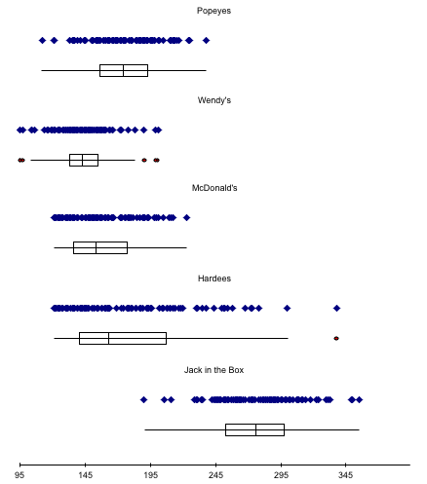
Box Plots…
These box plots are based on data in Xm04-15.
Wendy’s service time is shortest and least variable.
Hardee’s has the greatest variability, while Jack-in-the-Box has the longest service times.

Slide 36
Stroop Interference
Naming the ink color of color words can be difficult. For example, if asked to name the color of the word "blue" is difficult because the answer (red) conflicts with the word "blue." This interference is called "Stroop Interference" after the researcher who first discovered the phenomenon.
There were 31 female and 16 male students in an intro stat class who were part of this experiment.
Variable | Description
Gender | 1 for female, 2 for male
Words | Time in seconds to read 60 color words
Colors | Time in seconds to name 60 color rectangles
Interfer | Time in seconds to name colors of conflicting words

Slide 37
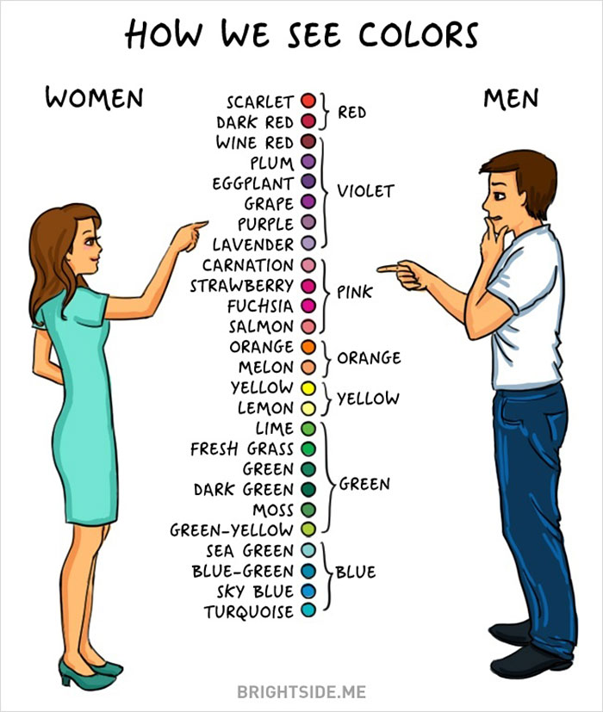

Slide 38
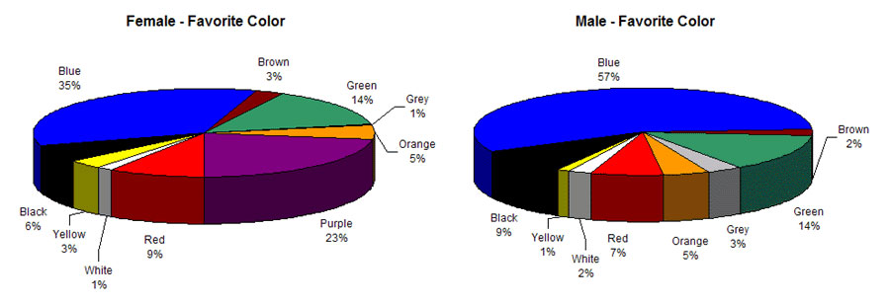
Yahoo Image Search

Slide 39
Guys' eyes are more sensitive to small details and moving objects, while women are more perceptive to color changes
They found that the guys required a slightly longer wavelength of a color to experience the same shade as women and the men were less able to tell the difference between hues

Slide 40
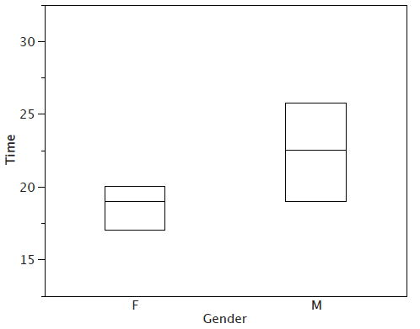
Stroop Interference (time for colors)
Descriptions of Variables
http://onlinestatbook.com/2/graphing_distributions/boxplots.html

Slide 41
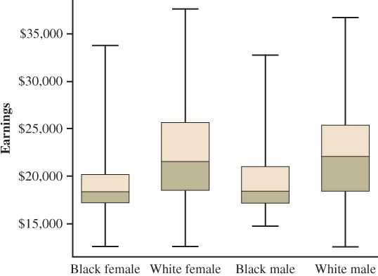
Side-by-side boxplots
Side-by-side boxplots comparing the earnings of four groups of hourly workers at National Bank

Slide 42
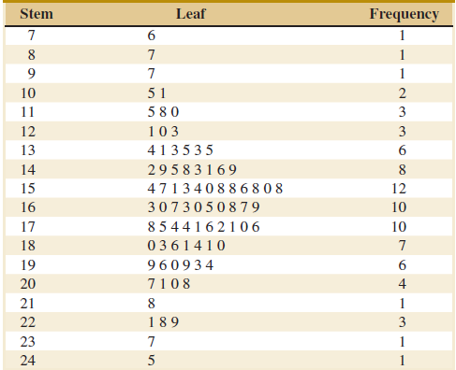
Example: Alloy Strength
To illustrate the construction of a stem-and-leaf diagram, consider the alloy compressive strength data in.
Stem-and-leaf diagram for data. Center is about 155 and most data is between 110 and 200. Leaves are unordered.

Slide 43
Table Compressive Strength (psi) of Aluminum-Lithium Specimens
105 | 221 | 183 | 186 | 121 | 181 | 180 | 143
97 | 154 | 153 | 174 | 120 | 168 | 167 | 141
245 | 228 | 174 | 199 | 181 | 158 | 176 | 110
163 | 131 | 154 | 115 | 160 | 208 | 158 | 133
207 | 180 | 190 | 193 | 194 | 133 | 156 | 123
134 | 178 | 76 | 167 | 184 | 135 | 229 | 146
218 | 157 | 101 | 171 | 165 | 172 | 158 | 169
199 | 151 | 142 | 163 | 145 | 171 | 148 | 158
160 | 175 | 149 | 87 | 160 | 237 | 150 | 135
196 | 201 | 200 | 176 | 150 | 170 | 118 | 149
76
87
97
101
105
110
115
118
120
121
123
131
133
133
134
135
135
141
142
143
145
146
148
149
149
150
150
151
153
154
154
156
157
158
158
158
158
160
160
160
163
163
165
167
167
168
169
170
171
171
172
174
174
175
176
176
178
180
180
181
181
183
184
186
190
193
194
196
199
199
200
201
207
208
218
221
228
229
237
245

Slide 44
Box Plot or Box-and-Whisker Chart
A box plot is a graphical display showing center, spread, shape, and outliers (SOCS).
It displays the 5-number summary: min, q₁, median, q₃, and max.
Description of a box plot.

Slide 45
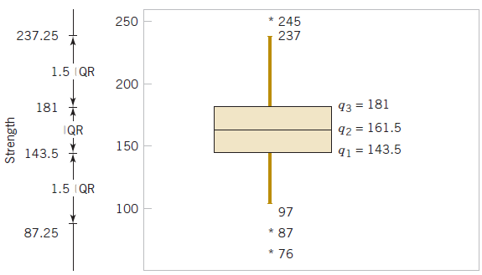
Box Plot of Compressive Data
Box plot of compressive strength of 80 aluminum-lithium alloy specimens. Comment: Box plot may be shown vertically or horizontally, data reveals three outliers and no extreme outliers. Lower outlier limit is: 143.5 – 1.5*(181.0-143.5) = 87.25.

Slide 46
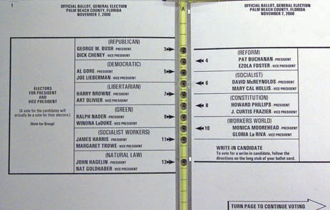
The ballot that changed history
Because of this 2000 presidential election confusing ballot in Palm Beach county, Gore lost about 6,607 votes to Buchanan, lost Florida, and lost the election to George Bush.

Slide 47
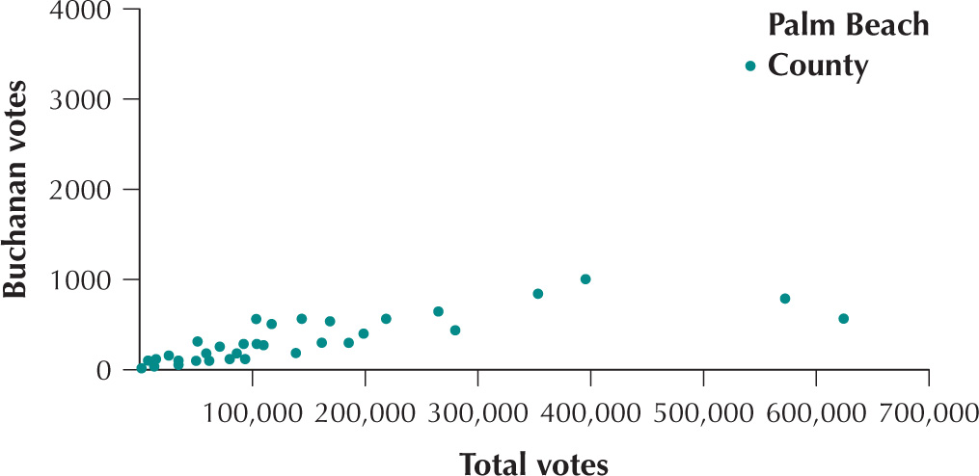
How did the statisticians figured 6,607 votes?
By means of a Scatterplot of Buchanan votes versus total votes in Florida counties

Slide 48
Measures of Linear Relationship…
We now present three numerical measures of linear relationship that provide information as to the strength & direction of a linear relationship between two variables (if one exists).
They are the covariance, the coefficient of correlation, and the coefficient of determination.

Slide 49
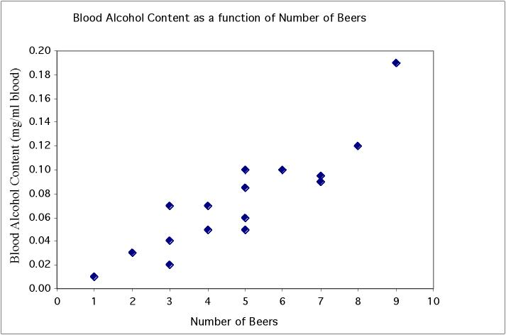
Beer vs blood alcohol
Student | Beers | BAC
1 | 5 | 0.1
2 | 2 | 0.03
3 | 9 | 0.19
6 | 7 | 0.095
7 | 3 | 0.07
9 | 3 | 0.02
11 | 4 | 0.07
13 | 5 | 0.085
4 | 8 | 0.12
5 | 3 | 0.04
8 | 5 | 0.06
10 | 5 | 0.05
12 | 6 | 0.1
14 | 7 | 0.09
15 | 1 | 0.01
16 | 4 | 0.05
Notes:
Quantitative data - have two pieces of data per individual and wonder if there is an association between them. Very important in biology, as we not only want to describe individuals but also understand various things about them. Here for example we plot BAC vs number of beers. Can clearly see that there is a pattern to the data. When you drink more beers you generally have a higher BAC. Dots are arranged in pretty straight line - a linear relationship. And since when one goes up, the other does too, it is a positive linear relationship. Also see that

Slide 50
Covariance… (Generally speaking)
When two variables move in the same direction (both increase or both decrease), the covariance will be a large positive number.
When two variables move in opposite directions, the covariance is a large negative number.
When there is no particular pattern, the covariance is a small number.
However, it is often difficult to determine whether a particular covariance is large or small. The next parameter/statistic addresses this problem.

Slide 51
Coefficient of Correlation…
The advantage of the coefficient of correlation over covariance is that it has fixed range from -1 to +1, thus:
If the two variables are very strongly positively related, the coefficient value is close to +1 (strong positive linear relationship).
If the two variables are very strongly negatively related, the coefficient value is close to -1 (strong negative linear relationship).
No straight line relationship is indicated by a coefficient close to zero.

Slide 52


The Least Squares Method
…produces a straight line drawn through the points so that the sum of squared deviations between the points and the line is minimized. This line is represented by the equation:
b₀ (“b” naught) is the y-intercept,
b₁ is the slope, and
(“y” hat) is the value of y determined by the line.

Slide 53
Example 4.17
A tool and die maker operates out of a small shop making specialized tools.
He is considering increasing the size of his business and needed to know more about his costs.
One such cost is electricity, which he needs to operate his machines and lights. (Some jobs require that he turn on extra bright lights to illuminate his work.)
He keeps track of his daily electricity costs and the number of tools that he made that day. Determine the fixed and variable electricity costs. [Xm04-17]

Slide 54
Example 4.17

Slide 55
Coefficient of Determination
Calculate the coefficient of determination for Example 4.17

Slide 56
Association is not causation
An association between an explanatory variable x and a response variable y, even if it is very strong, is not by itself good evidence that changes in x actually cause changes in y.
Example: There is a high positive correlation between the number of television sets per person (x) and the average life expectancy (y) for the world’s nations. Could we lengthen the lives of people in Rwanda by shipping them TV sets?
UberX

Slide 57
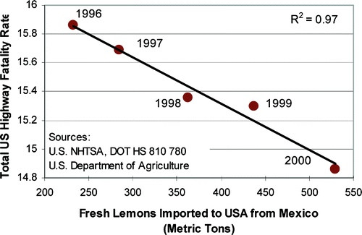
Do US Highway deaths have anything to do with Mexico?

Slide 58




Parameters and Statistics
 | Population | Sample
Size | N | n
Mean
Variance |  | S²
Standard Deviation |  | S
Coefficient of Variation | CV | cv
Covariance |  | S_{xy}
Coefficient of Correlation |  | r

