Slide 1
Chapter Six
Probability

Slide 2
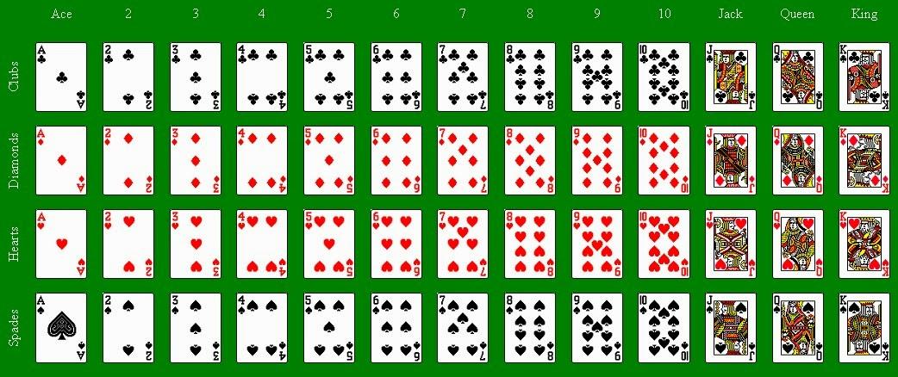
A deck of cards
Jacks, Queens, and Kings are called Face or Picture Cards.
Ace, 2, 3, , , 10 are called number cards.

Slide 3
What do you think?
You choose one card at random from a deck of 52 cards.
What is the prob. of getting a King?
What is the prob. of getting a Queen?
What is the prob. of getting a King and a Queen?
What is the prob. of getting a King or a Queen?
4/52; 4/52; 0/52; 8/52
Notes:
3

Slide 4
What do you think?
You choose one card at random from a deck of 52 cards.
What is the prob. of getting a Hearts?
What is the prob. of getting a Queen?
What is the prob. of getting a Queen or a Hearts?
13/52; 4/52; 13/52 + 4/52 – 1/52 = 16/52.
Notes:
4

Slide 5
What do you think?
What is the probability of pulling a King?
P(K) = 4/52
If the card I pulled is a face card. What is the probability it is a King?
P(K | Face card) = 4/12
Notes:
5

Slide 6
Of the cars on a used car lot, 70% have air conditioning (AC) and 40% have a CD player (CD). 20% of the cars have both.
A car you just saw has an AC. What’s the probability it also has a CD Player?
If there are 100 cars, 70 will have an AC and 20 of them will have a CD player. So, P(CD given AC) = 20/70

Slide 7
Try it . . .
The pass rate of a first-time taker for the bar exam is 70%. The students can the test one more time, and because this is the 2nd time, the pass rate now is 80%. Find the probability that a randomly selected law school graduate becomes a lawyer (candidates cannot take the exam more than twice).

Slide 8
Terminology
Experiment
Any well-defined action
Outcome
The result of performing an experiment
Random Variable
An expression whose value is the outcome of an experiment
Sample Space
The set of all possible outcomes associated with a given experiment
Event
The set of outcomes each having a given characteristic or attribute

Slide 9
Random Experiment…
An experiment is a procedure that is
carried out under controlled conditions, and
executed to discover an unknown result.
An experiment that results in different outcomes even when repeated in the same manner every time is a random experiment.
Experiment | Outcomes
Flip a coin | Heads, Tails
Exam Marks | Numbers: 0, 1, 2, ..., 100
Assembly Time | t > 0 seconds
Course Grades | F, D, C, B, A

Slide 10
Probabilities…
List the outcomes of a random experiment…
This list must be exhaustive, i.e. ALL possible outcomes included.
Die roll {1,2,3,4,5} Die roll {1,2,3,4,5,6}
The list must be mutually exclusive, i.e. no two outcomes can occur at the same time:
Die roll {odd number or even number}
Die roll{ number less than 4 or even number}

Slide 11
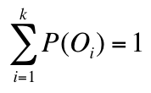
Sample Space…
A list of exhaustive and mutually exclusive outcomes is called a sample space and is denoted by S. The outcomes are denoted by O₁, O₂, …, O_{k}
We represent the sample space as: S = {O₁, O₂,…, O_{k}}
The probability of any outcome is between 0 and 1
i.e. 0 ≤ P(O_{i}) ≤ 1 for each i, and
The sum of the probabilities of all outcomes equals 1
i.e. P(O₁) + P(O₂) + … + P(O_{k}) = 1
S is discrete if it consists of a finite or countable infinite set of outcomes.
S is continuous if it contains an interval of real numbers.

Slide 12
Sample Space
The Sample Space is the collection of all possible events like . . .
all 6 faces of a die:
all 52 cards of a deck:

Slide 13
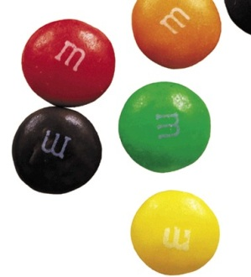
M&M candies
If you draw an M&M candy at random from a bag, the candy will have one of six colors. The probability is based on the manufacturing process:
What is the probability that an M&M chosen at random is blue?
Color | Brown | Red | Yellow | Green | Orange | Blue
Probability | 0.3 | 0.2 | 0.2 | 0.1 | 0.1 | ?
S = {brown, red, yellow, green, orange, blue} = Sample Space
P(S) = P(brown) + P(red) + P(yellow) + P(green) + P(orange) + P(blue) = 1
P(blue) = 1 – [P(brown) + P(red) + P(yellow) + P(green) + P(orange)]
= 1 – [0.3 + 0.2 + 0.2 + 0.1 + 0.1] = 0.1
What is the probability that a random M&M is any of red, yellow, or orange?
P(red or yellow or orange) = P(red) + P(yellow) + P(orange)
= 0.2 + 0.2 + 0.1 = 0.5

Slide 14
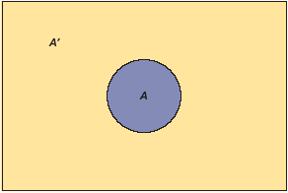
Complement Rule…
The complement of an event A is the event that occurs when A does not occur.
The complement rule gives us the probability of an event NOT occurring. That is:
P(A^{C}) = 1 – P(A)
P(A) = 1 – P(A^{C})
For example, in the simple roll of a die, the probability of the number “1” being rolled is 1/6. The probability that some number other than “1” will be rolled is 1 – 1/6 = 5/6.

Slide 15
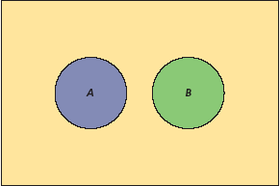
Mutually Exclusive Events
Events A and B are mutually exclusive (or disjoint) if their intersection is the null set that contains no elements.
What is the probability of getting an Ace and a Queen when you pull a card from a deck? Are the two events mutually exclusive?
Are the events of getting a Queen and a Spade mutually exclusive?
What is the probability of getting an Ace and a Queen when you pull a card from a deck? Zero. Are the two events mutually exclusive? Yes.
Are the events of getting a Queen and a Spade mutually exclusive? No.
5A-15
Notes:
15

Slide 16
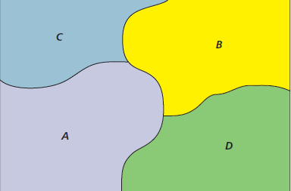
Collectively Exhaustive Events
Chapter 5
There can be more than two mutually exclusive, collectively exhaustive events, as illustrated below. For example, a Wal-Mart customer can pay by credit card (A), debit card (B), cash (C), or
check (D).
Question: If you can pay partly by credit card and partly by cash, will the events be mutually exclusive? No.
If you can pay using food stamps, will the 4 events be collective exhaustive? No.
5-16
Notes:
16

Slide 17
Collectively Exhaustive Events
A = aces; B = black cards; D = diamonds; H = hearts
Are events A, B, D, and H collectively exhaustive?
Are they mutually exclusive?
Are events B, D, and H collectively exhaustive?
Are they mutually exclusive?

Slide 18
Probability
Three approaches to assigning probability:
Approach | Example
Classical | There is a 50 % probability of heads on a coin flip. The probability is 1/6 that a 7 will be obtained when rolling 2 die. Here we make certain assumptions (such as equally likely, independence) about the situation.
Relative frequency | Based on previous records, there is a 12% chance that I’ll sell a house this week. These calculations are based on historical data.
Subjective | There is a 67% chance that Pittsburgh Steelers will win Superbowl this year. Agree? Such assumptions are based on a variety of facts but can’t always be verified.
5A-18
Notes:
18

Slide 19
Classical Method of Assigning Probabilities
Good when an experiment has equally likely outcomes.
What is the probability of getting a Queen from a deck of cards?
Of a Hearts?
Of a Queen of Hearts?
Of a total of 5 when you role two dice?
Answers: 4/52; 13/52; 1/52; 4/36
Notes:
19

Slide 20
Classical Approach…
Experiment: Rolling dice
Sample Space: S = {2, 3, …, 12}
Probability Examples:
P(2) = 1/36
P(7) = 6/36
P(10) = 3/36
 | 1 | 2 | 3 | 4 | 5 | 6
1 | 2 | 3 | 4 | 5 | 6 | 7
2 | 3 | 4 | 5 | 6 | 7 | 8
3 | 4 | 5 | 6 | 7 | 8 | 9
4 | 5 | 6 | 7 | 8 | 9 | 10
5 | 6 | 7 | 8 | 9 | 10 | 11
6 | 7 | 8 | 9 | 10 | 11 | 12

Slide 21
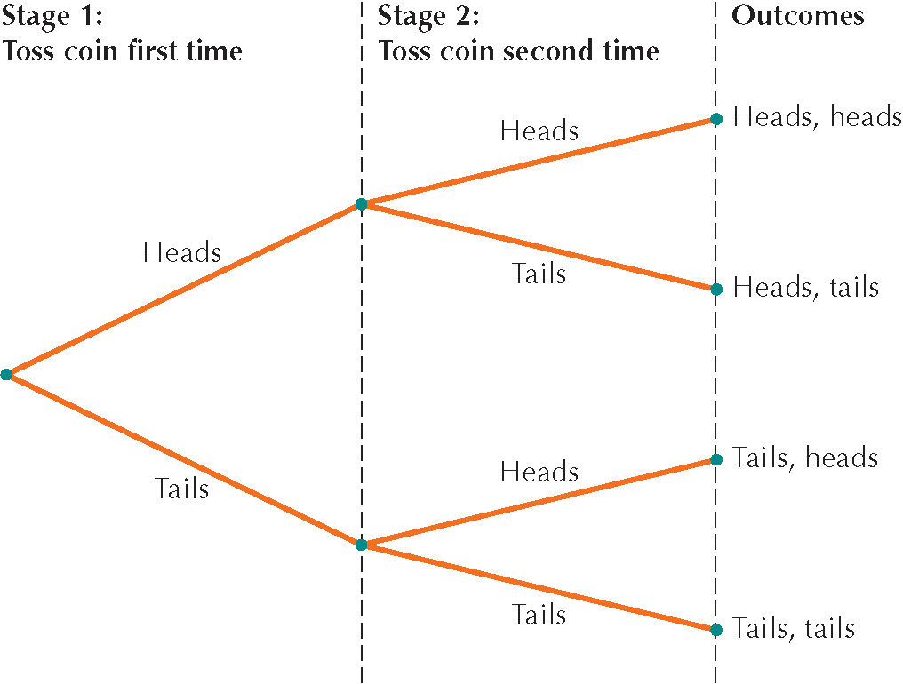
A Tree representation
Tree diagram for the experiment of tossing a fair coin twice.
Notes:
21

Slide 22
Law of Large Numbers
As the number of times that an experiment is repeated increases, the relative frequency (proportion) of a particular outcome tends to approach the probability of the outcome.
When you toss a coin, you expect to get a Head half the time and a Tail, half the time. This may not be the case when you toss the coin for 3 or 4 times. But if you toss it a 1,000 times, you will be very close to 50% Heads and 50% Tails. Even closer if you toss 10,000 times.
Notes:
22

Slide 23
Relative Frequency Approach…
Desktops Sold | # of Days | Desktops Sold
0 | 1 | 1/30 = .03
1 | 2 | 2/30 = .07
2 | 10 | 10/30 = .33
3 | 12 | 12/30 = .40
4 | 5 | 5/30 = .17
 |  | ∑ = 1.00
There is a 40% chance Bits & Bytes will sell 3 desktops on any given day”

Slide 24
Relative frequency – another example
If on a shopping spree, the following percentages were recorded for the four methods of payments.
credit card: | 32%
debit card: | 15%
cash: | 35%
check: | 18%
Sum = | 100%
What is the probability that the next person in line will pay by a credit card?

Slide 25
Joint, Marginal, Conditional Probability…
We study methods to determine probabilities of events that result from combining other events in various ways.
Lets us look at salary gains obtained after getting an MBA degree from schools presented in a contigency table.

Slide 26
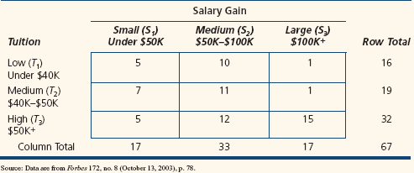

Slide 27
Contingency Tables
Example: Salary Gains and MBA Tuition
Consider the following cross-tabulation table for n = 67 top-tier MBA programs:
5B-27
Notes:
27

Slide 28
Contingency Tables
Marginal Probabilities
The marginal probability of a single event is found by dividing a row or column total by the total sample size.
P(S₂) = 33/67 = .4925 ; P(T₂) = 19/67
P(T₁) = 16/67 = .2388
5B-28

Slide 29
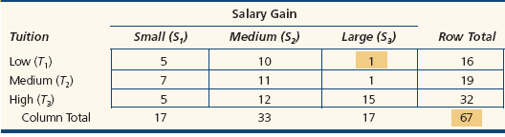
Contingency Tables
Joint Probabilities
A joint probability represents the intersection of two events in a cross-tabulation table.
Consider the joint event that the school has low tuition and large salary gains denoted as P(T₁ ∩ S₃)).
P(T₁ ∩ S₃) = 1/67 = .0149
5B-29
Notes:
29

Slide 30
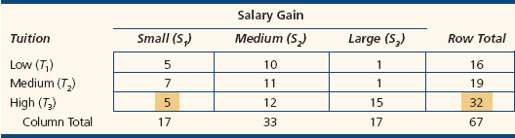
Contingency Tables
Conditional Probabilities
Found by restricting to a single row or column (the condition).
For example, knowing that a school’s MBA tuition is high (T₃), we would restrict ourselves to the third row of the table.
Find the probability that the salary gains are small (S₁) given that the MBA tuition is large (T₃).
P(S₁ | T₃) = 5/32 = .1563
5B-30
Notes:
30

Slide 31


Conditional Probability…
Conditional probability is used to determine how two events are related; that is, we can determine the probability of one event given the occurrence of another related event.
Conditional probabilities are written as P(A | B) and read as “the probability of A given B” and is calculated as:

Slide 32
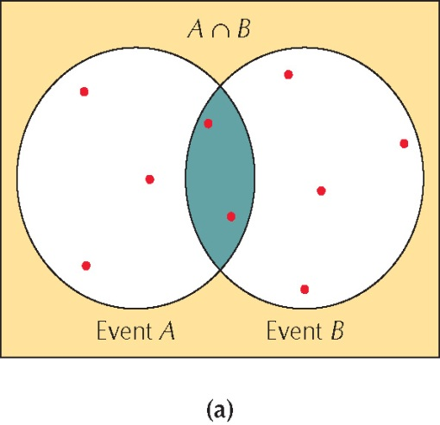
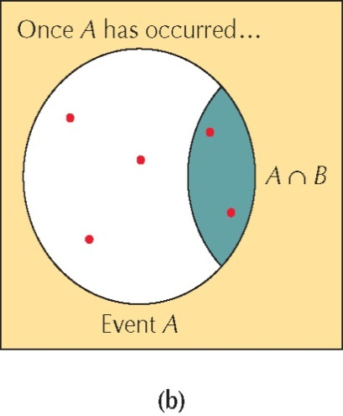
What do you think?
What is the probability of pulling a Queen of Hearts?
P(Q and H) = 1/52
Given you’ve pulled a Hearts, what is the probability of it being a Queen of Hearts?
P(Q | H) = 1/13
Given you’ve pulled a Queen, what is the probability of it being a Queen of Hearts?
P(H | Q) = 1/4
Notes:
32

Slide 33
Independence…
One of the objectives of calculating conditional probability is to determine whether two events are related.
In particular, we would like to know whether they are independent, that is, if the probability of one event is not affected by the occurrence of the other event.
Two events A and B are independent if
P(A|B) = P(A) or P(B|A) = P(B)

Slide 34
Contingency Tables
Independence
To check for independent events in a contingency table, compare the conditional to the marginal probabilities.
For example, if large salary gains (S3) were independent of low tuition (T1), then
P(S3 | T1) = P(S3).
Conditional | Marginal
P(S₃ | T₁)= 1/16 = .0625 | P(S₃) = 17/67 = .2537
What do you conclude about events S3 and T1? Are they independent? That is, does the tuition of a school affect the salary gain? Answer: Yes.
5B-34
Notes:
34

Slide 35
Contingency Tables – Addition rule
You meet an MBA graduate. Given the table below, what is the probability that she went to a high tuition school or got a medium salary gain? We need to find P(T₃ or S₂).
P(T₃ U S₂) = P(T₃) + P(S₂) – P(T₃ ∩ S₂) = 32/67 + 33/67 – 12/67
5B-35
Notes:
35

Slide 36
Rules of Probability (Venn Diagram)
A
B
A
B
A
B
A
B
=
C
+
C
+
C
C
A
B
A
B
A
B
-
C
-
C
-
C
A
B
+
C

Slide 37
Rules of Probability (Set Theory)
Let the Sample Space representing the role of a die be S = {1,2,3,4,5,6}
Let A = {1,2,3}
Let B = {2,3,5}
Let C = {3,4,6}
What is P(A∪B∪C) = ?
P({1,2,3,4,5,6})
=
P{1,2,3}
P{2,3,5}
P{3,4,6}
+
+
-
P{2,3}
-
-
P{3}
P{3}
+
P{3}

Slide 38
Example
In a large city, two newspapers are published, the Sun and the Post. The circulation departments report that 22% of the city’s households have a subscription to the Sun and 35% subscribe to the Post.
A survey reveals that 6% of all households subscribe to both newspapers. What proportion of the city’s households subscribe to either newspaper? That is, what is the probability that a subscriber is either getting a Sun or a Post or both?
P(Sun or Post) = P(Sun) + P(Post) – P(Sun and Post)
= .22 + .35 – .06 = .51 = 51%
If you are allowed to have only one newspaper, then P(Sun and Post) = 0 as they become mutually exclusive events. So, P(Sun or Post) = P(Sun) + P(Post) = .22 + .35 = .57

Slide 39
Multiplication Rule…
The multiplication rule is used to calculate the joint probability of two events. It is based on the formula for conditional probability defined earlier:
If we multiply both sides of the equation by P(B) we have:
P(A and B) = P(A | B)•P(B)
Likewise, P(A and B) = P(B | A) • P(A)
If A and B are independent events, then P(A and B) = P(A)•P(B)

Slide 40
Multiplication Rule…
Suppose you toss a coin two times. Does the second toss outcome depend on the 1st toss outcome? No as the tosses are independent.
That means, P(H | H) = P(H), P(H | T) = P(H), P(T | H) = P(T)
From our multiplication formula, we have
P(A and B) = P(A | B)•P(B)
That is, P(H and T) = P(H | T) • P(T)
But because the tossing events are independent, we can say
P(H and T) = P(H) x P(T)
So, if you toss 4 coins, what is the probability of getting 4 heads?
Answer: .5 x .5 x .5 x.5

Slide 41
Multiplication Rule
If A, B and C are events in S for which P(A) > 0, P(B) > 0, and P(C) > 0 , then;
P(A ∩ B ∩ C) = P(A)P(B|A)P(C|A ∩ B)
If A, B and C are independent events, then:
P(A ∩ B ∩ C) = P(A)P(B)P(C)

Slide 42
Reliability of independent events
Chapter 5
To illustrate system reliability, suppose a Web site has 2 independent file servers. Each server has 99% reliability. What is the total system reliability? Let,
`
F₁ be the event that server 1 fails
F₂ be the event that server 2 fails
5-42
Notes:
42

Slide 43
Chapter 5
What is the probability that both the systems will fail?
P(F₁ ∩ F₂ ) =
P(F₁) P(F₂) =
(.01)(.01) = .0001
So, the probability that both servers are down is .0001 = .01%
The probability that one or both servers is “up” is, that is, no server is down is:
1 - .0001 = .9999 or 99.99%
5-43
Notes:
43

Slide 44
Example
A graduate statistics course has 7 male and 3 female students. The professor will allow a student to answer only 1 question.
What is the probability that the two students chosen are female?
Probability of 1st being female = 3/10 = P(F)
If the 1st was a female, probability of 2nd student being a female = P(F | F) = 2/9
Thus, we want to answer the question: what is P(F and F)?
P(F and F) = P(F)•P(F|F) = (3/10)(2/9) = 6/90 = .067
“There is a 6.7% chance that the professor will choose two female students from her grad class of 10.”
Find P(M and F) and P(M and M).

Slide 45
Probability Trees
In can P(F and F) or other joint probability using a probability tree.
Joint probabilities
P(FF)=(3/10)(2/9)
P(F|F) = 2/9
Second selection
P(F) = 3/10
P( M|F) = 7/9
First selection
P(FM)=(3/10)(7/9)
P(F|M) = 3/9
P(MF)=(7/10)(3/9)
P( M) = 7/10
Second selection
P( M|M) = 6/9
P(MM)=(7/10)(6/9)

Slide 46
Example – changed rules
The professor has changed the rules. Now, anyone can answer any question any number of times.
What is the probability that the two students chosen are female?
Notice that now P(F|F) = P(F) = 3/10, P(M|F) = P(M) = 7/10, and so on. This is like tossing of a coin where earlier outcome has no effect on the later outcome.
So, P(F and F) = P(F)•P(F) = (3/10)(3/10) = 9/100 = .09 = 9%

Slide 47
Social Media and Depression
http://www.forbes.com/
Dr. Primack of University of Pittsburgh and the research team polled 1,787 adults in the U.S. between the ages of 19 and 32.
According to the questionnaire results, the participants used social media 61 minutes per day and visited various social media accounts 30 times per week on average. What made the study alarming was that more than a quarter of the participants were classified as having “high” indicators of depression.
Compared against users that viewed social media less frequently, participants that use social media very frequently have 2.7 times the likelihood of depression.
It is possible that people who are depressed use social media to fill a void, according to lead author Lui yi Lin. However, exposure to social media can cause depression — which leads to more social media usage.
Why would heavy social media usage cause depression? The exposure to “highly idealized representations of peers on social media elicits feelings of envy and the distorted belief that others lead happier, more successful lives,” says the study.

Slide 48
Bayes’ Theorem
Often we begin probability analysis with initial or
prior probabilities.
Then, from a sample, special report, or a product
test we obtain some additional information.
Given this information, we calculate revised or
posterior probabilities.
Bayes’ theorem provides the means for revising the
prior probabilities.
Prior
Probabilities
New
Information
Application
of Bayes’
Theorem
Posterior (revised)
Probabilities

Slide 49
Bayes’ Theorem – the formula
Chapter 5
General Form of Bayes’ Theorem
A generalization of Bayes’s Theorem allows event B to have as many
mutually exclusive and collectively exhaustive categories as we wish
(B₁, B₂, … B_{n}) rather than just two dichotomous categories (B and B').
5-49
Notes:
49

Slide 50
Bayes Theorem in Medicine
suppose that a patient shows up in an emergency room with a severe headache, muscle aches and fatigue. These symptoms are consistent with both Lyme disease (= H), which is rare in the area, and influenza (= H*), which is more common. We are about to learn whether the patient has a fever (= E). The known statistics for people exhibiting the patient's symptoms are given in the table below (not available).
While only 3% of people have Lyme disease, this illness is accompanied by fever 90% of the time. The much larger group of patients (about 27%) who have the flu are feverish only 70% of the time. Somewhat paradoxically, patients with both the flu and Lyme disease present with fevers slightly less often than patients with Lyme disease alone (perhaps because flu-induced fevers tend to show up more rapidly than those caused by Lyme disease).

Slide 51
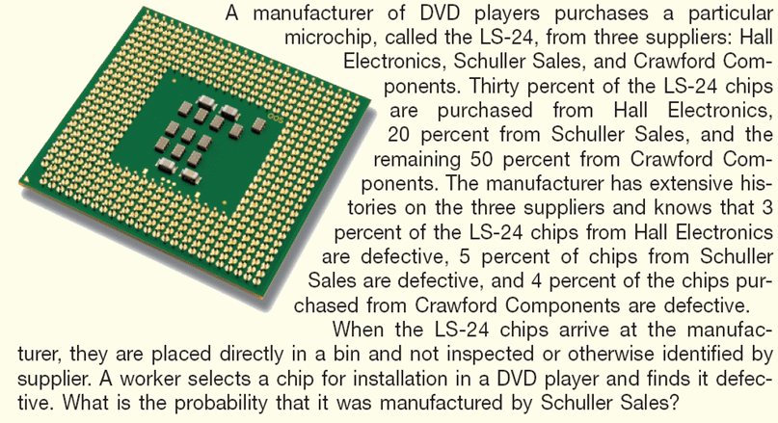
Bayes Theorem – Example

Slide 52
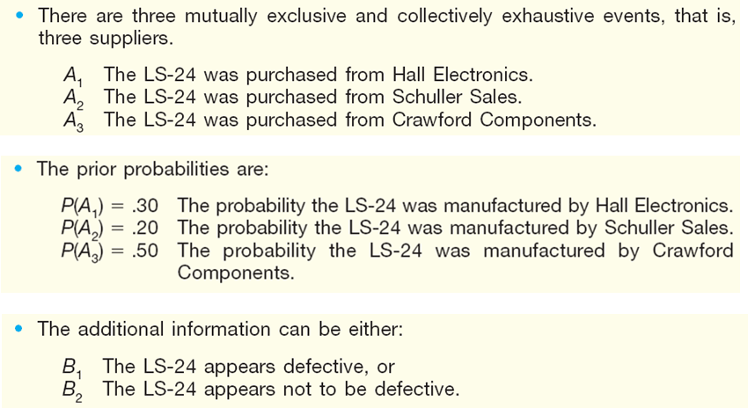
Bayes Theorem – Example (cont.)

Slide 53
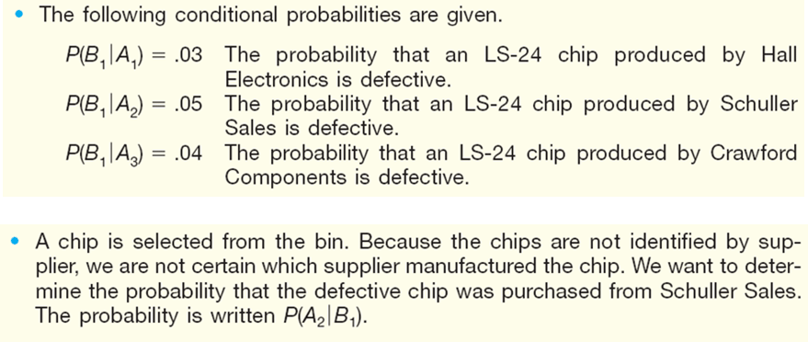
Bayes Theorem – Example (cont.)

Slide 54
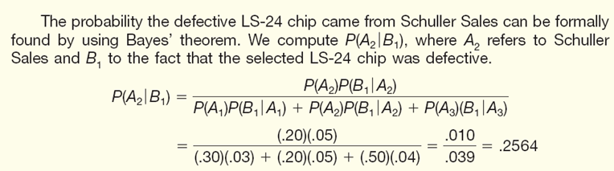
Bayes Theorem – Example (cont.)

Slide 55
Drug user
Joe lives in Portage county where 5% of the residents are drug users.
Joe is given a drug test.
The test correctly identifies users 95% of the time.
The test correctly identifies nonusers 90% of the time.
If Joe tests positive, what’s the probability he is a drug user?

Slide 56
Drug user
Joe moves to Portage county where 20% of the residents are drug users.
Joe is given a drug test.
The test correctly identifies users 95% of the time.
The test correctly identifies nonusers 90% of the time.
If Joe tests positive, what’s the probability he is a drug user?

Slide 57
Pregnancy test . . . Bayes’ theorem
Suppose 60% of the women who purchase pregnancy testing kits are actually pregnant. The kits are not accurate, however. A kit may give a positive result even if the woman is not pregnant (false positive) , or a negative result even when she is pregnant (false negative).
 | Positive test result | Negative test result
Actually pregnant | 96% | 4%
Not pregnant | 1% | 99%
If someone is buying a kit, there is a 60% chance she is pregnant. This is called Prior probability. Suppose the kit shows positive. So, we have this new information. Now what is the probability she is pregnant? This is called Posterior or Revised probability.

