Slide 1

Discrete Probability Distributions
Chapter 7

Slide 2
Types of Random Variables
DISCRETE RANDOM VARIABLE A random variable that can assume only certain clearly separated values. It is usually the result of counting something.
CONTINUOUS RANDOM VARIABLE can assume an infinite number of values within a given range. It is usually the result of some type of measurement

Slide 3
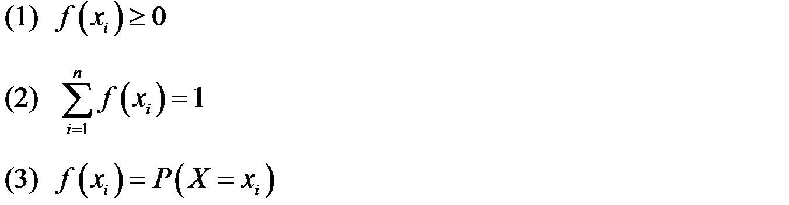
Probability Mass Function
For a discrete random variable X with possible values
x₁, x₂, …, x_{n}, a probability mass function is a function such that:

Slide 4
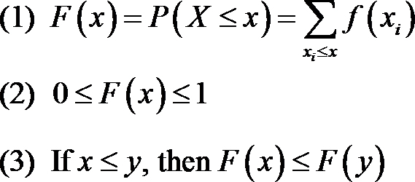
Cumulative Distribution Function and Properties
The cumulative distribution function, is the probability that a random
variable X with a given probability distribution will be found at a value
less than or equal to x.
Symbolically,
For a discrete random variable X, F(x) satisfies the following properties:

Slide 5
Distribution Functions
Consider the probability distribution for a digital channel
Example where X is a random variable measuring number of bits transmitted with an error
Find the probability of three or fewer bits in error.
The event (X ≤ 3) is the total of the events: (X = 0), (X = 1), (X = 2), and (X = 3).
From the table:
P(X ≤ 3) = P(X = 0) + P(X = 1) + P(X = 2) + P(X = 3) = 0.9999

Slide 6
Characteristics of a Probability Distribution
CHARACTERISTICS OF A PROBABILITY DISTRIBUTION
The probability of a particular outcome is between
0 and 1 inclusive.
2. The outcomes are mutually exclusive events.
3. The list is exhaustive. So the sum of the probabilities of the various events is equal to 1.

Slide 7
Example – Probability distribution
A mutual fund salesperson has arranged to call on three people tomorrow. Based on past experience the salesperson knows that there is a 20% chance of closing a sale on each call. Determine the probability distribution of the number of sales the salesperson will make.
Let S denote success, i.e. closing a sale P(S)=.20
Thus S^{C} is not closing a sale, and P(S^{C})=.80

Slide 8
Example . . .
Developing a Probability Distribution…
Sales Call 1
Sales Call 2
Sales Call 3
(.2)(.2)(.8)= .032
P(S)=.2
S S S
S S S^{C}
S S^{C} S
S S^{C} S^{C}
S^{C} S S
S^{C} S S^{C}
S^{C} S^{C} S
S^{C} S^{C} S^{C}
P(S)=.2
X P(x)
.2³ = .008
3(.032)=.096
3(.128)=.384
0 .8³ = .512
P(S^{C})=.8
P(S)=.2
P(S)=.2
P(S^{C})=.8
P(S^{C})=.8
P(S)=.2
P(S^{C})=.8
P(S)=.2
P(S^{C})=.8
P(S)=.2
P(S^{C})=.8
P(S^{C})=.8
P(X=2) is illustrated here…

Slide 9
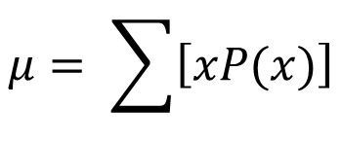
The Mean of a Probability Distribution
MEAN
The mean is a typical value used to represent the central location of a probability distribution.
The mean of a probability distribution is also referred to as its expected value.
$$μ= \sum{\left[xP(x)\right]}$$

Slide 10

Weighted Mean
The weighted mean of a set of numbers X₁, X₂, ..., X_{n}, with corresponding weights w₁, w₂, ...,w_{n}, is computed from the following formula:

Slide 11

EXAMPLE – Weighted Mean
The Carter Construction Company pays its hourly employees $16.50, $19.00, or $25.00 per hour. There are 26 hourly employees, 14 of which are paid at the $16.50 rate, 10 at the $19.00 rate, and 2 at the $25.00 rate. What is the mean hourly rate paid the 26 employees?

Slide 12
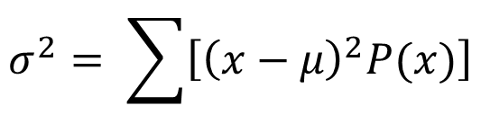
The Variance and Standard Deviation of a Probability Distribution
Variance and Standard Deviation
Measures the amount of spread in a distribution
The computational steps are:
1. Subtract the mean from each value, and square this difference.
2. Multiply each squared difference by its probability.
3. Sum the resulting products to arrive at the variance.
The standard deviation is found by taking the positive square root of the variance.
$$σ^{2}= \sum{\left[{\left(x−μ\right)}^{2}P(x)\right]}$$

Slide 13
Distribution Functions
Find the mean and variance for the number of bits transmitted in error for the digital channel example

Slide 14
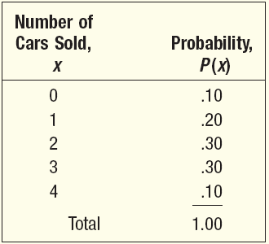
Mean, Variance, and Standard Deviation of a Probability Distribution - Example
John Ragsdale sells new cars for Pelican Ford. John usually sells the largest number of cars on Saturday. He has developed the following probability distribution for the number of cars he expects to sell on a particular Saturday.

Slide 15
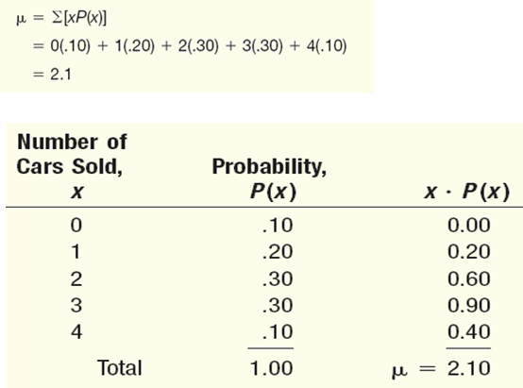
Mean of a Probability Distribution - Example

Slide 16
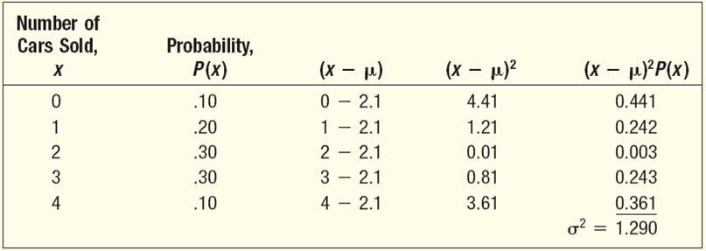

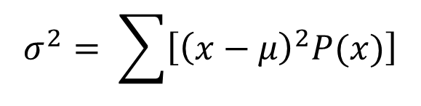
Variance and Standard Deviation of a Probability Distribution - Example
$$σ^{2}= \sum{\left[{\left(x−μ\right)}^{2}P(x)\right]}$$
$$σ=\sqrt{σ^{2}}=1.136$$

Slide 17
Laws of Expected Value…
0
E(c) = c
The expected value of a constant (c) is just the value of the constant.
E(X + c) = E(X) + c
E(cX) = cE(X)
We can “pull” a constant out of the expected value expression (either as part of a sum with a random variable X or as a coefficient of random variable X).

Slide 18
Laws of Variance…
0
V(c) = 0
The variance of a constant (c) is zero.
V(X + c) = V(X)
The variance of a random variable and a constant is just the variance of the random variable (per 1 above).
V(cX) = c²V(X)
The variance of a random variable and a constant coefficient is the coefficient squared times the variance of the random variable.

Slide 19

Example 7.4…
0
Monthly sales have a mean of $25,000 and a standard deviation of $4,000. Profits are calculated by multiplying sales by 30% and subtracting fixed costs of $6,000.
Find the standard deviation of monthly profits.
1) Describe the problem statement in algebraic terms:
sales have a standard deviation of $4,000
➔ V(Sales) = 4,000² = 16,000,000
(remember the relationship between standard deviation and variance )
profits are calculated by… ➔ Profit = .30(Sales) – 6,000
$$σ=\sqrt{σ^{2}}$$

Slide 20
Example 7.4…
0
Monthly sales have a mean of $25,000 and a standard deviation of $4,000. Profits are calculated by multiplying sales by 30% and subtracting fixed costs of $6,000.
Find the standard deviation of monthly profits.
2) The variance of profit is = V(Profit)
=V[.30(Sales) – 6,000]
=V[.30(Sales)] [by rule #2]
=(.30)²V(Sales) [by rule #3]
=(.30)²(16,000,000) = 1,440,000
Again, standard deviation is the square root of variance,
so standard deviation of Profit = (1,440,000)^{1/2} = $1,200

Slide 21
Example 7.4 (summary)
0
Monthly sales have a mean of $25,000 and a standard deviation of $4,000. Profits are calculated by multiplying sales by 30% and subtracting fixed costs of $6,000.
Find the mean and standard deviation of monthly profits.
The mean monthly profit is $1,500
The standard deviation of monthly profit is $1,200

Slide 22
Bivariate Distributions…
0
Up to now, we have looked at univariate distributions, i.e. probability distributions in one variable.
As you might guess, bivariate distributions are probabilities of combinations of two variables.
Bivariate probability distributions are also called joint probability. A joint probability distribution of X and Y is a table or formula that lists the joint probabilities for all pairs of values x and y, and is denoted P(x,y).
P(x,y) = P(X=x and Y=y)

Slide 23
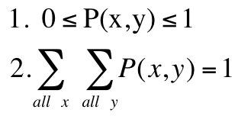
Discrete Bivariate Distribution…
0
As you might expect, the requirements for a bivariate distribution are similar to a univariate distribution, with only minor changes to the notation:
for all pairs (x,y).

Slide 24
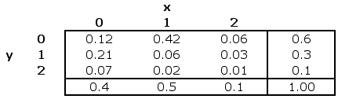
Example 7.5…
0
Xavier and Yvette are real estate agents. Let X denote the number of houses that Xavier will sell in a month and let Y denote the number of houses Yvette will sell in a month. An analysis of their past monthly performances has the following joint probabilities (bivariate probability distribution).

Slide 25



Marginal Probabilities…
0
As before, we can calculate the marginal probabilities by summing across rows and down columns to determine the probabilities of X and Y individually:
E.g the probability that Xavier sells 1 house = P(X=1) =0.50

Slide 26
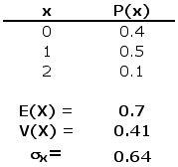
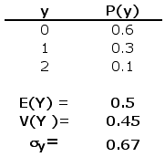
Describing the Bivariate Distribution…
0
We can describe the mean, variance, and standard deviation of each variable in a bivariate distribution by working with the marginal probabilities…
same formulae as for univariate distributions…

Slide 27

Covariance…
0
The covariance of two discrete variables is defined as:

Slide 28
Sum of Two Variables…
0
The bivariate distribution allows us to develop the probability distribution of any combination of the two variables, of particular interest is the sum of two variables.
If we consider our example of Xavier and Yvette selling houses, we can create a probability distribution…
…to answer questions like “what is the probability that two houses are sold”?
P(X+Y=2) = P(0,2) + P(1,1) + P(2,0) = .07 + .06 + .06 = .19

Slide 29
Sum of Two Variables…
0
Likewise, we can compute the expected value, variance, and standard deviation of X+Y in the usual way…
E(X + Y) = 0(.12) + 1(.63) + 2(.19) + 3(.05) + 4(.01) = 1.2
V(X + Y) = (0 – 1.2)²(.12) + … + (4 – 1.2)²(.01) = .56

Slide 30
Laws…
0
We can derive laws of expected value and variance for the sum of two variables as follows…
E(X + Y) = E(X) + E(Y)
V(X + Y) = V(X) + V(Y) + 2COV(X, Y)
If X and Y are independent, COV(X, Y) = 0 and thus
V(X + Y) = V(X) + V(Y)

Slide 31
Laws
0
E(X + Y) = E(X) + E(Y) = .7 + .5 = 1.2
V(X + Y) = V(X) + V(Y) + 2COV(X, Y)
= .41 + .45 + 2(-.15) = .56

Slide 32
Binomial Probability Distribution
A Widely occurring discrete probability distribution
Characteristics of a Binomial Probability Distribution
There are only two possible outcomes on a particular trial of an experiment.
The outcomes are mutually exclusive,
The random variable is the result of counts.
Each trial is independent of any other trial

Slide 33
Binomial Probability Experiment
An outcome on each trial of an experiment is classified into one of two mutually exclusive categories—a success or a failure.
2. The random variable counts the number of successes in a fixed number of trials.
3. The probability of success and failure stay the same for each trial.
4. The trials are independent, meaning that the outcome of one trial does not affect the outcome of any other trial.

Slide 34
Binomial Probability Distribution
Expected Value
E(x) = μ = np
Variance
Var(x) = σ ² = np(1 − p)
Standard Deviation

Slide 35
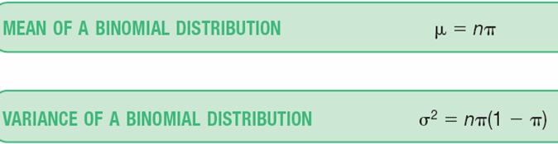
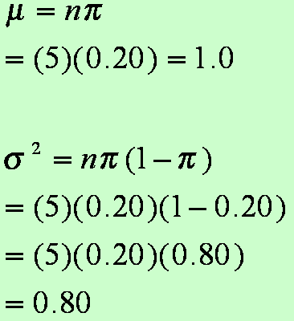
Binomial Dist. – Mean and Variance:
For the example regarding the number of late flights, recall that π =.20 and n = 5.
What is the average number of late flights?
What is the variance of the number of late flights?

Slide 36
Binomial Distribution Problem
Twenty percent of the worm gears produced by an automatic, high-speed Carter-Bell milling machine are defective. The machine has just produced 18 gears.
Use the table (next slide) to find the probability of
Zero defective: .0180 = 1.8%
Exactly three defective: .2297 = 22.97%
Three or less defective: .0180 + .0811 + .1723 + .2297 = .5011
Four or more defective: 1 - .5011 = .4989

Slide 37
Binomial table for n = 18
n | X |  |  | probability of success
 |  | 0.10 | 0.15 | 0.20 | 0.25 | 0.30 | 0.35 | 0.40 | 0.45 | 0.50
18 | 0 | 0.1501 | 0.0536 | 0.0180 | 0.0056 | 0.0016 | 0.0004 | 0.0001
 | 1 | 0.3002 | 0.1704 | 0.0811 | 0.0338 | 0.0126 | 0.0042 | 0.0012 | 0.0003 | 0.0001
 | 2 | 0.2835 | 0.2556 | 0.1723 | 0.0958 | 0.0458 | 0.0190 | 0.0069 | 0.0022 | 0.0006
 | 3 | 0.1680 | 0.2406 | 0.2297 | 0.1704 | 0.1046 | 0.0547 | 0.0246 | 0.0095 | 0.0031
 | 4 | 0.0700 | 0.1592 | 0.2153 | 0.2130 | 0.1681 | 0.1104 | 0.0614 | 0.0291 | 0.0117
 | 5 | 0.0218 | 0.0787 | 0.1507 | 0.1988 | 0.2017 | 0.1664 | 0.1146 | 0.0666 | 0.0327
 | 6 | 0.0052 | 0.0301 | 0.0816 | 0.1436 | 0.1873 | 0.1941 | 0.1655 | 0.1181 | 0.0708
 | 7 | 0.0010 | 0.0091 | 0.0350 | 0.0820 | 0.1376 | 0.1792 | 0.1892 | 0.1657 | 0.1214
 | 8 | 0.0002 | 0.0022 | 0.0120 | 0.0376 | 0.0811 | 0.1327 | 0.1734 | 0.1864 | 0.1669
 | 9 |  | 0.0004 | 0.0033 | 0.0139 | 0.0386 | 0.0794 | 0.1284 | 0.1694 | 0.1855
 | 10 |  | 0.0001 | 0.0008 | 0.0042 | 0.0149 | 0.0385 | 0.0771 | 0.1248 | 0.1669
 | 11 |  |  | 0.0001 | 0.0010 | 0.0046 | 0.0151 | 0.0374 | 0.0742 | 0.1214
 | 12 |  |  |  | 0.0002 | 0.0012 | 0.0047 | 0.0145 | 0.0354 | 0.0708
 | 13 |  |  |  |  | 0.0002 | 0.0012 | 0.0045 | 0.0134 | 0.0327
 | 14 |  |  |  |  |  | 0.0002 | 0.0011 | 0.0039 | 0.0117
 | 15 |  |  |  |  |  |  | 0.0002 | 0.0009 | 0.0031
 | 16 |  |  |  |  |  |  |  | 0.0001 | 0.0006
 | 17 |  |  |  |  |  |  |  |  | 0.0001
 | 18

Slide 38
Binomial Probability Distributions – Using Excel (BINOM.DIST in Excel)
A study by the Illinois Department of Transportation concluded that 76.2 percent of front seat occupants used seat belts. A sample of 12 vehicles is selected.
What is the probability the front seat occupants in exactly 7 are wearing seat belts?
What is the probability that less than 3 will be wearing seat belts?
What is the probability that more than 4 people will be wearing seat belts?
What is the probability that between 3 and 8 people will be wearing seat belts?

Slide 39


Exercise: Organic virus-1
Each mosquito has a 10% chance of containing the West Nile virus. Assume that the samples are independent with
regard to the presence of the virus. Find the probability that, in the
next 18 samples, exactly 2 contain the virus.
Answer:
Let X denote the number of samples that contain the pollutant in the
next 18 samples analyzed. Then X is a binomial random variable with
p = 0.1 and n = 18

Slide 40
Poisson Probability Distribution
The Poisson probability distribution describes the number of times some event occurs during a specified interval. The interval may be time, distance, area, or volume.
Assumptions of the Poisson Distribution
The probability is proportional to the length of the interval.
The intervals are independent.

Slide 41
Poisson Probability Distribution
The Poisson probability distribution is characterized by the number of times an event happens during some interval or continuum.
Examples include:
• The number of misspelled words per page in a newspaper.
• The number of calls per hour received by Dyson Vacuum Cleaner Company.
• The number of potholes in 1 mile.
• The number of customers coming to a bank in an hour.

Slide 42
Poisson Distribution
Suppose that we have a situation in which a certain kind of occurrence happens at random over a period of time. For example, the occurrences that we are interested in might be incoming telephone calls to a police station in a large city. We want to model this situation so that we can consider the probabilities of events such as more than 10 phone calls occurring in a 5-minute time interval.
Presumably, in our example, there would be more incoming calls between 6:00 and 7:00 P.M. than between 4:00 and 5:00 A.M., and this fact would certainly affect the above probability.
Thus, to have a hope of computing such probabilities, we must assume that the average rate, i.e., the average number of occurrences per minute, is a constant. This rate we will denote by λ.
This means that if we were to apply our model to the two time periods given above, we would simply use different rates for the two time periods, thereby obtaining two different probabilities for the given event.

Slide 43
Poisson Distribution
The number of outcomes occurring in one time interval or specified region is independent of the number that occurs in any other disjoint time interval or region of space. In this way we say that the Poisson process has no memory
The probability that a single outcome will occur during a very short time interval or in a small region is proportional to the length of the time interval or the size of the region and does not depend on the number of outcomes occurring outside this time interval or region
The probability that more than one outcome will occur in such a short time interval or fall in such a small region is negligible

Slide 44
So if the star emits N photons in total and we collect a fraction, p, of those, then λ = Np
So if we make many identical observations of the star and plot out the frequency distribution of the numbers of photons collected each time, we expect to see a Poisson distribution.

Slide 45
Hypergeometric Distribution
Motivation
Suppose that we have a set of N items, of which k are acceptable and N − k are not acceptable. We choose n of these items (as our sample size), without replacement, and define X to be the number of acceptable items in our sample. The distribution of X is called the hypergeometric distribution.
Conditions:
Population size = N
K members are “successes” (acceptable)
N - K members are “failures” (unacceptable)
Sample size = n
Obtained without replacement
X = the number of successes (acceptable items) in a sample

Slide 46
In-Class Exercise
Lots of 40 components each are called acceptable if they contain no more than 3 defectives.
The procedure for sampling the lot is to select 5 components at random and to reject the lot if a defective is found.
What is the probability that exactly 1 defective is found in the sample if there are 3 defectives in the entire lot?
Answer: In Class Exercise.
What is the Expected number of defects (average number of defects) for each sample lot of 5 components?
Answer: In Class Exercise.

