Slide 1
Chapter 8
Continuous Probability Distributions
Normal, Exponential, and t distribution tables are available on the website. Use these to solve quiz / test problems. Use Excel’s functions to solve HW problems.

Slide 2
Continuous Random Variable…
Unlike a discrete random variable, a continuous random variable is one that can assume an uncountable number of values.
➔ We cannot list the possible values because there is an infinite number of them. How many possible weights are there between 7 and 8 pounds?
➔ Because there is an infinite number of values, the probability of each individual value is virtually 0. What is the probability of a human being 5.813244291389 feet tall?

Slide 3
Probability Density Function…
A function f(x) is called a probability density function (over the range a ≤ x ≤ b if it meets the following requirements:
f(x) ≥ 0 for all x between a and b, and
The total area under the curve between a and b is 1.0
f(x)
area=1
a
b
x

Slide 4
Continuous distribution
Our focus will be on
Uniform distribution
Normal distribution
Exponential distribution
t distribution

Slide 5


Uniform Distribution…
Consider the uniform probability distribution (sometimes called the rectangular probability distribution).
It is described by the function:
f(x)
a
b
x
area = width x height = (b – a) x = 1

Slide 6

Example …
The amount of gasoline sold daily at a service station is uniformly distributed with a minimum of 2,000 gallons and a maximum of 5,000 gallons.
Find the probability that daily sales will fall between 2,500 and 3,000 gallons.
Algebraically: what is P(2,500 ≤ X ≤ 3,000) ?
f(x)
2,000
5,000
x

Slide 7
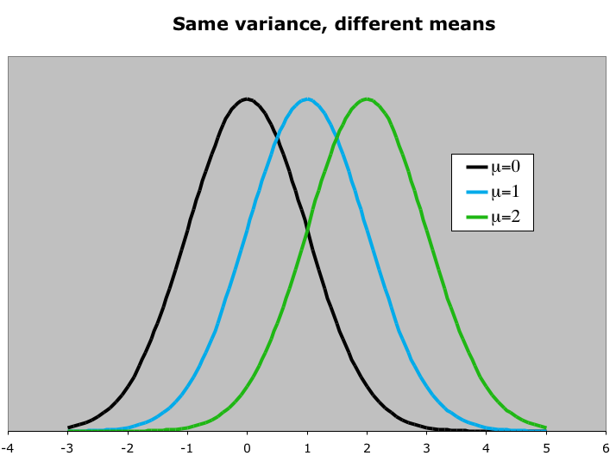
Normal Distribution…
The normal distribution is described by two parameters:
its mean μ and its standard deviation σ. Increasing the mean shifts the curve to the right…

Slide 8
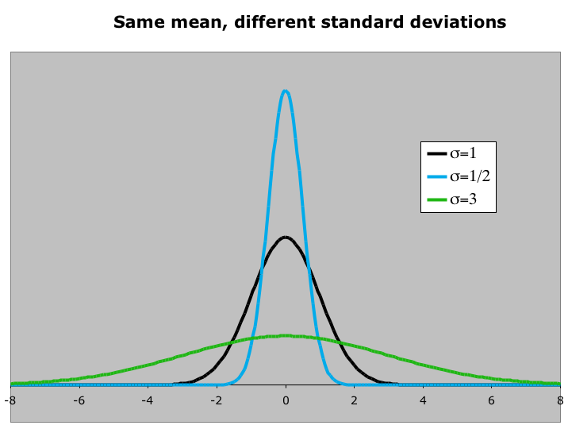
Normal Distribution…
The normal distribution is described by two parameters:
its mean μ and its standard deviation σ. Increasing the standard deviation “flattens” the curve…

Slide 9
Properties of the Normal Model - effects of μ and σ
f(t)
σ = 1
Normal probability distributions with identical means but the different standard deviation
σ = 5
σ = 10
μ = 50
t
f(t)
f(t)
f(t)
Normal probability distributions with different means but the same standard deviation
σ = 5
σ = 5
σ = 5
μ = 15
μ = 25
μ = 40
t
f(t)
Three normal probability distributions, each with a different mean and a different standard deviation
f(t)
f(t)
σ = 1
σ = 3
σ = 10
μ = 5
μ = 10
μ = 20
t

Slide 10
Normal Probability Distribution
99.72%
95.44%
68.26%
x
μ
μ – 3σ
μ – 1σ
μ + 1σ
μ + 3σ
μ – 2σ
μ + 2σ

Slide 11
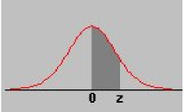
 | 0 | 0.01 | 0.02 | 0.03 | 0.04 | 0.05 | 0.06 | 0.07 | 0.08 | 0.09
0.0 | 0.0000 | 0.0040 | 0.0080 | 0.0120 | 0.0160 | 0.0199 | 0.0239 | 0.0279 | 0.0319 | 0.0359
0.1 | 0.0398 | 0.0438 | 0.0478 | 0.0517 | 0.0557 | 0.0596 | 0.0636 | 0.0675 | 0.0714 | 0.0753
0.2 | 0.0793 | 0.0832 | 0.0871 | 0.0910 | 0.0948 | 0.0987 | 0.1026 | 0.1064 | 0.1103 | 0.1141
0.3 | 0.1179 | 0.1217 | 0.1255 | 0.1293 | 0.1331 | 0.1368 | 0.1406 | 0.1443 | 0.1480 | 0.1517
0.4 | 0.1554 | 0.1591 | 0.1628 | 0.1664 | 0.1700 | 0.1736 | 0.1772 | 0.1808 | 0.1844 | 0.1879
0.5 | 0.1915 | 0.1950 | 0.1985 | 0.2019 | 0.2054 | 0.2088 | 0.2123 | 0.2157 | 0.2190 | 0.2224
0.6 | 0.2257 | 0.2291 | 0.2324 | 0.2357 | 0.2389 | 0.2422 | 0.2454 | 0.2486 | 0.2517 | 0.2549
0.7 | 0.2580 | 0.2611 | 0.2642 | 0.2673 | 0.2704 | 0.2734 | 0.2764 | 0.2794 | 0.2823 | 0.2852
0.8 | 0.2881 | 0.2910 | 0.2939 | 0.2967 | 0.2995 | 0.3023 | 0.3051 | 0.3078 | 0.3106 | 0.3133
0.9 | 0.3159 | 0.3186 | 0.3212 | 0.3238 | 0.3264 | 0.3289 | 0.3315 | 0.3340 | 0.3365 | 0.3389
1.0 | 0.3413 | 0.3438 | 0.3461 | 0.3485 | 0.3508 | 0.3531 | 0.3554 | 0.3577 | 0.3599 | 0.3621
1.1 | 0.3643 | 0.3665 | 0.3686 | 0.3708 | 0.3729 | 0.3749 | 0.3770 | 0.3790 | 0.3810 | 0.3830
1.2 | 0.3849 | 0.3869 | 0.3888 | 0.3907 | 0.3925 | 0.3944 | 0.3962 | 0.3980 | 0.3997 | 0.4015
1.3 | 0.4032 | 0.4049 | 0.4066 | 0.4082 | 0.4099 | 0.4115 | 0.4131 | 0.4147 | 0.4162 | 0.4177
1.4 | 0.4192 | 0.4207 | 0.4222 | 0.4236 | 0.4251 | 0.4265 | 0.4279 | 0.4292 | 0.4306 | 0.4319
1.5 | 0.4332 | 0.4345 | 0.4357 | 0.4370 | 0.4382 | 0.4394 | 0.4406 | 0.4418 | 0.4429 | 0.4441
1.6 | 0.4452 | 0.4463 | 0.4474 | 0.4484 | 0.4495 | 0.4505 | 0.4515 | 0.4525 | 0.4535 | 0.4545
1.7 | 0.4554 | 0.4564 | 0.4573 | 0.4582 | 0.4591 | 0.4599 | 0.4608 | 0.4616 | 0.4625 | 0.4633
1.8 | 0.4641 | 0.4649 | 0.4656 | 0.4664 | 0.4671 | 0.4678 | 0.4686 | 0.4693 | 0.4699 | 0.4706
1.9 | 0.4713 | 0.4719 | 0.4726 | 0.4732 | 0.4738 | 0.4744 | 0.4750 | 0.4756 | 0.4761 | 0.4767
2.0 | 0.4772 | 0.4778 | 0.4783 | 0.4788 | 0.4793 | 0.4798 | 0.4803 | 0.4808 | 0.4812 | 0.4817
2.1 | 0.4821 | 0.4826 | 0.4830 | 0.4834 | 0.4838 | 0.4842 | 0.4846 | 0.4850 | 0.4854 | 0.4857
2.2 | 0.4861 | 0.4864 | 0.4868 | 0.4871 | 0.4875 | 0.4878 | 0.4881 | 0.4884 | 0.4887 | 0.4890
2.3 | 0.4893 | 0.4896 | 0.4898 | 0.4901 | 0.4904 | 0.4906 | 0.4909 | 0.4911 | 0.4913 | 0.4916
2.4 | 0.4918 | 0.4920 | 0.4922 | 0.4925 | 0.4927 | 0.4929 | 0.4931 | 0.4932 | 0.4934 | 0.4936
2.5 | 0.4938 | 0.4940 | 0.4941 | 0.4943 | 0.4945 | 0.4946 | 0.4948 | 0.4949 | 0.4951 | 0.4952
2.6 | 0.4953 | 0.4955 | 0.4956 | 0.4957 | 0.4959 | 0.4960 | 0.4961 | 0.4962 | 0.4963 | 0.4964
2.7 | 0.4965 | 0.4966 | 0.4967 | 0.4968 | 0.4969 | 0.4970 | 0.4971 | 0.4972 | 0.4973 | 0.4974
2.8 | 0.4974 | 0.4975 | 0.4976 | 0.4977 | 0.4977 | 0.4978 | 0.4979 | 0.4979 | 0.4980 | 0.4981
2.9 | 0.4981 | 0.4982 | 0.4982 | 0.4983 | 0.4984 | 0.4984 | 0.4985 | 0.4985 | 0.4986 | 0.4986
3.0 | 0.4987 | 0.4987 | 0.4987 | 0.4988 | 0.4988 | 0.4989 | 0.4989 | 0.4989 | 0.4990 | 0.4990
This is the only z-table that you’ll get during the test. So, use this table to solve quiz / practice problems. It’s available on eLearning. Download and bring a copy to every class.

Slide 12
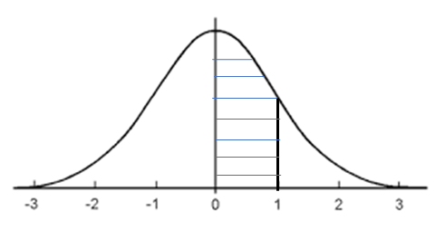
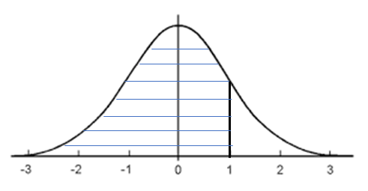
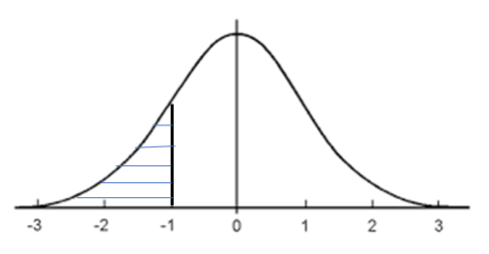
Which table to use?
Does it really matter?

Slide 13
Class Exercise: Normal Distribution
The time it takes a driver to react to the brake lights on a decelerating vehicle is critical in helping to avoid rear-end collisions.
The reaction time for an in-traffic response to a brake signal from standard brake lights can be modeled with a normal distribution having mean value 1.25 sec and standard deviation 0.46 sec.
What is the probability that reaction time is between 1.00 and 1.75 seconds?
If we view 2 seconds as a critically long reaction time, what is the probability that actual reaction time will exceed this value?

Slide 14
Examples
1. Suppose that at another gas station the daily demand for regular gasoline is normally distributed with a mean of 1,000 gallons and a standard deviation of 100 gallons.
The station manager has just opened the station for business and notes that there is exactly 1,100 gallons of regular gasoline in storage.
The next delivery is scheduled later today at the close of business. The manager would like to know the probability that he will have enough regular gasoline to satisfy today’s demands.
2. Consider an investment whose return is normally distributed with a mean of 10% and a standard deviation of 5%.
a. Determine the probability of losing money.
b. Find the probability of losing money when the standard deviation is equal to 10%.

Slide 15


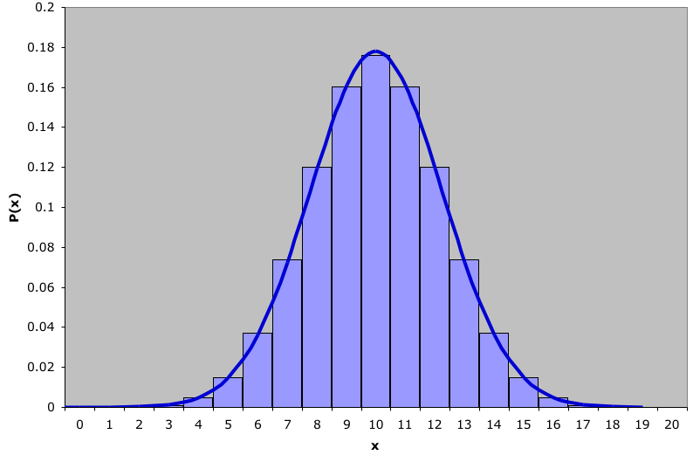
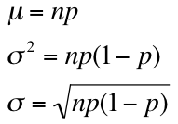


Normal Approximation to Binomial…
Binomial distribution with n=20 and p=.5 with a normal approximation superimposed ( =10 and =2.24)
where did these values come from?!
From Ch 7 we saw that:
Hence:
and

Slide 16
Normal Approximation to Binomial…
Normal approximation to the binomial works best when the number of experiments, n, (sample size) is large, and the probability of success, p, is close to 0.5
For the approximation to provide good results two conditions should be met: 1) np ≥ 5
2) n(1–p) ≥ 5

Slide 17
Normal Approximation to Binomial…
To calculate P(X=10) using the normal distribution, we can find the area under the normal curve between 9.5 & 10.5
P(X = 10) ≈ P(9.5 < Y < 10.5)
To find the probability of X > 10, we will find P(X > 10.5)
To find the probability of X < 8, we will find P(X < 7.5)

Slide 18
Normal Approximation to Binomial…
In fact:
P(X = 10) = .176
while
P(9.5 < Y < 10.5) = .1742
the approximation is quite good.
P(X = 10) ≈ P(9.5 < Y < 10.5)
where Y is a normal random variable approximating
the binomial random variable X

Slide 19
t Distribution…
In much the same way that µ and σ define the normal distribution, ν (= n -1), the degrees of freedom, defines the Student t Distribution:
As the number of degrees of freedom increases, the t distribution approaches the standard normal distribution.
Using Excel’s function
For T-score = 1.2 and sample size n = 30, then the area from negative infinity
= T.DIST(1.2, 29, 1) = .88007
T.INV(0.95, 29) = 1.69912 which is the t-score if the sample size n = 30 and the area from negative infinity is .95. Note that this is same as saying the right tail is .05.
To find the t-score for the left tail area = .05, we will use T.INV(0.05, 29) = -1.69912
Excel has other t-distribution function which deal with 2-tails, but you can (should) do without them.

Slide 20
Suppose
Mean = 240
Std Dev = 40
Sample size n = 25
What will be the cut-off number for the top 10%?
We have Degrees of freedom = n – 1 = 24
So, t-score = 1.318
Cut-off for top 10% =
240 + t × 40 = 292.72

Slide 21
Exponential Distribution…
Another important continuous distribution is the exponential distribution.
The exponential distribution is often used for time related phenomena such as the length of time between phone calls or between parts arriving at an assembly station. It is also used in determining the failure rate of a product.

Slide 22
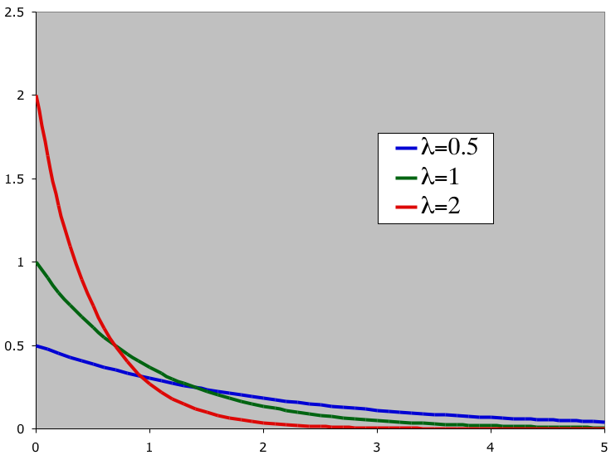
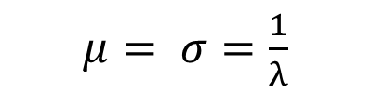
Exponential Distribution…
The exponential distribution depends upon the value of λ
Smaller values of λ “flatten” the curve:
(E.g. exponential distributions for λ = .5, 1, 2)
For Exponential Distribution
$μ= σ=\frac{1}{λ}$

Slide 23
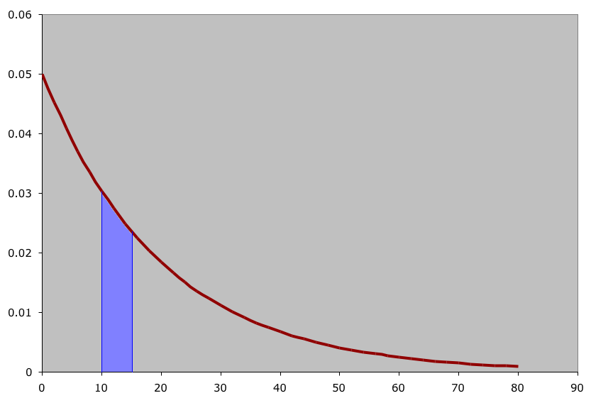
Example
The lifetime of an alkaline battery (measured in hours) is exponentially distributed with a mean of 20 hours. Find the probability a battery will last between 10 & 15 hours.
Here we have λ = 1/20 = .05. We will use Excel’s EXPON.DIST function. Excel functions computes areas from negative infinity.
EXPON.DIST(15, 0.05, 1) - EXPON.DIST(10, 0.05, 1) = .52763 - .39346 = .13416
What’s the probability a battery will last more than 16 hours?
P(10<X<15)
1- Expon.Dist(16, .05, 1) = .44932

Slide 24
Exponential Distribution and waiting lines
The service time at a checkout counter is exponentially distributed with a service rate of 6 / hour. A customer arrives. Find the following properties:
1. The service time is less than 5 minutes?
2. More than 10 minutes?
3. Between 5 and 8 minutes?
Service time = 10 minutes (6 / hour); so λ = 1/10 = .1
Answers
1. EXPONDIST(5,.1,1) = .3935 (from the table: 1 - .6065)
2. 1 - EXPONDIST(10,.1,1) = .3679 (from the table: .3679)
3. EXPONDIST(8,.1,1) - EXPONDIST(5,.1,1) = .5507 - .3935
(from the table: .6065 - .4493)
Note: Excel’s function provides probability of (X ≤ k). Our table provides probability of (X ≥ k).

Slide 25
Other Continuous Distributions…
There are dozens of continuous distributions used in statistics. For us, the other two important distributions (to be discussed later) are the
Chi-Squared Distribution
F Distribution

