Slide 1
Chapter 9
Sampling Distributions

Slide 2
Sampling Distributions…
A sampling distribution is created by, as the name suggests, sampling. Here we work with the distribution of the sample statistic – like sample mean, proportion, etc.
Note: it is extremely critical that you understand what sampling distribution really means, and how it differs from the ‘regular’ distribution.

Slide 3
Central Limit Theorem…
The sampling distribution of the mean of a random sample drawn from any population is approximately normal for a sufficiently large sample size.
The larger the sample size, the more closely the sampling distribution of X will resemble a normal distribution.

Slide 4
Central Limit Theorem…
If the population is normal, then X is normally distributed for all values of n.
If the population is non-normal, then X is approximately normal only for larger values of n.
In most practical situations, a sample size of 30 may be sufficiently large to allow us to use the normal distribution as an approximation for the sampling distribution of X.

Slide 5


Sampling Distribution of the Sample Mean
1.
2.
3. If X is normal, X is normal. If X is nonnormal, X is approximately normal for sufficiently large sample sizes.
Note: the definition of “sufficiently large” depends on the extent of nonnormality of x (e.g. heavily skewed; multimodal)

Slide 6

Example
According to CanEquity Mortgage company, the mean age of mortgage applicants in the City of Toronto is 37 years old. Assume that the standard deviation is 6 years. Find the mean and standard deviation of the sample mean for the sample sizes:
4,
9,
25,
49,
100,
225.
Note: standard deviation of the sample mean is typically referred to as standard error of the sample mean.
$$\overline{x}$$
Notes:
6

Slide 7
Example continued
Solution
We have = μ = 37.
Value for does not depend on the sample size, so the value is true for any sample size.
Now, we have σ = 6 which is the standard deviation of the population. What will be the standard deviations of the sample means? It will be different for each case as it depends on the sample size.
Notes:
7

Slide 8
Example continued
Solution

Slide 9
Sampling Distribution of the Sample Mean
The summaries above assume that the population is infinitely large. However if the population is finite the standard error is
where N is the population size and
is the finite population correction factor.
Note: In this course, we’ll deal with infinite populations only. The HW / Quizz / Test questions will always assume the population to be infinitely large.

Slide 10
Sampling Distribution of the Sample Mean
If the population size is large relative to the sample size the finite population correction factor is close to 1 and can be ignored.
We will treat any population that is at least 20 times larger than the sample size as large.
In practice most applications involve populations that qualify as large.
As a consequence the finite population correction factor is usually omitted.

Slide 11
Example 9.1(a)…
The foreman of a bottling plant has observed that the amount of soda in each “32-ounce” bottle is actually a normally distributed random variable, with a mean of 32.2 ounces and a standard deviation of .3 ounce.
If a customer buys one bottle, what is the probability that the bottle will contain more than 32 ounces?

Slide 12
Example 9.1(a)…
We want to find P(X > 32), where X is normally distributed and µ = 32.2 and σ =.3
“there is about a 75% chance that a single bottle of soda contains more than 32oz.”

Slide 13
Example 9.1(b)…
The foreman of a bottling plant has observed that the amount of soda in each “32-ounce” bottle is actually a normally distributed random variable, with a mean of 32.2 ounces and a standard deviation of .3 ounce.
If a customer buys a carton of four bottles, what is the probability that the mean amount of the four bottles will be greater than 32 ounces?

Slide 14

Example 9.1(b)…
We want to find P(X > 32), where X is normally distributed
With µ = 32.2 and σ =.3
Things we know:
X is normally distributed, therefore so will X.
= 32.2 oz.

Slide 15

Example 9.1(b)…
If a customer buys a carton of four bottles, what is the probability that the mean amount of the four bottles will be greater than 32 ounces?
“There is about a 91% chance the mean of the four bottles will exceed 32oz.”

Slide 16
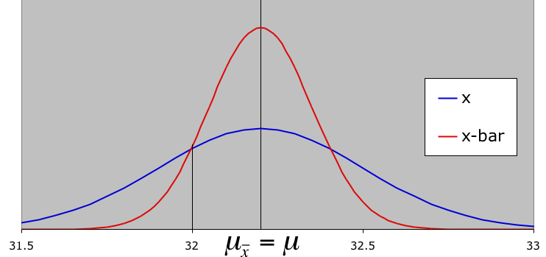
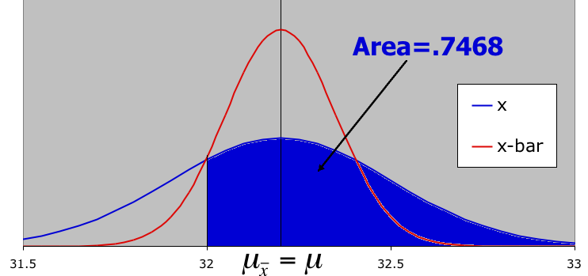
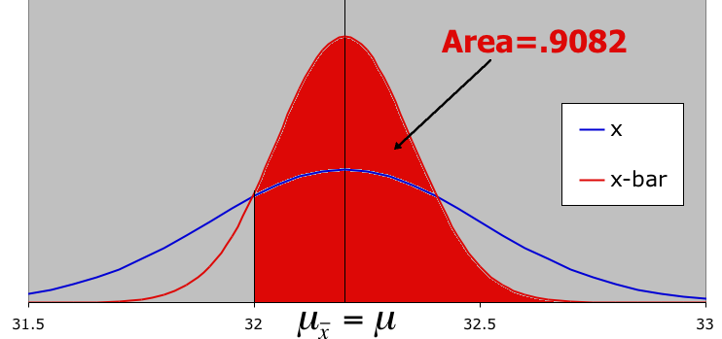
Graphically Speaking…
mean=32.2
what is the probability that one bottle will contain more than 32 ounces?
what is the probability that the mean of four bottles will exceed 32 oz?

Slide 17
Chapter-Opening Example
Salaries of a Business School’s Graduates
In the advertisements for a large university, the dean of the School of Business claims that the average salary of the school’s graduates one year after graduation is $800 per week with a standard deviation of $100.
A second-year student in the business school who has just completed his statistics course would like to check whether the claim about the mean is correct.

Slide 18
Chapter-Opening Example
Salaries of a Business School’s Graduates
He does a survey of 25 people who graduated one year ago and determines their weekly salary.
He discovers the sample mean to be $750.
To interpret his finding he needs to calculate the probability that a sample of 25 graduates would have a mean of $750 or less when the population mean is $800 and the standard deviation is $100.
After calculating the probability, he needs to draw some conclusions.

Slide 19
Chapter-Opening Example
We want to find the probability that the sample mean is less than $750. Thus, we seek
The distribution of X, the weekly income, is likely to be positively skewed, but not sufficiently so to make the distribution of nonnormal. As a result, we may assume that is normal with mean
and standard deviation

Slide 20
Chapter-Opening Example
Thus,
The probability of observing a sample mean as low as $750 when the population mean is $800 is extremely small. Because this event is quite unlikely, we would have to conclude that the dean's claim is not justified.

Slide 21

Sampling Distribution of a Proportion…
The estimator of a population proportion of successes is the sample proportion. That is, we count the number of successes in a sample and compute:
(read this as “p-hat”).
X is the number of successes, n is the sample size.

Slide 22
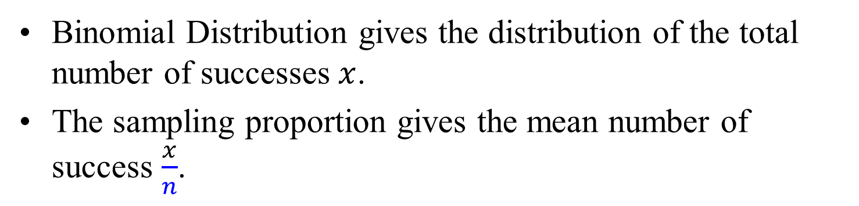
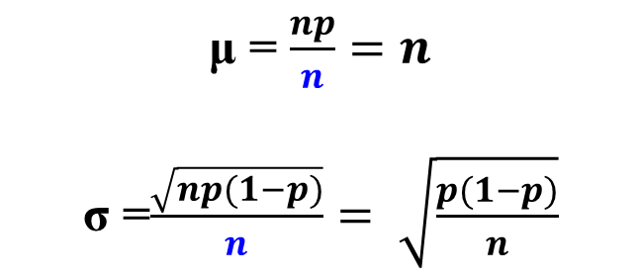
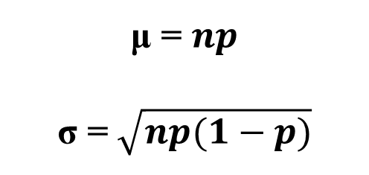
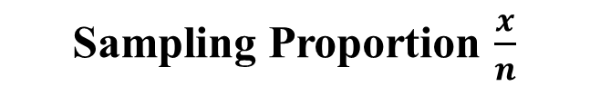
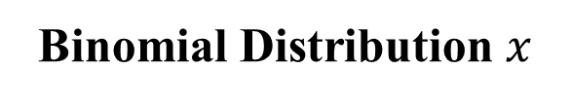
Sampling Distribution of a Proportion…
Binomial Distribution gives the distribution of the total number of successes $x$.
The sampling proportion gives the mean number of success $\frac{x}{n}$.
Binomial Distribution $x$
Sampling Proportion $\frac{x}{n}$
μ = $np$
σ = $\sqrt{np(1−p)}$
μ = $\frac{np}{n}=n$
σ =$\frac{\sqrt{np(1−p)}}{n}= \sqrt{\frac{p(1−p)}{n}}$

Slide 23
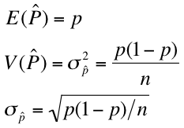
Sampling Distribution of a Sample Proportion…
Using the laws of expected value and variance, we can determine the mean, variance, and standard deviation of .
(The standard deviation of is called the standard error of the proportion.)

Slide 24
Example 9.2
In the last election a state representative received 52% of the votes cast.
One year after the election the representative organized a survey that asked a random sample of 300 people whether they would vote for him in the next election.
If we assume that his popularity has not changed what is the probability that more than half of the sample would vote for him?

Slide 25
Example 9.2
The number of respondents who would vote for the representative is a binomial random variable with n = 300 and p = .52.
We want to determine the probability that the sample proportion is greater than 50%. That is, we want to find
We now know that the sample proportion is approximately normally distributed with mean p = .52 and standard deviation

Slide 26
Example 9.2
Thus, we calculate
If we assume that the level of support remains at 52%, the probability that more than half the sample of 300 people would vote for the representative is 75.49%.

Slide 27
Example - Color blindness in men
The National Institutes of Health reported that
color blindness linked to the X chromosome
afflicts 8% of men. Suppose we take a random
sample of 100 men and let p denote the
proportion of men in the population who have
color blindness linked to the X chromosome.

Slide 28
Example continued
Solution
This is a binomial experiment with p = 0.08 and n = 100
Fact 6 tells us that
The sampling distribution of the sample proportion p has a mean of p = 0.08
ˆ

Slide 29
Example continued
Solution
Fact 7 states

Slide 30

Sampling Distribution: Difference of two means
The final sampling distribution introduced is that of the difference between two sample means. This requires:
independent random samples be drawn from each of two normal populations
If this condition is met, then the sampling distribution of the difference between the two sample means, i.e.
will be normally distributed.
(note: if the two populations are not both normally distributed, but the sample sizes are “large” (>30), the distribution of is approximately normal)

Slide 31


Sampling Distribution: Difference of two means
The expected value and variance of the sampling distribution of are given by:
mean:
standard deviation:
(also called the standard error if the difference between two means)

Slide 32
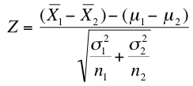
Example 9.3…
Since the distribution of is normal and has a
mean of
and a standard deviation of
We can compute Z (standard normal random variable) in this way:

Slide 33


Example 9.3…
Starting salaries for MBA grads at two universities are normally distributed with the following means and standard deviations. Samples from each school are taken…
 | University 1 | University 2
Mean | 62,000 $/yr | 60,000 $/yr
Std. Dev. | 14,500 $/yr | 18,300 $/yr
sample size n | 50 | 60
What is the probability that the sample mean starting salary of
University #1 graduates will exceed that of the #2 grads?

Slide 34
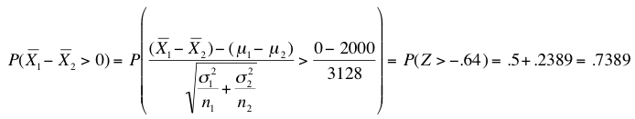
Example 9.3…
“What is the probability that the sample mean starting salary of University #1 graduates will exceed that of the #2 grads?”
We are interested in determinging P(X₁ > X₂). Converting this to a difference of means, what is: P(X₁ – X₂ > 0) ?
“there is about a 74% chance that the sample mean starting salary of U. #1 grads will exceed that of U. #2”

Slide 35
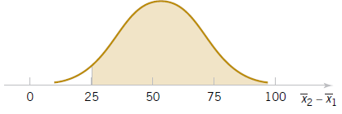
Example: Aircraft Engine Life
The effective life of a component used
in jet-turbine aircraft engine is a
random variable with mean 5000 and
SD 40 hours and is close to a normal
distribution. The engine manufacturer
introduces an improvement into the
Manufacturing process for this
component that changes the
parameters to 5050 and 30. Random
samples of size 16 and 25 are
selected.
What is the probability that the
difference in the two sample means is
at least 25 hours?

