Slide 1
Chapter 10
Introduction to Estimation

Slide 2
Statistical Inference…
Statistical inference is the process by which we acquire information and draw conclusions about populations from samples.
In order to do inference, we require the skills and knowledge of descriptive statistics, probability distributions, and sampling distributions.

Slide 3


Estimation…
There are two types of inference: estimation and hypothesis testing; estimation is introduced first.
The objective of estimation is to determine the approximate value of a population parameter on the basis of a sample statistic.
E.g., the sample mean ( ) is employed to estimate the population mean ( ).

Slide 4
Estimation…
The objective of estimation is to determine the approximate value of a population parameter on the basis of a sample statistic.
There are two types of estimators:
Point Estimator
Interval Estimator

Slide 5
Qualities of Estimators…
Qualities desirable in estimators include unbiasedness, consistency, and relative efficiency:
An unbiased estimator of a population parameter is an estimator whose expected value is equal to that parameter.
An unbiased estimator is said to be consistent if the difference between the estimator and the parameter grows smaller as the sample size grows larger.
If there are two unbiased estimators of a parameter, the one whose variance is smaller is said to be relatively efficient.

Slide 6

Estimating when is known…
In Chapter 8 we produced the following general probability statement about
And from Chapter 9 the sampling distribution of is approximately normal with mean µ and standard deviation
Thus
is (approximately) standard normally distributed.

Slide 7
Estimating when is known…
The interval can be expressed as
Lower confidence limit =
Upper confidence limit =
The probability 1 – α is the confidence level, which is a measure of how frequently the interval will actually include µ.

Slide 8
Interval Estimate of a Population Mean
Sampling
distribution
of
α/2
1 - α of all
values
α/2
μ

Slide 9
Example 10.1…
The Doll Computer Company makes its own computers and delivers them directly to customers who order them via the Internet.
To achieve its objective of speed, Doll makes each of its five most popular computers and transports them to warehouses from which it generally takes 1 day to deliver a computer to the customer.
This strategy requires high levels of inventory that add considerably to the cost.

Slide 10
Example 10.1…
To lower these costs the operations manager wants to use an inventory model. He notes demand during lead time is normally distributed and he needs to know the mean to compute the optimum inventory level.
He observes 25 lead time periods and records the demand during each period. Xm10-01
The manager would like a 95% confidence interval estimate of the mean demand during lead time. Assume that the manager knows that the standard deviation is 75 computers.

Slide 11
Example 10.1…

Slide 12


Example 10.1…
In order to use our confidence interval estimator, we need the following pieces of data:
therefore:
The lower and upper confidence limits are 340.76 and 399.56.
 | 370.16
 | 1.96
 | 75
n | 25
Calculated from the data…
Given

Slide 13
Example 10.1…
INTERPRET
The estimation for the mean demand during lead time lies between 340.76 and 399.56 — we can use this as input in developing an inventory policy.
That is, we estimated that the mean demand during lead time falls between 340.76 and 399.56, and this type of estimator is correct 95% of the time. That also means that 5% of the time the estimator will be incorrect.
Incidentally, the media often refer to the 95% figure as “19 times out of 20,” which emphasizes the long-run aspect of the confidence level.

Slide 14
EXAMPLE: Metallic Material Transition
Ten measurements of impact energy (J) on specimens of A238 steel cut at 60°C are as follows: 64.1, 64.7, 64.5, 64.6, 64.5, 64.3, 64.6, 64.8, 64.2, and 64.3. The impact energy is normally distributed with σ = 1J. Find a 95% CI for μ, the mean impact energy.
The required quantities are z_{α/2} = z_{0.025} = 1.96, n = 10, σ = l, and .
The resulting 95% CI is found from Equation 8-1 as follows:
Interpretation: Based on the sample data, a range of highly plausible values for mean impact energy for A238 steel at 60°C is
63.84J ≤ μ ≤ 65.08J

Slide 15
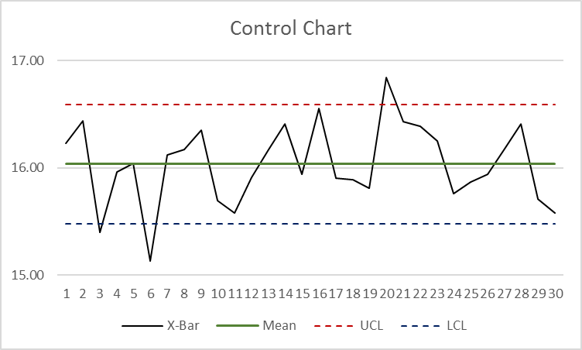
Control Charts
Used to study a process variation over time
Distinguishes between assignable and random variations

Slide 16
Control Charts
Mean of the sample means = 16.04
Std Error of the Sample Means = 0.185
UCL = 16.04 + 3 x 0.185
LCL = 16.04 - 3 x 0.185

Slide 17
Example: Discount Sounds
Discount Sounds has 260 retail outlets throughout
the United States. The firm is evaluating a potential
location for a new outlet, based in part, on the mean
annual income of the individuals in the marketing
area of the new location.
A sample of size n = 36 was taken; the sample
mean income is $41,100. The population is not
believed to be highly skewed. The population
standard deviation is estimated to be $4,500, and the
confidence coefficient to be used in the interval
estimate is .95.

Slide 18
Example: Discount Sounds
95% of the sample means that can be observed
are within + 1.96 of the population mean μ.
The margin of error is:
Thus, at 95% confidence,
the margin of error is $1,470.

Slide 19
Example: Discount Sounds
Interval estimate of μ is:
$41,100 + $1,470
or
$39,630 to $42,570
We are 95% confident that the interval contains the
population mean.

Slide 20
Interval Width…
A wide interval provides little information.
For example, suppose we estimate with 95% confidence that an accountant’s average starting salary is between $15,000 and $100,000.
Contrast this with: a 95% confidence interval estimate of starting salaries between $42,000 and $45,000.
The second estimate is much narrower, providing accounting students more precise information about starting salaries.

Slide 21

Interval Width…
The width of the confidence interval estimate is a function of the confidence level, the population standard deviation, and the sample size…

Slide 22


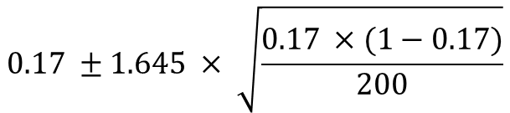
Confidence Interval for Population Proportion
You took of a sample of n = 200 parts. 17% parts in this sample were defective. What’ll be the 90% confidence interval for the proportion of defective parts in the population?
$$0.17 ±1.645 × \sqrt{\frac{0.17 ×(1−0.17)}{200}}$$

Slide 23
Selecting the Sample Size…
In Chapter 5 we pointed out that sampling error is the difference between an estimator and a parameter.
We can also define this difference as the error of estimation.
In this chapter this can be expressed as the difference between and µ.

Slide 24
Selecting the Sample Size…
The bound on the error of estimation is
B =
With a little algebra we find the sample size to estimate a mean.

Slide 25
Selecting the Sample Size…
To illustrate suppose that in Example 10.1 before gathering the data the manager had decided that he needed to estimate the mean demand during lead time to with 16 units, which is the bound on the error of estimation.
We also have 1 –α = .95 and σ = 75. We calculate

Slide 26
Selecting the Sample Size…
Because n must be an integer and because we want the bound on the error of estimation to be no more than 16 any non-integer value must be rounded up.
Thus, the value of n is rounded to 85, which means that to be 95% confident that the error of estimation will be no larger than 16, we need to randomly sample 85 lead time intervals.
Note: For online quizzes / tests, do not round up / down your answer as the computer may mark it wrong.

Slide 27
How do they choose the sample size for elections?
Margin of error = 3%
Confidence interval = 95%
Population proportion = 50%
What should be the smallest sample size to meet the above conditions?

