Slide 1
Chapter 16
Simple Linear Regression
and Correlation

Slide 2
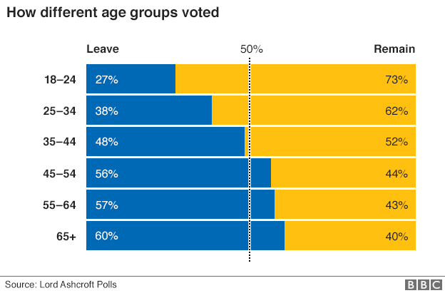
Brexit Votes by age
Median Age | % leave
21 | 27
29 | 38
40 | 48
50 | 56
60 | 57
70 | 60
Correlation = 0.95

Slide 3
Linear Regression
Managerial decisions often are based on the
relationship between two or more variables.
Regression analysis can be used to develop an
equation showing how the variables are related.
The variable being predicted is called the dependent
variable and is denoted by y.
The variables being used to predict the value of the
dependent variable are called the independent
variables and are denoted by x.

Slide 4
Simple Linear Regression
Simple linear regression involves one independent
variable and one dependent variable.
The relationship between the two variables is
approximated by a straight line.
Regression analysis involving two or more
independent variables is called multiple regression.

Slide 5
Regression Analysis…
Our problem objective is to analyze the relationship between interval variables; regression analysis is the first tool we will study.
Regression analysis is used to predict the value of one variable (the dependent variable) on the basis of other variables (the independent variables).
Dependent variable: denoted Y
Independent variables: denoted X₁, X₂, …, X_{k}

Slide 6
Simple Linear Regression Equation
Negative Linear Relationship
E(y)
Intercept
β₀
Regression line
Slope β₁
is negative
x

Slide 7
Simple Linear Regression Equation
No Relationship
E(y)
Intercept
β₀
Regression line
Slope β₁
is 0
x

Slide 8
Random Term…
We now represent the price of a house as a function of its size in this Probabilistic Model:
y = 100,000 + 100x +
Where (Greek letter epsilon) is the random term (a.k.a. error variable). It is the difference between the actual selling price and the estimated price based on the size of the house. Its value will vary from house sale to house sale, even if the square footage (i.e. x) remains the same.

Slide 9

Simple Linear Regression Model…
A straight line model with one independent variable is called a first order linear model or a simple linear regression model. Its is written as:
dependent
variable
independent
variable
y-intercept
slope of the line
error variable
Where (Greek letter epsilon) is the random term (a.k.a. error variable). It is the difference between the actual selling price and the estimated price based on the size of the house. Its value will vary from house sale to house sale, even if the square footage (i.e. x) remains the same.

Slide 10
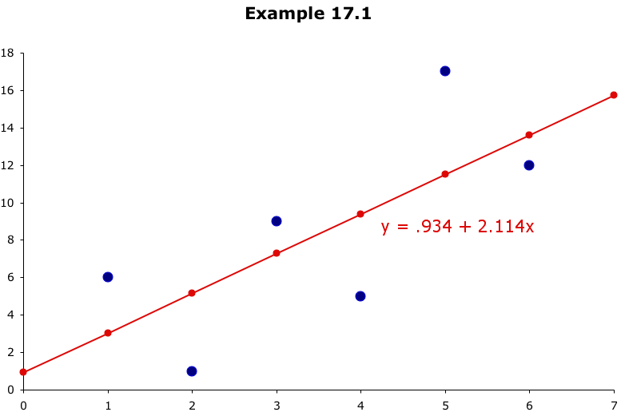
Least Squares Line…
Example 16.1
these differences are called residuals
This line minimizes the sum of the squared differences
between the points and the line…

Slide 11
Example 16.2…
Car dealers across North America use the "Red Book" to help them determine the value of used cars that their customers trade in when purchasing new cars.
The book, which is published monthly, lists the trade-in values for all basic models of cars.
It provides alternative values for each car model according to its condition and optional features.
The values are determined on the basis of the average paid at recent used-car auctions, the source of supply for many used-car dealers.

Slide 12
Example 16.2…
However, the Red Book does not indicate the value determined by the odometer reading, despite the fact that a critical factor for used-car buyers is how far the car has been driven.
To examine this issue, a used-car dealer randomly selected 100 three-year old Toyota Camrys that were sold at auction during the past month.
The dealer recorded the price ($1,000) and the number of miles (thousands) on the odometer. (Xm16-02).
The dealer wants to find the regression line.

Slide 13
Example 16.2…
Click Data, Data Analysis, Regression

Slide 14

Example 16.2…

Slide 15

Example 16.2…
INTERPRET
As you might expect with used cars…
The slope coefficient, b₁, is –0.0669, that is, each additional mile on the odometer decreases the price by $.0669 or 6.69¢
The intercept, b₀, is 17,250. One interpretation would be that when x = 0 (no miles on the car) the selling price is $17,250. However, we have no data for cars with less than 19,100 miles on them so this isn’t a correct assessment.

Slide 16
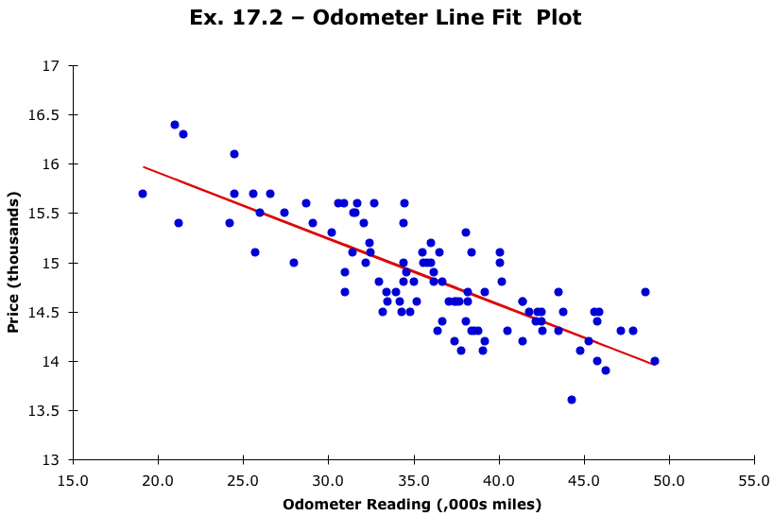
Example 16.2…
INTERPRET
Selecting “line fit plots” on the Regression dialog box, will produce a scatter plot of the data and the regression line…

Slide 17

Required Conditions…
For these regression methods to be valid the following four conditions for the error variable ( ) must be met:
• The probability distribution of is normal.
• The mean of the distribution is 0; that is, E( ) = 0.
• The standard deviation of is , which is a constant regardless of the value of x.
• The value of associated with any particular value of y is independent of associated with any other value of y.

Slide 18
Assessing the Model…
The least squares method will always produce a straight line, even if there is no relationship between the variables, or if the relationship is something other than linear.
Hence, in addition to determining the coefficients of the least squares line, we need to assess it to see how well it “fits” the data. We’ll see these evaluation methods now. They’re based on the sum of squares for errors (SSE).

Slide 19
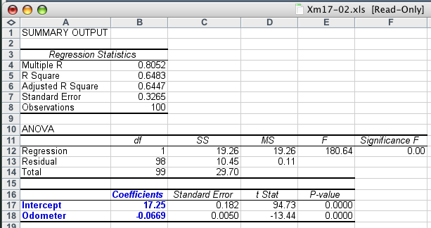
Standard Error of Estimate…
If s_{ε} is small, the fit is excellent and the linear model should be used for forecasting. If s_{ε} is large, the model is poor…
But what is small and what is large?

Slide 20
Using the Regression Equation…
We could use our regression equation:
y = 17.250 – .0669x
to predict the selling price of a car with 40 (,000) miles on it:
y = 17.250 – .0669x = 17.250 – .0669(40) = 14,574
We call this value ($14,574) a point prediction. Chances are though the actual selling price will be different, hence we can estimate the selling price in terms of an interval.

Slide 21

Standard Error of Estimate…
Judge the value of by comparing it to the sample mean of the dependent variable ( ).
In this example,
s_{ε} = .3265 and
= 14.841
so (relatively speaking) it appears to be “small”, hence our linear regression model of car price as a function of odometer reading is “good”.

Slide 22
Coefficient of Determination
INTERPRET
R² has a value of .6483. This means 64.83% of the variation in the auction selling prices (y) is explained by the variation in the odometer readings (x). The remaining 35.17% is unexplained, i.e. due to error.
Unlike the value of a test statistic, the coefficient of determination does not have a critical value that enables us to draw conclusions.
In general the higher the value of R², the better the model fits the data.
R² = 1: Perfect match between the line and the data points.
R² = 0: There are no linear relationship between x and y.

Slide 23
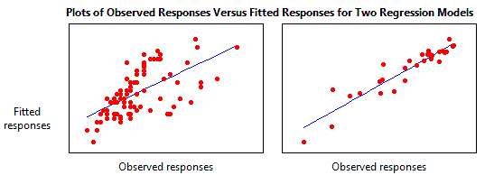
R² - Coefficient of Determination
R² = Explained variation / Total variation
http://www.investopedia.com/terms/r/r-squared.asp

Slide 24
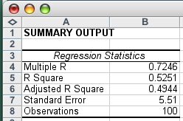


Adjusted R² value…
What’s this?
The “adjusted” R² is:
the coefficient of
determination adjusted for degrees of freedom.
It takes into account the sample size n, and k, the number of independent variables, and is given by:

Slide 25
Regression Diagnostics…
There are three conditions that are required in order to perform a regression analysis. These are:
• The error variable must be normally distributed,
• The error variable must have a constant variance, &
• The errors must be independent of each other.
How can we diagnose violations of these conditions?
➔ Residual Analysis, that is, examine the differences between the actual data points and those predicted by the linear equation…

Slide 26
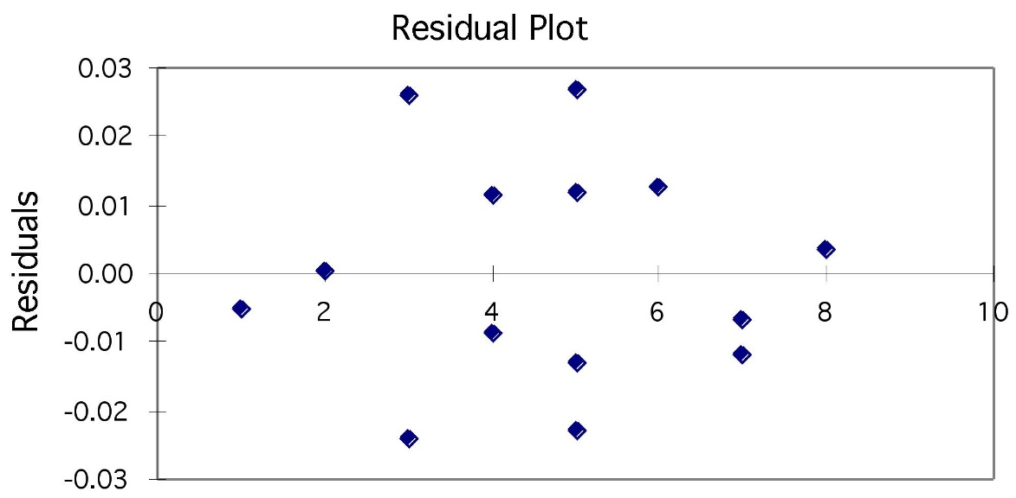
Using residual plots to check for regression validity
The residuals (y − ŷ) give useful information about the contribution of individual data points to the overall pattern of scatter.
We view the residuals in a residual plot:
If residuals are scattered randomly around 0 with uniform variation, it indicates that the data fits a linear model, and has normally distributed residuals for each value of x and constant standard deviation σ.

Slide 27
Heteroscedasticity
The variance of error is supposed to be constant. When this requirement is violated, we call it Heteroscedasticity (as opposed to homoscedasticity). One way to find this is to scatter-plot residuals against the predicted value of y. If there is no relation between y and the residuals, then we assume everything is fine.

Slide 28
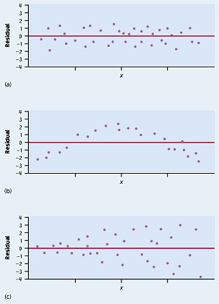
Residuals are randomly scattered → good!
Curved pattern → the relationship is not linear.
Change in variability across plot → σ not equal for all values of x.

Slide 29
Outliers…
Possible reasons for the existence of outliers include:
There was an error in recording the value
The point should not have been included in the sample
Perhaps the observation is indeed valid.
Outliers can be easily identified from a scatter plot.
If the absolute value of the standard residual is > 2, we suspect the point may be an outlier and investigate further.
They need to be dealt with since they can easily influence the least squares line…

