Slide 1
Chapter 17
Multiple Regression

Slide 2
Multiple Regression Model
Example: Programmer Salary Survey
A software firm collected data for a sample of 20
computer programmers. A suggestion was made that
regression analysis could be used to determine if
salary was related to the years of experience and the
score on the firm’s programmer aptitude test.
The years of experience, score on the aptitude test
test, and corresponding annual salary ($1000s) for a
sample of 20 programmers is shown on the next slide.

Slide 3
Multiple Regression Model
Exper.
(Yrs.)
Test
Score
Salary
($000s)
Exper.
(Yrs.)
Test
Score
Salary
($000s)
4
7
1
5
8
10
0
1
6
6
78
100
86
82
86
84
75
80
83
91
24.0
43.0
23.7
34.3
35.8
38.0
22.2
23.1
30.0
33.0
9
2
10
5
6
8
4
6
3
3
88
73
75
81
74
87
79
94
70
89
38.0
26.6
36.2
31.6
29.0
34.0
30.1
33.9
28.2
30.0

Slide 4
Multiple Regression…
The simple linear regression model was used to analyze how one interval variable (the dependent variable y) is related to one other interval variable (the independent variable x).
Multiple regression allows for any number of independent variables.
We expect to develop models that fit the data better than would a simple linear regression model.

Slide 5
The Model…
We now assume we have k independent variables potentially related to the one dependent variable. This relationship is represented in this first order linear equation:
In the one variable, two dimensional case we drew a regression line; here we imagine a response surface.
dependent
variable
independent variables
error variable
coefficients

Slide 6

Required Conditions…
For these regression methods to be valid the following four conditions for the error variable ( ) must be met:
• The probability distribution of the error variable ( ) is normal.
• The mean of the error variable is 0.
• The standard deviation of is , which is a constant.
• The errors are independent.

Slide 7

Estimating the Coefficients…
The sample regression equation is expressed as:
We will use computer output to:
Assess the model…
How well it fits the data
Is it useful
Are any required conditions violated?
Employ the model…
Interpreting the coefficients
Predictions using the prediction equation
Estimating the expected value of the dependent variable

Slide 8
Regression Analysis Steps…
u Use a computer and software to generate the coefficients and the statistics used to assess the model.
v Diagnose violations of required conditions. If there are problems, attempt to remedy them.
w Assess the model’s fit.
standard error of estimate,
coefficient of determination,
F-test of the analysis of variance.
x If u, v, and w are OK, use the model to predict or estimate the expected value of the dependent variable.

Slide 9
Example 17.1
La Quinta Motor Inns is a moderately priced chain of motor inns located across the United States. Its market is the frequent business traveler.
The chain recently launched a campaign to increase market share by building new inns. The management of the chain is aware of the difficulty in choosing locations for new motels. Moreover, making decisions without adequate information often results in poor decisions.
Consequently the chain management acquired data on 100 randomly selected inns belonging to La Quinta. The objective was to predict which sites are likely to be profitable.

Slide 10
Example 17.1
To measure profitability La Quinta used operating margin, which is the ratio of the sum of profit, depreciation, and interest expenses divided by total revenue.
The higher the operating margin, the greater the success of the inn.
La Quinta defines profitable inns as those with an operating margin in excess of 50% and unprofitable inns with margins of less than 30%.

Slide 11
Example 17.1
After a discussion with a number of experienced managers La Quinta decided to select one or two independent variables from each of the categories:
Competition
Market awareness
Demand generators
Demographics
Physical

Slide 12
Example 17.1
To measure the degree of competition they determined the total number of motel and hotel rooms within 3 miles of each La Quinta inn.
Market awareness was measured by the number of miles to the closest competing motel.
Two variables that represent sources of customers were chosen.
The amount of office space and college and university enrollment in the surrounding community are demand generators. Both of these are measures of economic activity.

Slide 13
Example 17.1
A demographic variable that describes the community is the median household income.
Finally, as a measure of the physical qualities of the location La Quinta chose the distance to the downtown core.

Slide 14
Example 17.1 – La Quinta Inns…
Where should La Qunita locate a new motel? Factors influencing profitability…
Profitability
Competition
Market
Awareness
Demand Generators
Community
Physical
factor
# of rooms within
3 mile radius
Distance to
the nearest
La Quinta inn.
Offices,
Higher Ed.
Median
household
income.
Distance to
downtown.
measure
*these need to be interval data !

Slide 15
Example 17.1 – La Quinta Inns…
Where should La Qunita locate a new motel?
Several possible predictors of profitability were identified, and data (Xm17-01) were collected. Its believed that operating margin (y) is dependent upon these factors:
x₁ = Total motel and hotel rooms within 3 mile radius
x₂ = Number of miles to closest competition
x₃ = Volume of office space in surrounding community
x₄ = College and university student numbers in community
x₅ = Median household income in community
x₆ = Distance (in miles) to the downtown core.

Slide 16
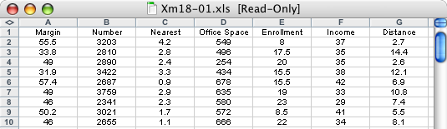
Transformation…
Can we transform this data:
into a mathematical model that looks like this:
margin
awareness
(distance to
nearest alt.)
physical
(distance to
downtown)
competition
(i.e. # of rooms)
…

Slide 17
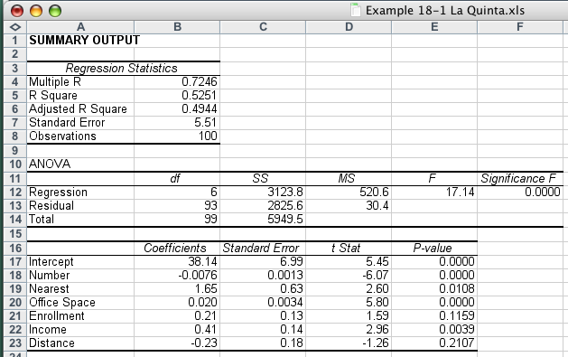
Example 17.1…
COMPUTE
In Excel: Data > Data Analysis > Regression

Slide 18
The Model…
INTERPRET
Although we haven’t done any assessment of the model yet, at first pass:
it suggests that increases in
The number of miles to closest competition, office space, student enrollment and household income will positively impact the operating margin.
Likewise, increases in the total number of lodging rooms within a short distance and the distance from downtown will negatively impact the operating margin…

Slide 19


Standard Error of Estimate…
In multiple regression, the standard error of estimate is defined as:
n is the sample size and k is the number of independent variables in the model. We compare this value to the mean value of y:
It seems the standard error of estimate is not particularly small. What can we conclude?
calculate

Slide 20
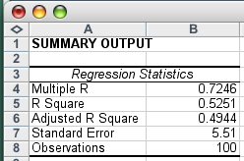

Coefficient of Determination…
Again, the coefficient of determination is defined as:
This means that 52.51% of the variation in operating margin is explained by the six independent variables,
but 47.49% remains unexplained.

Slide 21
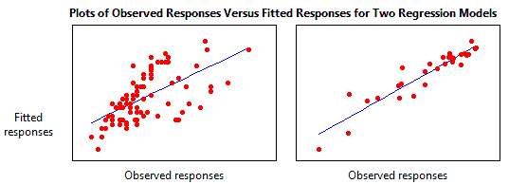
R² - Coefficient of Determination
R² = Explained variation / Total variation
http://www.investopedia.com/terms/r/r-squared.asp

Slide 22

Adjusted R² value…
What’s this?
The “adjusted” R² is:
the coefficient of
determination adjusted for degrees of freedom.
It takes into account the sample size n, and k, the number of independent variables, and is given by:

Slide 23
R² and β in Finance
R² values range from 0 to 100. An R-squared of 100 means that all movements of a security are completely explained by movements in the index. A high R² (between 85 and 100) indicates the fund's performance patterns have been in line with the index. A fund with a low R² (70 or less) doesn't act much like the index.
A higher R² value will indicate a more useful β figure. For example, if a fund has an R² value of close to 100 but has a β below 1, it is most likely offering higher risk-adjusted returns. A low R² means you should ignore the β.
http://www.investopedia.com/terms/r/r-squared.asp

Slide 24
Interpreting the Coefficients*
Intercept (b₀) 38.14 • This is the average operating margin when all of the independent variables are zero. Its meaningless to try and interpret this value, particularly if 0 is outside the range of the values of the independent variables (as is the case here).
# of motel and hotel rooms (b₁) –.0076 • Each additional room within three miles of the La Quinta inn, will decrease the operating margin. (I.e. for each additional 1000 rooms the margin decreases by 7.6%)
Distance to nearest competitor (b₂) 1.65 • For each additional mile that the nearest competitor is to a La Quinta inn, the average operating margin increases by 1.65%.
*in each case we assume all other variables are held constant…

Slide 25
Interpreting the Coefficients*
Office space (b₃) .020 • For each additional thousand square feet of office space, the margin will increase by .020. E.g. an extra 100,000 square feet of office space will increase margin (on average) by 2.0%.
Student enrollment (b₄) .21 • For each additional thousand students, the average operating margin increases by .21%
Median household income (b₅) .41 • For each additional thousand dollar increase in median household income, the average operating margin increases by .41%
Distance to downtown core (b₆) –.23 • For each additional mile to the downtown center, the operating margin decreases on average by .23%
*in each case we assume all other variables are held constant…

Slide 26
Using the Regression Equation
Predict the operating margin if a La Quinta Inn is built at a location where…
u There are 3815 rooms within 3 miles of the site.
v The closest other hotel or motel is .9 miles away.
w The amount of office space is 476,000 square feet.
x There is one college and one university nearby with a total enrollment of 24,500 students.
y Census data indicates the median household income in the area (rounded to the nearest thousand) is $35,000, and,
z The distance to the downtown center is11.2 miles.
our x_{i}’s…

