Slide 1

0:00
Wildfire decisions now happen in minutes
24M+ ha burned
8,110 CA fires in 2024
1

Slide 2
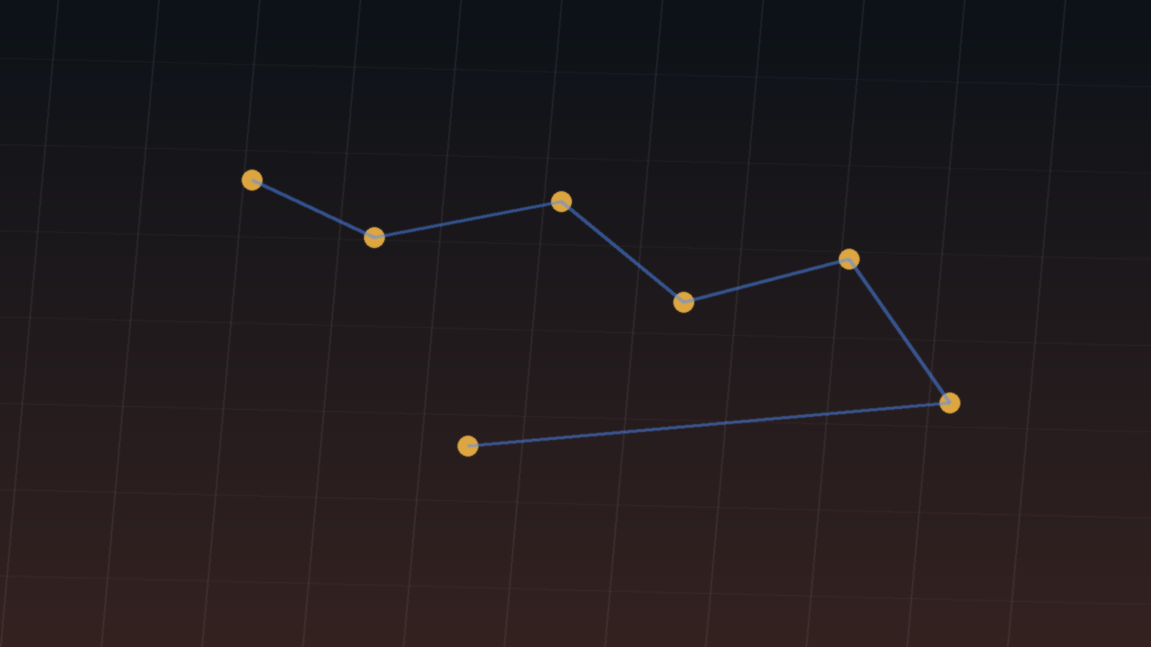
0:15
Climate pressure
Hotter
Drier
Windier
2

Slide 3
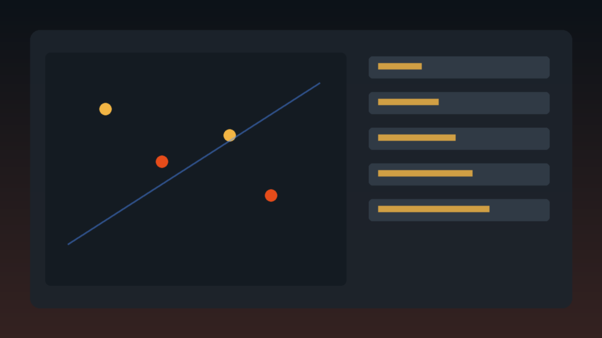
0:35
The operations gap
Many feeds
Spatial complexity
Approval pressure
3

Slide 4
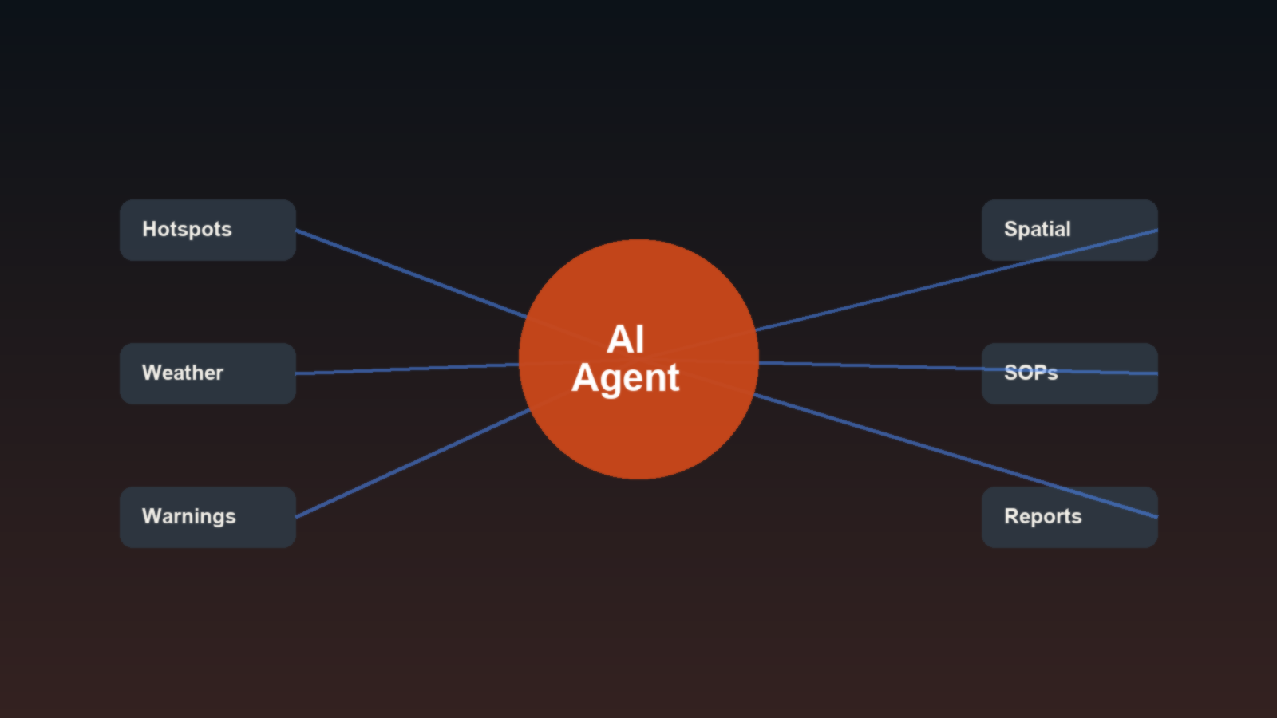
0:55
AI agent bridge
Sense
Reason
Act with approval
4

Slide 5
1:12
Wildfire Ops Copilot
Monitor AOI
Explain risk
Draft safe actions
5

Slide 6
1:28
Top features
Live AOI focus
Risk + report
What-if + advisory
6

Slide 7



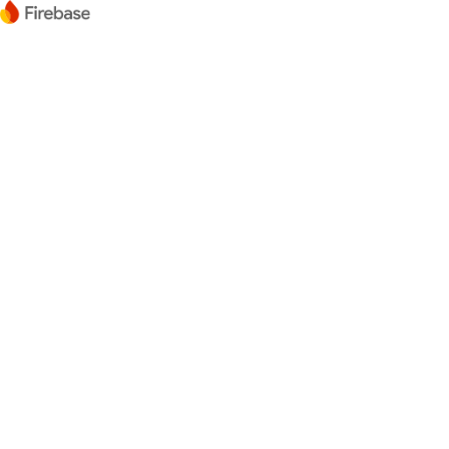
1:52
GCP + Elastic stack
Firebase
Hosting
Cloud Run
Backend
Vertex AI
Gemini
Firestore
State
Elastic
MCP
7

Slide 8
2:08
Why Elastic MCP
SOPs
Incident history
Warning guidance
Advisory templates
searchable
memory
8

Slide 9
2:24
Demo flow
Focus AOI
Analyze report
Run what-if
9

Slide 10
2:53
Explainable action, faster
Situational awareness
Risk reasoning
Human approval
10

