Slide 1
Parallel massive dataset cleaning
Jianmeng Yu
Supervised by:
Bob Fisher
Notes:
What is the project about?
Define the goal of this project
Is it similar to projects in the past or is it a new effort?
Define the scope of this project
Is it an independent project or is it related to other projects?
* Note that this slide is not necessary for weekly status meetings

Slide 2
Project Overview
What is the project about?
  Information abstraction for reducing the massive amount of video data.
  396901 video clips, with corresponding metadata.
Define the goal of this project.
  The goal of this project is to develop a framework to apply the previously developed dataset cleaning algorithms at a massive parallel scale.
Notes:
What is the project about?
Define the goal of this project
Is it similar to projects in the past or is it a new effort?
Define the scope of this project
Is it an independent project or is it related to other projects?
* Note that this slide is not necessary for weekly status meetings

Slide 3
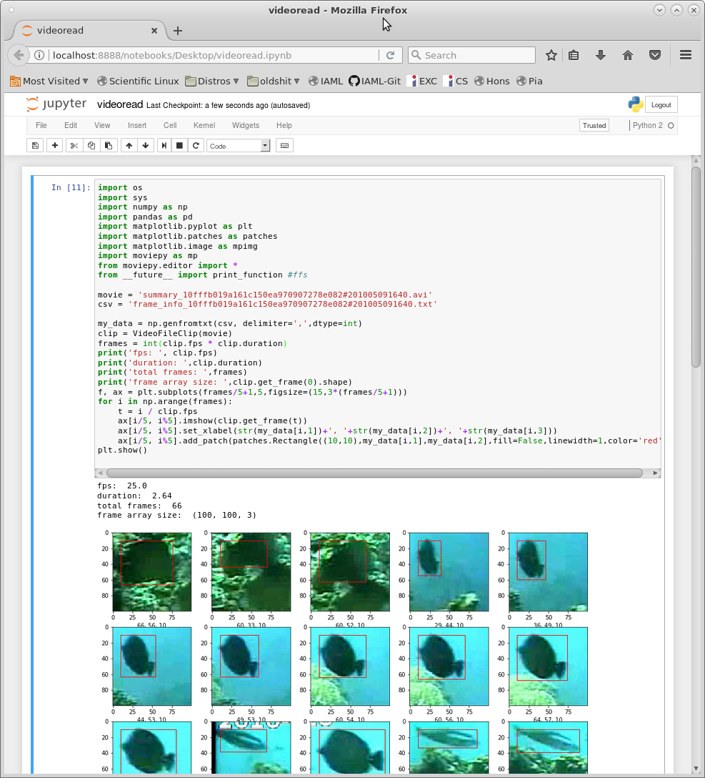
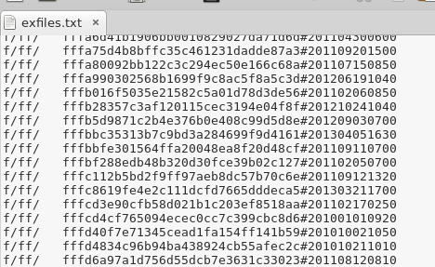
Current Status
What progress has been made now?
  A short python script to extract RGB array from video.
  Extracted path and
  filename from videos
  and metadata
Notes:
* If any of these issues caused a schedule delay or need to be discussed further, include details in next slide.

Slide 4
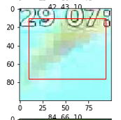
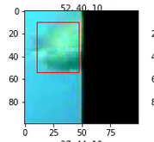
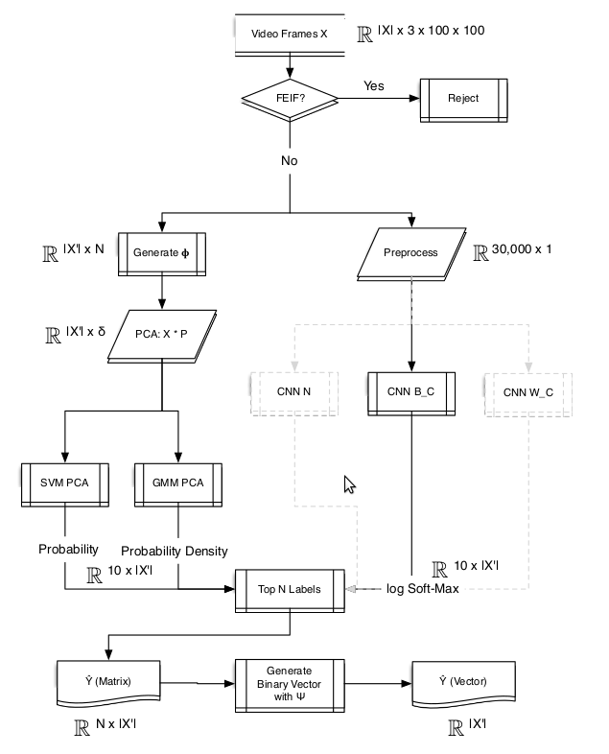
Future Tasks
Applying the Frame Edge Indicator Function (FEIF)
  To remove partial fish detection caused by the frame window/time stamp.
Translate the Pipeline Classifier by Matt Pugh
  From matlab into python scripts.
Develope a task farming program
  To distribute jobs to idle DICE machines
Actual cleaning of the data, rebuild the
SQL and AVI files for the project
Evaluation of the quality of cleaning
Notes:
* If any of these issues caused a schedule delay or need to be discussed further, include details in next slide.

Slide 5
Timetabling
Sem 1, week 4-11
  Translate/Implement code for classification.
December Exam Period / Christmas
  Develop the task farming program.
  Process the data using the idle DICE machines.
January and onwards.
  Post process cleaning, start working on reports.
Notes:
Duplicate this slide as necessary if there is more than one issue.
This and related slides can be moved to the appendix or hidden if necessary.

