Slide 1
Parallel massive dataset cleaning
Jianmeng Yu
Supervised by:
Bob Fisher
Notes:
What is the project about?
Define the goal of this project
Is it similar to projects in the past or is it a new effort?
Define the scope of this project
Is it an independent project or is it related to other projects?
* Note that this slide is not necessary for weekly status meetings

Slide 2
Project Recap
What is the project about?
  Translate the existing decision algorithms into Python.
  Develop a framework to apply the algorithm at a massive parallel scale.
  Apply the cleaning algorithm (task farming) and reconstruct the video files.
Why parallel?
  The original code take 2000 hours to finish.
  There are about 839,000,000 frames in 396,000 video clips.
  And 1,446,000,000 records in a 500 GB sql file.
Notes:
What is the project about?
Define the goal of this project
Is it similar to projects in the past or is it a new effort?
Define the scope of this project
Is it an independent project or is it related to other projects?
* Note that this slide is not necessary for weekly status meetings

Slide 3
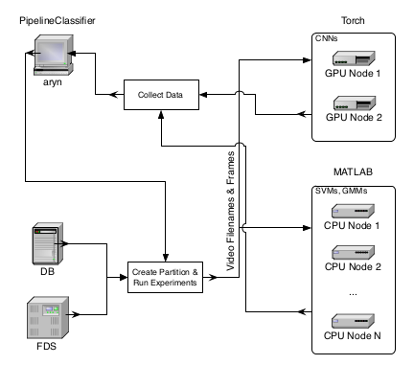
Current Progress – Code Translation
Original Framework by Matthew
  Python Script with SQL to extract frame infos and store them on AFS.
  Partitioned data feed into trained classifiers using MATLAB interface.
  The output vectors are collected and processd into final classification result.
Notes:
* If any of these issues caused a schedule delay or need to be discussed further, include details in next slide.

Slide 4

Current Progress – Code Translation
Difficulties
  The framework isn't fully implemented.
  The 500GB SQL is too large for the university servers.
  DICE machines have Intel HD 530 GPU, does not support CUDA.
  No documentation, the code checks if it's running on 'Aryn' instead of pulling libraries used.
Notes:
* If any of these issues caused a schedule delay or need to be discussed further, include details in next slide.

Slide 5
Current Progress – Code Translation
Solution for not having a SQL server
  The 500 GB SQL file is the 'dump' file of the original database.
    Including irrelevent tables like login logs.
  Instead of loading the entire SQL file into server and run 400,000 queries, A python script pipeline is used to extract and partition the required data from SQL.
  The extraction pipeline take about 300 hour to finish. After optimization it only took about 12 hours.
    Most of the time is wasted on repeatedly open/close files.
  Loading a video and corresponding extracted SQL file in Jupyter Notebook took about 0.5 seconds on average now.
Notes:
* If any of these issues caused a schedule delay or need to be discussed further, include details in next slide.

Slide 6

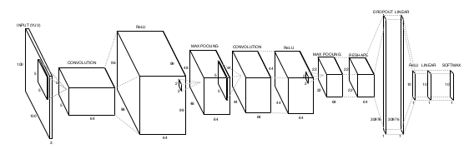
Current Progress – Code Translation
Solution for not having a NVIDIA GPU on DICE machine.
  The original CNN classification uses Torch, a lua library.
    It uses NVIDIA CUDA backend which DICE doen't support.
  The CNN classifier will be translated into python using the TensorFlow library.
  Unfortunately I have no experience on Neural Networks, I am currently working on TensorFlow tutorials online.
  The CNN is already trained, only need to load weight.
Notes:
* If any of these issues caused a schedule delay or need to be discussed further, include details in next slide.

Slide 7
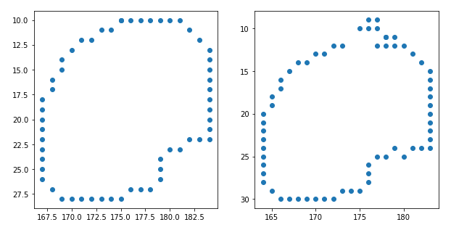
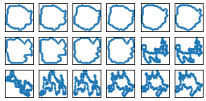
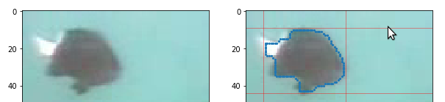
Current Progress – Preprocessing
  The classification need a 'bb_cc' field from the sql, which means “bounding box chain code”, and it's stored in raw binary form.
  First attempt on extracting information from bb_cc yields a 'corrupted' bounding box.
    Image on left is original contour
    Image on right is corrupted
  By looking into the binary values of the data, the error is actually caused by the encoding of the binary files in sql.
    Null bytes: “0000 0000” becomes \0: “0101 1100 0011 0000”
Notes:
* If any of these issues caused a schedule delay or need to be discussed further, include details in next slide.

Slide 8
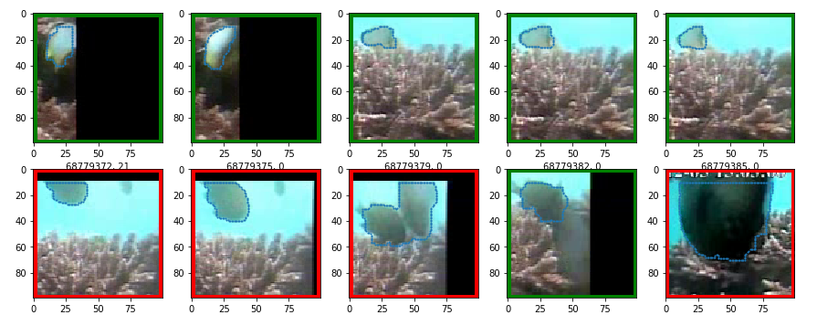
Current Progress – First Stage Cleaning
  The first stage of the cleaning uses a Frame Edge Indicator Function (FEIF)
    It checks number of points on the contour touches the edge.
    It removes detections with high edge point count.
  This effectively removes the 'partial fish' false positives.
Notes:
* If any of these issues caused a schedule delay or need to be discussed further, include details in next slide.

Slide 9
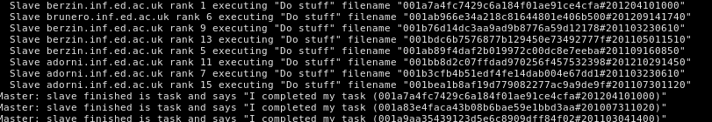
Current Progress – Task Distribution
“MPI for Python” package
  Allows message passing between python process.
  Assigning the process with the highest ID as 'master' process, and all other process as 'slave', The master assigns task to idle slave whenever they are available.
  For testing, a dummy mpi4py program is used to extract the 'ID' field from summary files, using 4 different DICE machine.
    By printing the Processor ID, it shows that the task is actually distributed to different machines.
Notes:
* If any of these issues caused a schedule delay or need to be discussed further, include details in next slide.

Slide 10

Current Progress – Task Distribution
How do I know which machines are available?
  I recorded the location and name of every DICE machine in labs of Appleton Tower, floor 4-6. (about 200 machines)
  A “marauder's map” bash script to ping every machine on the list. If a connection is made, then ssh into it to see who's using the machine, if I am the only user, then mark it as available.
  Ideally, most of the DICE machines will be available during Christmas.
Notes:
* If any of these issues caused a schedule delay or need to be discussed further, include details in next slide.

Slide 11
Future Tasks
Translate the feature extraction algorithms and the 3 remaining Classifier: SVM, GMM, and CNN.
Put the classification code into the dummy task distributor program.
Actual cleaning of the data, rebuild the AVI files for the project.
Create more test dataset to evaluate of the quality of cleaning.
Possibly implement the unfinished divide-and-conquer classifier in original pipeline.
Notes:
* If any of these issues caused a schedule delay or need to be discussed further, include details in next slide.

Slide 12
Timetabling
December Exam Period / Christmas
  Finish the translation of the code.
  Process the data using the idle DICE machines.
January and onwards.
  Evaluate the cleaning, and start working on reports.
Notes:
Duplicate this slide as necessary if there is more than one issue.
This and related slides can be moved to the appendix or hidden if necessary.

