Slide 1
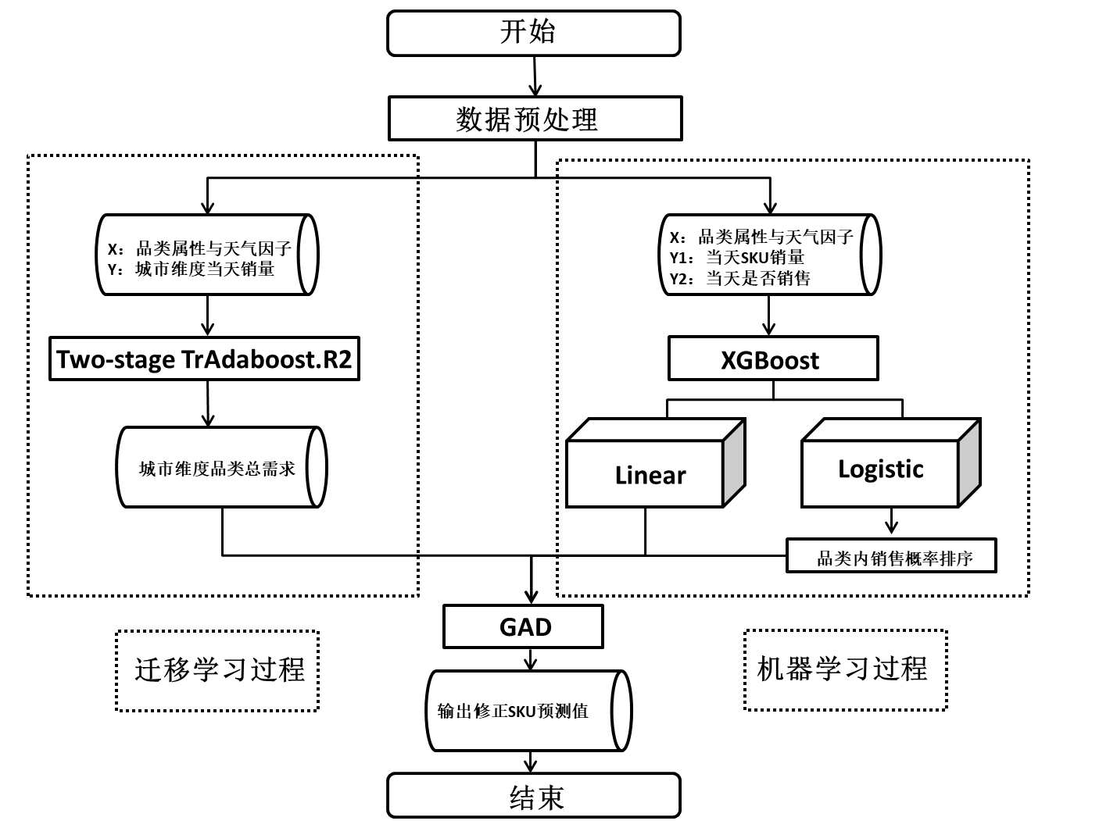
WEATHER-SENSITIVE DEMAND FORECASTING MODEL FOR FAST MOVING CONSUMER GOODS BASED ON TL-XGBoost ALGORITHMS
The connotation of weather sensitive demand: the demand for products or services, affected by the abnormal fluctuation of weather factors, changes abnormally on the basis of the original seasonal fluctuation.
The problems to be solved:
1.The description and selection of weather variables 2. The influence of weather on product substitutability;
3. The establishment of weather sensitive demand model4. The limitations of machine learning model in industry application
Chap1& Chap2： research background of FMCG's rapid development since 2010; introduction of weather sensitive demand theory and boosting algorithm
Chap3：TL-XGBoost Weather-sensitive demand forecasting model
Description and selection of weather variables
11 weather variables (day weather, night weather, maximum temperature, minimum temperature, morning wind direction, night wind direction, morning wind force, night wind force etc.)
TL-XGBoost framework
4 category
2684 product
685460 rows sales data
Two-stage TrAdaboost.R2 model
Original dataset：305 sales data(shanghai)
Support dataset：sales data(other cities)
Input：Weather V & product attribute
Output：sales in each category(city dim)
Transfer Learning
XGBoost model
dataset：sales of each item in each store
Input： Weather V & product attribute
Output 1：SKU sales (store dim)
Output 2：SKU sales prob (store dim)
Machine Learning
GAD greedy aggregation and decomposition
Step 1:order SKU in category based on prob；
Step 2:add up SKU sales，stop when add-up
sales > sales in each category；
Step 3:set other sales to 0；
Step 4:Output adjusted SKU sales in 4 categories
GAD
Chap4： Empirical analysis
Missing Value
Garble in original dataset
Lack two day of min temp
Feature Engineering
Method 1：business insight & literature review
11 Weather features
Method 2：split and combine current feature
6 sales features（Last week sales、Last month average etc.）
3 holiday features（holiday、T/F、days of holidays）
3 stores features（index、type、area）
Data Transform
Day sales to month/year average
Weather data processing
Z-score
Log sales
qualitative to quantitative feature
Model validation categ：MAPE stores：MAE
Chap5： Conslusion
（1）Company should fully consider the impact of weather；
（2）Accelerate digitalization and prepare for large-size modeling；
（3）Pay attention to before/in/after sales season demand management

Slide 2
WEATHER-SENSITIVE DEMAND FORECASTING MODEL FOR FAST MOVING CONSUMER GOODS BASED ON TL-XGBoost ALGORITHMS
Two-stage TrAdaboost.R2
Average MAPE 11.96%
TL-XGBoost MAE 0.841
Lowest
Compare to SVM 0.219 less
Compare to XGBoost 0.018 less
Consider take weather factor into consideration, MAE increase 0.024 and 0.006

