Slide 1

Capri:
Compiler and Architecture Support for Whole-System Persistence
Jungi Jeong*, Jianping Zeng, and Changhee Jung
* Now at Google
Notes:
Good afternoon, everyone,
This is Jianping Zeng from Purdue. Today, I am going to present our paper Capri, a compiler and architecture support for whole-system persistence.

Slide 2
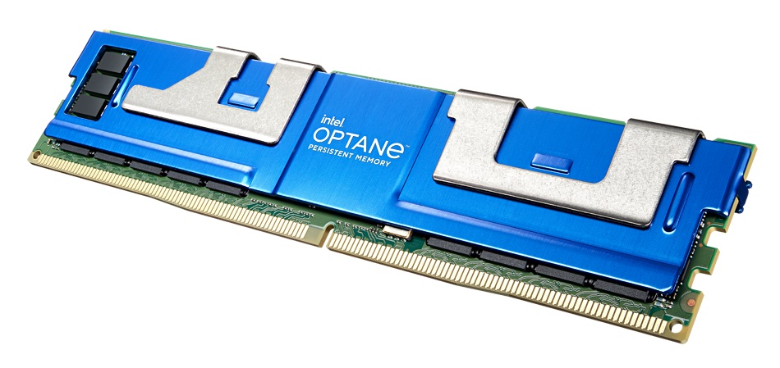
Prevalence of Nonvolatile Memory
High areal density
Comparable speed as DRAM
Byte-addressability
Notes:
Nonvolatile memory (NVM) [click] is now commercialized as Intel Optane memory and widely deployed in data centers to achieve high performance thanks to its unique benefits such as [click] high areal density [click] comparable speed as DRAM, and [click] byte-addressability.
To better utilize the benefits of NVM [click]

Slide 3
Intel PMEM Operation Modes
Memory Mode
App-Direct Mode
Can we have both large memory space and non-volatility?
Reg. File
Reg. File
Caches
Caches
DRAM as Cache
NVM as Main Memory
DRAM as Main Memory
NVM as Persistent Heap
Transparence and
High Performance
Persistence but No Transparence and High Performance
Notes:
Optane memory (PMEM) provides two use models; [click] memory mode and [click] app-direct mode where NVM is accessed by ordinary store/load instructions.
When being used under the memory mode, PMEM is used as the main memory while DRAM works as a last-level cache, which is transparent to user program. Thanks to the high areal density, program see a huge physical memory space and achieves high performance. However, data in NVM are considered dead when power failure happens.
On the other hand, in the app-direct mode, data in NVM are durable and persistent and accessed directly by user-level application instead of OS. Therefore, it is not transparent due to needing to modify program source code to replace I/O operations by load/store instructions, which limits the usability of NVM and thus makes only in-memory databases or key-value stores benefit from NVM technology.
As a result, both modes do not utilize the full potential of NVM.
Then, there is a natural question coming up, [click] can we have both large memory space and non-volatility at same time? The answer is yes, let’s see how our work achieves both under whole-system persistence (WSP).

Slide 4
WSP: Unlocking Full NVM Potential
Reg. File
Persistence
Caches
Transparency
High Performance
DRAM Cache
NVM as Main Memory
Notes:
With PMEM memory mode, we already achieve both [click] high performance and [click] transparence. Our goal is to equip an entire system with persistence. To achieve that, [click] we extend the persistence domain up to covering caches and register file. This is whole system persistence.
we believe that whole-system persistence is promising, but unprecedented. The problems might be not clear at this point.
I will show you a simple design that is working but inefficient to give you a feeling of how a whole-system persistence looks like and how we solve these problems.

Slide 5


Naïve yet Costly Whole-System Persistence (WSP)
Reg. File
It is expensive to flush register and memory statuss to NVM periodically
Periodic Checkpoint
Caches
DRAM Cache
NVM as Main Memory
WSP under
Memory Mode
Notes:
In this simple design, [click] we assume the system has both DRAM and NVM where DRAM is used as a last-level cache, while NVM works as a main memory as in PMEM's memory mode.
The high-level idea is [click] periodic checkpoint. That is, [click] at a certain point, we checkpoint [click] the whole system states including register file and DRAM status to NVM through flushing instructions. Using this checkpoint strategy, an interrupted program can resume its execution from last checkpoint. This is the biggest difference from prior partial system persistence, where program has to restart its execution from the beginning to survive power failure.
To ensure correct failure recovery, it is required to persist stores to NVM in program order. However, [click] this is really challenging because stores go through multiple layers of memory hierarchy and usually are reordered due to buffering effect of caches. This is the main reason why supporting persistence is hard and comes with significant performance overhead.
Let’s see how to speed up in-order store persistence [click]

Slide 6
Non-Temporal Path for Accelerating
Store Persistence [DPO;MICRO’16]
* Write Combining Buffer (WCB) is disabled
for persist path
Reg. File
Caches
Persist
Path
DRAM Cache
NVM as Main Memory
Notes:
We leverage [click] existing non-temporal data path between L1D cache and NVM as a separate persist path which has been used in prior partial system persistence. Unlike costly flushing instructions, we take advantage of this separate data path to accelerate store persistence. That is, [click] for each committed store, except for writing its data to caches, [click] it will be also conveyed to NVM directly along the persist path. By doing so, we can bypass the entire memory hierarchy and guarantee in-order NVM store on the cheap.
Note that the persist path alone does not provide whole system persistence. With that in mind, let’s see how we achieve whole system persistence [click]

Slide 7

Capri: Failure-Atomic Region-Level WSP
Memory Controller
Store r1, [A]
Store r2, [B]
…
Store r3, [C]
…
Nonvolatile
Proxy Buffer
Store r1, [A]
Store r2, [B]
…
C
B
A
C
B
A
Region #1
L1D Cache
Persist
Path
…
Store r3, [C]
Region #2
NVM
Notes:
The key idea is that, with a dedicated nonvolatile proxy buffer in memory controller, Capri hardware ensures failure-atomic persistence for compiler-formed regions. This is an example, Capri compiler [click] partitions the input program into [click] region 1 and region 2. [click] During region execution, [click] store A and store B of region 1 are buffered in the proxy buffer first to ensure failure-atomic region-level NVM update. [click] At region boundary, processor waits here for all prior store A and B to be moved to NVM before proceeding to region 2. Similarly for regio 2, [click] once store C is committed, [click] it will be first buffered in proxy buffer and [click] eventually flushed to NVM.
Let's first see how Capri compiler works [click]

Slide 8
Proxy Buffer Directed Region
Formation
Store r1, [A]
Store r2, [B]
…
Store r3, [C]
…
Store r1, [A]
Store r2, [B]
…
Region #1
Capri Compiler
…
Store r3, [C]
Region #2
Notes:
Capri compiler is responsible for region formation. That is, [click] Capri compiler takes a source program as an input and [click] inserts region boundary instructions as determined by the partitioning criterion. Here, the criterion is the number of stores in a region. As a result, we guarantee no buffer overflow during region execution. By using this partitioning strategy, we can simplify hardware design to support failure-atomic region-level persistence.
Here, we only show how program is partitioned. Let's see how we unify register persistence with store persistence by register checkpointing [click]

Slide 9
Register Persistence by Checkpointing
Store r1, [A]
Store r2, [B]
r3 = …
Live Out
Region #1
Checkpoint is essentially a store
Persist registers as store persistence
CKPT r3
…
Store r3, [C]
Region #2
Notes:
Once region boundaries are determined, Capri compiler leverages [click] the static live-out analysis to calculate a minimal set of live-out registers of each region, and then [click] inserts checkpoints to save the values of live-out registers to NVM. By doing so, [click] Capri turns register persistence into store persistence as a checkpoint is essentially a store.
Again, we guarantee the number of stores in a region is always not bigger than the partitioning threshold even after register checkpointing.
Now Capri is working to achieve whole-system persistence [click]

Slide 10


Boost Region-Level Persistence with ILP
Wait for Proxy Buffer
Drain at Region Ends
Overlap Proxy Buffer
Drain with ILP Execution
Notes:
but it comes with high performance overhead. That is, [click] processor needs to wait at region boundaries for all prior stores being written back to NVM, which leads to frequent pipeline stalls especially in the presence of long NVM write latency and low write bandwidth. To [click] speed up proxy buffer drain, [click] we propose a protocol which enables ILP execution.
Let’s see how this protocol is realized [click]

Slide 11
Two-Phase Store for Higher ILP
Two-Phase Store: Nonvolatile proxy buffer in memory controller as a staging area for stores
Store r1, [A]
Store r2, [B]
…
St A
Bdry
St C
L1D
Cache
St B
bdry
Region #1
Phase #1
Proxy
Buffer
…
Store r3, [C]
Phase #2
Region #2
NVM
St A
St B
Notes:
[click] With partitioned program in mind, Capri hardware enables a high-performance region-level persistence with ILP execution. The key idea [click] is two-phase store protocol, which means all stores must be buffered in the proxy buffer before moving to their original NVM locations. So, the first phase store is from L1D cache to the NVM proxy buffer, while second second phase is from the proxy buffer to their original NVM locations.
Let’s see an example here to understand how two-phase store works. In this example, we assume two regions with stores therein.
[click] When store A and store B get drained along the persist path, they are buffered in the proxy buffer first. Here, [click] processor considers a region boundary instruction as a special persist barrier , which means it waits for all stores within a region being written back to the proxy buffer before proceeding to the next region.
So, once all stores have been buffered in the proxy buffer and the region boundary has been passed, [click] they will be moved to their original NVM locations.
To reduce persistence overhead, [click] the second phase of the region 1 overlaps with the first phase of the following region 2, achieving ILP execution.
As we can see, the first phase is on the critical path, which means the processor needs to wait for the first phase to be completed, while the second phase happens in background and overlaps with the execution of a following region.
Although two-phase store protocol enables high ILP execution, it relies on a backup to support correct failure-atomic region persistence, let’s see what is reason behind that [click]

Slide 12


Partial Region Persistence Due to Unordered Regular and Persist Path
Caches
Store r1, [A]
Store r2, [B]
…
C
C
Nonvolatile
Proxy Buffer
Region #1
DRAM Cache
Persist
Path
Store r3, [C]
…
Region #2
NVM as Main Memory
Notes:
The main point is that there is no ordering constraint between regular path and persist path. With ILP execution, it might lead to a partial region persistence.
This is because, to simplify hardware design without searching proxy buffer for subsequent loads, for each committed store [click] such as store C here, Capri places its data to both regular data path and persist path. As a result, [click] if the persist path is clogged at this moment, [click] the store C reaches NVM through caches before proxy buffer drains store C to NVM along the persist path. [click] If region 2 gets interrupted by power failure, it generates a partial NVM update, leading to a violation of failure-atomic region persistence and failed recovery.
Let’s see how we deal with this issue [click]

Slide 13
Undo Logging for Cancelling Partial Region Persistence
Caches
Store r1, [A]
Store r2, [B]
…
C’
Nonvolatile Proxy Buffer
Region #1
DRAM Cache
Persist
Path
Store r3, [C]
…
Region #2
NVM as Main Memory
A
B
C
Notes:
The key idea is to leave an undo logging entry for each store in the proxy buffer, for example [click] we leave an undo logging entry C prime in proxy buffer. At this moment, [click] we assume region 1 has been persisted and store C has been evicted to NVM through regular data path. when power failure happens in region 2, [click] we use the undo logging entry C prime in the proxy buffer to cancel the update of store C in NVM, guaranteeing failure-atomic region persistence.
We already see Capri is working. But its performance is still not optimal. Let's see the reason behind that and how we address it [click]

Slide 14
Low ILP Due to Short Regions
Few stores in regions, i.e., less than 5 stores
Short Loops of static-unknow iteration count
Traditional loop unrolling fails to extend Loops of static-unknown iteration counts
Loop Header
Loop Body
Exit
Notes:
Unfortunately, [click] our region formation generates many short regions no matter how large the partitioning threshold is such as 1000.
As a result, processor sees a region boundary for every 10 or 20 instructions according to our experiments, leading to frequent pipeline stalls and high-performance overhead. Therefore, we prefer longer region size.
We found out that [click] the main cause of short regions are loops. Loops are commonly used in most program, and their iteration counts are usually static-unknown. For example, [click] we have a short loop, to prevent proxy buffer overflow during region execution, [click] Capri compiler conservatively places a region boundary in the loop header. If the loop body contains more stores than the threshold, it also places a region boundary in the middle of the loop body.
Anyway, the region size is limited to one iteration of loops. This is the main reason why we see abundant short regions in the program.
One might think we can leverage loop unrolling to enlarge loop size, [click] however, traditional loop unrolling can not guarantee correctness for a loop with static-unknown iteration count.
Since it is critical for Capri to achieve high performance, we must do something to extend region size as much as possible, [click]

Slide 15
Enlarging Region Size for Higher ILP
Speculatively unroll loop body and exit condition even if loop iteration count is static-unknown
Loop Header
Loop Header
Loop Body
Exit Cond
Loop Body
Exit
Exit
Loop Body
Before Spec Unrolling
After Spec Unrolling
Notes:
We propose speculative loop unrolling [click] which duplicates the loop body and exit condition with proxy buffer size in mind even if the loop iteration count is static-unknown, while traditional loop unrolling only duplicates the loop body. In this way, the exit condition is checked for each loop body, guaranteeing correctness of program. [click] for a short loop, speculative loop unrolling can [click] enlarge the loop size dramatically. In this example, if the loop body has only 1 store before unrolling and proxy buffer size is 2, [click] with placed region boundary in loop header, our speculative loop unrolling can enlarge the region size by 2 times.
Then, let’s talk about how to recover the interrupted program. [click]

Slide 16
Redo+Undo Logging for Failure Recovery
Nonvolatile
Proxy Buffer
…
Store r1, [A]
Store r2, [B]
…
C’
B
A
Region #1
Recovery
Block
Persist
Path
ldr r3
ldr r4
Store r3, [C]
Store r4, [D]
…
Region #2
NVM Main Memory
Notes:
We leverage undo and redo logging to recover the interrupted program. Let’s look at this example. At this moment, we assume [click] all stores of region 1 have been already buffered in the proxy buffer, [click] while region 2 has only store C being buffered. [click] When power failure interrupts region 2, to recover the system, we [click] first flush store A and store B to NVM as a redo because region 1 has been finished. Then we [click] cancel the store C of region 2 with undo logging because region 2 is not completed yet. Thereafter, [click] Capri runtime redirects program control to the beginning of a compiler-generated per-region recovery block which reloads checkpointed values of live-in register r3 and r4 of region 2, and then [click] going back to the beginning of region2 for recovery.

Slide 17
Methodology
LLVM-13 based compiler optimizations
Recompile entire software stack (Linux Kernel 4.14.239 and user apps such as CPU2017, STAMP, and SPLASH-3)
Hardware implementation on gem5 simulating an 8-core ARMv8 out-of-order processor
Notes:
[click] We implement our compiler techniques on top of LLVM 13 and use gem5 as our architecture simulator to simulate an 8-core out-of-order processor.
As a whole-system persistence design, we compile the entire software stack from Linux Kernel to the benchmarks using our compiler.

Slide 18
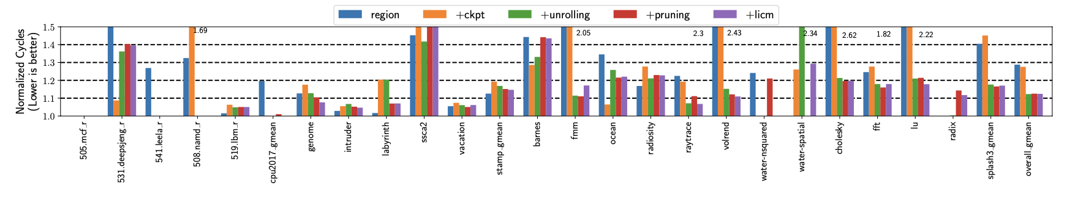
Impact of Compiler Techniques
Region formation + checkpoint ⇒ 28% overheads
Speculative loop unrolling ⇒ 12% overheads
Notes:
Let us first see how Capri compiler makes whole-system persistence efficient.
Initially, region formation and register checkpoint incur about 28% overhead. This is mainly because of short regions, leading to frequent pipeline stalls at end of regions.
With out speculative loop unrolling, we can reduce the overhead to only 12% with extended region size.

Slide 19
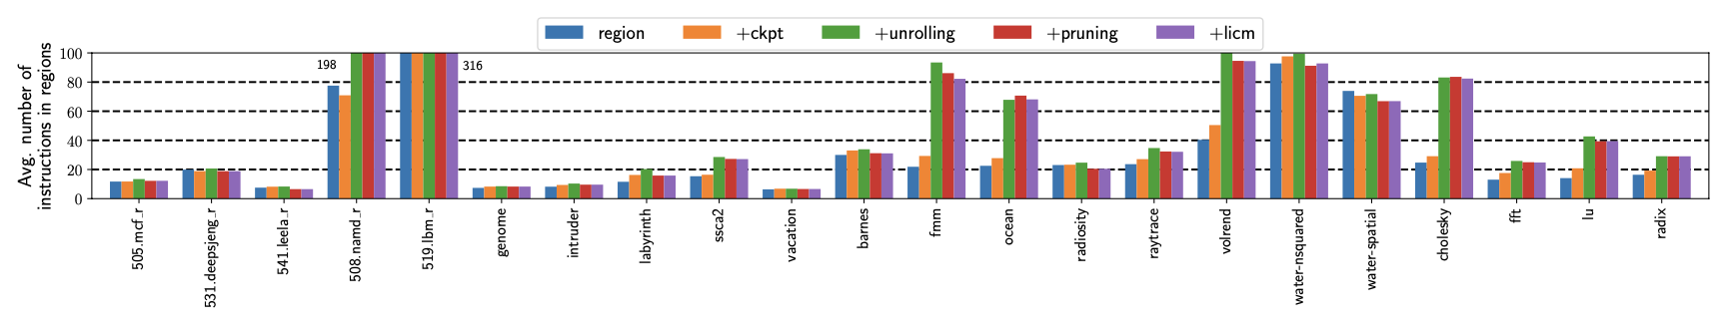
Region Characteristics
Initial region formation leads to short regions (~20 instructions)
Speculative loop unrolling extends regions by 1.6x
Notes:
Next, this graph shows region size depending on compiler optimizations.
The initial region formation provides relatively short regions; about 20 instructions, which means processor encounters a region boundary for every 20 instructions, leading to frequent pipeline stalls.
With our speculative loop unrolling, we can enlarge region size by 1.6x.

Slide 20
Conclusion
First lightweight yet efficient whole-system persistence, unlocking full potential of NVM
Synergistic codesign simplifies hardware complexity and reduces energy requirement
Notes:
So, conclusion.
Capri is the fist lightweight yet efficient whole-system persistence, which unlocks the full potential of NVM. With its synergistic hardware and software codesign, we can dramatically simplify hardware design and reduce energy requirement compared to prior work.

Slide 21
Thank you!
Notes:
Thank you for listening. I am happy to take any question if you have.

