Slide 1
Persistent Processor Architecture
Jianping Zeng, Jungi Jeong*, Changhee Jung
CompArch Lab, Purdue University
* Now at Google
Notes:
Hi, this is Jianping Zeng from Purdue. I am going to present our paper PPA: Persistent Processor Architecture for whole system persistence.

Slide 2
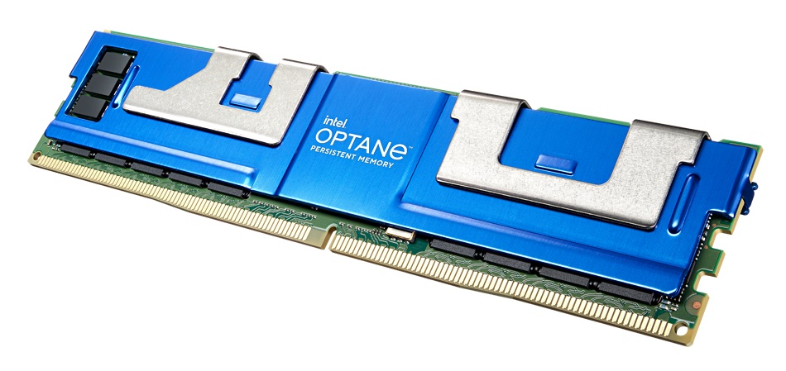
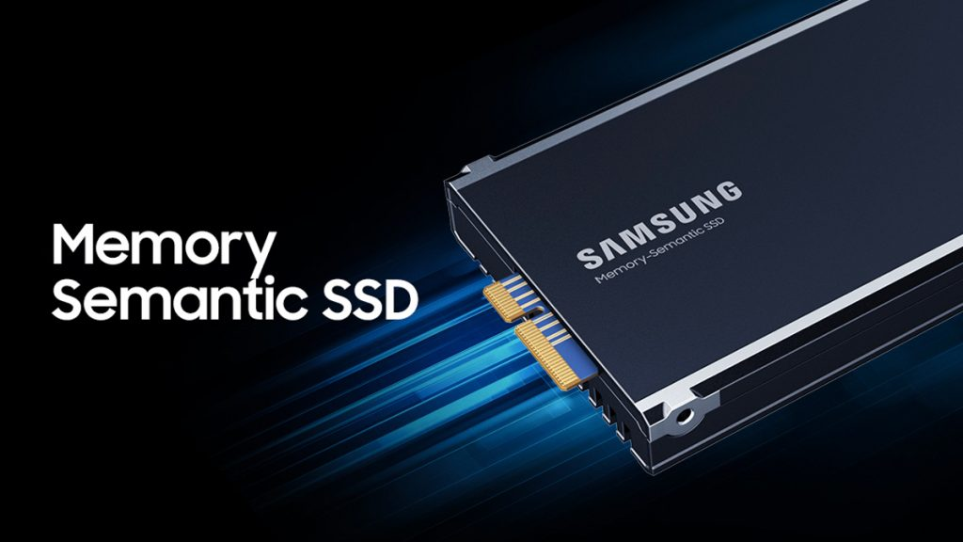
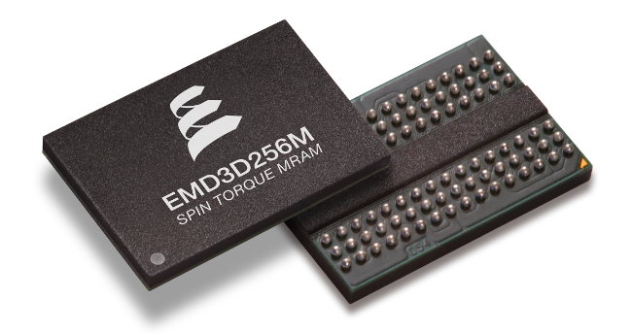
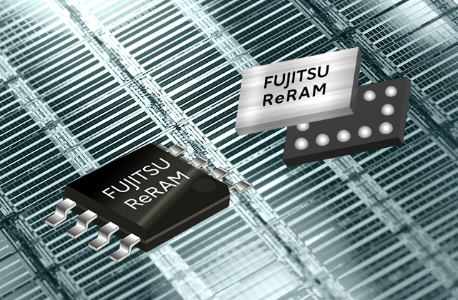
Prevalence of Nonvolatile Memory (NVM)
High areal density
Comparable speed as DRAM
Byte-addressability with load/store
Nonvolatility (data persistence)
Notes:
As you know, nonvolatile memory (NVM) has been commercialized by many vendors, such as [click] Intel PMEM, [click] Samsung memory semantic SSD, [click] Everspin STT-MRAM, and [click] Fujitsu ReRAM. They can be deployed in data centers to achieve high performance thanks to the unique benefits such as [click] high areal density [click] comparable speed as DRAM, byte-addressability with store/load instructions, and nonvolatility [click]
To better utilize the benefits of NVM [click]

Slide 3








Intel PMEM’s Two Operation Modes
Persistent
Programming
is hard
Memory Mode
App-Direct Mode
PMEM is not
persistent?
ARF
ARF
Caches
Caches
DRAM Cache
NVM
Main Memory
DRAM Main Memory
NVM
Persistent Heap
Transparence and
High Performance
Persistence but No Transparence and High Performance
* ARF: architectural register file
Notes:
Intel PMEM provides two use modes; [click] memory mode and [click] app-direct mode.
When PMEM is used under memory mode, DRAM works as a last-level cache, while PMEM is used as a main memory, which is [click] transparent to user program. Thanks to the high areal density, [click] program sees a huge memory space and achieves high performance. However, [click] data in NVM are dead when power failure happens. Ironically, [click] Persistent memory is not persistent at all!
On the other hand, in the app-direct mode, [click] data in NVM are durable and persistent. But [click] this mode is not transparent, meaning that we need to modify program source code, [click] leading to programming burden.
As a result, both two modes do not fully utilize the potential of NVM technologies.
Then, there is a natural question coming up, can we have both large memory space and non-volatility with transparency guaranteed? Yes, WSP can do that; let’s see how that is possible.

Slide 4

WSP: Unlocking the Full Potential of NVM
ARF
Caches
DRAM Cache
NVM Main Memory
Memory Mode
* WSP: Whole-System Persistence
* ARF: architectural register file
Notes:
With PMEM memory mode, we already achieve [click] high performance with dram as a cache and [click] transparency. Our goal is to equip the entire system with persistence. To achieve that, [click] we extend the persistence domain all the way up to register file including caches along the way. [click] This is so-called whole system persistence. In particular, whole system persistence requires correct recovery across power failure, which is so-called crash consistency.

Slide 5

Logging-Based Crash Consistency Is Super Expensive
High overhead (2x-4x) with prior logging techniques [Atlas;OOPSLA’14] [Nvthreads; EuroSys’17] [JustDO; ASPLOS’16] [iDO; MICRO’18]
ARF
L1
L2
Need to pay for such high persist barrier overhead no matter which logging is used
L3
DRAM Cache
NVM Main Memory
* ARF: architectural register file
Notes:
To achieve crash consistency, [click] prior approaches usually leverage logging involving expensive persist barriers [click] to flush the data being stored all the way down to NVM and [click] wait for their acknowledgements on the way back. [click] Therefore, no matter which logging technique is used, users have to pay for such high persist barrier overhead periodically. Fortunately, we found out our prior work ReplayCache has a potential to achieve high performance crash consistency.

Slide 6



ReplayCache ^{[MICRO’21]} with Roll Forward Recovery
Program resumption from power failure point
Just-in time (JIT) checkpoint ARF to NVM upon power failure
ARF
Only do just-in-time checkpointing upon power failure
L1
L2
L3
DRAM Cache
NVM Main Memory
* ARF: architectural register file
Notes:
[click] ReplayCache relies on a so-called roll forward recovery that can resume program execution exactly from power failure point. To achieve that, [click] upon impending power failure, [click] this technique just in time checkpoints entire architectural registers to NVM. [click] Once power comes back, [click] it restores architectural registers and [click] resumes program execution from the failure point. [click] The beauty of this approach is that it only does just in time checkpointing at the moment of power failure, meaning that, when program is running, there is no overhead at all compared to prior logging approaches.
However, in the presence of volatile caches, just in time checkpointing architectural registers along is not enough to ensure crash consistency. Let’s visit an example to see what is the fundamental reason for that. [click]

Slide 7

Reason for Crash Inconsistency of Volatile Cache
I am the evil
* ARF: architectural register file
ARF
…
Store r2, [r3]
…
r4 = Load [r3]
…
New
data
L1
r2
r3
New
data
L2
L3
r3
DRAM Cache
Power
interrupted
It is not my r4
NVM Main
Memory
Old
data
Notes:
In this example, we assume the store and load access the same memory location. [click] When power is on, [click] processor executes the store instruction and writes its data to the L1D cache (we assume a cache hit here). [click] Then processor continues executing following load. [click] When a power failure happens at that load, [click] we detect that and just in time checkpoint entire architectural register file to NVM. [click] then all data in RF and Caches are lost when power is off. [click] Once power comes back, [click] RF content we once just in time checkpointed is now restored from NVM, [click] here, register r2 and r3 are restored, [click] Then we restart the program from the failure point. But [click] processor reads an old data instead of the new data just written by the store, [click] causing crash inconsistency issue. [click] We can see the crash inconsistency issue is caused by the store left behind the power failure. [click]

Slide 8

ReplayCache [MICRO’21]: Unpersisted Stores
* Recovery status after power failure happens
ARF
…
Store r2, [r3]
…
r4 = Load [r3]
…
r2
r3
L1
New
data
L2
L3
r3
Power
interrupted
DRAM Cache
I got my r4
New
data
Old
data
NVM Main Memory
Notes:
To deal with unpersisted stores, ReplayCache proposes to replay those stores before resuming from the failure point. Here, the figure shows the recovery status after power failure happens. [click] When power comes back, [click] RF data is restored from NVM, like register r2 and r3, as with original recovery protocol. [click] Then processor replays that problematic store again with recovered register r2 and r3 [click], ensuring the store is persisted. [click] processor then resumes at the power failure point to execute that load instruction [click] by loading the new data. [click] As a result, we correctly recover the program states.

Slide 9

ReplayCache [MICRO’21] Incurs High
Run-time Overhead Due to Its Software-Oriented Design.
Persistent Processor
Architecture (PPA) Can
Help!!
Notes:
However, ReplayCache incurs too much performance overhead on server processors due to its software-oriented design. With that in mind, [click] we come up with high performance processor based whole system persistence, which we call PPA: persistent processor architecture. Before talking about how PPA works, let’s show you a few challenges PPA must deal with.

Slide 10

Register Reuse Prevents Store Replaying
Compiler reuses store registers whenever it can.
Store integrity : register operands of stores must be not overwritten by following definitions.
…
Store r0, [10]
…
= r1 + 1
…
Write-after-read
(WAR) dep
r0
Power
interrupted
Notes:
It is not always possible to replay stores. [click] This is because compiler never expects replaying stores, their registers are likely to be reused by following definitions. As you can see here, [click] we have a write-after-read (WAR) dependence on store register r0. Because of the WAR dependence, [click] in the wake of power failure, [click] replaying the store will write an increased value into memory location, [click] leading to failed program recovery. To address this issue, [click] we come up with a new program property so-called store integrity. The idea is super simple. We just ensure that store registers mustn’t be overwritten. The good news here is that current out of order processors already have an ability to eliminate such false register dependence. Let’s look at how it works.

Slide 11
Dynamic Register Renaming for Store Integrity
* Assume the store commits
…
Store r0, [10]
…
= r1 + 1
…
…
Store p0, [10]
…
= p1 + 1
…
Write-after-read
(WAR) dep
r0
Dynamic register renaming
p2
r0
(a) Original assembly code
(b) Store integrity by renaming
Notes:
Assume the core pipeline already commits the store instruction. [click] with dynamic register renaming, [click] when the core pipeline tries to execute the addition instruction, [click] it will use physical register p2 to replace the architectural register r0 so that it can eliminate the WAR dependence on store register p0 and [click] ensure correct store replaying.
As you will see later, we should prevent those store registers such as p0 from being recycled. Because of that, you might think enforcing store integrity puts more pressure on physical register file, but it is not true. [click]

Slide 12
Abundant Free Physical Registers in Out-of-Order Cores
* Numbers collected on a simulated Skylake core
Integer (180)
Floating-Point (168)
127
122
116
112
120
115
103
101
110
112
102
99
99
# Free Physical
Registers
67
CPU2006
CPU2017
SPLASH3
WHISPER
STAMP
Mini-apps
All gmean
Notes:
[click] This is because modern out-of-order processors have a lot of unused physical registers that can minimize the register pressure. As shown in the figure, an Intel Skylake core has 115 free of 180 integer registers and 102 free of 168 floating-point registers.
But it does not mean physical register file never runs out. We must handle this structural hazard of the register file.

Slide 13



Region-Level Persistence for Store
Rg1
ST1: Store p0, [10]
ST2: Store p1, [20]
…
No Store Integrity
ST1: Store p0, [10]
ST2: Store p1, [20]
…
r3 = load [p2]
ST3: Store r3, [30]
ST1
ST2
Rg2
r3 = load [p2]
ST3: Store r3, [30]
NVM Main Memory
* Omit caches for the sake of example
Notes:
Let me walk you through an example to show how PPA handles this problem. [click] When power is on, [click] processor keeps executing the following instructions. Here, [click] we assume the core pipeline runs out of physical registers at renaming stage, that indicates, from this point, [click] it is impossible to enforce store integrity anymore. To free the registers, [click] PPA persists prior stores to NVM. here the key insight is that we don’t have to keep the registers of the stores if they are already persisted. Once prior stores are all persisted, [click] we place a region boundary that serves as a natural recovery point in case the following region gets interrupted. [click] In this way, PPA allows each region to have freedom to reuse all physical registers for its execution.
Now, PPA achieves region-level persistence with store integrity enforced without worrying about the lack of free registers. But this requires PPA to wait for the completion of all prior stores at each region boundary. [click]

Slide 14

Naïve Region-Level Persistence
Rg1
…
ST1: Store p0, [10]
ST2: Store p1, [20]
…
ARF
ST1
Wait!
ST1
ST2
L1
ST2
L2
L3
…
r3 = load [p2]
ST3: Store r3, [30]
…
Rg2
DRAM Cache
NVM Main Memory
Notes:
In this example, [click] the processor first commits store ST1 and merges it into the data cache. Similarly, [click] Then the processor commits and merges ST2 to the data cache. [click] Once the processor reaches the end of the first region, [click] it must wait here until all prior stores are persisted in NVM, resulting in high run-time overhead.

Slide 15
Asynchronous Store Writeback
Rg1
# Unpersisted
cachelines
…
ST1: Store p0, [10]
ST2: Store p1, [20]
…
ARF
ST1
1
ST1
ST2
0
L1
ST2
No wait
L2
L3
Rg2
…
r3 = load [p2]
ST3: Store r3, [30]
…
DRAM Cache
NVM Main Memory
Notes:
To reduce pipeline stalls, PPA persists the data being stored to NVM in the background. For this purpose, [click] PPA proposes a counter register to track the number of unpersisted stores in each region, and this counter register is initialized to 0. [click] each time once the data being stored is merged to L1D Cache, [click] we increase the register by 1. [click] Then, the processor moves on to the second store ST2. While ST2 is being merged into the data cache, ST1 is on the way to NVM. Then, [click] we increase the register by one. [click] Once ST2 arrives in NVM, the register is cleared. Whenever program control encounters a region boundary, it checks the register to see if it is zero. If so, [click] we can move on to the next region because it turns out all prior stores have already been persisted. Now, PPA works correctly to achieve high-performance region-level persistence, let’s see how PPA prepares processor architecture for power failure recovery with store integrity guaranteed [click]

Slide 16
PPA Microarchitectural Diagram
Core
MaskReg
Physical
Register File
Load Queue (LQ)
I$
L1
Fetch
Decode
Out of Order Scheduling
Load/Store
Unit
Store-to-load
forwarding
L2
L3
PC
Reorder Buffer (ROB)
Register Alias
Table (RAT)
Store Queue (SQ)
D$
LCPC
DRAM Cache
Signal
Commit Rename Table (CRT)
Committed
Store Queue (CSQ)
NVM Main Memory
For
* LCPC: last committed program counter
* Blue indicates nonvolatile or capacitor-backed
* Rounded are proposed by PPA
Notes:
This is the architectural diagram of PPA based on out-of-order processors. [click] In this figure, bold rounded boxes along with thick data paths are newly proposed by PPA, while [click] blue should be just-in-time checkpointed to NVM at the moment of power failure. Among them, [click] LCPC is used for failure recovery pointing to the last committed instruction before power failure. Note that we just in time checkpoint only a part of physical register file. Let’s go over the remaining structures one by one. [click]

Slide 17
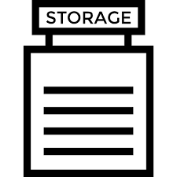


Store Integrity in Hardware
Out-of-order cores reclaim physical registers
Must prevent store registers from being reclaimed
MaskReg: tracks source registers of committed stores
MaskReg
Free List
Store p0, [10]
…
= p0 + 1
…
p0 = p1 x 4
p0
p0
Store Integrity is broken!
p1
p0
p1
p0
Write-after-read
(WAR) dep
Reclaim
* Assume 2 physical registers p0 and p1
Notes:
Just a little background here, out of order cores would reclaim physical registers once they are no longer used. In this example, [click] once the core pipeline commits the addition instruction, [click] store register p0 is reclaimed back to the free list and [click] therefore reused by the multiplication instruction, [click] breaking store integrity. To address this issue, [click] PPA needs to prevent committed store registers from being reclaimed. For this purpose, [click] PPA proposes a vector register called MaskReg to track source physical registers of committed stores. [click] Here, in this example, [click] Once the store is committed, we [click] mark p0 in MaskReg. [click] When the core pipeline commits the addition instruction, [click] PPA does not reclaim p0 to the free list. In this way, [click] PPA ensures that store registers are never to be overwritten.
So far, we talk about how store integrity is guaranteed when program is running. Let’s see how PPA resumes program execution across power failure [click].

Slide 18

What PPA Does Across Power Failure
…
ST1: Store p0, [10]
ST2: Store p1, [20]
…
r3 = load [p2]
ST3: Store r3, [30]
…
Volatile
Minimal
Hardware States (e.g., LCPC) of Committed Instructions
Committed Insts
LCPC
PC (Power
Interrupted)
NVM Main Memory
In-flight Insts
LCPC: Last committed Program Counter
PC: Program Counter
Non-volatile
Notes:
This figure shows the program states where LCPC points to the second store ST2, while the program counter PC points to the last store ST3 because of out of order execution. [click] When power failure is going to be cut off, PPA just in time checkpoints minimal microarchitectural states, including LCPC, to NVM. Here, PPA only checkpoints the architectural states related to committed instructions, including last committed program counter LCPC, and discards any other states related to inflight instructions. [click] When power is off, [click] all volatile states are lost. []click Once power comes back, [click]PPA first restores those checkpointed architectural states, [click] replays the committed stores of the interrupted regions, [click] and resumes program execution from the last committed point. Let's go over two examples to see how PPA's recovery protocol works in detail. [click]

Slide 19
What PPA Just-In-Time Checkpoints
ST1: Store p0, [10]
ST2: Store p1, [20]
…
LCPC
PRF
MaskReg
p3
p2
p1
p0
p1
p0
Power
interrupted
CSQ
Physical register
p1
p0
Destination
address
[20]
[10]
Architectural
register
r1
r0
NVM Main Memory
CRT
Physical
register
p1
p0
Notes:
At the moment of power failure, PPA just in time checkpoint 5 structures. [click] In addition to LCPC, [click] we should checkpoint CSQ that maintains metadata for committed stores for their replaying once power comes back. Since LCPC points to the store ST2, we have those two stores contained in CSQ. Note that CSQ only maintains the source physical register index. Also, [click] we need to checkpoint an existing hardware component, commit rename table that tracks mapping from architectural registers to physical registers of prior committed instructions. Although we don’t show the definitions of architectural registers r0 and r1 in this code, they are ensured to be already committed. This is the reason why we have their mappings in CRT table. [click] PRF is kind of interesting, we consult CSQ and CRT to checkpoint only a part of physical registers such as p0 and p1 since other physical registers are not needed for store replaying and program resumption in the wake of power failure. [click] we also need to checkpoint MaskReg that is required for correct store integrity once power comes back. [click] When the power is going to be cut off, we just in time checkpoint all these 5 structures to NVM. So that they can be recovered in the wake of power failure. Now, let’s see PPA’s failure recovery protocol.

Slide 20
What PPA Just-In-Time Restores
ST1: Store p0, [10]
ST2: Store p1, [20]
…
ST1
PRF
MaskReg
ST2
Power
interrupted
CSQ
LCPC
p1
p0
p1
p0
p1
p0
[20]
[10]
r1
r0
NVM Main Memory
CRT
p1
p0
Notes:
Here, we see the program states after power failure happens. [click] In the wake of power failure, we restore those 5 structures. [click] With restored register p0 and p1 in mind, [click] we replay those two unpersisted stores. Thereafter, [click] we set PC to the instruction following the LCPC to continue program execution. In this way, PPA can correctly recover program from power failure. Now, let’s look at the evaluation and performance numbers [click]

Slide 21

Methodology and Evaluation
Gem5 Simulator
Benchmarks
Comparing Schemes
Original program on PMEM’s memory mode
The state-of-the-art WSP Capri ^{[HPDC’22]}
PPA [This Work]
Processor | 8-core, Out-of-Order, 2GHz, Skylake running on Ubuntu 18.04 FS mode
L1I & L1D | Private, 32/64KB, 8-way, 3/4-cycles, writeback
L2 Cache | Shared, 16MB, 16-way, 44-cycles, writeback
DRAM Cache | 4GB DDR4 2400 8x8, writeback
PMEM | 32GB, Read=175ns/Write=90ns, 16-entry WPQ, 2.3GB/s write bandwidth
CSQ | 40-entry FIFO queue
CPU2006 | CPU2017 | SPLASH3 | WHISPER | STAMP | Mini-apps
Notes:
We implement PPA’s hardware on top of the gem5 simulator. We compare PPA against our prior work Capri for totally 41 applications.

Slide 22
Run-time Overheads (Lower is Better)
Capri; HPDC’22
PPA
* Baseline is running original application on PMEM’s memory mode without crash consistency support
63%
Normalized
Overhead
34%
35%
26%
13%
17%
12%
1%
2%
4%
1%
2%
0%
0%
CPU2006
CPU2017
SPLASH3
WSHIPER
STAMP
Mini Apps
All geomean
Notes:
This figure shows the normalized performance overheads of PPA and Capri to the baseline. Here the baseline is running original program on PMEM’s memory mode. We can see from the figure, PPA outperforms Capri for all benchmarks. In summary, [click] PPA can lower Capri’s overhead from its 26% to only 2% [click]

Slide 23




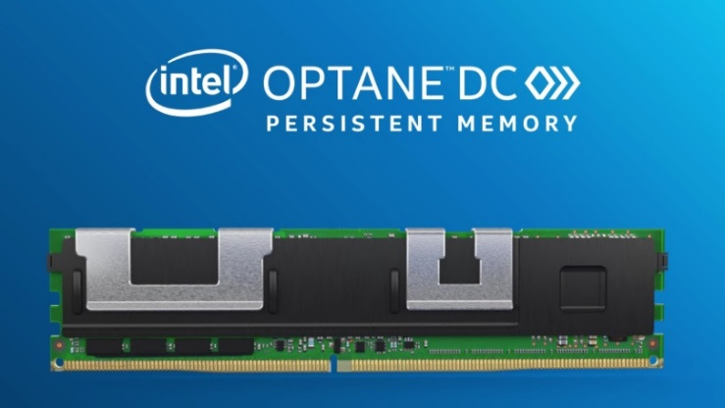

Citation Test of Time
High Performance
ARF
L1
L2
L3
Persistence
Transparency
DRAM Cache
Notes:
In conclusion, PPA is the first lightweight yet high-performance microarchitectural approach to WSP with negligible hardware cost and energy consumption. Because of this, PPA opens the door to significantly improve the performance of many critical applications, such as machine learning, HPC programs, and in-memory databases, especially in the presence of CXL technology.

Slide 24
Backup Slides

Slide 25
Region Characteristics
501
466
447
319
# Instructions
Per Regions
274
207
66
CPU2006
CPU2017
SPLASH3
WHISPER
STAMP
Mini Apps
All geomean
Notes:
This figure shows the average region size across 6 benchmark suites. Thanks to the abundant free physical registers, PPA forms sufficiently long regions, [click] 319 instructions in each region on average. In this way, PPA has enough room to keep the core pipeline busy while performing asynchronous store persistence.

Slide 26
Stall Cycles at Region End
# Stall Cycles
at Region End
1.8%
0.2%
0.8%
0.4%
0.2%
0.1%
0.1%
CPU2006
CPU2017
SPLASH3
WHISPER
STAMP
Mini Apps
All geomean
Notes:
To showcase why PPA incurs such a low overhead. We compute the average ratio of the stall cycles occurred at the end of each region to the execution cycles of that region. As shown in the figure, PPA increases the stall cycle ratio of the baseline (PMEM’s memory mode) by [click] only 0.2% on average thanks to the long enough regions.

Slide 27
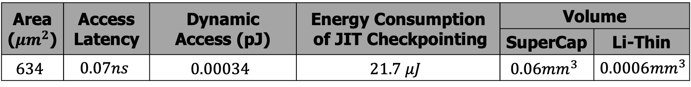
Hardware Overheads
Area ($μm^{2}$) | Access Latency | Dynamic Access (pJ) | Energy Consumption of JIT Checkpointing | Volume
 |  |  |  | SuperCap | Li-Thin
$$634$$ | $$0.07ns$$ | $$0.00034$$ | $$21.7 μJ$$ | $$0.06mm^{3}$$ | $$0.0006mm^{3}$$
0.005% area cost for a Skylake core and 21.7 uJ for JIT checkpointing!
*Skylake core size (11.85 $mm^{2}$) is calculated with McPAT after excluding shared L2
Notes:
To demonstrate how lightweight PPA is, we evaluate PPA’s hardware costs with CACTI with 22 nm processing node. This table shows our design PPA incurs negligible hardware cost and energy consumption, [click] only 0.005% area cost for a Skylake core and 21.7 uJ for JIT checkpointing.

Slide 28


ReplayCache Does Checkpointing Only upon Power Failure
Occasional
ReplayCache
Logging approaches
Notes:
[click] The beauty is that ReplayCache only replays unpersisted stores once power comes back, while prior logging approaches have to synchronously flush dirty cachelines for every single store.

