Slide 1
Compiler-Directed Whole-System Persistence
Jianping Zeng¹, Tong Zhang², Changhee Jung¹
1. CompArch Lab, Purdue University, USA
2. Samsung Electronics, USA
Notes:
Hello, this is Jianping Zeng from Purdue. I am going to present our paper cWSP: compiler-directed whole system persistence.

Slide 2
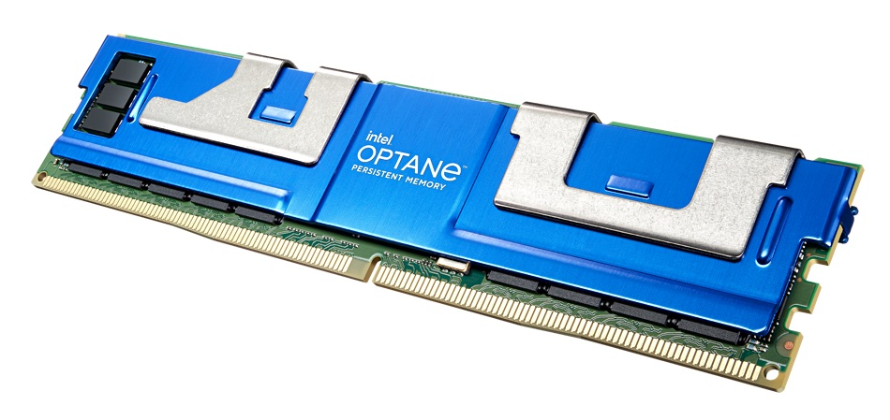

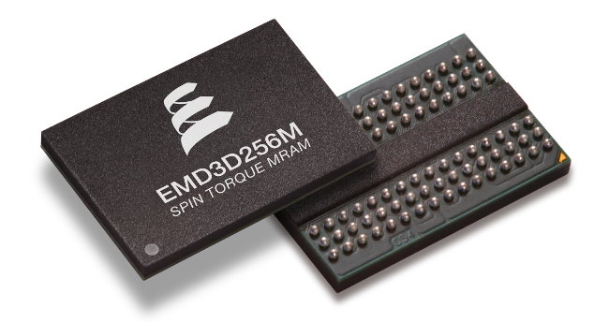
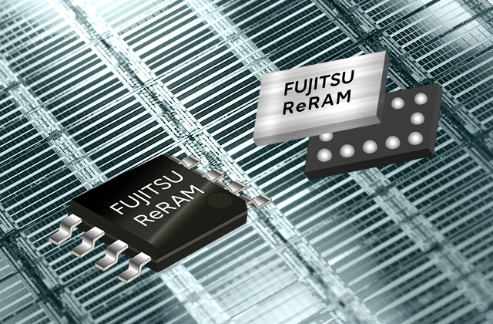
Prevalence of Nonvolatile Memory (NVM)
High areal density (large memory space)
Comparable speed as DRAM
Byte-addressability with load/store
Nonvolatility (data persistence)
Notes:
As you know, nonvolatile memory (NVM) has been commercialized by many vendors, such as [click] Intel PMEM, [click] Samsung memory semantic SSD, [click] Everspin STT-MRAM, and [click] Fujitsu ReRAM. They can be deployed in data centers to achieve high performance thanks to the unique benefits such as [click] high areal density, meaning large memory space, [click] comparable speed as DRAM, byte-addressability with regular store and load instructions, [click] and nonvolatility. To better utilize the benefits of NVM [click]

Slide 3








Intel PMEM’s Two Operation Modes
Persistent
Programming
is hard
Memory Mode
App-Direct Mode
PMEM is not
persistent?
Core
Core
Caches
Caches
DRAM Cache
NVM
Main Memory
DRAM Main Memory
NVM
Persistent Heap
Transparence and
High Performance
Persistence but No Transparence and High Performance
Notes:
Intel PMEM provides two use modes; [click] memory mode and [click] app-direct mode. In memory mode, DRAM works as a last-level cache, while PMEM is used as a main memory, which is [click] transparent to user program. Thanks to the high areal density, [click] program sees a huge memory space and achieves high performance. However, [click] data in NVM are dead when power failure happens. Ironically, [click] Persistent memory is not persistent at all!
On the other hand, in the app-direct mode, [click] data in NVM are durable and persistent. But [click] this mode is not transparent, meaning that we need to modify program source code, [click] leading to programming burden. As a result, both two modes do not fully utilize the potential of NVM technologies. Then, there is a natural question coming up, can we have both high performance and transparency with persistence guaranteed? The answer is yes. Let’s see how that is possible.

Slide 4

WSP: Unlocking the Full Potential of NVM
Core
(ARF)
Caches
DRAM Cache
NVM Main Memory
Memory Mode
* WSP: Whole-System Persistence
* ARF: architectural register file.
Notes:
With PMEM memory mode, we already achieve [click] high performance with dram as a cache and [click] transparency. Our goal is to equip the entire system with persistence. To achieve that, [click] we extend the persistence domain up to covering register file including caches along the way. [click] This is so-called whole system persistence. Here, whole system persistence requires correct power failure recovery, which is so-called crash consistency. To achieve high performance crash consistency [click]

Slide 5
DPO ^{[MICRO’16]}: Asynchronous Persist Using Non-Temporal Data Path as Persist Path
* ARF: architectural register file
* The existing Intel’s write combining buffer
(WCB) is disabled for the FIFO persist path
Core
The persist path alone cannot provide whole-system persistence.
Caches
Persist
Path
DRAM Cache
Avoiding expensive persist barriers, e.g., clwb and sfence in x86
NVM Main Memory
Notes:
[click] prior work DPO leverages the existing Intel non-temporal data path between the L1 data cache and NVM as a persist path to asynchronously persist the data being stored. That is, [click] for each single data merged into L1 data cache, [click] DPO also sends the data to the persist path so that they can arrive in NVM in program order [click] without using expensive persist barriers. However, [click] the persist path alone cannot provide whole system persistence. Let’s see what reason is behind that.

Slide 6



Reason for Crash Inconsistency of Volatile Cache with the Persist Path
* ARF: architectural register file
* PB: volatile persist buffer based on Intel WCB
Core
r0 = r1 + 4
Store #0, [r0]
…
r4 = Load [r3]
…
Store r2, [r3]
Store r4, [r1]
New
data
L1
New
data
I am the evil
L2
It is not my r4
Persist path
L3
PC
Memory write-after-read dep.
DRAM Cache
New
data
NVM Main
Memory
New
data
Old
data
Power
interrupted
Integrated Memory Controller (iMC)
Notes:
When power is on, [click] the processor executes the second store instruction, [click] writing the new data to the L1 data cache; we assume a cache hit here. After that, [click] the cache block is directly flushed to the NVM through the persist path. [click] Once power failure happens, all volatile states are lost. [click] When power comes back, [click] we have no choice but reexecuting the program from its beginning. [click] But this results in the load reading the new data instead of the old data from NVM, [click] leading to wrong program output and crash inconsistency. [click] We can see from this figure that the crash inconsistency is caused by the memory WAR dependence. To address this issue [click]

Slide 7

Capri ^{[HPDC’22]}: Hardware Redo Buffer-Based Region-Level Whole-System Persistence
* ARF: architectural register file
Core
r0 = r1 + 4
Store #0, [r0]
…
Rg1
r0 = r1 + 4
Store #0, [r0]
…
r4 = Load [r3]
…
Store r2, [r3]
Store #10, [r1]
High run-time overhead for multiple memory controllers (MCs).
Complicated hardware for stale read issue.
High energy requirement for just-in-time (JIT) checkpointing redo buffer.
New
data
L1
L2
Persist path
Rg2
L3
PC
r4 = Load [r3]
…
Store r2, [r3]
Store r4, [r1]
Memory WAR dependence
DRAM Cache
New
data
Battery-Backed Redo Buffer
New
data
NVM Main
Memory
Old
data
Power
interrupted
Integrated Memory Controller (iMC)
Notes:
Prior work Capri proposes a battery-backed hardware redo buffer to ensure failure-atomic persistence. Here, because redo buffer size is limited, its overflow leads to failed power failure recovery. Therefore, [click] Capri compiler cuts off input program into [click] a series of regions with the redo buffer size in mind. [click] When power is on, [click] the processor executes the store instruction of region 2, [click] writing the new data to the L1 data cache; we assume a cache hit here. After that, [click] the cache block is copied to the redo buffer. [click] When power failure happens, [click] the new data in the redo buffer is dropped since region 2’s persistence is not completed yet. [click] once power comes back, [click] Capri runtime resumes the program execution from the beginning of region 2, [click] ensuring crash consistency. However, [click] Capri incurs a high run-time overhead for multiple memory controllers since Capri needs to stop store persistence at end of each region. In addition, [click] Capri requires complicated hardware design to deal with stale read issue due to the persist path. Moreover, [click] Capri requires high energy to just-in-time checkpoint the redo buffer. To address these issues [click]

Slide 8


cWSP: Compiler-Directed Whole-System Persistence with Minimal Hardware Support
Slow
ReplayCache [MICRO’21]
Performance Overhead
Capri [HPDC’22]
cWSP
Ideal
Ideal WSP [ASPLOS’12]
Expensive
Notes:
We propose cWSP: a compiler-directed whole system persistence with minimal hardware support. [click] As we have seen before, even though Capri is hardware/software codesign, it incurs a high run-time overhead and requires complicated hardware support. [click] Another design is so-called whole-system persistence that just-in-time flushes all volatile states to NVM upon impending power failure, causing significantly high energy consumption. In addition, [click] naively adapting ReplayCache to server systems causes a 5x slowdown because of its software nature. [click] Even though cWSP is still a hardware/software codesign, we perform aggressive optimizations to make its performance as close to that of the ideal WSP as possible. Now, let’s see how cWSP works [click].

Slide 9
cWSP Compiler Breaking Memory Write-after-Read Dependence for Safe Region Re-execution
* Recovery status after power failure happens
* ARF: architectural register file
* PB: volatile persist buffer based on Intel WCB
Core
r0 = r1 + 4
Store #0, [r0]
…
r4 = Load [r3]
Rg1
New
data
L1
PB
New
data
L2
Persist path
Rg2
L3
Memory write-after-read dep.
…
Store r2, [r3]
Store r4, [r1]
DRAM Cache
Silently Eviction
Dropping
New
data
New
data
NVM Main
Memory
New
data
Power
interrupted
It is my r4
Integrated Memory Controller (iMC)
Notes:
to deal with those memory WAR dependence, our compiler uses idempotent processing to cut off any input program so that there is no memory WAR dependence in each region as shown in this example. This figure shows the program states after power failure happens at end of region 2. Here, we repurpose Intel write combining buffer as a volatile persist buffer PB that connects the store buffer in the core to memory controller, bypassing the entire cache hierarchy. [click] In the wake of power failure, since there is no memory WAR dependence in region 2, [click] it is safe to re-execute the region from its beginning, [click] persisting the stores to NVM along the persist path [click] and generating the correct value of r4. But, we must deal with the potential stale read issue. Let’s see how it happens [click]

Slide 10

Potential Stale Read Issue Due to No Ordering between Persist Path and Regular Path (Caches)
* ARF: architectural register file
* PB: volatile persist buffer based on Intel WCB
Core
Mem[r3] = 100
Mem[r3] = 100
L1
PB
PC
Prior approaches complicate the underlying hardware due to including the PB in cache coherence domain or using bloom filter.
r3 = r1 + 4
Store r0, [r3]
…
r4 = Load [r3]
Rg1
L2
Mem[r3] = 100
Mem[r3] = 100
L3
Persist path
DRAM Cache
Silently Eviction
Dropping
NVM Main
Memory
It is not my r4
MEM[r3] = 0
Integrated Memory Controller (iMC)
Notes:
In this example, we assume store and load access the same memory location. [click] When power is on, the processor executes the store instruction. [click] writing the new data into L1 data cache and PB. Then, [click] what if the persist path is clogged here, [click] and the new data cache block is silently dropped on its LLC eviction? [click] Later on, when the processor executes the load, [click] it reads incorrect old data from NVM instead of the new data just written by the store, [click] leading to wrong program output and crash inconsistency. We can see from the figure the crash inconsistency is caused by the load reading outdated data from NVM. To address this issue, [click] prior approaches need to search the PB for every load by including the PB in the cache coherence domain or using expensive bloom filter. Now, let’s see how we address this issue with negligible hardware overhead. [click]

Slide 11

Enforcing Load-After-Store Order by Occasionally Delaying the Regular Path (Caches)
Wait!
* ARF: architectural register file
* PB: volatile persist buffer based on Intel WCB
Core
Mem[r3] = 100
Mem[r3] = 100
L1
PB
PC
r3 = r1 + 4
Store r0, [r3]
…
r4 = Load [r3]
Rg1
L2
L3
Persist path
Practically no run-time overhead as the order is not enforced almost at all time due to fast persist path.
DRAM Cache
Silently Eviction
Dropping
NVM Main
Memory
MEM[r3] = 0
Mem[r3] = 100
It is my r4
Mem[r3] = 100
Integrated Memory Controller (iMC)
Notes:
We find out we can prevent the stale read issue by enforcing the order of load-after-store. To achieve that, [click] we delay the L1 data cache block eviction until the corresponding data is flushed from the PB down to NVM as shown in this figure. Then, [click] it does not matter that the new data is silently dropped on L3 eviction. This is because, [click] when the core pipeline executes the load instruction, [click] this time it reads the new data from NVM and [click] therefore generate correct program outputs. [click] The beauty of this approach is that this order enforcement incurs practically no run-time overhead since the persist path is faster than the regular path. So far, cWSP works great to achieve high performance crash consistency for single memory controller. But it is challenging to achieve that for multiple memory controllers, [click].

Slide 12
Crash Inconsistency Due to NUMA Effect of Multiple Memory Controllers (MCs)
Rg1
NVM DIMM
r0 = r1 + 4
ST1: Store #0, [r0]
…
r4 = Load [r3]
Stores persist out of region order if they target different MCs due to NUMA effect.
Stopping store persistence at region boundaries solves the problem at the cost of high run-time overhead.
Mem[r0]=0
Far MC
Mem[r0]=0
Mem[r0]=1
It is not my r4
Power
interrupted
Rg2
Memory write-after-read dep.
…
ST2: Store r2, [r3]
ST3: Store r4, [r1]
Mem[r3]=0
Mem[r3]=1
Mem[r3]=1
Near MC
Mem[r3]=1
NVM DIMM
* NUMA: non-uniform memory access
Notes:
This is because of NUMA effect of multiple memory controllers. Let’s look at this example to see how the issue happens. Here, store 1 in region 1 targets a far memory controller, while store 2 in region 2 targets a near memory controller. Since the core pipeline continues persisting stores across regions without waiting, [click] when power is on, [click] store 2 could persist in NVM before store 1. [click] When power failure interrupts region 1, store 1 is lost. [click] Then, we need to reexecute region 1 from its beginning once power comes back. But [click] the load reads incorrect new data and generates incorrect program output, [click] leading to crash inconsistency. Here, [click] the crux of the problem is that stores persist out of region order if they target different memory controllers. One simple way to deal with this issue is stopping store persistence at each region boundary until all prior stores are already persisted in NVM, but this naïve approach leads to a high-performance overhead. Now, Let’s see how to achieve high performance store persistence with multiple memory controllers [click]

Slide 13
Solution: Memory Controller Speculation
Persist reordering across regions is ok as long as there is no power failure!
Speculate no power failure in the oldest unpersisted region (i.e., not all its stores are persisted) and keep persisting the following regions with their data undo-logged in NVM.
Notes:
[click] We find out there is no harm to persist stores out of region order if no power failure. Given rare power failure in data centers, we don’t have to stop store persistence at every region boundary. [click] Based on this, we propose memory controller speculation. It speculates no power failure in the oldest unpersisted region and keeps persisting the following regions. In case power failure happens in the following regions, we undo log their data at memory controller level. Now, let’s look at how memory controller speculation works in detail [click]

Slide 14

Implementation of Memory Controller Speculation
I’m persisted
Oldest
unpersisted
region
Rg1
r0 = r1 + 4
ST1: Store #0, [r0]
…
r4 = Load [r3]
NVM DIMM
Far MC
ST1
PC
Rg2
Speculative
Region
NVM DIMM
Memory write-after-read dep.
…
ST2: Store r2, [r3]
ST3: Store r4, [r1]
ST2
ST2
ST2’s log
Near MC
ST3
ST3
ST3’s log
* Initially, Rg1 is the oldest unpersisted region, while Rg2 is under speculation
Notes:
In this example, we assume region 1 is the oldest unpersisted region and region 2 is under speculation. While store 1 is still on the way to NVM, [click] the processor crosses the region boundary and [click] continues persisting store 2 and [click] store 3 with their data undo-logged in NVM. [click] Once store 1 arrives in NVM, [click] region 1 becomes persisted since its all stores are already persisted. Here, we don’t undo log store 1 since region 1 is not speculative. After that, [click] region 2 becomes the oldest unpersisted region. Therefore, [click] we deallocate the region2’s logging entries since its interruption can be recovered by its re-execution. Now, let’s see how we recover program execution from power failure with memory controller speculation [click].

Slide 15
Power Failure Recovery with Memory Controller Speculation
Oldest
unpersisted
region
Rg1
r0 = r1 + 4
ST1: Store #0, [r0]
…
r4 = Load [r3]
NVM DIMM
Far MC
ST1
It is my r4
Power
interrupted
Rg2
Memory write-after-read dep.
NVM DIMM
…
ST2: Store r2, [r3]
ST3: Store r4, [r1]
ST2
ST2’s log
Near MC
ST3
ST3’s log
* Initially, Rg1 is the oldest unpersisted region, while Rg2 is under speculation
Notes:
This figure shows the same example, while store 2 and store 3 have already been speculatively persisted in NVM with their data undo logged. [click] Upon power failure, Store 1 is lost. [click] Once power comes back, we need to recover program states. To do so, we first [click] reverts store 2 and store 3 using their undo logs. After that, [click] we can safely resume program execution from the beginning of region 1. In this way, [click] we ensure crash consistency. Now, let’s see the evaluation and performance numbers [click].

Slide 16

Evaluation
Gem5 Simulator
Clang/LLVM 13 and Benchmarks
Comparing Schemes
Original program on PMEM’s memory mode
The state-of-the-art WSP Capri ^{[HPDC’22]}
cWSP [This Work]
Processor | 8-core, Out-of-Order, 2GHz, Skylake running on Ubuntu 18.04 FS mode
L1I & L1D | Private, 32/64KB, 8-way, 3/4-cycles, writeback
L2 Cache | Shared, 16MB, 16-way, 44-cycles, writeback
DRAM Cache | 4GB DDR4 2400 8x8, writeback
PMEM | 32GB, Read=175ns/Write=90ns, 16-entry WPQ, 2.3GB/s write bandwidth
RBT/PB | 16/50-entry FIFO queue with CAM searching
CPU2006 | CPU2017 | Mini-apps | SPLASH3 | WHISPER | STAMP
Notes:
We implement our hardware design and compiler techniques on top gem5 simulator and LLVM compiler. We compare our design against prior Capri for total 6 benchmark suites.

Slide 17
Normalized Run-time Overhead to PMEM’s Memory Mode
* Baseline is running original application on PMEM’s memory mode without crash consistency support
Capri; HPDC’22
cWSP
73%
Normalized
Overhead
33%
34%
35%
27%
13%
9%
14%
7%
6%
3%
4%
2%
4%
CPU2006
CPU2017
SPLASH3
WSHIPER
STAMP
Mini Apps
Notes:
This figure shows the normalized run-time overheads of our design and Capri to the baseline. Thanks to the asynchronous store persistence and memory controller speculation, cWSP incurs only a 6% run-time overhead, while Capri incurs a 27% run-time overhead.

Slide 18





Conclusion
High Performance
Core
L1
L2
cWSP
L3
Persistence
Transparency
DRAM Cache
Notes:
In conclusion, cWSP is the first lightweight yet high performance whole-system persistence approach that significantly reduces hardware complexity to only 176 bytes and eliminates expensive just in time checkpointing in prior work. This is particularly important for many applications such as machine learning and HPC program and future CXL technology.

