Slide 1
Exposing Errors Related to Weak Memory in GPU Applications
Tyler Sorensen
Imperial College London
Supervisor: Alastair F. Donaldson
PLDI 2016

Slide 2
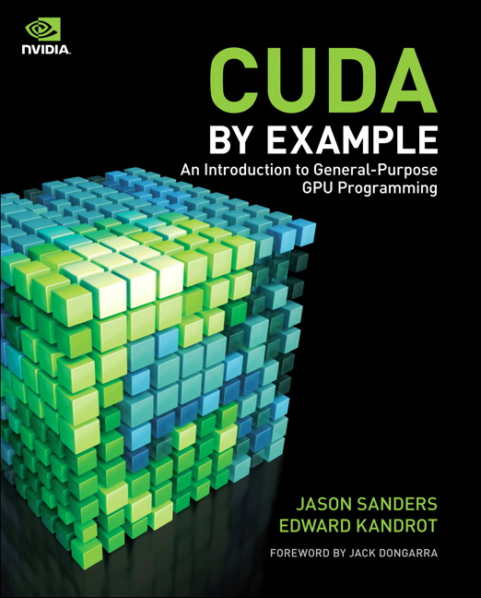
Example
GPU dot product

Slide 3
Example
__global__ void dot(int *mutex, float *a, float *b, float *c) {
int tid = threadIdx.x + blockIdx.x * blockDim.x;
float temp = 0;
while (tid < N) {
temp += a[tid] * b[tid];
tid += blockDim.x * gridDim.x;
}
// local computation code omitted
if (threadIdx.x== 0) {
lock(mutex);
*c += cache[0];
unlock(mutex);
}
}
__device__ void lock(int *mutex) {
while (atomicCAS(l, 0, 1) != 0 );
}
__device__ void unlock(int *mutex) {
atomicExch(l, 0);
}
GPU dot product

Slide 4
Example
GPU dot product
Testing the code:
Run for 1 hour (~2 seconds per run) and check for errors

Slide 5
Example
GPU dot product
Testing the code:
Run for 1 hour (~2 seconds per run) and check for errors
No errors observed! Code is probably correct right?

Slide 6
Example
GPU dot product
Testing the code:
Run for 1 hour (~2 seconds per run) and check for errors
No errors observed! Code is probably correct right?
Wrong! Weak memory bug reported in previous work

Slide 7
Example
GPU dot product
Previous bug found through hand analysis by experts
This is laborious and no guarantees

Slide 8
Example
GPU dot product
Our goals:

Slide 9
Example
GPU dot product
Our goals:
Create a method for programmers to find bugs

Slide 10
Example
GPU dot product
Our goals:
Create a method for programmers to find bugs
Automatically suggest bug fixes

Slide 11
Example
GPU dot product
Developed a stress/fuzz testing environment
Run for 1 hour (~2 seconds per run) and check for errors

Slide 12
Example
GPU dot product
Developed a stress/fuzz testing environment
Run for 1 hour (~2 seconds per run) and check for errors
396 erroneous runs observed

Slide 13
Example
GPU dot product
How to fix the bug?

Slide 14
Example
__global__ void dot(int *mutex, float *a, float *b, float *c) {
int tid = threadIdx.x + blockIdx.x * blockDim.x;
float temp = 0;
while (tid < N) {
temp += a[tid] * b[tid];
tid += blockDim.x * gridDim.x;
}
// local computation code omitted
if (threadIdx.x== 0) {
lock(mutex);
*c += cache[0];
unlock(mutex);
}
}
__device__ void lock(int *mutex) {
while (atomicCAS(l, 0, 1) != 0 );
}
__device__ void unlock(int *mutex) {
atomicExch(l, 0);
}
GPU dot product

Slide 15
Example
__global__ void dot(int *mutex, float *a, float *b, float *c) {
int tid = threadIdx.x + blockIdx.x * blockDim.x;
float temp = 0;
while (tid < N) { threadfence();
temp += a[tid] * b[tid];
tid += blockDim.x * gridDim.x;
}
// local computation code omitted
if (threadIdx.x== 0) {
lock(mutex); threadfence();
*c += cache[0];
unlock(mutex);
}
}
__device__ void lock(int *mutex) { threadfence();
while (atomicCAS(l, 0, 1) != 0 ) threadfence();
}
__device__ void unlock(int *mutex) {threadfence();
atomicExch(l, 0);
}
GPU dot product

Slide 16
Example
GPU dot product
Developed a stress/fuzz testing framework
Run for 1 hour (~2 seconds per run) and check for errors

Slide 17
Example
GPU dot product
Developed a stress/fuzz testing framework
Run for 1 hour (~2 seconds per run) and check for errors
0 erroneous runs observed
Did we fix it?

Slide 18
Example
GPU dot product
0 erroneous runs observed
Did we fix it?
Fences cost performance overhead:
60% runtime and energy overhead

Slide 19
Example
__global__ void dot(int *mutex, float *a, float *b, float *c) {
int tid = threadIdx.x + blockIdx.x * blockDim.x;
float temp = 0;
while (tid < N) { threadfence();
temp += a[tid] * b[tid];
tid += blockDim.x * gridDim.x;
}
// local computation code omitted
if (threadIdx.x== 0) {
lock(mutex); threadfence();
*c += cache[0];
unlock(mutex);
}
}
__device__ void lock(int *mutex) { threadfence();
while (atomicCAS(l, 0, 1) != 0 ) threadfence();
}
__device__ void unlock(int *mutex) {threadfence();
atomicExch(l, 0);
}
GPU dot product

Slide 20
Example
__global__ void dot(int *mutex, float *a, float *b, float *c) {
int tid = threadIdx.x + blockIdx.x * blockDim.x;
float temp = 0;
while (tid < N) {
temp += a[tid] * b[tid];
tid += blockDim.x * gridDim.x;
}
// local computation code omitted
if (threadIdx.x== 0) {
lock(mutex);
*c += cache[0];
unlock(mutex);
}
}
__device__ void lock(int *mutex) {
while (atomicCAS(l, 0, 1) != 0 );
}
__device__ void unlock(int *mutex) { threadfence();
atomicExch(l, 0);
}
GPU dot product

Slide 21
Example
GPU dot product
0 erroneous runs observed
Did we fix it?
Fences cost performance overhead:
60% runtime and energy overhead

Slide 22
Example
GPU dot product
0 erroneous runs observed
Did we fix it?
Fences cost performance overhead:
Less than 3% runtime and energy overhead

Slide 23
Example
GPU dot product
0 erroneous runs observed
Did we fix it?
Fences cost performance overhead:
Empirically fixed, not formally fixed!

Slide 24
Roadmap
Background
Testing environment
Environment evaluation
Fence placement

Slide 25
Roadmap
Background
Testing environment
Environment evaluation
Fence placement

Slide 26
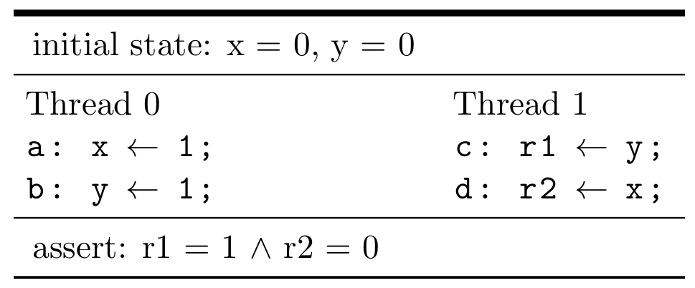
Weak memory models
consider the test known as message passing (MP)

Slide 27
Weak memory models
consider the test known as message passing (MP)

Slide 28
Weak memory models
consider the test known as message passing (MP)

Slide 29
Weak memory models
consider the test known as message passing (MP)

Slide 30
Message passing (MP) test
Tests how to implement a handshake idiom
Data
Data

Slide 31
Message passing (MP) test
Tests how to implement a handshake idiom
Flag
Flag

Slide 32
Message passing (MP) test
Tests how to implement a handshake idiom
Stale Data

Slide 33
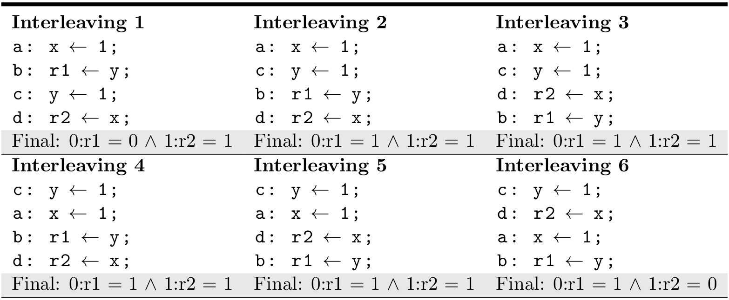

Slide 34
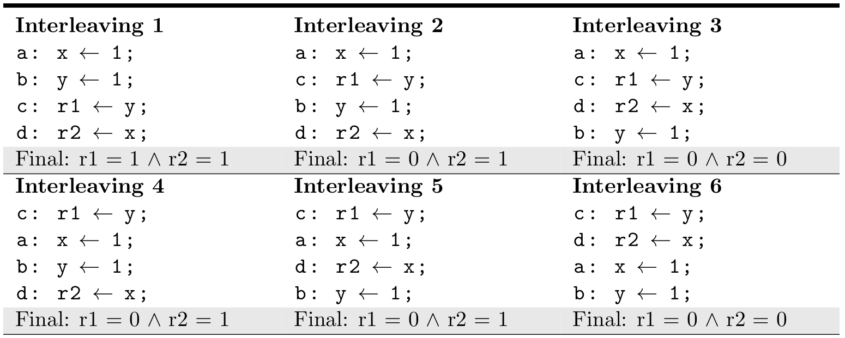

Slide 38
assertion cannot
be satisfied by interleavings

Slide 39
Weak memory models
can we assume assertion will never pass?

Slide 40
Weak memory models
can we assume assertion will never pass? No!

Slide 41
Weak memory models
what happened?
architectures implement weak memory models where the hardware is allowed to re-order certain memory instructions.
weak memory models can allow weak behaviors (executions that do not correspond to an interleaving)

Slide 42
Roadmap
Background
Testing environment
Environment evaluation
Fence placement

Slide 43
Testing environment
Goal: Design a testing environment to reveal weak memory behaviors in GPU applications

Slide 44
Memory stress
thread 0
. . . . .
thread n
Run application
Application Memory

Slide 45
Memory stress
thread 0
. . . . .
thread n
extra thread 0
. . . . .
extra thread x
Run application
Memory
stress
Application Memory
Scratchpad Memory

Slide 46
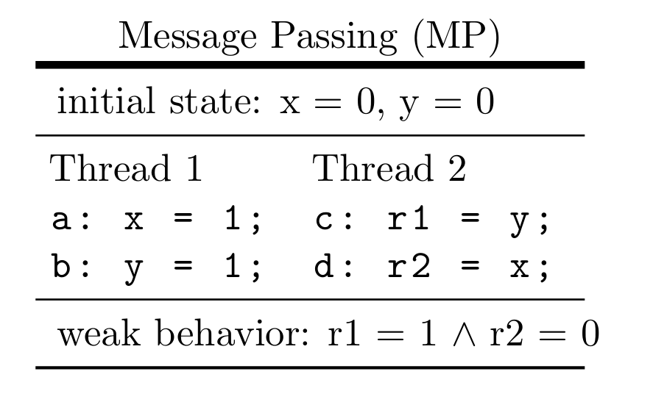
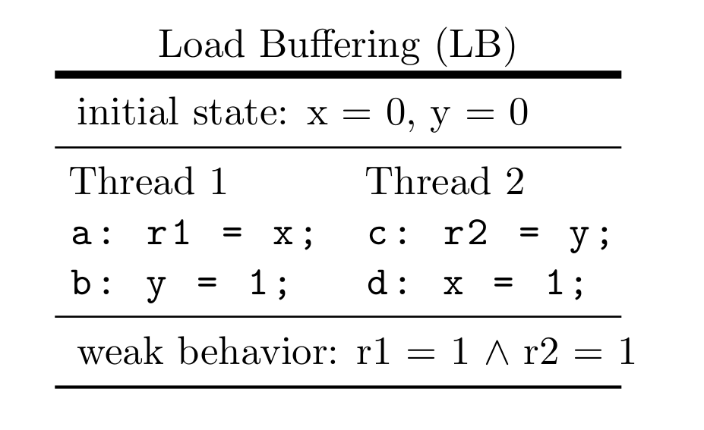
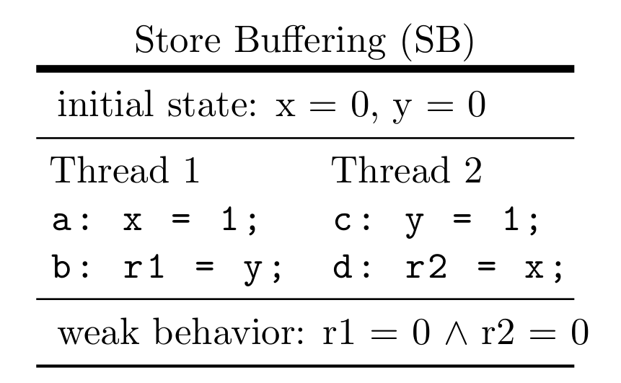
Litmus tests

Slide 47
Memory stress
Where to stress:

Slide 48
Memory stress
Where to stress:
For each distance D:
application memory
X
Y

Slide 49
Memory stress
Where to stress:
For each distance D:
application memory
X
Y

Slide 50
Memory stress
Where to stress:
For each distance D:
application memory
X
Y

Slide 51
Memory stress
Where to stress:
For each distance D:
application memory
X
Y

Slide 52
Memory stress
Where to stress:
For each distance D:
application memory
X
D
Y

Slide 53
Memory stress
Where to stress:
For each distance D:
For each scratchpad location I:
application memory
X
D
Y
scratchpad memory
I

Slide 54
Memory stress
Where to stress:
For each distance D:
For each scratchpad location I:
application memory
X
D
Y
scratchpad memory
I
I

Slide 55
Memory stress
Where to stress:
For each distance D:
For each scratchpad location I:
application memory
X
D
Y
scratchpad memory
I
I

Slide 56
Memory stress
Where to stress:
For each distance D:
For each scratchpad location I:
Run MP, SB, LB at distance D litmus tests stressing only location I for 1000 iterations
application memory
X
D
Y
scratchpad memory
I
I

Slide 57
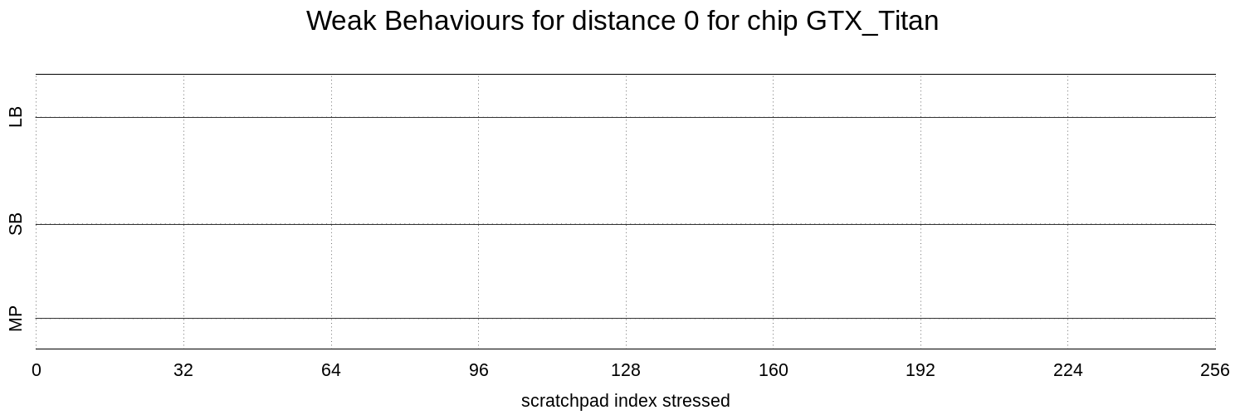
Memory stress

Slide 58
Memory stress
Distance D

Slide 59
Memory stress
X
D
Y
application memory
Distance D

Slide 60
Memory stress
Distance D
Index I stressed

Slide 61
Memory stress
I
I
scratchpad memory
Distance D
Index I stressed

Slide 62
Memory stress
Distance D
Litmus test
Index I stressed

Slide 63
Memory stress
Vertical bar represents the magnitude of weak behaviors observed

Slide 64
Memory stress
Visualization samples

Slide 65
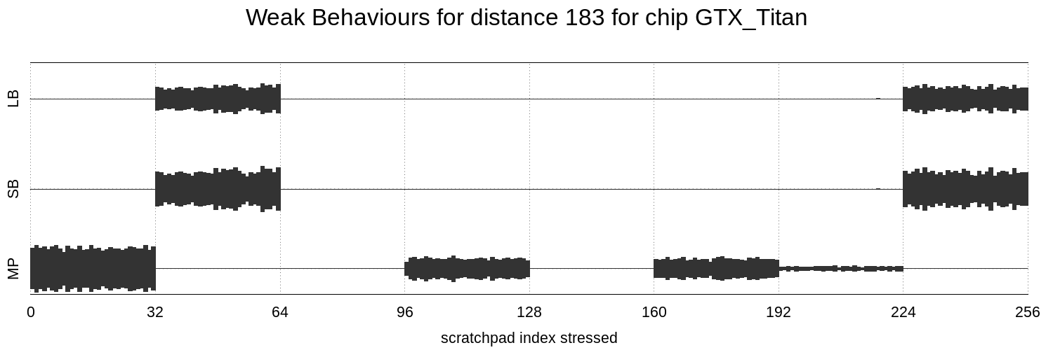
Memory stress
Visualization samples

Slide 66
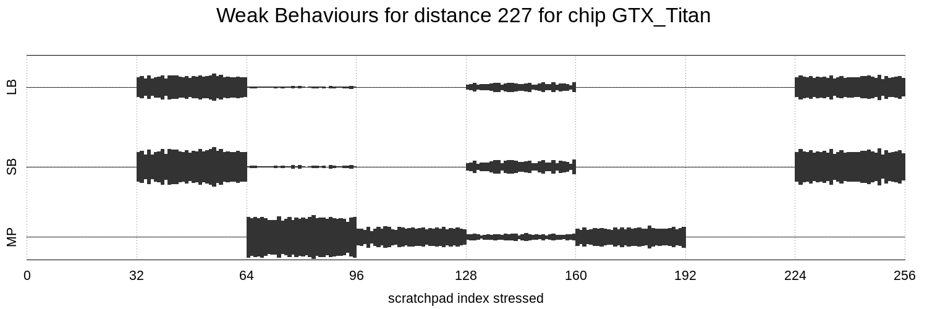
Memory stress
Visualization samples

Slide 67
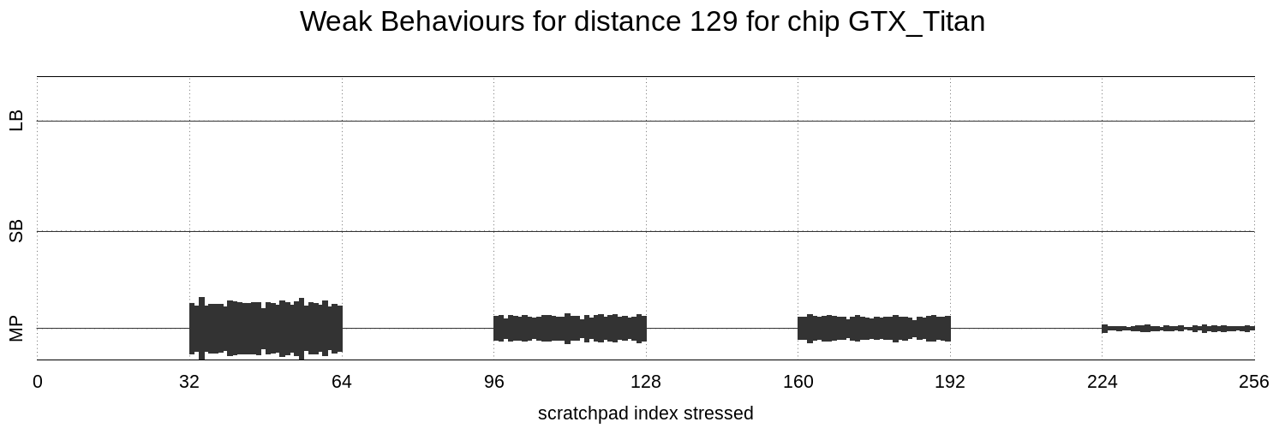
Memory stress
Visualization samples

Slide 68
Memory stress
What does this tell us?

Slide 69
Memory stress
What does this tell us?
To reveal weak behaviors we only need to stress 1 in every 32 locations*
We call a contiguous region of 32 elements a patch
*64 for some chips

Slide 70
Memory stress
How many patches can we effectively stress?
If D is unknown (as in applications), we would like to stress as many disjoint patches as possible

Slide 71
Memory stress
Scratchpad has size of 64 patches
We try stressing a randomly selected n patches for values 1 – 64 for n

Slide 72
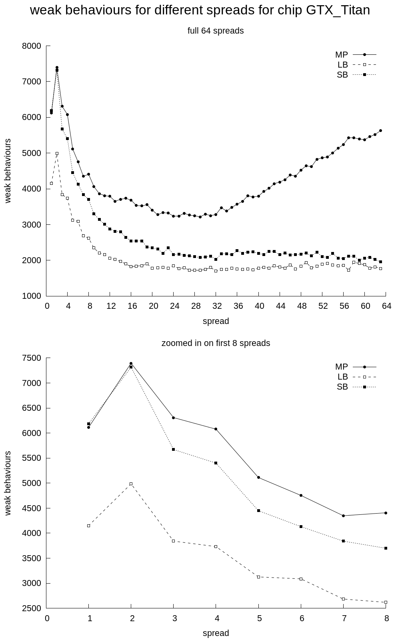

Slide 73
Zoom in on first 8

Slide 75
Stressing 2 random patches is most effective

Slide 76
Memory stress
Now we have a memory stressing strategy
Stress two random patches in the scratchpad

Slide 77
Roadmap
Background
Testing environment
Environment evaluation
Fence placement

Slide 78
Applications
Observed weak memory issues in 8 applications
7 Nvidia chips (across 3 architectures)
Run applications for 1 hour

Slide 79
Applications
CHIP | No-stress | Stress
980
K5200
Titan
K20c
770
C2075
C2050

Slide 80
Applications
CHIP | No-stress | Stress
980 | 0
K5200 | 1
Titan | 0
K20c | 0
770 | 1
C2075 | 0
C2050 | 0

Slide 81
Applications
CHIP | No-stress | Stress
980 | 0 | 7
K5200 | 1 | 8
Titan | 0 | 8
K20c | 0 | 8
770 | 1 | 8
C2075 | 0 | 8
C2050 | 0 | 8

Slide 82
Some results:
We provided empirical confirmation of 3 bugs reported in prior work
We discovered unreported weak memory bugs in 2 applications

Slide 83
Roadmap
Background
Testing environment
Environment evaluation
Fence placement

Slide 84
Fence insertion
Start with conservative fence placement
Attempt to remove fences
Use our testing framework as an unsound oracle
If errors are observed, put fence back

Slide 85
Fence insertion
App | Conservative Fences | Reduced Fences
cbe-ht | 10
cbe-dot | 4
ct-octree | 33
tpo-tm | 28
sdk-red | 6
cub-scan | 51
ls-bh | 90

Slide 86
Fence insertion
App | Conservative Fences | Reduced Fences
cbe-ht | 10 | 1
cbe-dot | 4 | 1
ct-octree | 33 | 1
tpo-tm | 28 | 1
sdk-red | 6 | 1
cub-scan | 51 | 2
ls-bh | 90 | 4

Slide 87
Fence insertion
Median overhead of reduced fences:
4% energy
Less than 3% runtime
Median overhead of consv. Fences
63% energy
59% runtime

Slide 88
Conclusion
Stress/fuzz testing can be used to test applications for weak memory bugs
Stress is best tuned on micro benchmarks
Fences in applications can be costly, but can be reduced with high confidence using stress/fuzz testing
Tyler Sorensen https://www.doc.ic.ac.uk/~tsorensen/
Alastair F. Donaldson http://multicore.doc.ic.ac.uk/

