Slide 1
Just-in-Time Static Type Checking for Dynamic Languages
Brianna Ren and Jeff Foster
University of Maryland, College Park

Slide 2
Type Checking and Metaprogramming
Standard type systems cannot type check this simple Ruby on Rails example
class Talk < ActiveRecord::Base
belongs_to(:owner, :class_name => “User”)
def owner?(user)
return owner == user
end
Defines owner using metaprogramming
No explicit def of owner

Slide 3
Solution: Just-in-Time Type Checking
Type annotations execute at run-time
Calling type … stores type info in global table
Extend metaprogramming to also generate types as meths created
Easy to do in practice
Statically type check method body when called at run-time
Using current global type table
Memoize type checking for better performance

Slide 4
Hummingbird Results
Hummingbird: Implementation for Ruby
Applied to range of Ruby apps
3 Rails apps, 2 other metaprogramming apps, 1 plain app
Hummingbird successfully type checks all 6 apps
1.2x – 5.7x performance overhead
Found type errors in earlier versions of 1 Rails app
Also applied to 1 Rails app as it was updated in dev mode to test cache invalidation

Slide 5
Hummingbird Example
args passed to belongs_to
Pre-contract for belongs_to
Gets return type of getter
pre(:belongs_to) do |name, options|
name_str = name.to_s
cn = options[:class_name] if options
cls_str = cn ? cn : name_str.singularize.camelize
type name.singularize, “() -> #{cls_str}”
type “#{name.singularize}=“, “(#{cls_str}) -> #{cls_str}”
end
pre contract adds types
:owner, “() -> User”
:owner=, “(User) -> User”
belongs_to(:owner, :class_name => “User”)

Slide 6
Hummingbird and Struct
Creates methods
:type, :type=,
:account_name, :account_name=,
:amount, :amount=
for Transaction class
Transaction = Struct.new(:type, :account_name, :amount)
Transaction.add_types(“String”, “String”, “String”)
t = # some Transaction
name = t.account_name
Annotate the attribs to get getter/setter types
Can now type check ☺
zip names with annotated types
class Struct
def self.add_types(*types)
members.zip(types).each do |name, t|
self.class_eval do
type name, “() -> #{t}”
type “#{name}=“, “(t) -> #{t}”
end end end end
creates type annotations for getters/setters. i.e.,
account_name, “() -> String”

Slide 7
Core Calculus for Hummingbird
Formalized Hummingbird in a core, Ruby-like language
Method definitions can occur at arbitrary points
Type “annotations” execute at run-time
At e1.m(e2), statically type check body of m
Resulting typing proof cached for future reuse
v ::= nil | [A]
e ::= v | x | self | x = e | e; e | A.new | if e then e else e | e.m(e)
| def A.m = λx.e | type A.m : t → t
t ::= A | nil

Slide 8
Static Type Checking
TT: type table mapping methods to types, updated at run-time
Init type env Γ
expression e
TT ⊢ ⟨Γ, e⟩ ⇒⟨Γ’, t⟩
new type env Γ’
e has type t

Slide 9
Dynamic Semantics
cache mapping A.m to type checking proof for its body
type table
⟨X, TT, DT, e, …⟩
Maps A.m to its definition
expression e

Slide 10
Type Semantics
⟨X, TT, DT, type A.m: (t1) → t2, …⟩
⟨X, TT[A.m : (t1) → t2], DT, nil, …⟩

Slide 11
Cache Invalidation on Def
X with proofs for A.m and everything that depends on A.m. removed
⟨X, TT, DT, def A.m: λx.e, …⟩
⟨X\A.m, TT DT[A.m ⟼ λx.e], …⟩

Slide 12
Function Application
TT[A.m]: (t1) → t2
typeof(v) ≤ t1?
no
⟨X, TT, A.m(v)⟩
Exception!
yes
A.m ∈ dom(X)?
cache miss
no
cache hit
TT ⊢⟨Γ, e⟩⇒⟨Γ, v’⟩ ?
yes
⟨X, TT[self ↦ A, x ↦ v], e⟩
if A.m = λx.e
Add TT ⊢ … to X

Slide 13
Soundness Theorem
Theorem: Well-typed methods do not go wrong at runtime
E.g, they don’t call methods with bad argument types
Some errors may still occur at runtime
Invoking method on nil
Calling method whose body does not type check at run-time
Calling method that has type annotation but is itself undefined

Slide 14
Implementation
Ruby Intermediate Language (RIL) parser
def foo(x)
# foo body
end
CFG json of foo
Hummingbird static checking
def foo(x)
# dyn type check x
# static type check foo body
foo_original(x)
end
def foo_original(x)
# foo body
end
Ruby Contract System (RDL)

Slide 15
Cache Invalidation in Rails Dev Mode
Rails automatically reloads modified files in dev mode
Implementation does not support arbitrary invalidation
Hummingbird invalidates parts of cache on reload
Record method dependencies at run-time
If method changed/deleted, remove method and its dependencies from cache

Slide 16
Type Casts
type(Marshal, ‘self.load’, ‘(…) → Object’)
field_type(:@@cache, “Hash<A, B>”)
r = Marshal.load(…)
@@cache = r # type error!

Slide 17
Type Casts
type(Marshal, ‘self.load’, ‘(…) → Object’)
field_type(:@@cache, “Hash<A, B>”)
r = Marshal.load(…)
@@cache = r.rdl_cast(“Hash<A, B>”)
Static type checking: Assume r has casted type
Run-time: check if r is a member of casted type

Slide 18
Experiments
Ran on Mac with 2.3 GHz Intel Core i7 and 8GB memory
Tests came with app or we wrote them with the goal of covering all app methods
6 Applications
3 Rails: Talks, Pubs, Boxroom
2 other metaprogramming: Rolify, Credit Card Transactions (CCT)
1 plain: Countries

Slide 19
Type Annotations
Non-type checked annotations
Common Ruby core and standard libraries
String, Fixnum, etc
Type signatures for common Rails metaprogramming
E.g., belongs_to, …
App-specific Rails helper methods
Type checked annotations
All application methods (manually annotated)

Slide 20
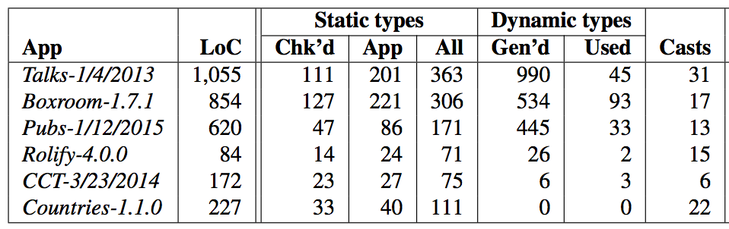
Type Checking Results: Annotations
Safe down casts +
Adding parameters to raw generic types like Array
Chk’d + App +
Core/standard lib types
Dyn generated types that are used
Chk’d + app types with trusted annotations
Lines of code
Statically checked types
Dyn generated types

Slide 21
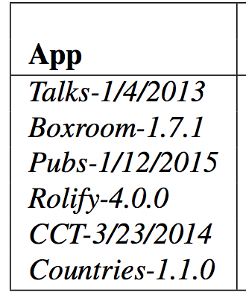
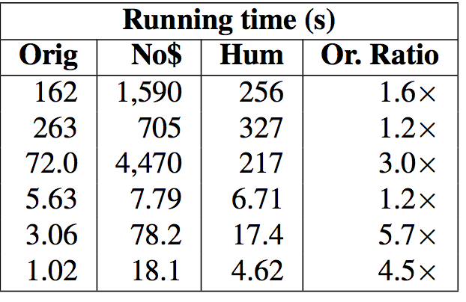
Type Checking Results: Performance
with Hummingbird
and caching
w/o Hummingbird
with Hummingbird
but no caching
Orig vs Hum ratio

Slide 22
Type Errors in Talks
version | code | bug
1/8/12-4 | copute_edit_fields | misspelled method
1/7/12-5 | @list.talks.upcoming {|a, b| ...} | extra block
1/26/12-3 | subscribed_talks(true) | wrong arg type
1/28/12 | handler.object | undefined method

Slide 23
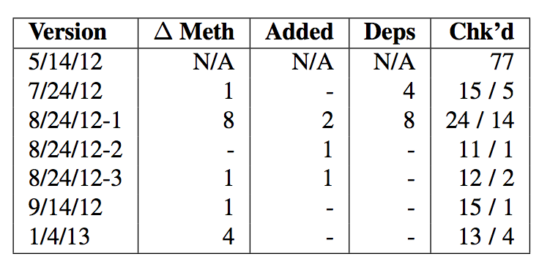
Rails Live Version Update Experiment
Method re-checked (A/B)
A: actual methods rechecked due to limitation in Hummingbird
B: methods rechecked if no limitation
Initial version checked 77 methods
Modified methods
Dependent methods
New methods
Updated a Talks version to 6 consecutive versions in dev mode
Modified files automatically load
Cache invalidation useful since small number of methods changed by each update

Slide 24
Conclusions
Hummingbird: just-in-time static type checking for Ruby
Type information tracked dynamically
Methods checked statically at run-time when called
Easy to check code that use metaprogramming-generated methods
Caching used to eliminate redundant type checking
https://www.cs.umd.edu/~bren/pldi16_artifact/
https://github.com/plum-umd/rdl

