Slide 1
Cardinalities and Universal Quantifiers for Verifying Parameterized Systems
Klaus v. Gleissenthall, UC San Diego and TU Munich
Nikolaj Bjørner and Andrey Rybalchenko, Microsoft Research

Slide 2


Parallel / Distributed systems
Verify!
Paxos/ Chubby
Zab/Zookeeper
Raft

Slide 3
Consensus: majorities
That means v=w
x=v
x=w

Slide 4
One third rule:
Nodes try to agree on a value
1
3
Broadcast value in each round
3
6
Update own value
Messages may be lost

Slide 5
One third rule:
n= # of nodes
choose 3
received 1,3,3
Hear form >2/3n
then
choose most reveived
1
3
3
6
>2/3n share value v then
decide on v

Slide 6
One third rule:
decide on value 3
Received 3,3,3
Hear form >2/3n
then
choose most reveived
3
3
3
3
3
3
6
>2/3n share value v then
decide on v

Slide 7
One third rule: property
We want to verify
forall p,p’: decide(p,v) and decide(p’,w) then v=w
Agreement

Slide 8
One third rule: invariant
Quantification: number of processes not known statically
Agreement by: no two majorities
forall p: decide(p,v) then #{t | candidate(t)=v } >2/3n
Count # of nodes with same candidate

Slide 9
Filter lock: description
start at level 0
critical section: level n-1
n threads in total
level n-1
try to increase level
…
level 1
level 0

Slide 10
Filter lock: description
Advance
iff
level n-1
no one is above you
…
someone else is at your level
level 1
level 0

Slide 11

Filter lock: description
no one is above you
Level 2
someone else is at your level
…
level 1
level 0

Slide 12
Filter Lock: property
Mutual exclusion
#{ t | lv(t) = n-1 } ≤ 1
level 1

Slide 13
Filter Lock: invariant
Quantify over level
count processes at level
∀l: 0≤l≤n-1→ #{t | lv(t)≥l} ≤ n-l
Infinitely many cardinalities

Slide 14
Filter lock:
Mutual exclusion
preserved under
level n-1
1 thread
no one is above you
…
…
someone else is at your level
level 1
n-1 threads
level 0
n threads

Slide 15






Program Verifiers:
Protocol
Property
Proof

Slide 16
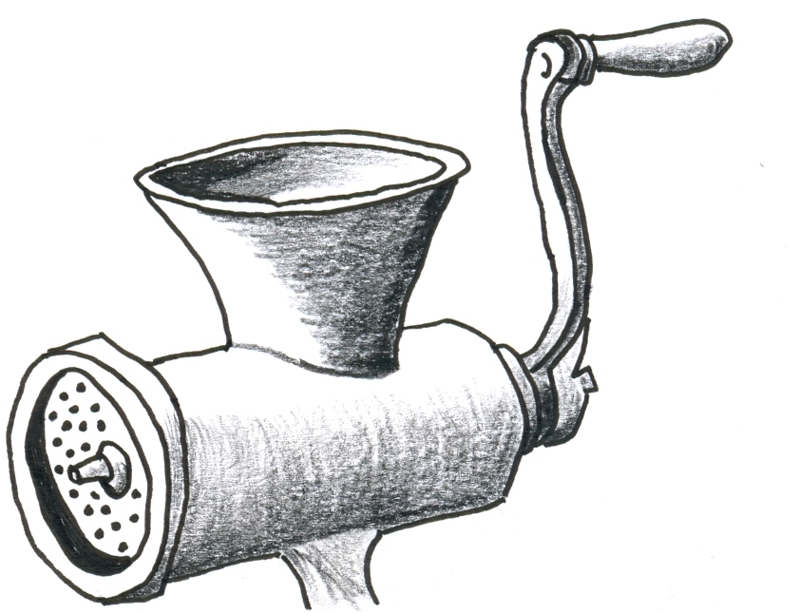
In this talk:
Sharpie
1: What to count
2: How to do the counting
#π
Verifies properties show before

Slide 17
A simple example:
Some number n of threads
If there is a thread at location 2, then a>0
global int a=0;
1: a++;
2:

Slide 18
Example: in logic
Local variables as functions
initial states:
∀t: pc(t)=1∧ a=0
primed = after transition
transition relation
pc(me)=1 ∧ pc’:=pc(me←2) ∧ a’=a+1
safety
pc(me)=2 → a>0

Slide 19
Example: constraints
Horn clauses
find:
inv
∀t: pc(t)=1∧ a=0
→
inv(a,pc)
pc(me)=1 ∧ pc’:=pc(me←2) ∧ a’=a+1
inv(a,pc)
→
inv(a’,pc’)
∧
inv(a,pc)
→
pc(me)=2 → a>0

Slide 20
Solving:
→
∧
(
∨
)
→
∧
∧
→
:
#{t | pc(t)>1}≤a

Slide 21

How to count: invariant checking
Checking: not supported by existing method
∀t: pc(t)=1∧a=0
→
#{t | pc(t)>1}≤a
#{t | pc(t)>1}≤a
→
pc(me)=2 → a>0

Slide 22
How to count: invariant checking
Set is empty
∀t: pc(t)=1∧a=0
→
#{t | pc(t)>1}≤a
0≤0
Set is non-empty
1≤a
→
pc(me)=2 → a>0
#{t | pc(t)>1}≤a

Slide 23
Example: point wise update
How to deal with upd?
pc(me)=1 ∧pc’:=pc(me←2) ∧ a’=a+1
#{t | pc(t)>1}≤a
→
#{t |pc’(t)>1}≤a’
∧

Slide 24
Example: point wise update
are unaffected
pc(t)>1
pc’(t)>1
pc’(t)=1
me
me
point wise update
pc(me)=1 ∧ pc’:=pc(me←2)

Slide 25
What to count
cardinality free
Find s and inv
#{t| s(t)}=k ∧ inv(a,pc,k)
∃ :
inv
#π chooses s s.t. the proof goes through
→
∧
(
∨
)
→
∧
∧
→

Slide 26
Cardinality axioms:
Instantiate axioms
→
→
∧
Remove #{…}
→
→
∧
Cardinality free
Existing (Horn clause) solver
Solution

Slide 27
Example: finding the solution
#{t | s(t)}=k
∀t: pc(t)=1∧a=0
→
#{t | s(t) }=k ∧ inv(a,pc,k)
∧
inv(a,pc,k)
(∀t: ¬s(t)) → k=0

Slide 28
Cardinality axioms:
→
→
∧
→
→
∧
s = pc(t)>1
inv = k=<a

Slide 29
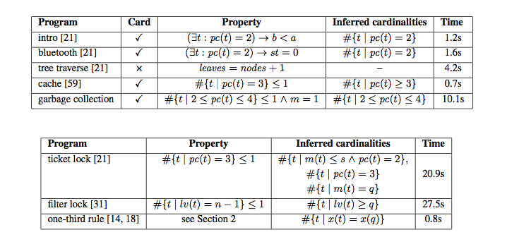
Evaluation:
Works on problems from the literature
cache coherence
garbage collection
locking
consensus
First automated cardinality proofs

Slide 30
Conclusion:
3
Verifying protocols requires cardinalities
3
3
3
Existing verifiers can’t count
3
3
6
Sharpie
Knows how to count
Chooses what to count to complete proof
#π

Slide 31
That’s it!

