Slide 1
Assessing the Limits of Program-Specific GC Performance
June 17, 2016 - PLDI
Nicholas Jacek, Meng-Chieh Chiu, Ben Marlin, and Eliot Moss
{njacek,joechiu,marlin,moss}@cs.umass.edu
University of Massachusetts, Amherst

Slide 2
What this talk is about
Garbage Collection (GC)
Lower bounds on GC cost
Not generic, but for a particular program run
After-the-fact analysis – not a mechanism
Optimal for full-heap GC
Approximately optimal for generational GC
Optimization methods from machine learning
Some tricks to make optimization practical

Slide 3
Program-Specific GC
Existing GC performance bounds framed in terms of best a GC algorithm can do in the face of any possible program behavior
Argued by devising an adversial program
If we tune GC to a program, or even to a program run, the problem is different:
What is the best we can do in the face of a particular sequence of allocations and object deaths, given heap space S ?

Slide 4
Why is this interesting?
In our larger research project we aim to tune GC for individual programs.
How do we know how well we are doing?
Suppose we can indicate x% improvement over some existing scheme. Is there more to be had?
If we fail to see improvement, could it be because very little is possible?
Determines whether, and maybe for which programs, this tuning might be interesting.

Slide 5
Model of GC
Heap
Collect
or
Death(σ)
F
[σ ≤ F] Alloc(σ)
Alloc(σ)
Program
(Mutator)
Controller
HAlloc(σ)
[enabling predicate] Action(parameters)

Slide 6
Heap states, action effects
[σ ≤ F] Alloc(σ): σ
Death(σ): σ
Invariant: F + L + D = S (heap size)
Actions change the state of bytes
Visible to controller: F (not L or D)
F (free)
(Initially S)
L (live)
(Initially 0)
D (dead)
(Initially 0)
Collect: D {L}
[enabling predicate] Action(parameters): # of bytes {cost}

Slide 7
Cost model and optimization
Cost of a GC taken as proportional to L (live bytes)
More or less true for tracing / copying collectors
Since the live size at any given point during a program’s execution is a fixed property of the execution, cost to collect at time t is a constant
The Markov Decision Process is first-order – does not depend on the history of prior decisions
Therefore, dynamic programming will find an exact solution to determining the optimal GC schedule – places to collect to obtain minimal total cost – for a particular trace (program execution)

Slide 8
Solution Cost
N = number of units (objects) allocated
Cost to solve is O(N²)
Assuming you have the live size at each point
Can refine to O(H∙N) where H is the heap size
Can look back/forward at most O(H) allocations

Slide 9
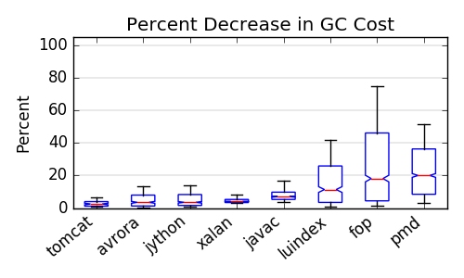
Cost reduction: Full GC
See the paper for more Full GC results

Slide 10
Making optimization practical
Group allocations into blocks, say 256 Kb
Reduces N by a factor of (say) 5000
Does this by constraining when GC occurs
Smaller blocks do not change things much
Pre-analyze object connectivity
Identify objects treated the same by GC
Summarize behavior in three numbers
No detailed simulation while optimizing!

Slide 11
Generational Collection
Splits heap into young and old portions
Allocation goes into the young generation
Full collection finds liveness of all objects
Young collection assumes old objects live
Thus treats some dead young objects as if live
We call these baggage
Young collection promotes apparently live young objects to old space

Slide 12
Model with Gen GC
FullCollect,
YoungCollect,
or
Heap
Death(σ^{O}, σ^{Y}, σ^{B})
F^{O}
F^{Y}
[σ ≤ F^{Y}] Alloc(σ)
Program
(Mutator)
Controller
HAlloc(σ)

Slide 13
States, effects with Gen GC
YC: L^{Y}+B {L^{Y}+B}
D(σ^{O},σ^{Y},σ^{B}): σ^{O}
FC: L^{Y} {L^{Y}}
F^{O} (free old)
(Initially S^{O})
L^{O} (live old)
(Initially 0)
D^{O} (dead old)
(Initially 0)
FC: D^{O} {L^{O}}
YC, FC: B
B (baggage)
(Initially 0)
[σ ≤ F^{Y} & S^{Y}-F^{Y} ≤ F^{O}]
Alloc(σ): σ
D(σ^{O},σ^{Y},σ^{B}): σ^{B}
D(σ^{O},σ^{Y},σ^{B}): σ^{Y}
F^{Y} (free young)
(Initially S^{Y})
L^{Y} (live young)
(Initially 0)
D^{Y} (dead young)
(Initially 0)
YC, FC: L^{Y}
YC, FC: D^{Y}

Slide 14
Impact on Optimization
Full GC cost, and resulting state, depends only on time of collection
This is not true for Young GC!
Previous promotions affect whether a dying object goes to D^{Y} or B …
Which later affects cost (and future promotion)
We approximate by considering visible states based on current time and time of previous collection

Slide 15
Computing Cost Efficiently
For a given trace, can precompute necessary reachability information, avoiding simulation
We have (birth, death) for each object
Precise death comes from Elephant Tracks’ analysis
Add prebirth, giving (prebirth, birth, death)
GC of object in Young space at t > death causes promotion if previous GC was between prebirth and birth
Aggregate blocks of objects by (p,b,d)

Slide 16
Prebirth Time
birth
x₀
death
Pointer existing when x₀ dies
x₁
x₀ has earliest birth among x_{n}’s predecessors
……………….
x_{n}
prebirth
birth
death
Collection here causes some x_{i} to be promoted – so x_{n} is reachable from Old space and will be promoted

Slide 17
Gen GC Optimization
Develop collection of sample states:
(F^{Y}, F^{O}, t_{last}, t_{now}) where t_{last} is time of most recent GC
Cost of legal actions (noC, YC, FC) in each state
Use “collect when full” to get to each t_{last}
Only a sample – full search space huge!
Treat as Markov decision process
Conflation of states treated as randomness
Apply Least Squares Policy Iteration

Slide 18
Experiments
7 programs from DaCapo suite + javac
For most of them, added more inputs
About 10² to 10⁴ 256 Kb blocks
Ran under Elephant Tracks to generate traces of alloc, death, pointer updates
Computed (prebirth,birth,death) times
Aggregated into blocks
Applied LSPI
Compared with default: collect when full

Slide 19
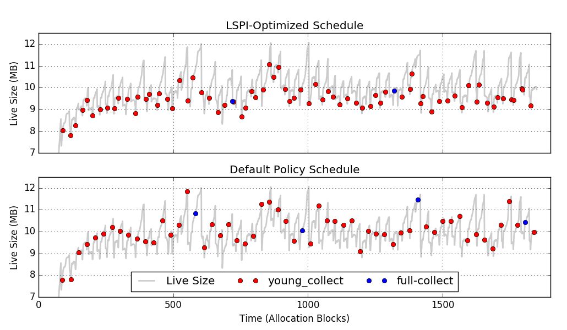
Results: Sample Schedules

Slide 20
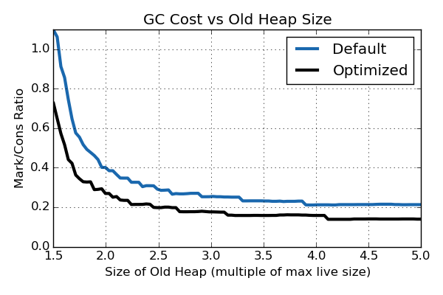
Cost vs Heap size (S^{Y}=8Mb)
Space savings
Cost savings

Slide 21
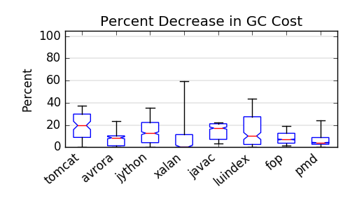
Reduction: Gen GC (S^{Y}=4Mb)

Slide 22
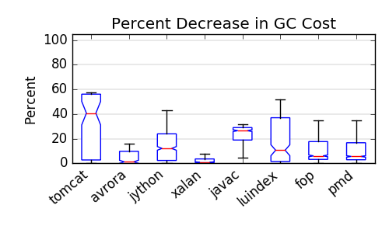
Reduction: Gen GC (S^{Y}=8Mb)

Slide 23
Additional Results
Improvement is not better for smaller blocks – more fragmentation, etc.
Cost of optimization is ~ O(N^{2.2})
More graphs in paper

Slide 24
Ongoing Work
Program-specific policies
Reinforcement learning, or “deep” learning
Collect feature-rich traces
Select features
Train GC triggering mechanism
Some success for “self test”
Generalization (over runs, heap sizes) hard
Hard lower bounds
Bound the baggage
Solve with dynamic programming

Slide 25
Conclusions
First per-program GC cost bounds
Program-specific GC policies promising
For at least some programs and heap sizes
Possibly useful reduction in GC time, or
Possibly substantial reduction in space
Sometimes hard to improve over default
Hard, not approximate, lower bounds would be welcome

Slide 26
Credits
Nicholas Jacek – RL work
Meng-Chieh (Joe) Chiu – ET work
Ben Marlin – co-PI
NSF Grant CCF-1320498

Slide 27
Markov Decision Process
A set of states, S
A set of actions, A
Probabilistic transition function:
a: p, cost
S₀
S₁

Slide 28
Reinforcement Learning
States s∈S, actions a∈A
Transition function T: S×A → S
“Policy” π: S→A (chooses action)
Bellman equation: value of each action in each state, for given policy π:
Q^{π}(s,a) = c₀ + Q^{π}(s’,π(s’)), for s’=T(s,a)
In matrix form:
Q^{π} = C + П^{π}Q^{π}
Given C and П^{π} can solve for Q^{π}

Slide 29
Policy Iteration (PI)
Sequence of policies π₀, π₁, …
Monotonically improving cost
Determine Q^{πm} for π_{m}
Form π_{m+1}(s) = arg min Q^{πm}(s,a)
That is, lowest cost action in each state, where remaining decision are as for π_{m}
This is no worse than π_{m}
Iterate until reach convergence: π*

Slide 30
Least Squares PI
Approximate Q^{π} as linear combination of a fixed set of basis functions Φ_{i}(s,a)
Weights θ_{i}
Matrix form: Q^{π} = Φ θ^{π}
Solves with standard linear methods
We use one basis function for each (s,a)
So: exact, not (additional) approximation
Cost is O(N³) per iteration, worst case
O(N^{2.2}) in practice
Using blocks was an important choice!

Slide 31
Learning “Take Home”
Use a big sample of states and cost
Approximation comes in this sampling
Our samples not random, but not full space
Solve with standard linear methods
Cost is O(N^{2.2})
Not really learning – an optimization technique borrowed from RL

