Slide 1


Higher-Order and Tuple-Based Massively-Parallel Prefix Sums
Sepideh Maleki*, Annie Yang, and Martin Burtscher
Department of Computer Science

Slide 2
Prefix Sum
Given an array of values (integer or real values)
Compute the array whose elements are the sum of all previous elements from the original array
A prefix scan is a generalization of the prefix sum where the operation doesn’t have to be addition
0
1
2
3
4
5
6
7
3
2
0
7
-6
1
-9
5
0
1
2
3
4
5
6
7
3
5
5
12
6
7
-2
3

Slide 3
Some Scan Operators
Operator | Identity element | Example
+ | 0 | X + 0 = X
Min | Maximum Representative value | Min(X, ∞) = X
Max | Minimum Representative value | Max(X, -∞) = X
Multiply | 1 | X * 1 = X
Logical Or | FALSE | X || FALSE = X
Logical AND | TRUE | X && TRUE = X

Slide 4
Uses of Prefix Sums and Scans
Fundamental building block of parallel algorithms
Can be computed efficiently in parallel in log(n) steps
Help parallelize many seemingly serial algorithms
Examples
Buffer allocation
Radix sort
Quicksort
String comparison
Lexical analysis
Run-length encoding
Histograms
Polynomial evaluation
Stream compaction
Data compression

Slide 5
Highlights
GPU-friendly algorithm for prefix scans called SAM
Novelties and features
Higher-order support that is communication optimal
Tuple-value support with constant workload per thread
Carry propagation scheme with O(1) auxiliary storage
Implemented in unified 100-statement CUDA kernel
Results
Outperforms CUB by up to 2.9-fold on higher-order and by up to 2.6-fold on tuple-based prefix sums

Slide 6
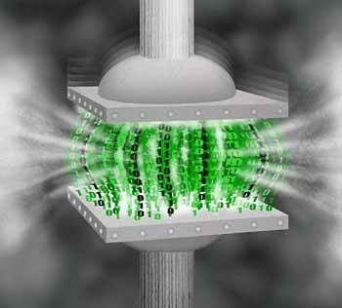
Data Compression
Data compression algorithms
Data model predicts next value in input sequence and emits difference between actual and predicted value
Coder maps frequently occurring values to produce shorter output than infrequent values
Delta encoding
Widely used data model
Computes difference sequence (i.e., predicts current value to be the same as previous value in sequence)
Used in image compression, speech compression, etc.
Charles Trevelyan for http://plus.maths.org/

Slide 7
Delta Coding
Delta encoding is embarrassingly parallel
Delta decoding appears to be sequential
Decoded prior value needed to decode current value
Prefix sum decodes delta encoded values
Decoding can also be done in parallel
Input sequence 1, 2, 3, 4, 5, 2, 4, 6, 8, 10
Difference sequence (encoding) 1, 1, 1, 1, 1, -3, 2, 2, 2, 2
Prefix sum (decoding) 1, 2, 3, 4, 5, 2, 4, 6, 8, 10

Slide 8
Extensions of Delta Coding
Higher orders
Higher-order predictions are often more accurate
First order out_{k} = in_{k} - in_{k-1}
Second order out_{k} = in_{k} - 2∙in_{k-1} + in_{k-2}
Third order out_{k} = in_{k} - 3∙in_{k-1} + 3∙in_{k-2} - in_{k-3}
Tuple values
Data frequently appear in tuples
Two-tuples x₀, y₀, x₁, y₁, x₂, y₂, …, x_{n-1}, y_{n-1}
Three-tuples x₀, y₀, z₀, x₁, y₁, z₁, …, x_{n-1}, y_{n-1}, z_{n-1}

Slide 9
Problem and Solution
Conventional prefix sums are insufficient
Do not decode higher-order delta encodings
Do not decode tuple-based delta encodings
Prior work
Requires inefficient workarounds to handle higher-order and tuple-based delta encodings
SAM algorithm and implementation
Directly and efficiently supports these generalizations
Even supports combination of higher orders and tuples

Slide 10

Work Efficiency of Prefix Sums
Sequential prefix sum requires only a single pass
2n data movement through memory
Linear O(n) complexity
Parallel algorithm should have same complexity
O(n) applications of the sum operator

Slide 11
Hierarchical Parallel Prefix Sum

Slide 12
Standard Prefix-Sum Implementation
Based on 3-phase approach
Reads and writes every element twice
4n main-memory accesses
Auxiliary array is stored in global memory
Calculation is performed across blocks
High-performance implementations
Allocate and process several values per thread
Thrust and CUDPP use this hierarchical approach

Slide 13
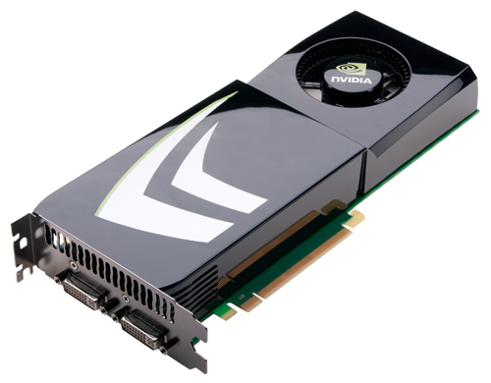
SAM Base Implementation
Intra-block prefix sums
Computes prefix sum of each chunk conventionally
Writes local sum of each chunk to auxiliary array
Writes ready flag to second auxiliary array
Inter-block prefix sums
Reads local sums of all prior chunks
Adds up local sums to calculate carry
Updates all values in chunk using carry
Writes final result to global memory

Slide 14



Pipelined Processing of Chunks
Block 1
Block 2
Block 3
Block 4
Sum1
Flag Array
Local Sum Array
Chunk 1
Sum2
Chunk 2
F1
S1
Sum3
Carry1 = 0
Chunk 3
F2
S2
Sum4
Carry2 = s1
Chunk 4
F3
S3
Time
Sum5
Chunk 5
Carry3 = s1+s2
F4
S4
Sum6
Chunk 6
Carry4 = s1+s2+s3
F5
S5
Sum7
Carry5 = Carry1 + Sum1 + s2+s3+s4
Chunk 7
F6
S6
Chunk 8
Carry6 = Carry2 + Sum2 + s3+s4+s5
Sum8
F7
S7
Carry7 = Carry3 + Sum3 + s4+s5+s6
F8
S8
Carry8 = Carry4 + Sum4 + s5+s6+s7

Slide 15
Carry Propagation Scheme
Persistent-block-based implementation
Same block processes every k^{th} chunk
Carries require only O(1) computation per chunk
Circular-buffer-based implementation
Only 3k elements needed at any point in time
Local sums and ready flags require O(1) storage
Redundant computations for latency hiding
Write-followed-by-independent-reads pattern
Multiple values processed per thread (fewer chunks)

Slide 16


Slide 17
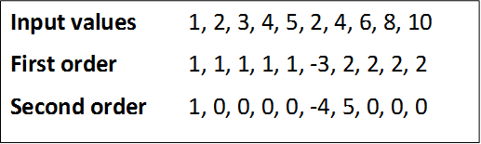
Higher-order Prefix Sums
Higher-order difference sequences can be computed by repeatedly applying first order
Prefix sum is the inverse of order-1 differencing
K prefix sums will decode an order-k sequence
No direct solution for computing higher orders
Must use iterative approach
Other codes’ memory accesses proportional to order

Slide 18
Higher-order Prefix Sums (cont.)
SAM is more efficient
Internally iterates only the computation phase
Does not read and write data in each iteration
Requires only 2n main-memory accesses for any order
SAM’s higher-order implementation
Employs multiple sum arrays, one per order
Each sum array is an O(1) circular buffer
Needs O(1) non-Boolean ready ‘flags’
Uses counts to indicate iteration of current local sum

Slide 19


Slide 20
Tuple-based Prefix Sums
Data may be tuple based x₀, y₀, x₁, y₁, …, x_{n-1}, y_{n-1}
Other codes have to handle tuples as follows
Reordering elements, compute, undo reordering
Slow due to reordering and may require extra memory
Defining a tuple data type as well as the plus operator
Slow for large tuples due to excessive register pressure
x₀, x₁, …, x_{n-1} | y₀, y₁, …, y_{n-1}
Σ₀⁰x_{i}, Σ₀¹x_{i}, …, Σ₀^{n-1}x_{i} | Σ₀⁰y_{i}, Σ₀¹y_{i}, …, Σ₀^{n-1}y_{i}
Σ₀⁰x_{i}, Σ₀⁰y_{i}, Σ₀1x_{i}, Σ₀¹y_{i}, …, Σ₀^{n-1}x_{i}, Σ₀^{n-1}y_{i}

Slide 21
Tuple-based Prefix Sums (cont.)
SAM is more efficient
No reordering
No special data types or overloaded operators
Always same amount of data per thread
SAM’s tuple implementation
Employs multiple sum arrays, one per tuple element
Each sum array is an O(1) circular buffer
Uses modulo operations to determine which array to use
Still employs single O(1) Boolean flag array

Slide 22
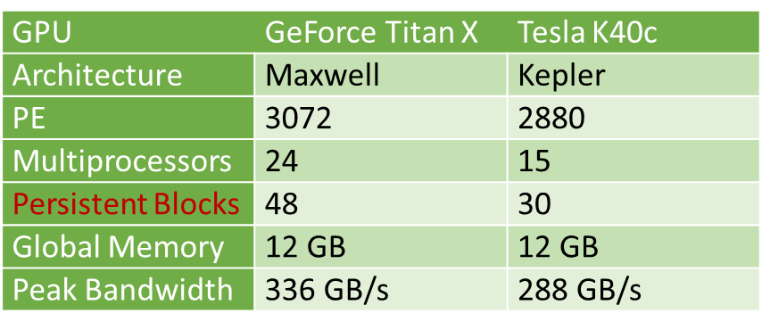
Experimental Methodology
Evaluate following prefix sum implementations
Thrust library (from CUDA Toolkit 7.5)
4n memory accesses
CUDPP library 2.2
4n memory accesses
CUB library 1.5.1
2n memory accesses
SAM 1.1
2n memory accesses

Slide 24
Prefix Sum Throughputs (Titan X)
32-bit integers
64-bit integers
SAM and CUB outperform the other approaches (2n vs. 4n)
For 64-bit values, throughputs are about half (but same GB/s)
SAM matches cudaMemcpy throughput at high end (264 GB/s)
Surprising since SAM was designed for higher orders and tuples

Slide 25
Prefix Sum Throughputs (K40)
32-bit integers
64-bit integers
K40 throughputs are lower for all algorithms
SAM is faster than Thrust/CUDPP on medium and large inputs
CUB outperforms SAM by 50% on large inputs on 32-bits ints
SAM’s implementation is not a particularly good fit for this older GPU

Slide 26
Higher-order Throughputs (Titan X)
32-bit integers
64-bit integers
Throughputs decrease as order increases due to more iterations
SAM’s performance advantage increases with higher orders
Always executes 2n global memory accesses
Outperforms CUB by 52% on order 2, 78% on order 5, and 87% on order 8

Slide 27
Higher-order Throughputs (K40)
32-bit integers
64-bit integers
CUB outperforms SAM on orders 2 and 5, but not on order 8
Again, SAM’s relative performance increases with higher orders
SAM’s relative performance over CUB is higher on 64-bit values
Baseline advantage of CUB over SAM is smaller for 64-bit values

Slide 28
Tuple-based Throughputs (Titan X)
32-bit integers
64-bit integers
Throughputs decrease with larger tuple sizes due to extra work
SAM’s performance advantage increases with larger tuple sizes
Larger tuples increase register pressure in CUB but not in SAM
SAM is 17% slower on 2-tuples but 20% faster on 5-tuples and 34% faster on 8-tuples

Slide 29
Tuple-based Throughputs (K40)
32-bit integers
64-bit integers
SAM outperforms CUB on 8-tuples (and larger tuples)
Again, SAM’s relative performance increases with larger tuple sizes
The benefit of SAM over CUB is higher with 64-bit values
SAM already outperforms CUB on 5-tuples

Slide 30
Summary
SAM directly supports generalized prefix scans
Higher-order prefix scans
Tuple-based prefix scans
SAM performance on Maxwell and Kepler GPUs
Reaches cudaMemcpy throughput on large inputs
Outperforms all alternatives by up to 2.9x on order-eight and by up to 2.6x on eight-tuple prefix sums
SAM’s relative performance increases with higher orders and larger tuple sizes

Slide 31

Question?
Contact Info: Smaleki@txstate.edu
http://cs.txstate.edu/~burtscher/research/SAM/
Acknowledgments
National Science Foundation
NVIDIA Corporation
Texas Advanced Computing Center

