Slide 1


Prediction for Airbnb New User Bookings
Where will users book their first travel destination?
Xia Xiaolong
Wang Sixin
Zhao Hengrui
Gao Wenhan

Slide 2


Problem Statement
Initiative
The development of internet opens a window of the colorful world; The improvement of people’s living standards gives people more choice
There are more than 150 billion travelers and 640,000 hosts in Airbnb, the amount of which are still rising.
Problem Statement
Data Description
Methodology & Implementation
Experimental Results
Conclusions

Slide 3



Problem Statement
Our project aims at using different algorithms to predict which country a new user will make the first booking on Airbnb.
Traveler
Hosts
Customize travel plan
Increase booking rate
Good reputation
Reduce their time for
Searching travel resort
Deciding their destinations
Make strategies of
Location choice
Problem Statement
Data Description
Methodology & Implementation
Experimental Results
Conclusions

Slide 4
Methodology
1
2
3
4
5
Data Exploration
Model Training
Model Optimization
Discussion and Summary
Feature Engineering
& Selection
Problem Statement
Data Description
Methodology & Implementation
Experimental Results
Conclusions

Slide 5
Data Description
Data Source
Kaggle Airbnb Recruiting: Airbnb New User Bookings.
Datasets
train_users.csv - the training set of users (213.5k Users, 14 Features)
test_users.csv - the test set of users (62.1k Users, 14 Features)
sessions.csv - web sessions log for users (10.6mil Session Details, 5 Features)
countries.csv - summary statistics of destination countries in this dataset and their locations
age_gender_bkts.csv - summary statistics of users' age group, gender, country of destination
sample_submission.csv - correct format for submitting predictions
Target Feature
Destination Country with 12 possible outcomes:
“US”, “FR, “CA”, “GB”, “ES”, “IT”, “PT”, “NL”, “DE”, “AU”, “NDF” (no destination found), and “other”.
Problem Statement
Data Description
Methodology & Implementation
Experimental Results
Conclusions

Slide 6
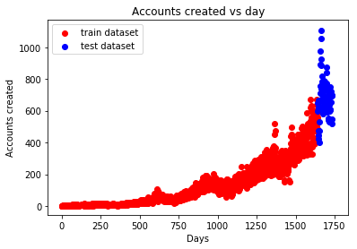
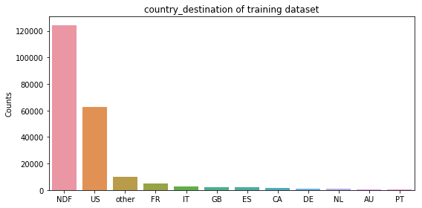
Data Exploration
“NDF” means the user ended up not booking any accommodations.
1600
Majority
Training dataset:
“days<1600” (before June 30, 2014)
Test dataset:
“days>1600” (after July 1, 2014)
"NDF" : largest share, over 120, 000 counts
“US”: the most popular destination 60,000 time
Problem Statement
Data Description
Methodology & Implementation
Experimental Results
Conclusions

Slide 7
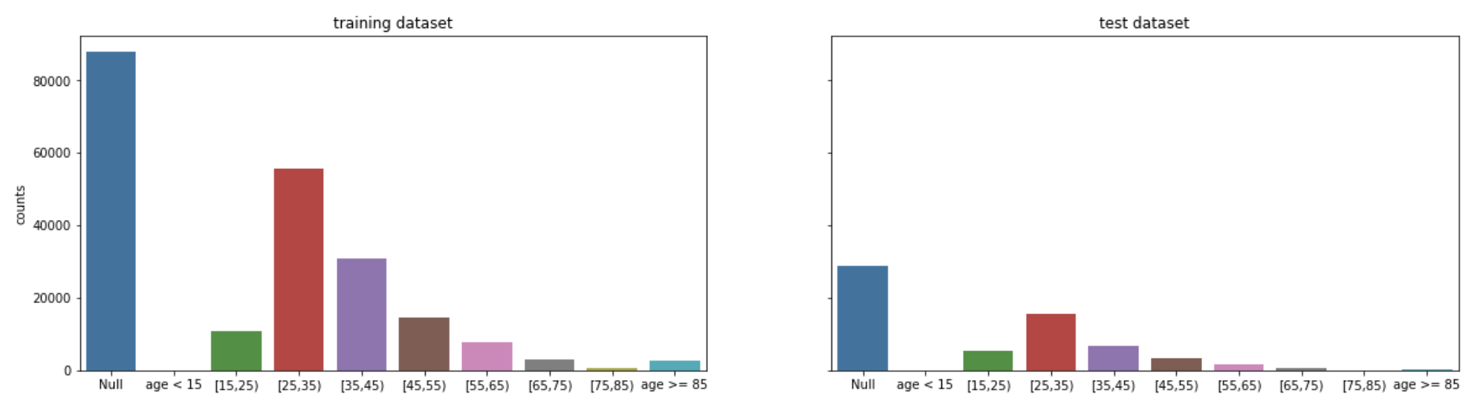
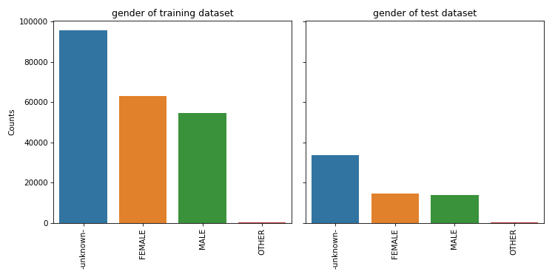
Data Exploration
User age distribution
Apart of null, 25-45 groups were majority
User gender distribution
Mostly unknown
Apart of null, female was majority
Problem Statement
Data Description
Methodology & Implementation
Experimental Results
Conclusions

Slide 8
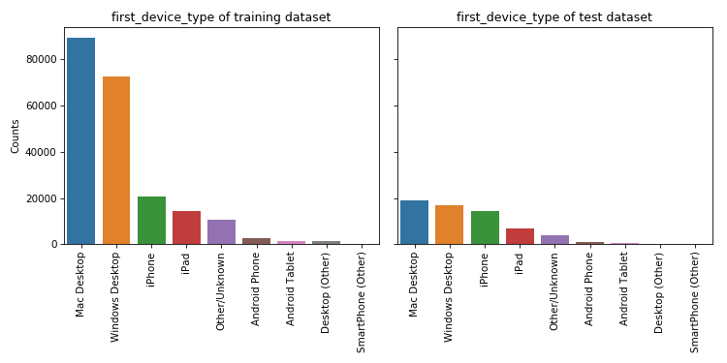
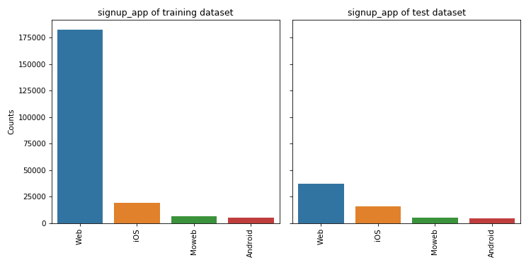
Data Exploration
All desktops devices > all mobiles devices
MacOS > Windows
iOS > Android
Web: the most common signup method
Much more than other mobile method (iOS, Mobile web or Android)
Problem Statement
Data Description
Methodology & Implementation
Experimental Results
Conclusions

Slide 9
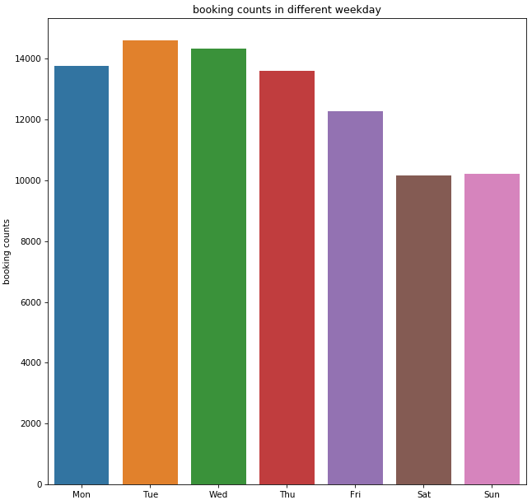
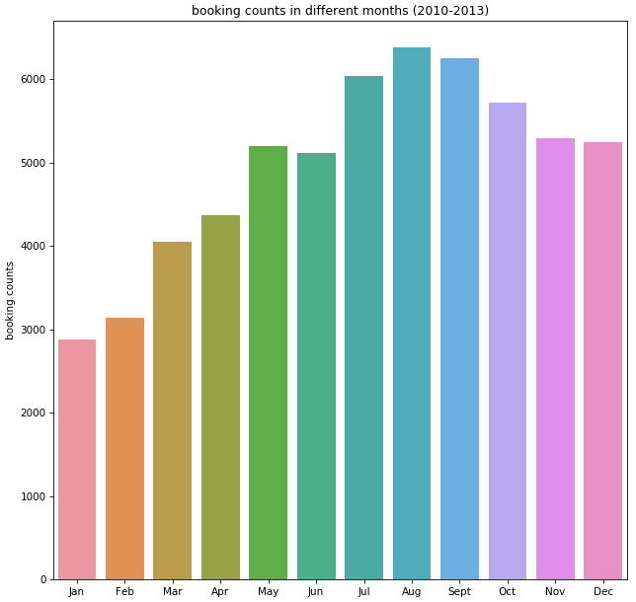
Data Exploration
Fewer bookings in weekends.
Summer: peak > January to April: clear dip
Seasonality of consumer interests in housing
Problem Statement
Data Description
Methodology & Implementation
Experimental Results
Conclusions

Slide 10
Feature Engineering
Missing Values Handling
all user dataset: 5 of 14 features have null values
session dataset: all of the 5 features have null values
Solution:
Replaced with 0 for. Missing value in “secs_elapsed”
Replaced with -1 for missing value in “action” & “action_type” & “action_detail”
Delete “data_first_booking” which is largely empty
03
Dataset Merging
training users and test users datasets were merged together for subsequent data preprocessing
01
02
Abnormal Values Handling
“Age” feature has values larger than 120, and some values are years, e.g. 1932, 1943.
Solution:
abnormal values, replaced with -1;
no. of year value, 2015- year=age
Problem Statement
Data Description
Methodology & Implementation
Experimental Results
Conclusions
Notes:
We cleaned up the dataset by dealing with abnormal values as well as missing values

Slide 11
Feature Engineering & Selection
Using domain knowledge of the data to create features that make algorithms work.
User Features
Merge
One Hot Coding
All Features
(648)
XGBoost
Features
Importance Ranking
Log Session Features
One hot encoding is a process by which categorical variables are converted into a form that could be provided to Machine Learning algorithms to do a better job in prediction
XGBoost is an improved algorithm based on the gradient boosting and can construct boosted trees efficiently and operate in parallel. Core of the algorithm is to optimize the value of objective function
Problem Statement
Data Description
Methodology & Implementation
Experimental Results
Conclusions

Slide 12
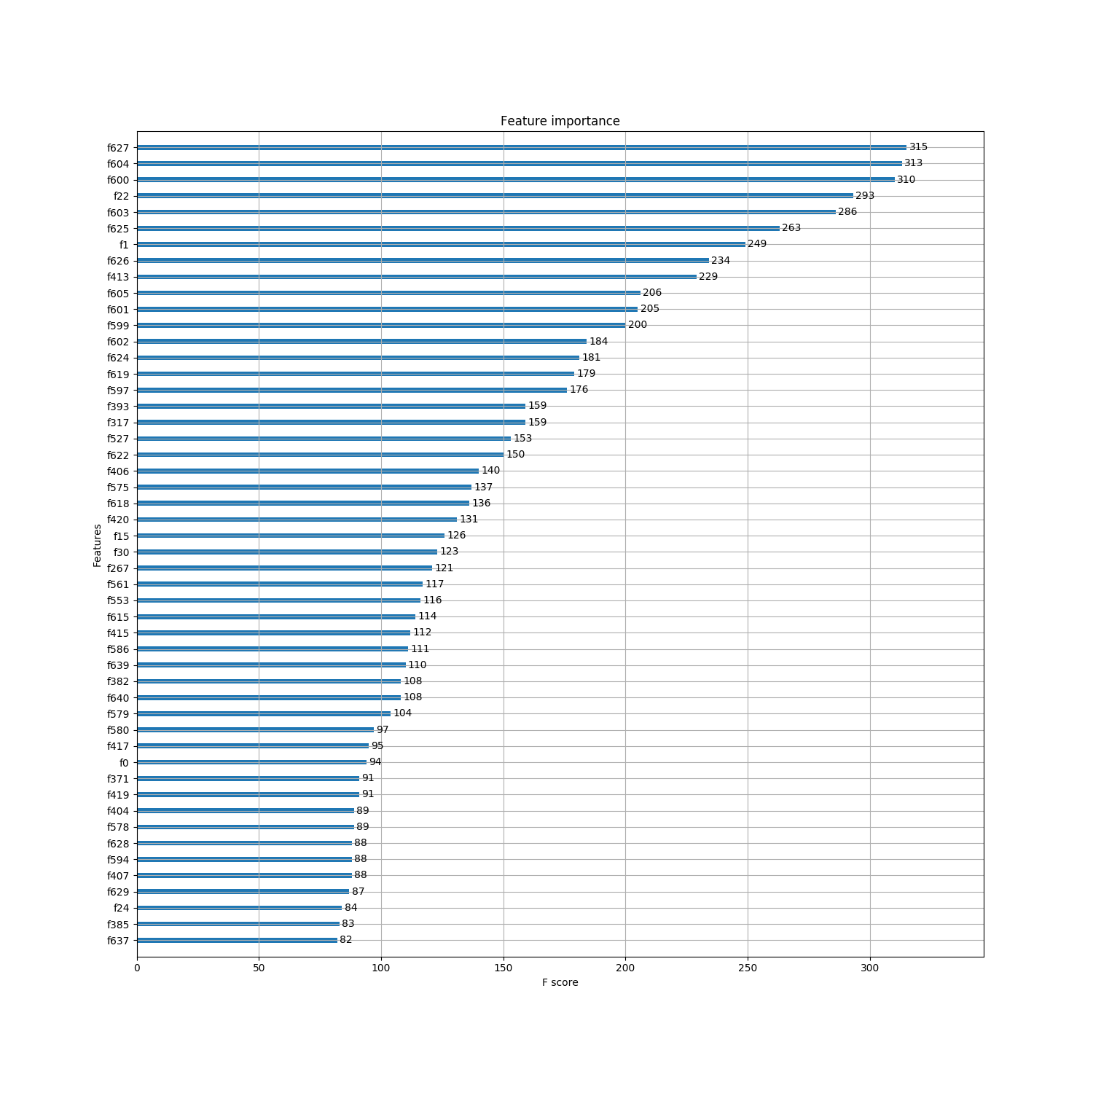
Feature Engineering & Selection
√
√
√
√
√
√
√
√
√
√
√
√
√
√
√
√
√
√
√
√
√
√
√
√
√
√
√
√
√
√
√
√
√
√
√
√
√
√
√
√
√
√
Features from session.csv: f187 to f648
Session data is important
Problem Statement
Data Description
Methodology & Implementation
Experimental Results
Conclusions

Slide 13
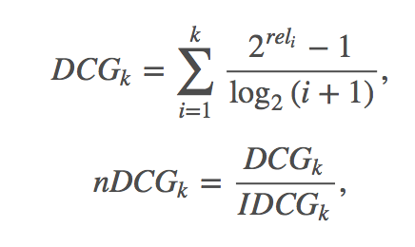
Evaluation Method
NDCG
(Normalized Discounted Cumulative Gain)
NDCG metric is calculated by the Kaggle system after submitting the prediction result file, it will directly decide our ranking position in the competition leaderboard.
(k=5)
where rel_{i} is the relevance of the result at position ii;
IDCG_{k} is the maximum possible (ideal) DCG for a given set of queries.
All NDCG calculations are relative values on the interval 0.0 to 1.0
Problem Statement
Data Description
Methodology & Implementation
Experimental Results
Conclusions
Notes:
Accuracy was used for our model selection, and NDCG is used by Kaggle system to evaluate the final prediction result. It takes the top 5 predicted probabilities for each user into consideration.

Slide 14
Model Training
training set with labels
# 73,815
test set without labels
# 62,096
actual training set
80%
20%
Validation set
model training
test-
model evaluation
test- submission file
Models
Problem Statement
Data Description
Methodology & Implementation
Experimental Results
Conclusions

Slide 15
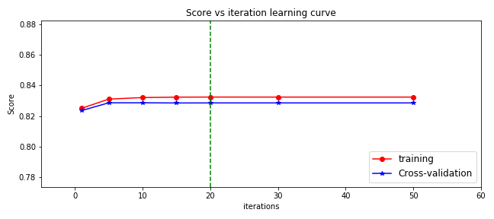
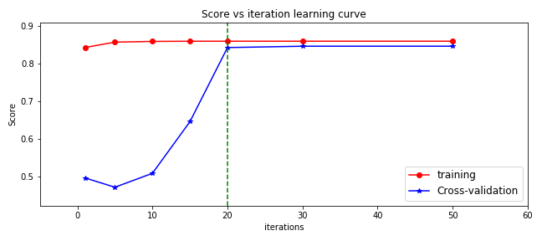
Model Training - Logistic Regression
Start with 50% of training data
# of iterations increased, NDCG score increased
After iterated for over 20 rounds, improvement shrunk.
Only adapt users’ records which include session data (35.8% of original training set)
Worked better than the previous one, even with less data records.
Problem Statement
Data Description
Methodology & Implementation
Experimental Results
Conclusions

Slide 16
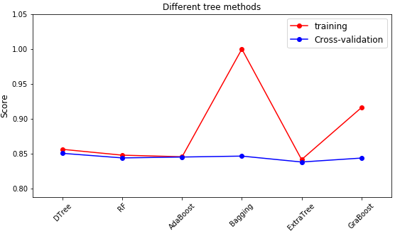
Model Training - Tree
Continued to train other algorithms with user records which includes session data .
Bagging was overfitting while Gradient Boosting performed good fits in both training and validation.
Problem Statement
Data Description
Methodology & Implementation
Experimental Results
Conclusions

Slide 17
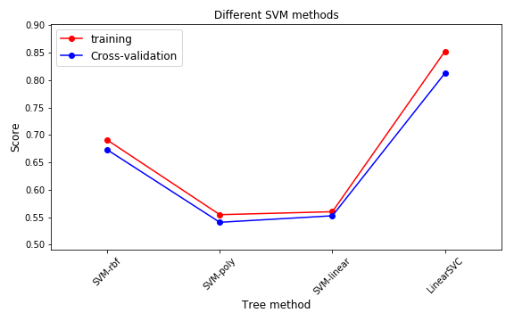
Model Training - SVM
Records are mapped as points in space, so that records from separate categories are divided by a clear gap that is as wide as possible.
In our case, Linear SVC outperformed other SVM classifiers.
Problem Statement
Data Description
Methodology & Implementation
Experimental Results
Conclusions

Slide 18
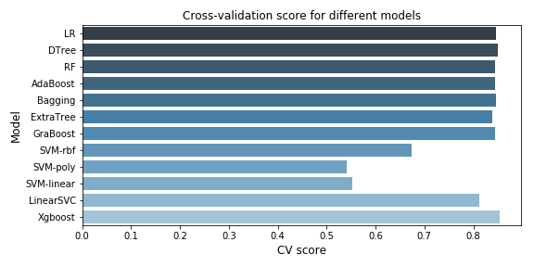
Model Training - Comparison
√（85.43%）
As the XGBoost Algorithm performed better than other algorithms, we had a further study to specify the best performance parameters.
Also imported prediction of this XGBoost model onto Kaggle.com, got testing NDCG score 0.8201
Problem Statement
Data Description
Methodology & Implementation
Experimental Results
Conclusions

Slide 19
Optimization
Comparison of results of different num_round
Dropped “month_account_created” and “year_account_created”. They benefitted training and validation performance, but no good for testing NDCG.
num_round is the number of rounds for XGBoosting. Higher value resulted in better training performance but easily lead to overfitting.
# of round settled to num_round =60, choosing based on testing NDCG score
Model | Fixed Parameters | Comparison parameter | Training NDCG | Testing NDCG
1 | max_depth=6, eta=0.1, subsample=0.8, colsample_bytree=0.6, seed=2018, eval_metric= “merror”, objective= "multi:softprob", nclass=12 | num_round =30 | 0.8688 | 0.8546
2 |  | num_round =60 | 0.8775 | 0.8550
3 |  | num_round =90 | 0.8855 | 0.8549
Problem Statement
Data Description
Methodology & Implementation
Experimental Results
Conclusions

Slide 20
Optimization
Comparison of results of different max_depth
After determined num_round, we compared models with different max_depth.
Max_depth is the maximum depth of a tree. Increasing depth value made the model more complex and more likely to overfit.
# of max depth settled to max_depth=5, choosing based on testing NDCG score
Model | Fixed Parameters | Comparison parameter | Training NDCG | Validation NDCG
4 | eta=0.1, num_round =60, subsample=0.8, colsample_bytree=0.6, seed=2018, eval_metric= “merror”, objective= "multi:softprob", nclass=12 | max_depth=4 | 0.8549 | 0.8481
5 |  | max_depth=5 | 0.8553 | 0.8645
6 |  | max_depth=6 | 0.8552 | 0.8567
7 |  | max_depth=7 | 0.8550 | 0.8562
Problem Statement
Data Description
Methodology & Implementation
Experimental Results
Conclusions

Slide 21
Optimization
Comparison of results of different # of features
In practical applications, determining the number of selected features is also an important issue.
Removing unimportant features will increase testing performance, but removing too many features will affect the model.
Time and memory consumption of model using part of features is more efficient.
# of features were decided on 300.
Model | Feature number | Validation NDCG | Testing NDCG
8 | Full features | 0.8553 | 0.8645
9 | Top 400 features | 0.8550 | 0.8803
10 | Top 300 features | 0.8549 | 0.8805
11 | Top 200 features | 0.8553 | 0.8801
Problem Statement
Data Description
Methodology & Implementation
Experimental Results
Conclusions

Slide 22
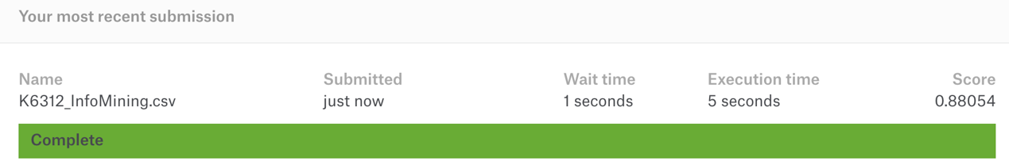
Result
88%
20%
Report
TOP
testing NDCG score
on leadership board
Problem Statement
Data Description
Methodology & Implementation
Experimental Results
Conclusions

Slide 23

Discussion & Summary
Middle > Youth > Senior
Mobile devices → NDF outcome
01
58% → Apple products
& desktop devices.
Distribute more marketing resource
02
Not fill-in their information
→the least likely to book
Need for improving user experience
on mobile devices
03
Increase attractiveness to Android users (credits reward system)
More marketing effort to increase rate of conversion
04
Problem Statement
Data Description
Methodology & Implementation
Experimental Results
Conclusions

Slide 24
Limitations
Only Adapt Part of User Data
Limitation on Time and Computer
Data Quality
No session data in 2010~2013, so the majority of users cannot be used.
No seasonal overlap with the training and test set of users lead to lack of information for accurate prediction
Most booking destinations lie in “NDF” and “US”--- cause problems in predicting destinations in other countries
Only use part of records for model training
Some more complex models are not adopted such as stacking
Deep learning algorithms might be more suitable due to the large volume data and diverse features
Problem Statement
Data Description
Methodology & Implementation
Experimental Results
Conclusions

Slide 25

Thank you!

