Slide 1
FELIX: A Virtual Learning Environment and an Intelligent Tutoring System to learn and apply Fire Safety
Béatrice Moissinac, School of Electrical Engineering and Computer Science
Kimmy Hescock, Technology Across the Curriculum
Jon Dorbolo, Technology Across the Curriculum

Slide 2
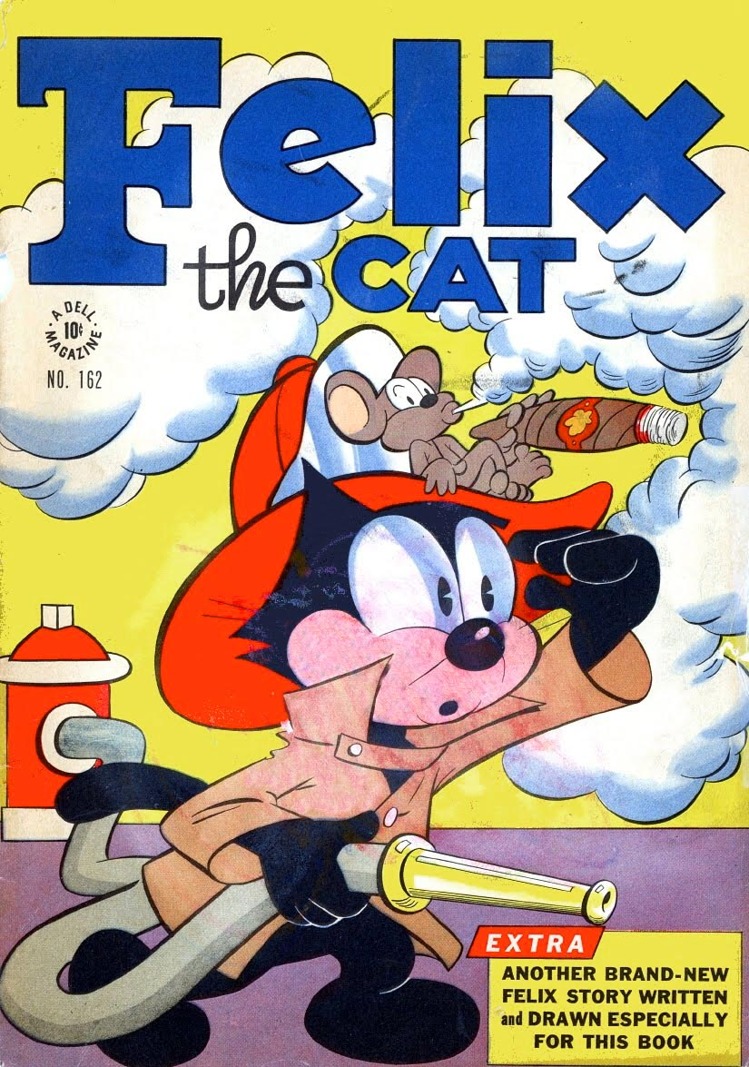
Fire Escape Learning Instrument X

Slide 3
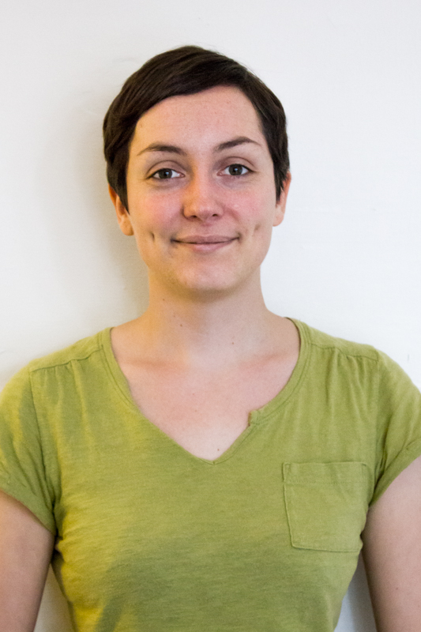
Fire Escape Learning Instrument X
Virtual
Learning Environment
Intelligent
Tutoring
System
TAC
PhD

Slide 4
Why a Virtual Learning Environment?
What’s done at OSU right now.
Immersion
Action
Narration
VLE

Slide 5


Why an Intelligent Tutoring System?
Hypothesis: ITS performs at least as well as one-on-one tutoring on the same set of skills and lessons.
VS

Slide 6
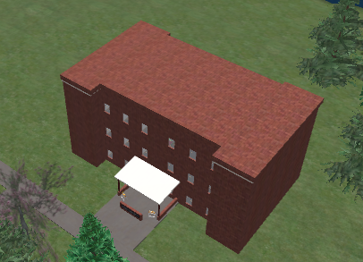
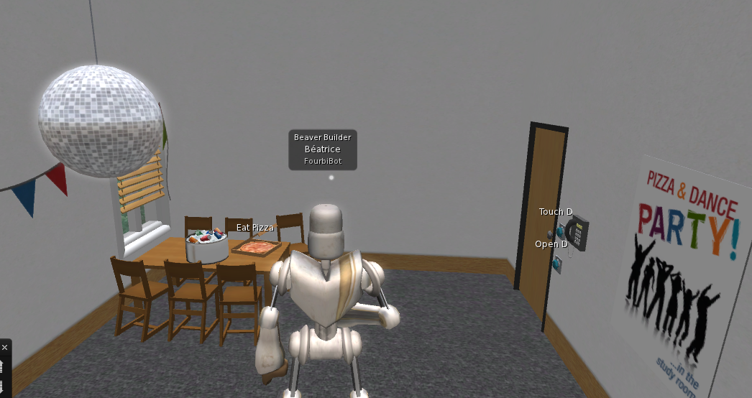
How is FELIX’s VLE Implemented?
Second Life
DEMO!

Slide 7
ITS Architecture
Offline
Online
Domain Knowledge
Cognitive Model used for knowledge tracing
Learn to be an expert
Design lessons and corresponding exercises using Cognitive model

Slide 8
ITS Challenges: Knowledge representation
Check
for smoke
True
False
Smoke
Action(check_smoke)
True
False
Crawl
True
Door
False
True
False
Action(crawl)
Check for
heat
Action(move)
True
False
Heat
Action(check_heat)
True
False
Action(move)
Action(open)

Slide 9
ITS Challenges: Knowledge representation (continued)
Exit Building
Change Floor
Window
Open Door
Distraction
Lift
Stairs
Open
Jump
Smoke
Open
Check Heat
Get Distracted
Go to Exit
Check Smoke
Crawl
Front Hand
Back Hand
Go Right
Go Left
Go Forward
Go backward

Slide 10
ITS Challenges (continued)
Cognitive Model: How does the student learn?
Knowledge tracing (Assessment)

Slide 11
ITS – Preliminary Results
ITS can learn to be an expert
ITS can designs lessons and exercises given a Cognitive Model

Slide 12
What’s next?
Implement ITS in VLE
Run user studies

Slide 13
Q&A
Thank you!

