Slide 1
Problem Statement
Are the first-2-hours engagement immediately after signup (onboarding experience) correlated to free trialer’s bill through rate?
What are drivers?

Slide 2
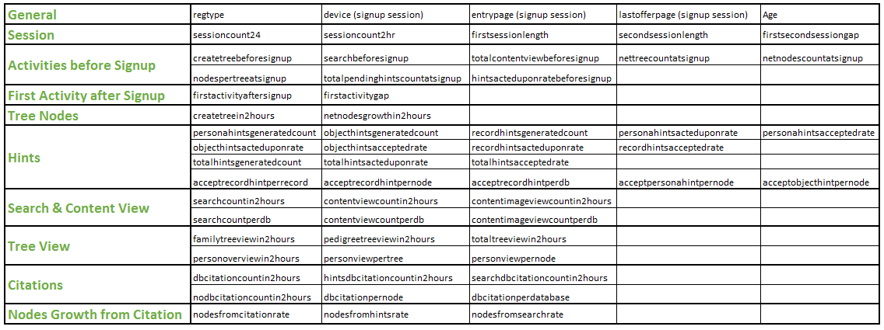
Variables Used in Analysis

Slide 3
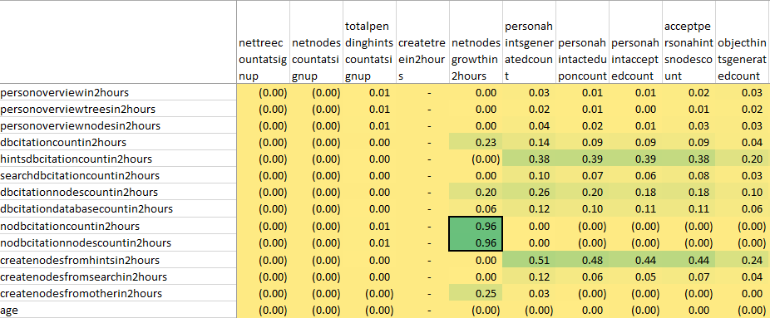
Scale numerical variables and removed those which have high covariance
Removed

Slide 4
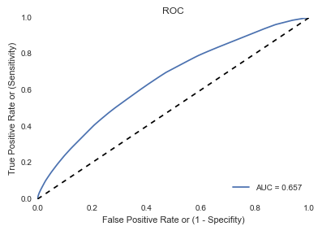
Model Parameter and Performance
Decision Tree
Max tree depth = 7

Slide 5
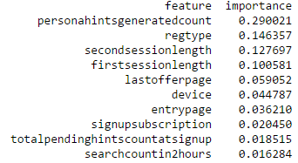
Important Variables

Slide 6
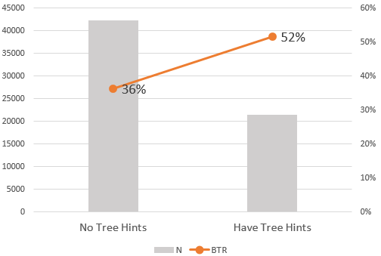
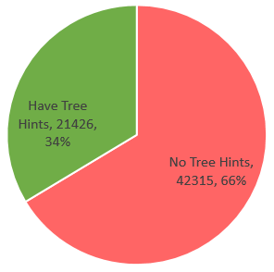
The most important Variable:
Whether Tree Hints Are Generated

