Slide 1
Data Science Final Project
Cindy Wang
July 2015

Slide 2
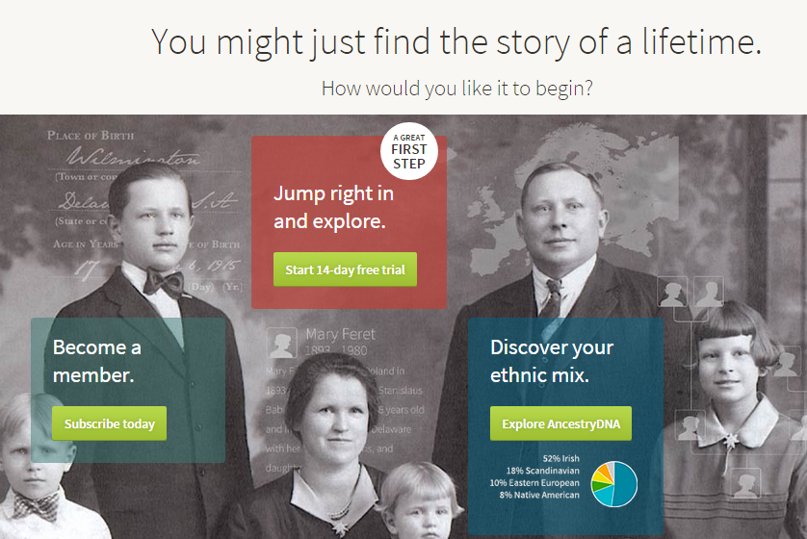
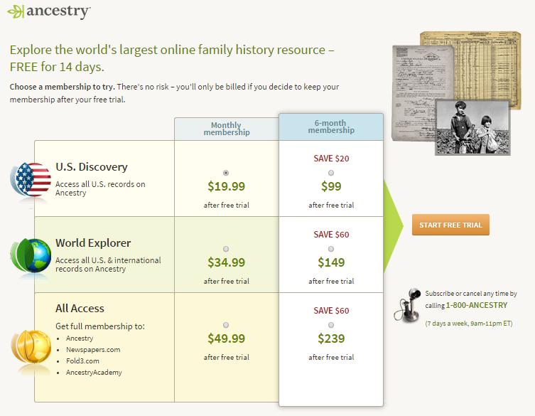

Slide 3
Problem Statement: Any early indicator of bill through rate?
Data source: Product feature database, log data in Hadoop and user order data
Data cleanup:
Standardized timestamps, sequenced all events and aggregate at user level
Only keep brand new users
Variables:
Product purchased?
How people registered?
First-2-hours engagement?

Slide 4
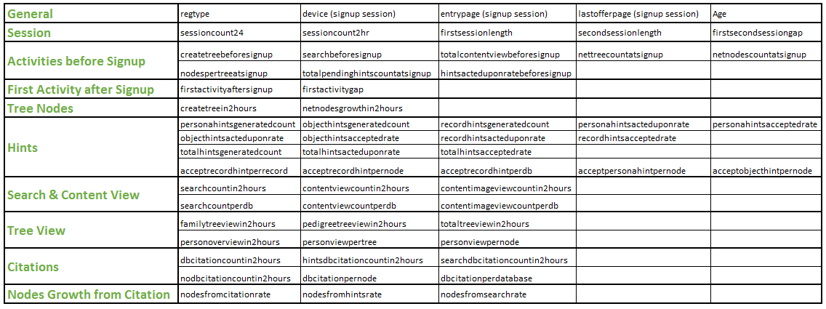
Variables in details

Slide 5
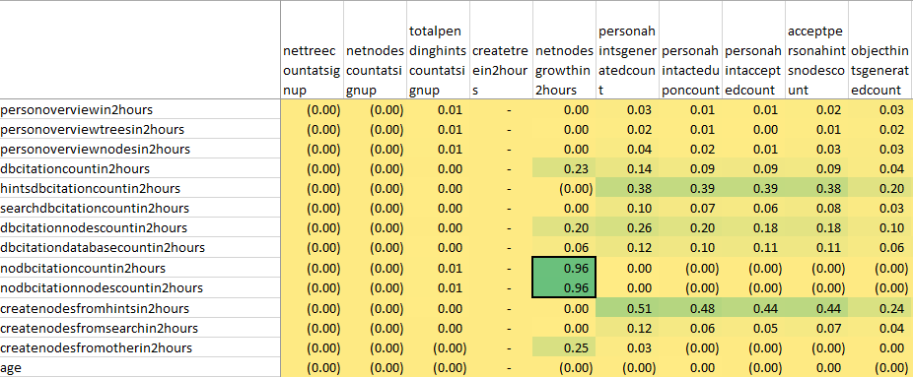
Scale numerical variables and removed those which have high covariance
Removed

Slide 6
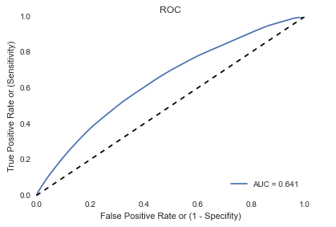
Model Parameter and Performance
Decision Tree
Max tree depth = 6 (Test 2 ~ 19)
Min Leaf Size 1% (Test 1% ~ 10%)
AUC = 0.641
True Positive Rate (Recall)
38%
False Positive Rate
20.1%
Precision
57%

Slide 7
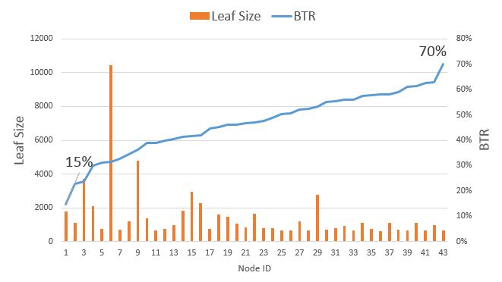
Best
Other than FT Signup Flow
Have tree with pending hints before signup
In first 2 hours
Have 7+ New Hint Generated
<=7 Searches
Worst
FT Signup Flow
Purchase radical offer
In first 2 hours
No New Hint Generated
First session <=21 mins
Second session <=4 mins

Slide 8
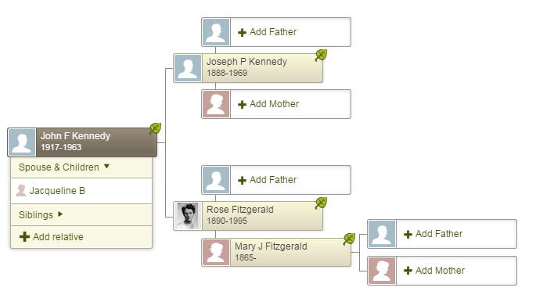
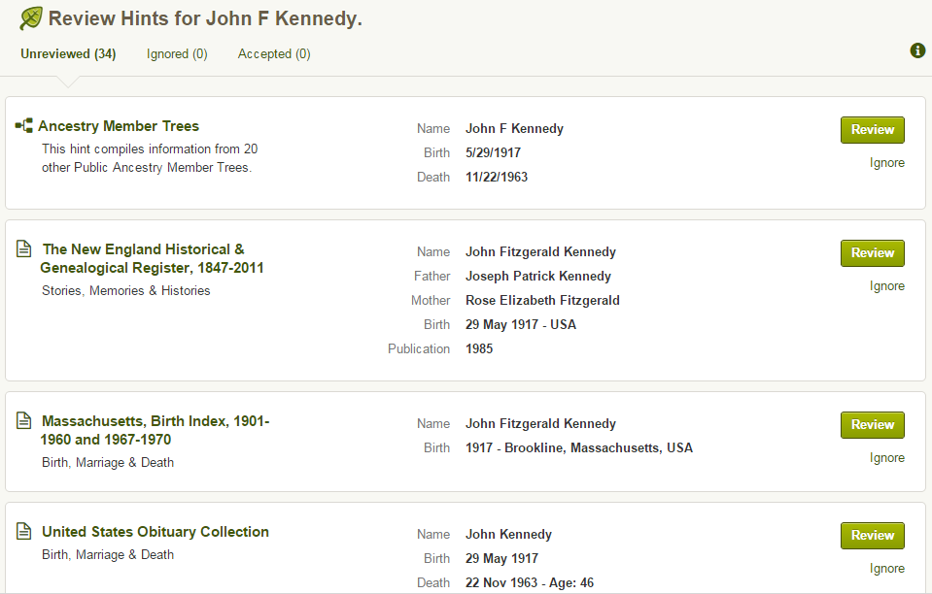

Slide 9
Decision Tree Visualization
BTR = XX%
Billthrough Rate
Root
BTR= 41%, N=64k
Increasing BTR
Decreasing BTR
Decision point/leaf
No New Hint
BTR = 36%, N=42k
Have New Hint
BTR = 52%, N=21k
FT Signup Reg
BTR = 34%, N=34k
Not FT SU Reg
BTR = 47%, N=8k
FT Signup Reg
BTR = 49%, N=15k
Not FT SU Reg
BTR = 59%, N=6k
2rd Session <=4.5
BTR = 31%, N=27k
2rd Session >4.5
BTR = 44%, N=7k
2rd Session <=18.5
BTR = 46%, N=10k
2rd Session >18.5
BTR = 54%, N=5k
2rd Session <=10.5
BTR = 45%, N=6k
2rd Session >10.5
BTR = 55%, N=2k
No Pending Hint
BTR = 56%, N=4k
Have Pending Hint
BTR = 63%, N=2k

Slide 10
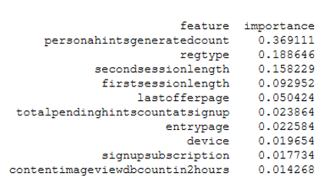
Important Variables

Slide 11
New Problem Statement: Minimal user input to trigger hint generation?
Data source: Service log which captured hint generation request and result
Log cleanup:
Keep all attends which didn’t succeed and de-duped all variables
For those attends which succeeded, only keep the first one
Variables:
Gender
# of Names (First, Middle and Last)
# of relatives (# of other nodes in tree)
# and type of facts (residence, military, marriage and etc.)
Birth Date and Location
Death date and location

Slide 12
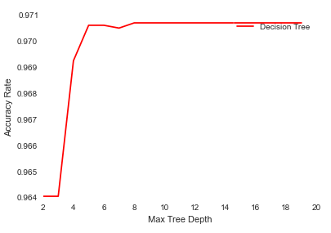
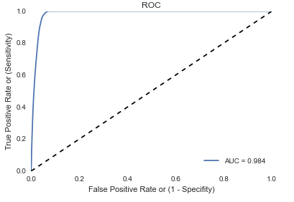
Model Parameter and Performance
Decision Tree – unbalanced dataset
Max tree depth = 8 (Test 2 ~ 19)
Min Leaf Size 3000
AUC = 0.986
True Positive Rate (Recall)
47.6 %
False Positive Rate
1 %
Precision
62 %

Slide 13
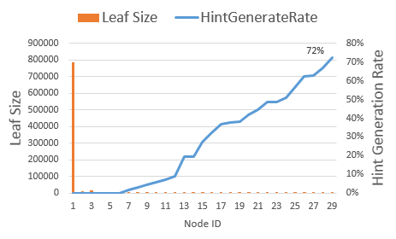
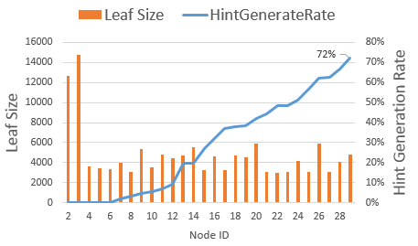
Best:
Has Death Date
Has birth date before 1922
First Node in the tree
Have three pieces of name
No birth state
Male
Worst:
No Death Date
Have Death Date, but No Birth Date

Slide 14
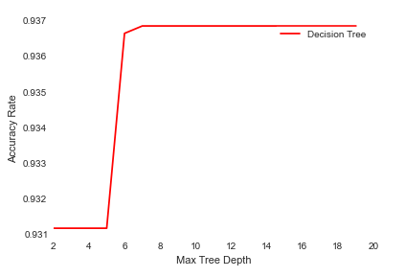
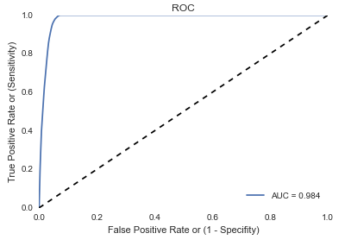
Model Parameter and Performance
Decision Tree – class weight = “auto”
Max tree depth = 7 (Test 2 ~ 19)
Min Leaf Size 3000
AUC = 0.986
True Positive Rate (Recall)
99.7 %
False Positive Rate
6.7 %
Precision
36 %

Slide 15
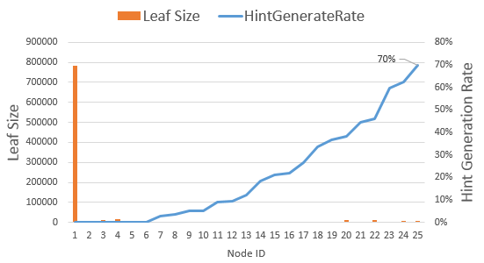
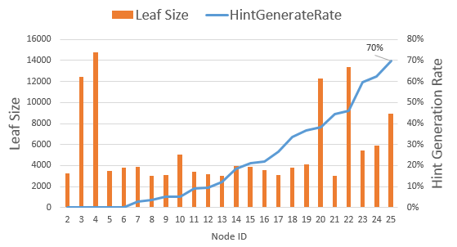
Best:
Has Death Date
Has birth date before 1922
First Node in the tree
Have three pieces of name
No Birth State
Worst:
No Death Date
Have Death Date, but No Birth Date

Slide 16
Root
HR= 4%, N=920K
Decision Tree Visualization
Not Dead Node
HR = 0%, N=806K
Dead Node
HR = 30%, N=111k
HR = XX%
Hint Generate Rate
Increasing HR
Decreasing HR
No Birth Date
HR = 0%, N=15k
Have Birth Date
HR = 34%, N=96k
Decision point/leaf
Tree Size > 1
HR = 21%, N=42k
First Node
HR = 45%, N=54k
Weird birth year
HR = 16%, N=7k
Valid birth year
HR = 49%, N=47k
Not three names
HR = 41%, N=28k
Three names
HR = 63%, N=18k
Born after 1922
HR = 45%, N=3k
Born before 1922
HR = 67%, N=15k
Born after 1930
HR = 27%, N=3k
Born before 1811
HR = 38%, N=12k
1811~1930
HR = 46%, N=13k

Slide 17
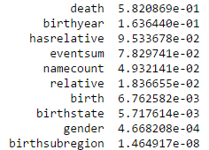
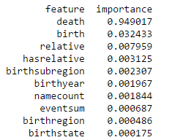
Important Variables
Not Balanced Dataset
Balanced Dataset

Slide 18
Summary
There were early indicator of bill through rate
Registrant Type, Product/Offer Purchased
First 2 hours: Whether hint generated, 1st/2nd session length
However, there were other factors playing big role considering low AUC value
What drive hint generation?
Dead node as first node with birth year old enough
Better to have three pieces of names

