Slide 1
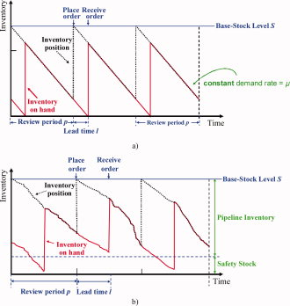
Integrated multi‐echelon supply chain design with inventories under uncertainty: MINLP models, computational strategies
AIChE Journal Volume 56, Issue 2, pages 419-440, 15 SEP 2009 DOI: 10.1002/aic.12010 http://onlinelibrary.wiley.com/doi/10.1002/aic.12010/full#fig1
Notes:
Inventory profile under base stock policy.(a) Deterministic demand case. (b) Under demand uncertainty. [Color figure can be viewed in the online issue, which is available at www.interscience.wiley.com.]
IF THIS IMAGE HAS BEEN PROVIDED BY OR IS OWNED BY A THIRD PARTY, AS INDICATED IN THE CAPTION LINE, THEN FURTHER PERMISSION MAY BE NEEDED BEFORE ANY FURTHER USE. PLEASE CONTACT WILEY'S PERMISSIONS DEPARTMENT ON PERMISSIONS@WILEY.COM OR USE THE RIGHTSLINK SERVICE BY CLICKING ON THE 'REQUEST PERMISSIONS' LINK ACCOMPANYING THIS ARTICLE. WILEY OR AUTHOR OWNED IMAGES MAY BE USED FOR NON-COMMERCIAL PURPOSES, SUBJECT TO PROPER CITATION OF THE ARTICLE, AUTHOR, AND PUBLISHER.

