Slide 1

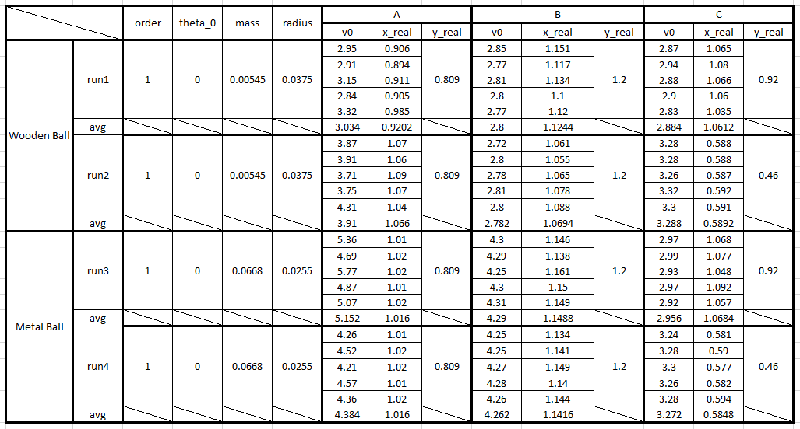
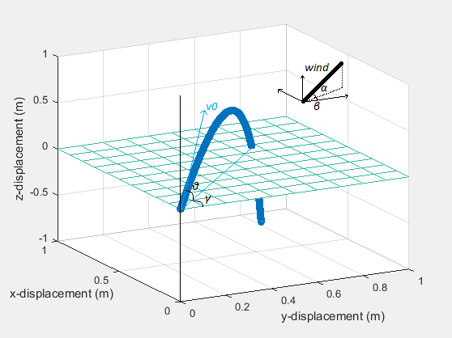
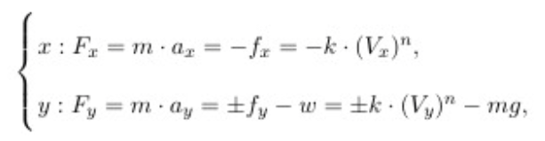
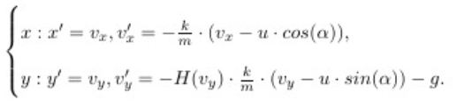
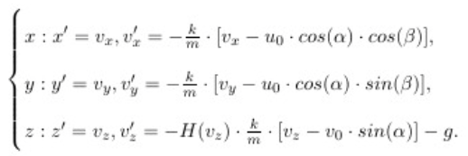

θ(0) = 75◦ , v(0) = 5 m/s, k = 0.008 (wooden ball)
θ(0) = 75◦ , v(0) = 5 m/s, k = 0.164 (metal ball)
θ(0) = 75◦ , v(0) = 5 m/s, k = 0.008 (wooden ball)
θ(0) = 75◦ , v(0) = 5 m/s, k = 0.164 (metal ball)
θ(0) = 75◦ , v(0) = 5 m/s, k = 0.008 (wooden ball)
θ(0) = 75◦ , v(0) = 5 m/s, k = 0.164 (metal ball)
θ(0) = 75◦ , v(0) = 5 m/s, k = 0.008 (wooden ball)
θ(0) = 75◦ , v(0) = 5 m/s, k = 0.164 (metal ball)
How to Be a Good Shooter: Analysis of Projectile Motion
Math Modeling Final Project
Jianqiu Bai
θ(0) = 75◦ , v(0) = 5 m/s, k = 0.008 (wooden ball)
θ(0) = 75◦ , v(0) = 5 m/s, k = 0.164 (metal ball)
θ(0) = 75◦ , v(0) = 5 m/s, k = 0.008 (wooden ball)
θ(0) = 75◦ , v(0) = 5 m/s, k = 0.164 (metal ball)
Abstract
Assumption and Model
Methods and Results
This study investigates the projectile motion associated with air resistance. A 2D and a 3D model are built based on Newton’s Second Law. According to the built model, the task is, from experimental data, specifically focusing on computing the drag friction coefficient, and figuring out the relationship between the friction and the object's velocity, and then finding the optimal launch angle.
Assumption
The friction is linear to the compounded velocity of the object over time t.
Any object should have a different k value due to its quality and shape.
Model
Newton’s Second Law: Newton's Second Law states that the net force on an object is the product of the object's mass and acceleration, F = ma.
2D Model:
3D Model:
Newton’s Second Law: Newton's Second Law states that the net force on an object is the product of the object's mass and acceleration, F = ma.
2D Model:
3D Model:
Data Management: The data is from Physics 111 Projectile Motion Lab. In that lab, students are asked to launch different kinds of balls by a launch machine on a table, and the ball will fall as a projectile motion when it goes to the edge of the table.
Find k: Assuming k = 0.01 initially, calling fminseach function to keep tracking k till the simulated trajectory gets closest to the real x - displacement and y – displacement. The final averaged optimal k = 0.008.
Find Optimal θ and v0: Assuming θ0 = 75 degrees and v0 = 5 m/s, which are pretty realistic assumptions in this case. Setting up θ0 and v0 as a vector, calling fminsearch function to keep tracking the vector as a whole till the simulated trajectory gets closest to the position of the hoop which is set at (0.5, 0.5) to the launch position. The optimal launch angle is 75.970 degrees and optimal initial velocity is 5 m/s.
Introduction
The projectile motion is the motion compounded of one which is uniform and horizontal and of another which is vertical and naturally accelerated.
Launch Velocity – v0.
Launch Angle – θ0.
Friction: air resistance, wind
References
Acknowledgments
Conclusion
[1] Korn, Granino A. Advanced Dynamic-system Simulation: Model - replication and Monte Carlo Studies. New Jersey, 2013.
[2] Kuehn, Kerry. A Student’s Guide through the Great Physics Texts. Springer, New York. 2015.
[3] Ahmad, Bashir, Hanan Batarfi, Juan J. Nieto, Óscar Otero-Zarraquiños, and Wafa Shammakh. "Projectile Motion via Riemann-Liouville Calculus." Adv Differ Equ Advances in Difference Equations 2015.1 (2015): n. pag. Web.
[4] Bernardo, Reginald Christian, Jose Perico Esguerra, Jazmine Day Vallejos, and Jeff Jerard Canda. "Wind-influenced Projectile Motion." European Journal of Physics 36, no. 2 (2015): 025016.
[5] Andersen, Poul Winther. "Comment on ‘Wind-influenced Projectile Motion’." European Journal of Physics Eur. J. Phys. 36, no. 6 (2015): 068003.
I had a conversation with Professor John Lindner. He confirmed that the order of the friction formula that I used in my project being 1 is realistic.
Wooden ball: k = 0.008, θ0 = 75.970 degrees, v0 = 5 m/s
Metal ball: k = 0.164, θ0 = 71.279 degrees, v0 = 5.273 m/s
Limitations: Only three students’ lab data have been utilized, which is not sufficient for calculation.

