Slide 1
Distributed Programming with Types and Supervision Tree:
Third Year PhD Progress Report
Jiansen HE
06 Sep 2013

Slide 2
Thesis Plan
TAkka = Typed Actor + Supervision
  Design and Implementation
  Measurement: Expressiveness & Scalability
  Helper Libraries: Chaos Monkey & Supervision View
Supervision as a Design Pattern
  Elements
  Reliability Measurement and Prediction

Slide 3
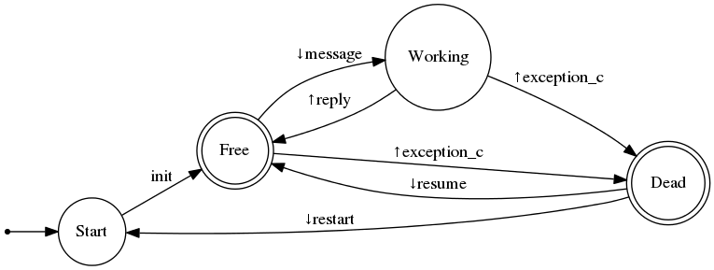
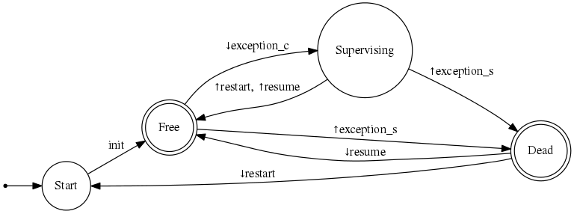
Supervision Tree: Node
Worker:
Supervisor:
Reliability(node) = P(node, Free)

Slide 4
Supervision Tree
SupTree = Worker a
| OneForOne Sup [SupTreei]
| OneForAll Sup [SupTreei]
| RestForOne Sup [SupTreei]
| ...

Slide 5
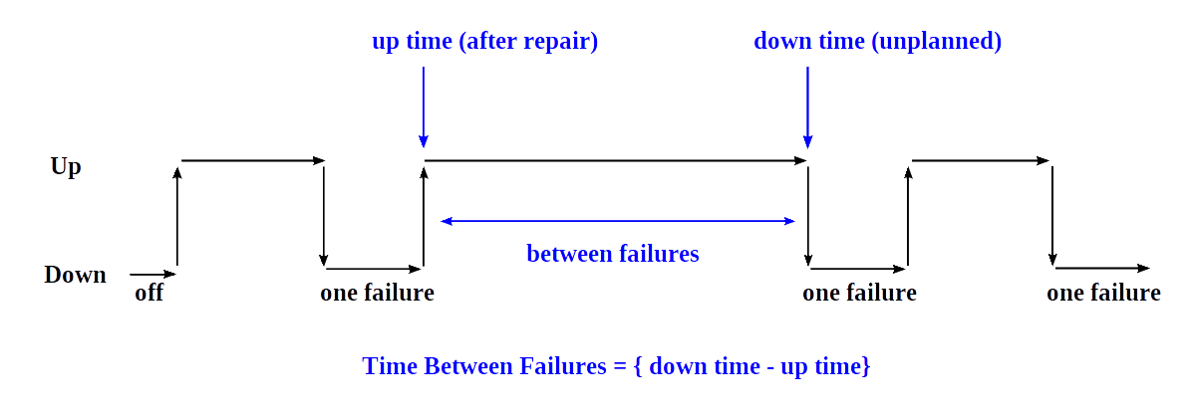
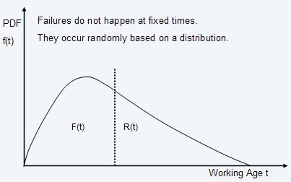





Reliability: Statistic Background
Reliability Function:
Failure Rate:
Hazard Function:
Mean Time Between Failures:
Check:

Slide 6


