Slide 1
Lecture 3: electrophysiology

Slide 2
Types of recording preparations
In vitro for ion channels
Xenopus oocytes
HEK293 cells
Purified proteins in lipids
Neurons in vitro
Cultured neurons
Squid axon
Neurons ex vivo
Slices: acute vs. slice culture
Anesthetized animal
Head-fixed awake animal
Freely moving animal

Slide 3
Types of electrodes and recordings
Intracellular
Sharp electrode
Patch electrode: cell-attached vs. perforated vs. whole-cell
Sharpened tungsten (experimental, not widely used)
Juxtacellular/loose patch
Excellent unit isolation
Cells can be filled iontophoretically
Extracellular
Different metal wire types: tungsten, nichrome, stainless steel
Multisite: stereotrode, tetrode, silicon probe
Field potentials
LFP: large wires
EEG: large surface electrodes

Slide 4
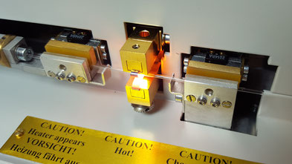
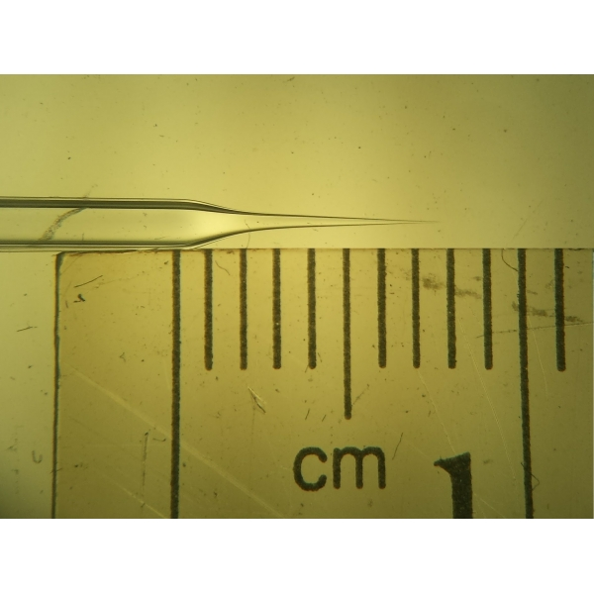
Intracellular electrodes: pulling glass pipettes

Slide 5
Types of intracellular recordings

Slide 6
Types of intracellular recordings

Slide 7
Pros and cons
Voltage clamp vs current clamp
Composition of pipette solutions
Mechanical stability
Dialysing cytoplasm

Slide 8
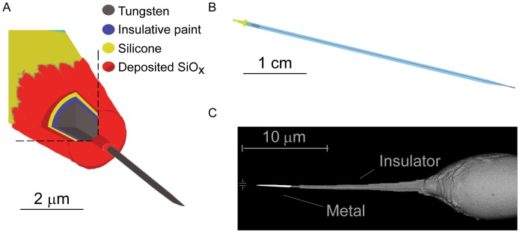
Intracellular tungsten
New technology, not widely used
https://www.ncbi.nlm.nih.gov/pmc/articles/PMC3419643/

Slide 9
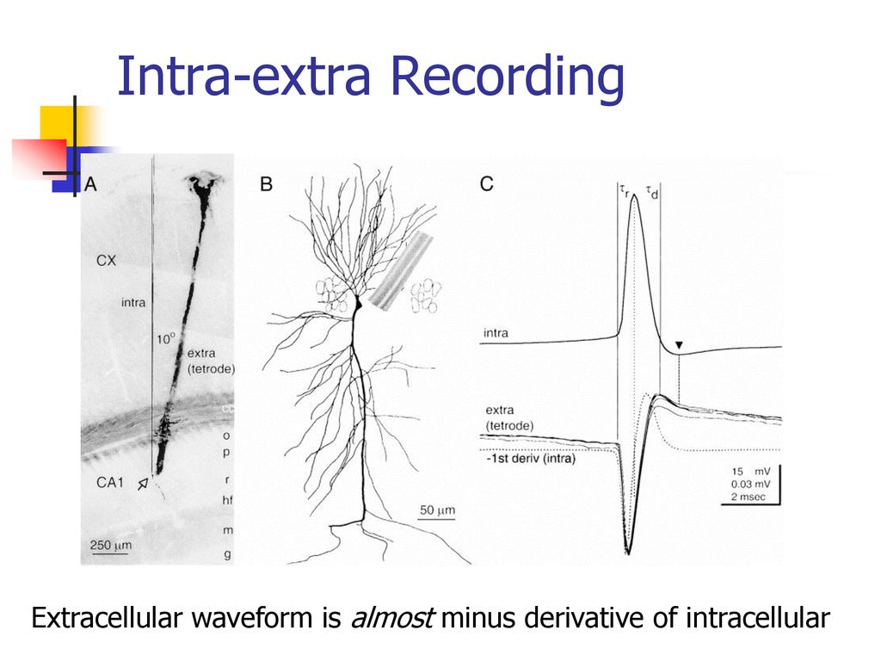
Extracellular recording: the waveform is upside down
https://slideplayer.com/slide/15830058/

Slide 10
Microwire recordings

Slide 11
Tip impedance

Slide 12
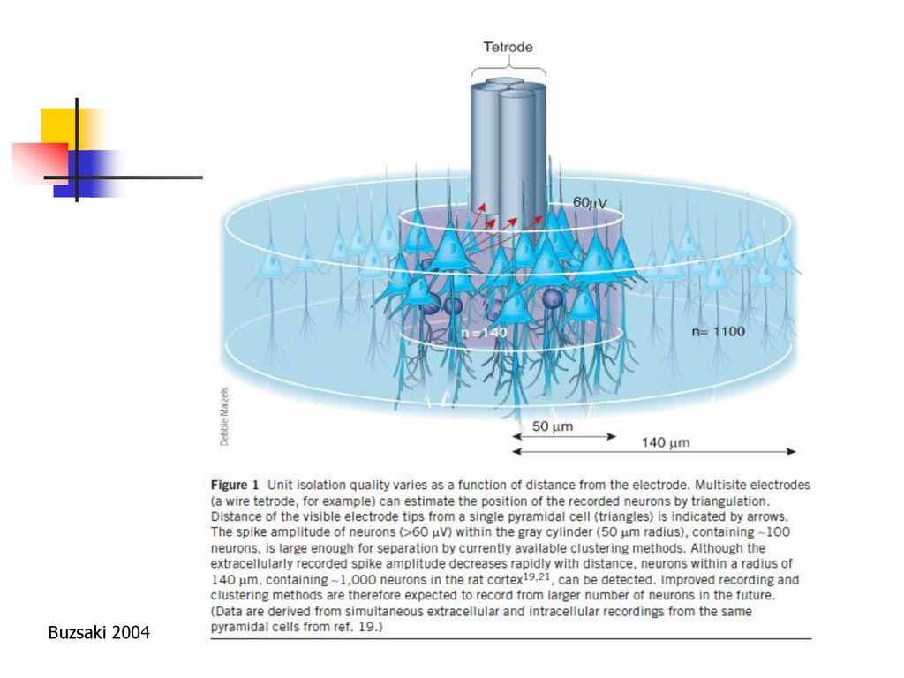
Tetrodes: recording several isolated units simultaneously

Slide 13
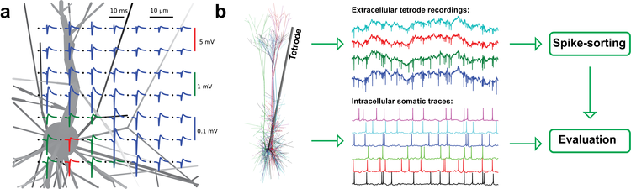
Multisite extracellular recording
http://neuroinformatics2012.org/abstracts/modeling-realistic-extracellular-recordings-of-neuronal-populations-for-the-purpose-of-evaluating-automatic-spike-sorting-algorithms.html

Slide 14
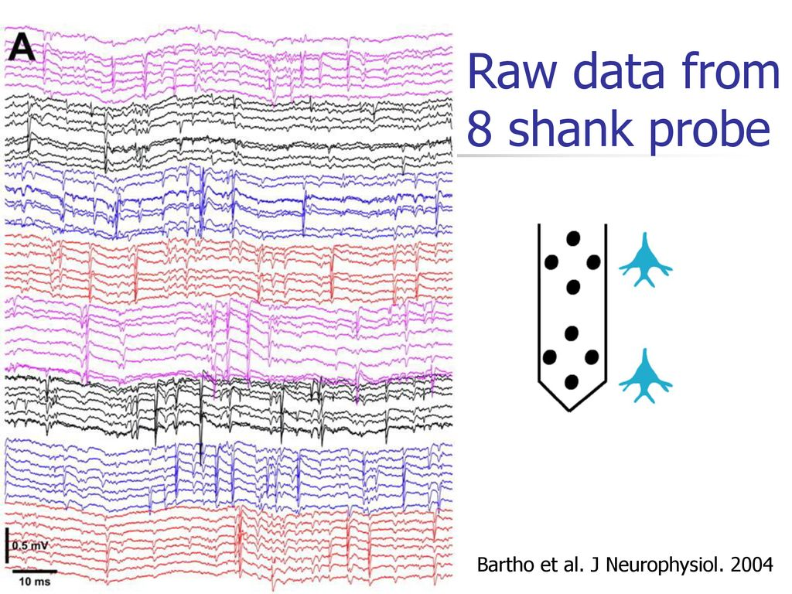

Slide 15
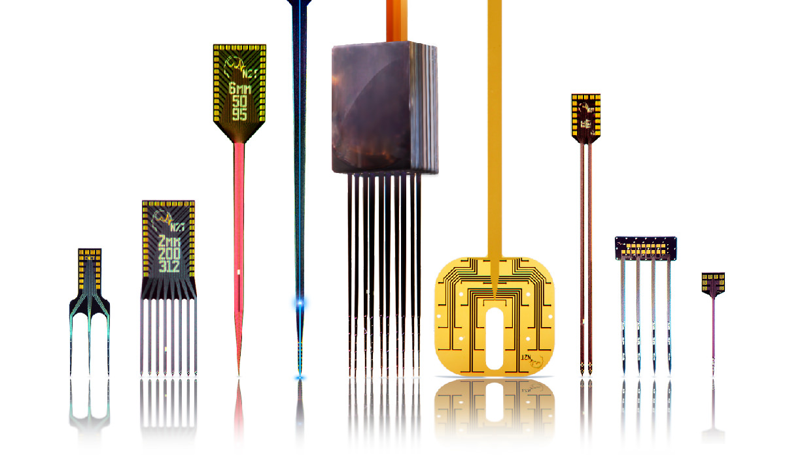
Silicon probes: precise geometry

Slide 16
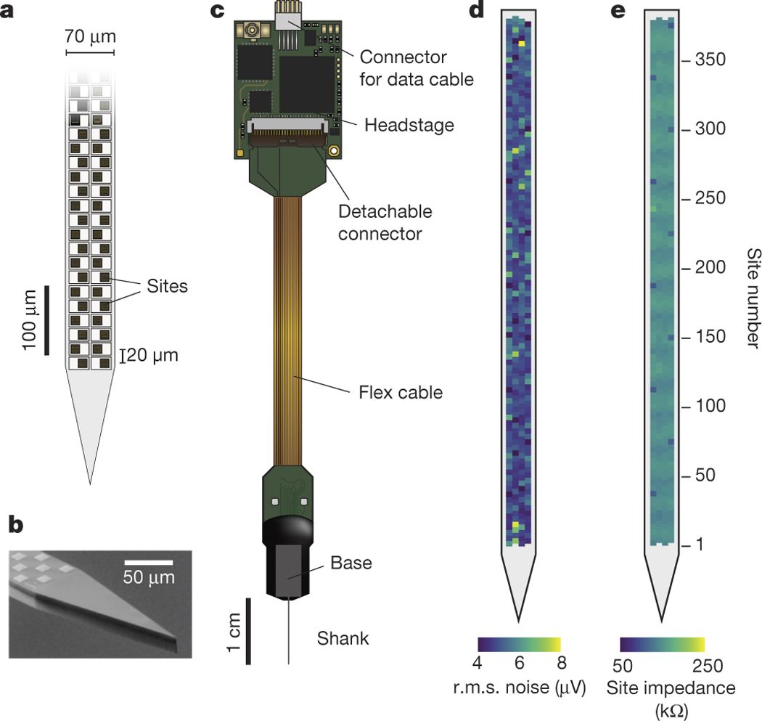
Neuropixels

Slide 17
How to check where your electrodes went?

Slide 18
LFP, EEG recordings

Slide 19
Referencing

Slide 20
Data acquisition

Slide 21
Grounding

