Slide 1
SciFi Mapping
John Williamson
University of Glasgow
November 2018

Slide 2
Overview
Testing of mapping from optical fibres to Fadc channels for SciFi
Plotting to confirm extraction of x and y co-ordinates from detector

Slide 3
SciFi overview
SciFi detector used for optics calibration: consists of 32 vertical and 32 horizontal fibers which can be used to obtain position of e beam
Each fiber read out into optical fibre then by PMT and ultimately Fadc250
Need for each channel of Fadc to be correctly calibrated and to make sure mapping (between channels and fibers) is correct

Slide 4
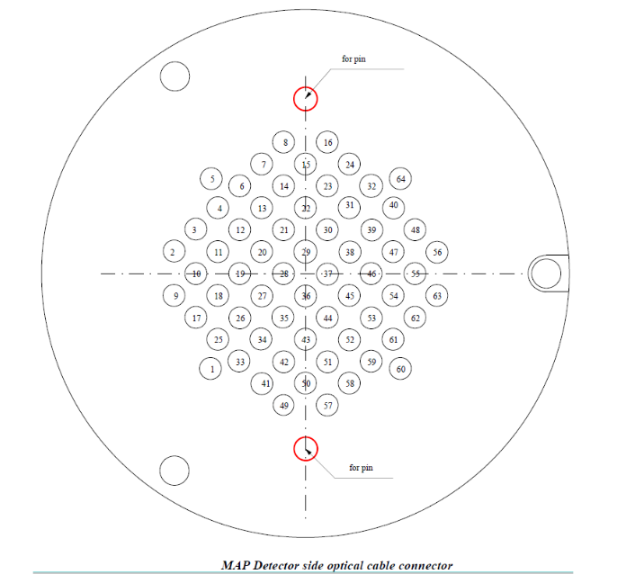
Map from fibres to optical guide

Slide 5
Map from fibres to optical guide
Maps for channels to optical guides tested using laser
Found that for both SciFi units that channels 9 & 11 were swapped with respect to previous diagram

Slide 6
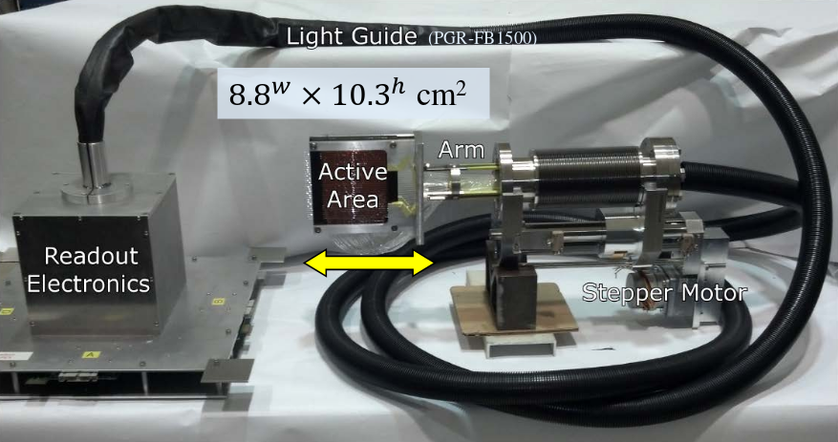
Map from fibres to PMT
fibres
PMT

Slide 7
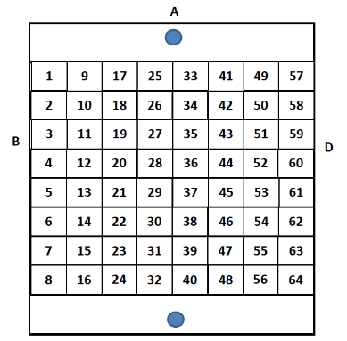
Map from fibres to PMT
fibres
PMT

Slide 8
Map from fibres to PMT

Slide 9
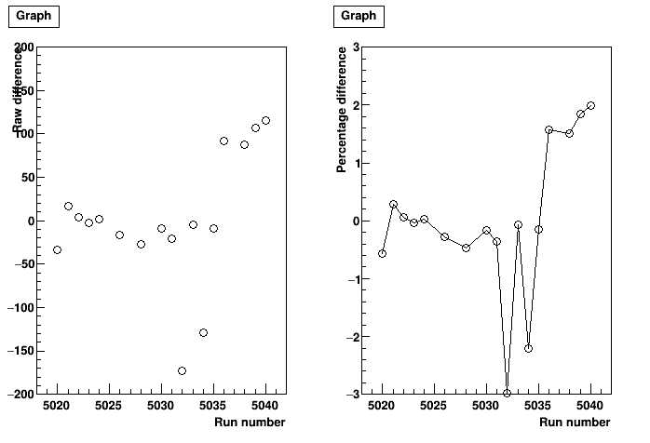
Stability of pedestals
Are these pedestals stable over time within a run and between runs?

Slide 10
Stability of pedestals
Between runs:

Slide 11
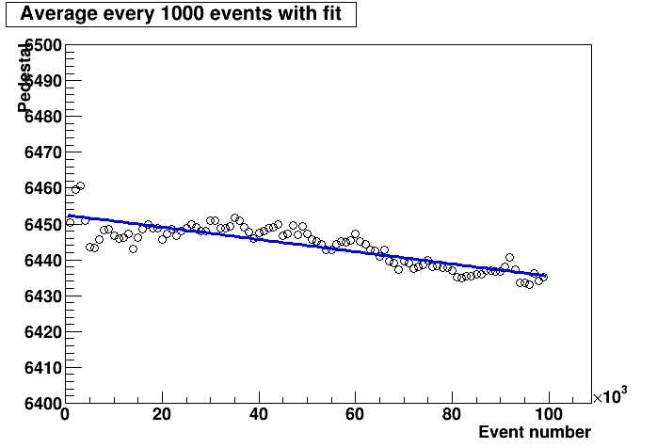
Stability of pedestals
Within runs:

Slide 12
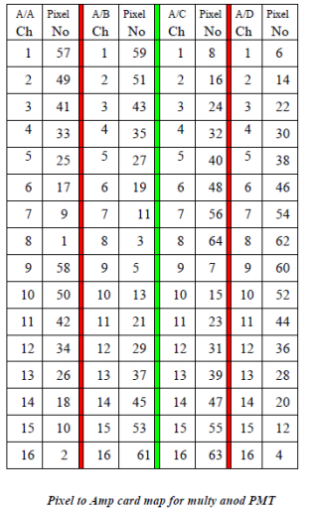
Channel mapping
Determining if pixel
to Fadc map (and optical
fiber to pixel map) is
correct
Needed for x-y (co-ord)
information

Slide 13
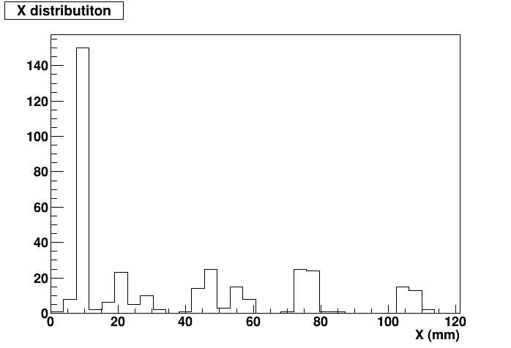
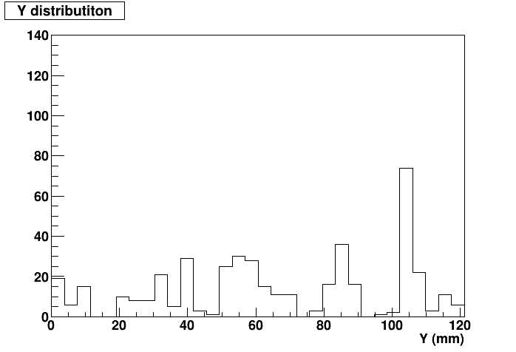
Channel mapping
Use scripts to plot x & y coords using existing maps (plots with source collimated in x-direction)

Slide 14
Channel mapping
Now setting up second detector for testing testing
Also creating analyzer class for SciFi such that it can process Fadc output in raw mode (for testing) or pulse mode for experiment

Slide 15
Experiment webpage
Discussed last week
Will be based on tritium webpage
https://hallaweb.jlab.org/experiment/APEX/

