Slide 1
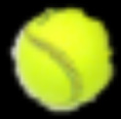
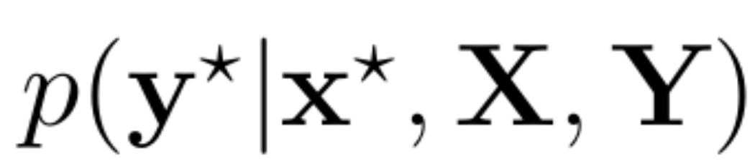
Flatten layer
FC
layer
FC
layer
FC
layer
...
...
...
Output
layer
Pre-trained ResNet 50
without output layer
...
...
...
...
...
Dropout

