Slide 1


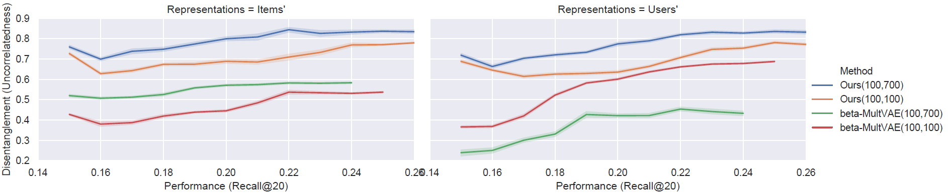
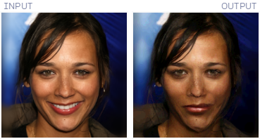
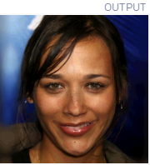
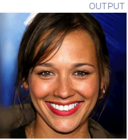
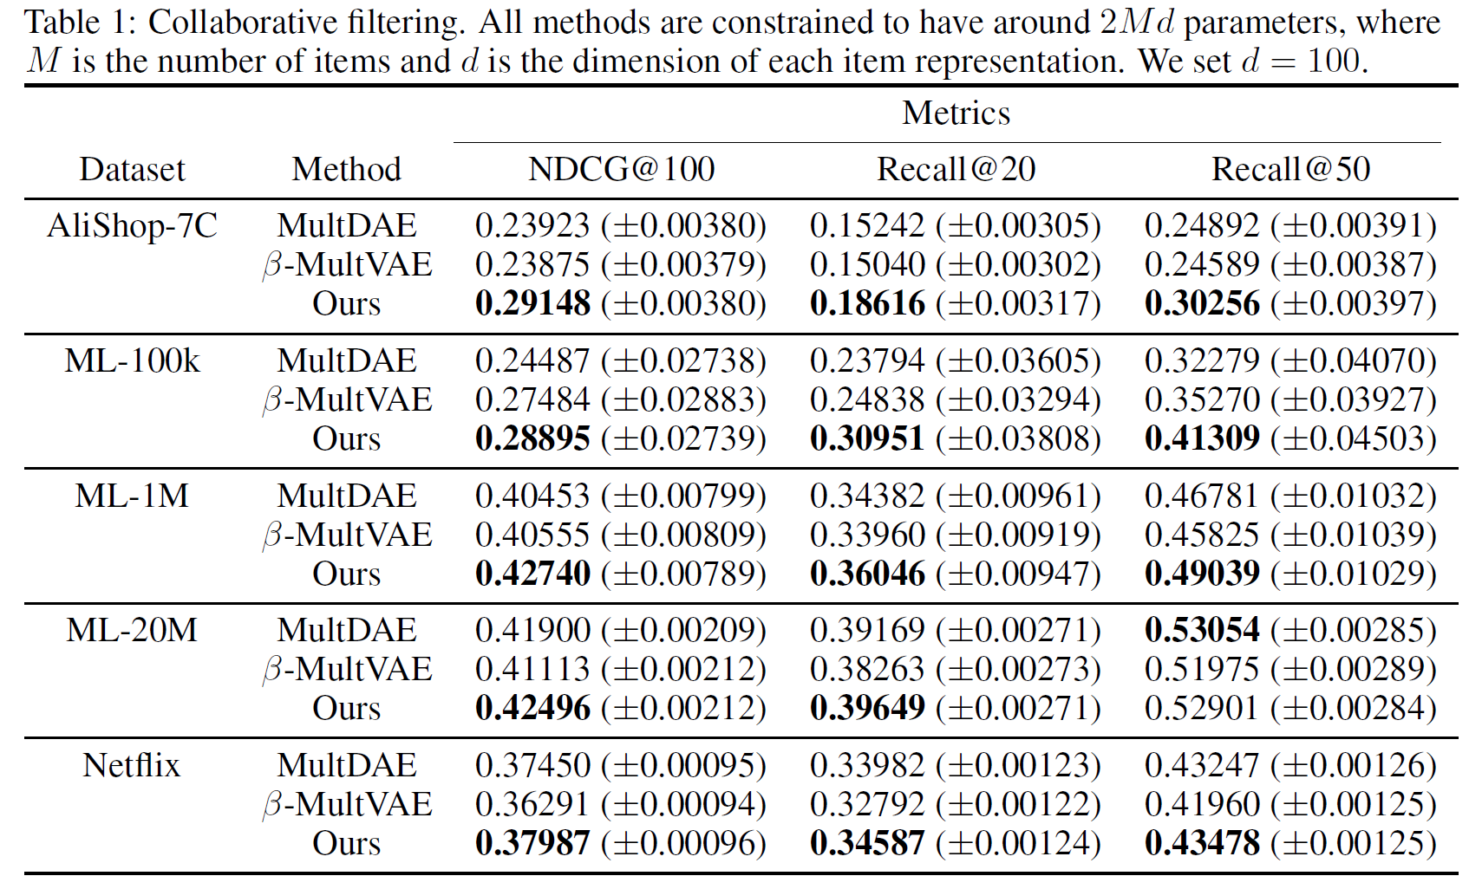
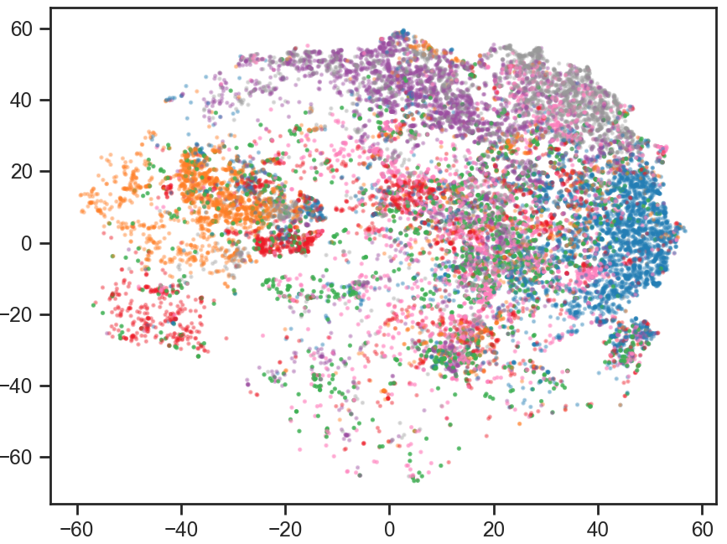
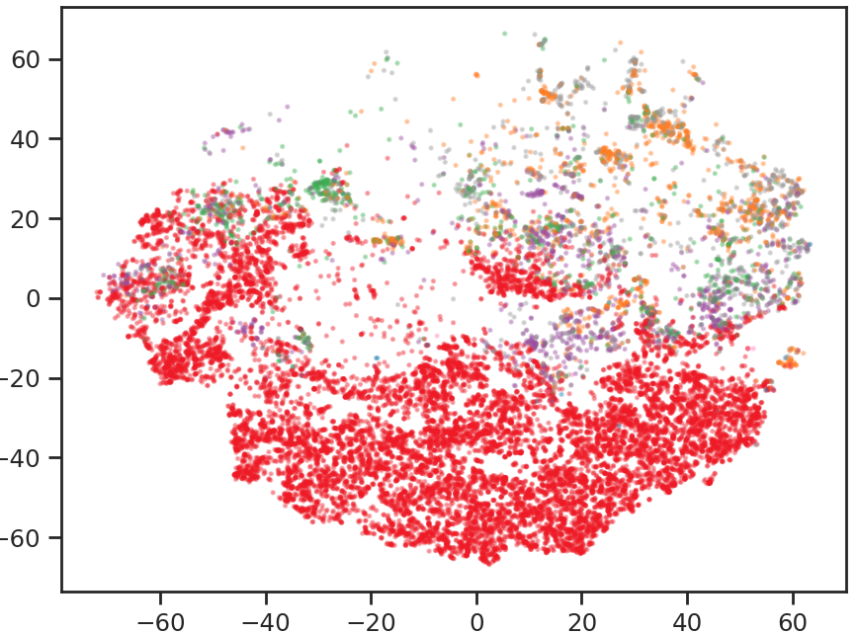
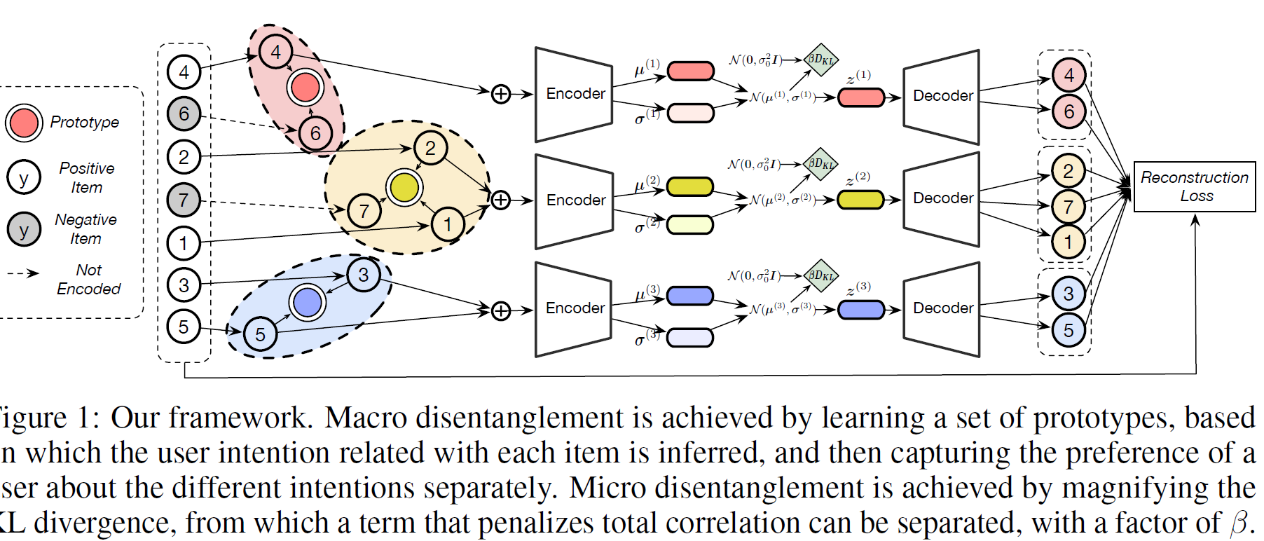
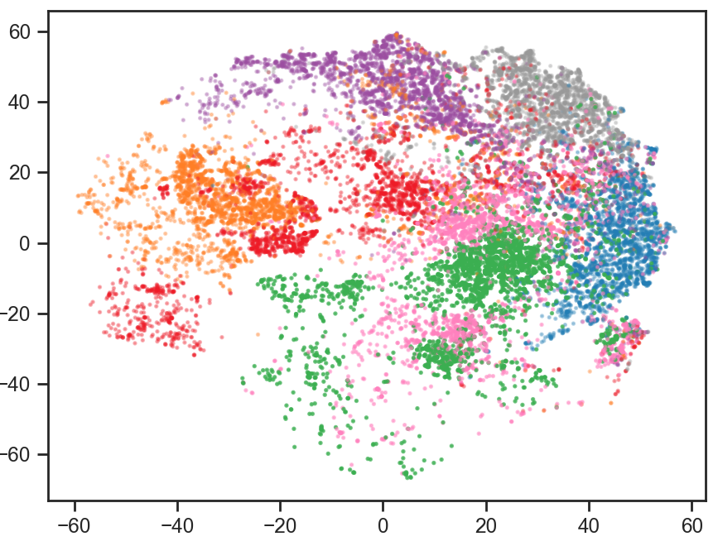

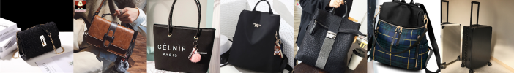
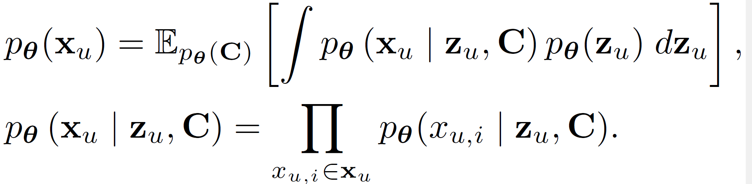




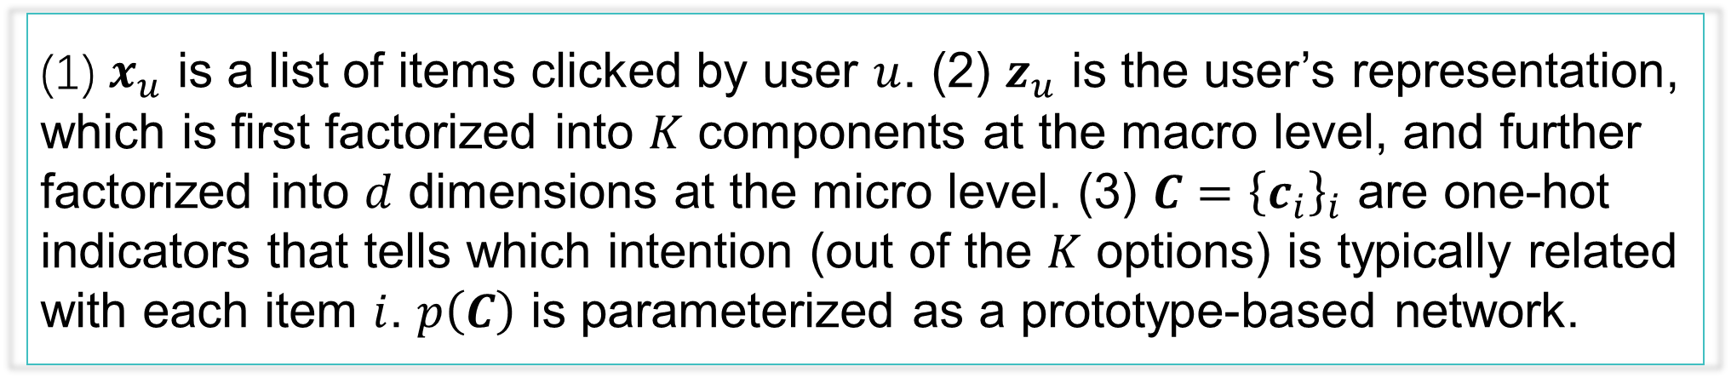
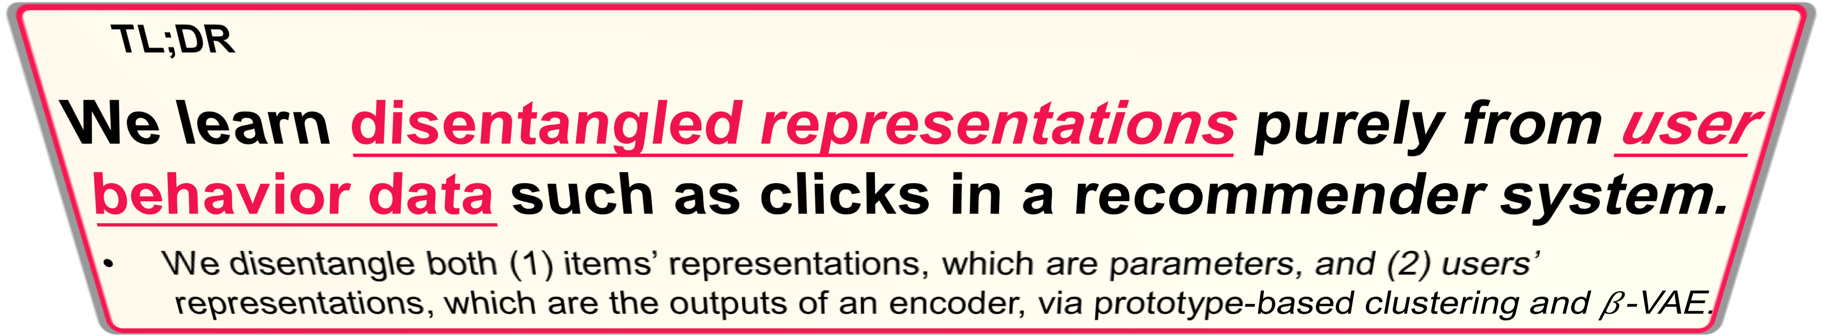


Learning Disentangled Representations for Recommendation Jianxin Ma^{1,2}*, Chang Zhou¹* (co-first), Peng Cui², Hongxia Yang¹, Wenwu Zhu² ¹Alibaba Group ²Tsinghua University
NeurIPS | 2019
0
TL;DR
We learn disentangled representations purely from user behavior data such as clicks in a recommender system.
We disentangle both (1) items’ representations, which are parameters, and (2) users’ representations, which are the outputs of an encoder, via prototype-based clustering and $β$-VAE.
3
(Analysis) Disentanglement vs. Performance
Our approach outperforms the baselines in terms of both disentanglement and performance. Moreover, it appears that:
Disentanglement is generally associated with better performance.
Macro disentanglement benefits micro disentanglement, since the blue curve (i.e., when $K=7$) is higher than the orange one (i.e., when $K=1$).
1
(Background) Disentangled Representation Learning
It aims to learn factorized representations that uncover and disentangle the latent causal factors hidden in the observed data (Bengio et al., 2013).
Existing work mostly focuses on image data, while we focus on the user behavior data collected in a recommender system.
5
(Visualize.) Macro
Disentanglement
To see how interpretable the macro factors are, we color the items according to their associated macro factors.
The macro factors resemble the categories.
Colored according to macro factors.
Colored according to categories.
We observe the said interpretability with cosine, but not with dot product.
(c) Mode collapse happens when we use dot product instead of cosine similarity.
$$\left[\begin{matrix}0.48 (Smile) \\ \begin{aligned}0.14 (Age)\#\# \\ 0.83 (Eye) \\ −0.61 (Hair) \\ ⋮\end{aligned}\end{matrix}\right]$$
$$\left[\begin{matrix}−0.2↓↓ \\ \begin{aligned}0.14 \\ 0.83 \\ −0.61 \\ ⋮\end{aligned}\end{matrix}\right]$$
$$\left[\begin{matrix}0.11↓ \\ \begin{aligned}0.14 \\ 0.83 \\ −0.61 \\ ⋮\end{aligned}\end{matrix}\right]$$
$$\left[\begin{matrix}0.90↑ \\ \begin{aligned}0.14 \\ 0.83 \\ −0.61 \\ ⋮\end{aligned}\end{matrix}\right]$$
4
(Results) Top-N Recommendation
2
(Method) Macro-Micro Disentangled VAE
Macro disentanglement: Separate a user’s different intentions, e.g., to buy a shirt or a phone.
Micro disentanglement: Separate a user’s preference regarding different aspects when executing a specific intention, e.g., the preferred price, color, or size when buying a shirt.
6
(Visualize.) Micro Disentanglement &
User-Controllable Recommendation
A user may now (1) vary a single dimension such as color, while (2) keeping the other dimensions constant when browsing the recommendation list.
(These images are not generated, but retrieved according to the altered query vectors.)
Note: Not all dimensions are human-understandable. Well-trained models can only be identified with the help of a few labels. We encourage future efforts to explore (semi-)supervised methods (Locatello et al., 2019a; 2019b).
Varying this single dimension results in different bag sizes.
(1) $x_{u}$ is a list of items clicked by user $u$. (2) $z_{u}$ is the user’s representation, which is first factorized into $K$ components at the macro level, and further factorized into $d$ dimensions at the micro level. (3) $C={\left\{c_{i}\right\}}_{i}$ are one-hot indicators that tells which intention (out of the $K$ options) is typically related with each item $i$. $p\left(C\right)$ is parameterized as a prototype-based network.
Another dimension is about bag colors.
(See the paper for details.)
Notes:
Board size is 4 ft x 8 ft. This poster is of A0 size.

