Slide 1
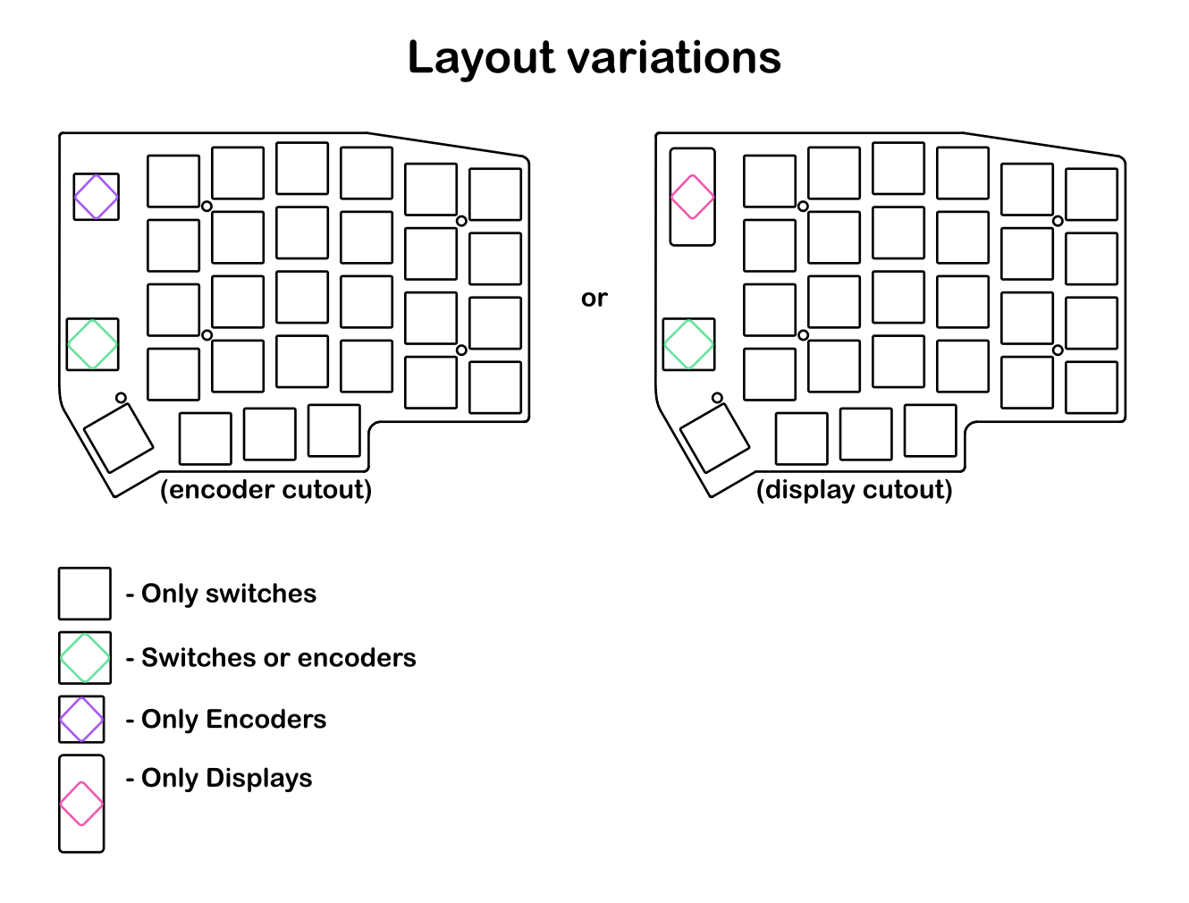
esc
1
2
3
4
5
6
7
8
9
0
`
tab
Q
W
E
R
T
Y
U
I
O
P
BS
cntrl
A
S
D
F
G
wheel
up/dn
H
J
K
L
;
’
X
C
V
B
[
N
M
,
.
shift
Z
/
Fn
Fn
alt
Win
space
enter
-
=
\
!
@
#
$
%
^
&
*
(
)
~
wheel
left/rigt
{
:
”
shift
<
>
?
Fn
_
+
|
F1
F2
F3
F4
F5
F6
F7
F8
F9
F10
F11
F12
mouup
moudn
moulft
mourgt
print
screen
scroll
lock
pause
break
del
voldn
volup
mute
eject
]
*
/
home
pgup
pretab
nxttab
swwin
swwin
+
-
end
pgdn
Fn
insert
stop

