Slide 1
机器学习基础 Machine Learning
实验一：逻辑回归
重庆大学计算机学院
2026年4月

Slide 2
逻辑回归
事件概况
数据集：标签-参数对，形成一个矩阵
模型（训练）：
1）模型结构： y=x1*theta1+x1*theta2+b，参数
2）模型参数： theta1， theta2，b
3）损失函数：对数损失
4）最优化算法：梯度下降
5）训练
应用（推理）
Notes:
Chongqing, located in the southwest of China.
Chongqing is famous for its mountain city. Because urban roads rises and falls, People travel mostly by private cars, taxis or public transit
. Bike and walk are relatively rare.
In addition, Changjiang River and jialingjiang River divide the city, there are many bridges and tunnels.
So, complex road system bring Chongqing more congestions, especially in rush hours.

Slide 3
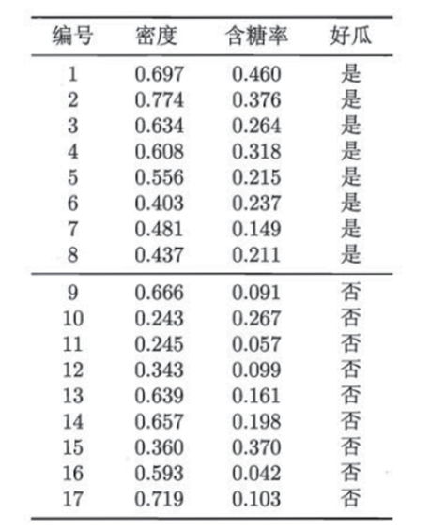
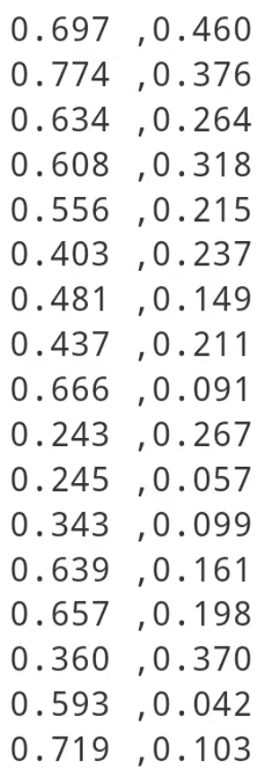
逻辑回归
标签
x
y
Notes:
Chongqing, located in the southwest of China.
Chongqing is famous for its mountain city. Because urban roads rises and falls, People travel mostly by private cars, taxis or public transit
. Bike and walk are relatively rare.
In addition, Changjiang River and jialingjiang River divide the city, there are many bridges and tunnels.
So, complex road system bring Chongqing more congestions, especially in rush hours.

Slide 4
逻辑回归
模型
y=w^{T}x+by=w^{T}x+b
w1/ theta1表示参数
y=x1*theta1+x2*theta2+b参数
Notes:
Chongqing, located in the southwest of China.
Chongqing is famous for its mountain city. Because urban roads rises and falls, People travel mostly by private cars, taxis or public transit
. Bike and walk are relatively rare.
In addition, Changjiang River and jialingjiang River divide the city, there are many bridges and tunnels.
So, complex road system bring Chongqing more congestions, especially in rush hours.

Slide 5
逻辑回归
模型训练是什么？
未知
已知
y=x1*theta1+x1*theta2+b
已知
未知
y=x1*theta1+x1*theta2+b
Notes:
Chongqing, located in the southwest of China.
Chongqing is famous for its mountain city. Because urban roads rises and falls, People travel mostly by private cars, taxis or public transit
. Bike and walk are relatively rare.
In addition, Changjiang River and jialingjiang River divide the city, there are many bridges and tunnels.
So, complex road system bring Chongqing more congestions, especially in rush hours.

Slide 6

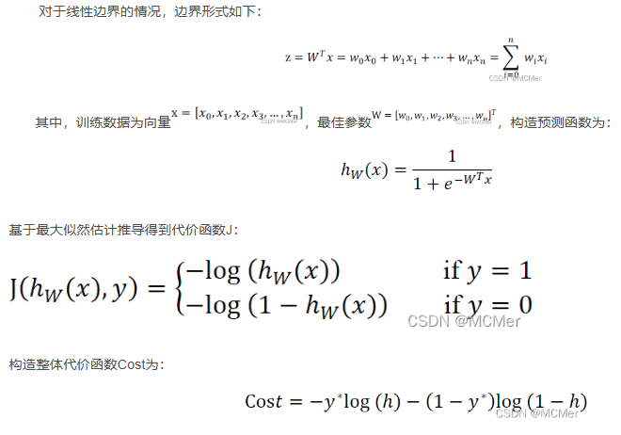
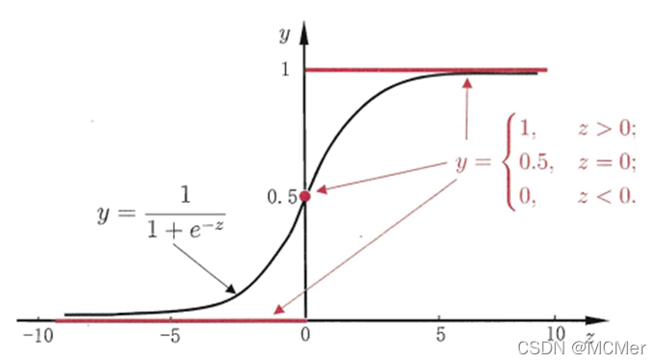

逻辑回归
损失函数
loss = -np.mean(y * np.log(h + 1e-8) + (1 - y) * np.log(1 - h + 1e-8))
当真实标签 $y∗=1$ 时，损失为 ，预测概率 $h$ 越接近1，损失越小。
当真实标签 $y∗=0$ 时，损失为 ，预测概率 $h$ 越接近0，损失越小。
Notes:
Chongqing, located in the southwest of China.
Chongqing is famous for its mountain city. Because urban roads rises and falls, People travel mostly by private cars, taxis or public transit
. Bike and walk are relatively rare.
In addition, Changjiang River and jialingjiang River divide the city, there are many bridges and tunnels.
So, complex road system bring Chongqing more congestions, especially in rush hours.

Slide 7
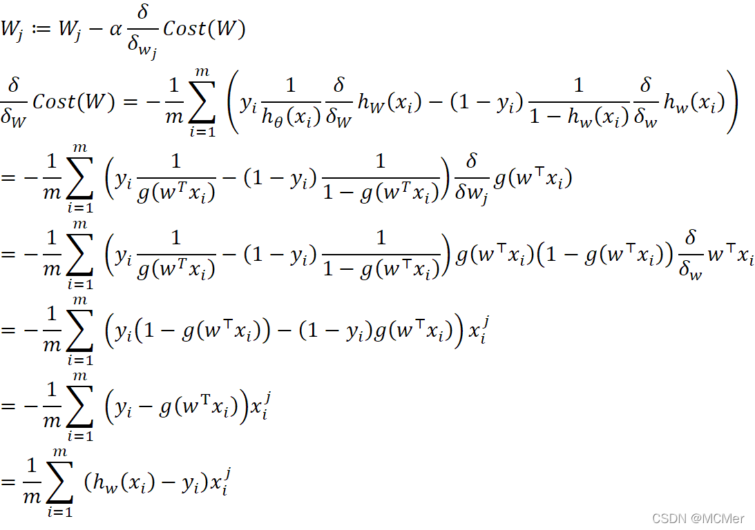
逻辑回归
最优化算法
z = X @ self.theta
h = self.sigmoid(z)
gradient = X.T @ (h - y) / y.size
self.theta -= self.lr * gradient
Notes:
Chongqing, located in the southwest of China.
Chongqing is famous for its mountain city. Because urban roads rises and falls, People travel mostly by private cars, taxis or public transit
. Bike and walk are relatively rare.
In addition, Changjiang River and jialingjiang River divide the city, there are many bridges and tunnels.
So, complex road system bring Chongqing more congestions, especially in rush hours.

Slide 8
逻辑回归
训练
for epoch in range(self.epochs):
#（2）构造了求解函数
z = X @ self.theta
h = self.sigmoid(z)
gradient = X.T @ (h - y) / y.size
#（3）
#使用梯度下降法求解Cost的最优解：
self.theta -= self.lr * gradient
# 计算当前轮的损失值（对数损失函数）
loss = -np.mean(y * np.log(h + 1e-8) + (1 - y) * np.log(1 - h + 1e-8))
self.losses.append(loss)
#迭代达到一定的次数或一定阈值
if loss<0.1:
return
print(loss)
超参数：
LR
轮数
Bachsize
………
Notes:
Chongqing, located in the southwest of China.
Chongqing is famous for its mountain city. Because urban roads rises and falls, People travel mostly by private cars, taxis or public transit
. Bike and walk are relatively rare.
In addition, Changjiang River and jialingjiang River divide the city, there are many bridges and tunnels.
So, complex road system bring Chongqing more congestions, especially in rush hours.

Slide 9
逻辑回归
推理
未知
已知
y=x1*theta1+x1*theta2+b
超参数：
LR
轮数
Bachsize
………
X = np.c_[np.ones((X.shape[0], 1)), X]
return self.sigmoid(X @ self.theta)
Notes:
Chongqing, located in the southwest of China.
Chongqing is famous for its mountain city. Because urban roads rises and falls, People travel mostly by private cars, taxis or public transit
. Bike and walk are relatively rare.
In addition, Changjiang River and jialingjiang River divide the city, there are many bridges and tunnels.
So, complex road system bring Chongqing more congestions, especially in rush hours.

Slide 10
逻辑回归
调试
加断点
观察
控制台
Notes:
Chongqing, located in the southwest of China.
Chongqing is famous for its mountain city. Because urban roads rises and falls, People travel mostly by private cars, taxis or public transit
. Bike and walk are relatively rare.
In addition, Changjiang River and jialingjiang River divide the city, there are many bridges and tunnels.
So, complex road system bring Chongqing more congestions, especially in rush hours.

