Slide 1
机器学习基础 Machine Learning
实验二：BP 算法
重庆大学计算机学院
王翊
2026年5月

Slide 2
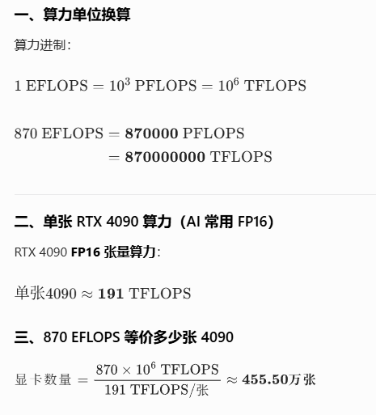
随着人工智能的发展，词元调用量呈现出指数级增长。截至3月底，日均值已突破140万亿，和2024年底相比增长超千倍。

Slide 3
BP 算法
要素
数据集：标签-参数对，形成一个矩阵
模型（训练）：
1）模型结构： 输入层、隐藏层、输出层，参数
2）模型参数： W1，W2，b1，b2
3）损失函数：交叉熵损失
4）最优化算法：梯度下降+反向传播
5）训练
应用（推理）
Notes:
Chongqing, located in the southwest of China.
Chongqing is famous for its mountain city. Because urban roads rises and falls, People travel mostly by private cars, taxis or public transit
. Bike and walk are relatively rare.
In addition, Changjiang River and jialingjiang River divide the city, there are many bridges and tunnels.
So, complex road system bring Chongqing more congestions, especially in rush hours.

Slide 4
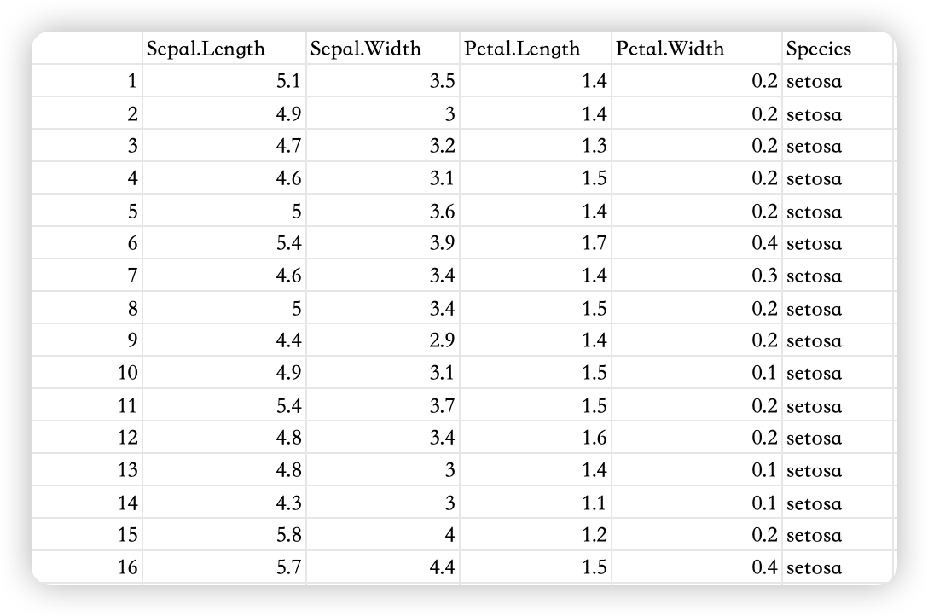
BP 算法
数据集-lris
X（4 个特征）
y（共有 3 类）
Notes:
Chongqing, located in the southwest of China.
Chongqing is famous for its mountain city. Because urban roads rises and falls, People travel mostly by private cars, taxis or public transit
. Bike and walk are relatively rare.
In addition, Changjiang River and jialingjiang River divide the city, there are many bridges and tunnels.
So, complex road system bring Chongqing more congestions, especially in rush hours.

Slide 5


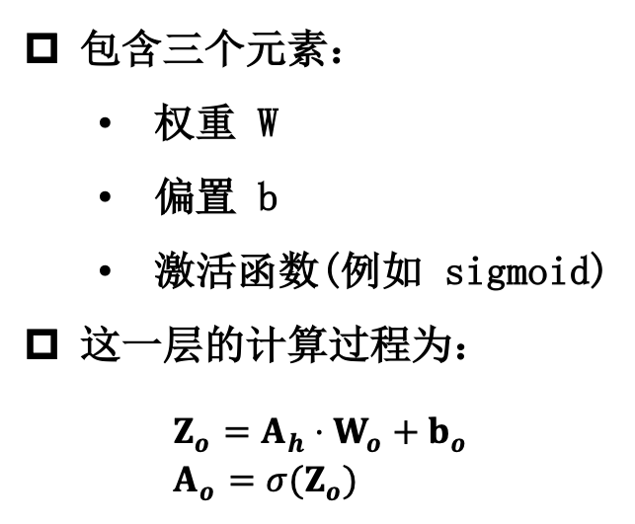
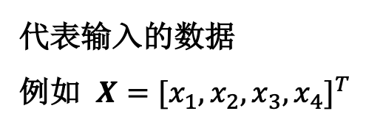
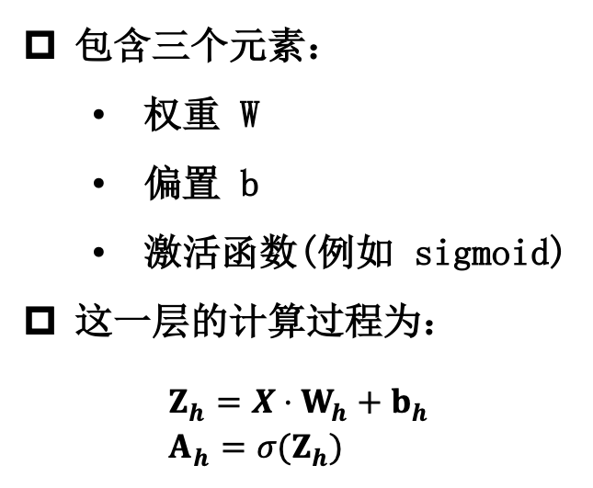

BP 算法
模型结构
输入层
$$X$$
隐藏层
$$A_{h}$$
输出层
$$A_{o}$$
代表输入的数据
例如 $X=[x_{1},x_{2},x_{3},x_{4}]^{T}$
包含三个元素：
权重 W
偏置 b
激活函数(例如 sigmoid)
这一层的计算过程为：
$$\begin{aligned}&Z_{h}=X⋅W_{h}+b_{h} \\ &A_{h}=σ(Z_{h})\end{aligned}$$
包含三个元素：
权重 W
偏置 b
激活函数(例如 sigmoid)
这一层的计算过程为：
$$\begin{aligned}&Z_{o}=A_{h}⋅W_{o}+b_{o} \\ &A_{o}=σ(Z_{o})\end{aligned}$$
输入层是没有任何计算的，只代表输入的数据；隐藏层可以多次堆叠，即为深度神经网络
Notes:
Chongqing, located in the southwest of China.
Chongqing is famous for its mountain city. Because urban roads rises and falls, People travel mostly by private cars, taxis or public transit
. Bike and walk are relatively rare.
In addition, Changjiang River and jialingjiang River divide the city, there are many bridges and tunnels.
So, complex road system bring Chongqing more congestions, especially in rush hours.

Slide 6
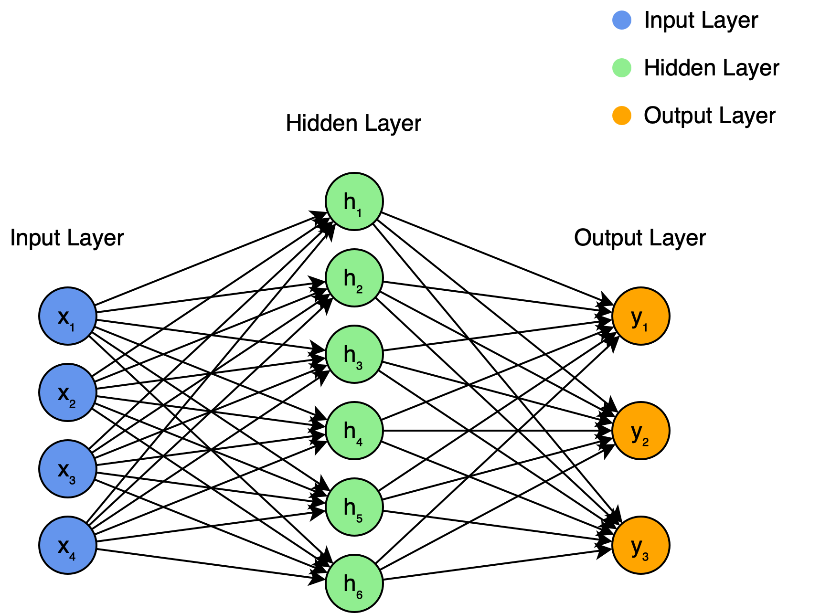
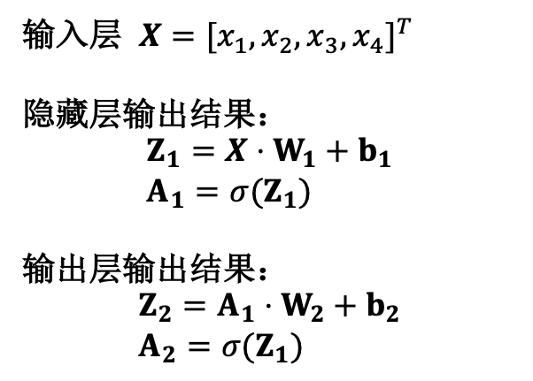
BP 算法
模型-例子
输入层 $X=[x_{1},x_{2},x_{3},x_{4}]^{T}$
隐藏层输出结果：
$$\begin{aligned}&Z_{1}=X⋅W_{1}+b_{1} \\ &A_{1}=σ(Z_{1})\end{aligned}$$
输出层输出结果：
$$\begin{aligned}&Z_{2}=A_{1}⋅W_{2}+b_{2} \\ &A_{2}=σ(Z_{1})\end{aligned}$$
Notes:
Chongqing, located in the southwest of China.
Chongqing is famous for its mountain city. Because urban roads rises and falls, People travel mostly by private cars, taxis or public transit
. Bike and walk are relatively rare.
In addition, Changjiang River and jialingjiang River divide the city, there are many bridges and tunnels.
So, complex road system bring Chongqing more congestions, especially in rush hours.

Slide 7
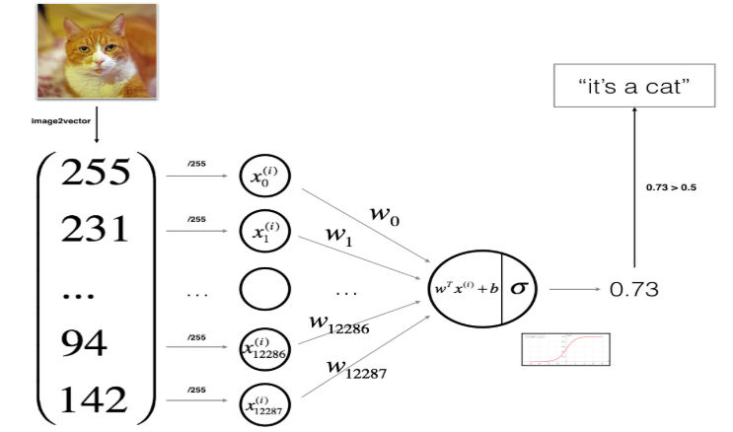
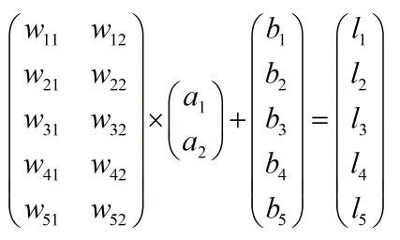
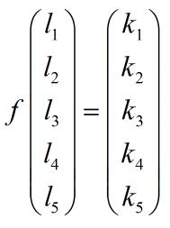

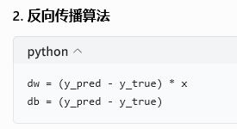
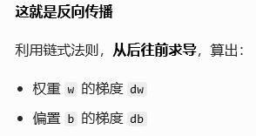
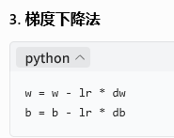
+ΔW
+Δb
前向传播 → 算损失函数 → 反向传播求梯度 → 梯度下降更新参数 → 循环

Slide 8
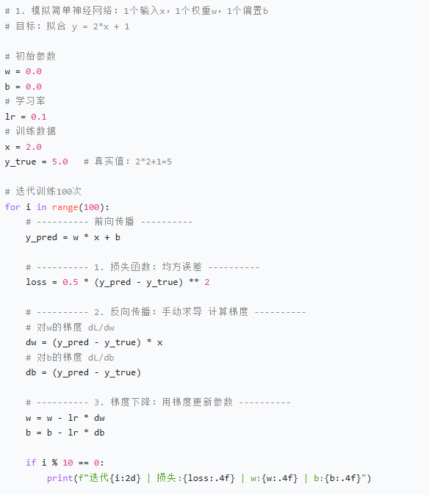

Slide 9
逻辑回归
One-hot Encoding
One-hot 编码是一种将分类变量转换为二进制向量的方法
假如我们有三种类别
类别 1
1 0 0
类别 2
0 1 0
N 位长的 One-hot 编码可以表示 N 个不同类别
类别 3
0 0 1
每个向量中只有一个位置是 1 ，其余都是 0
这代表了一个“独热”状态 —— 只有一个神经元被激活（值为 1），其他都为抑制状态（值为 0）
Notes:
Chongqing, located in the southwest of China.
Chongqing is famous for its mountain city. Because urban roads rises and falls, People travel mostly by private cars, taxis or public transit
. Bike and walk are relatively rare.
In addition, Changjiang River and jialingjiang River divide the city, there are many bridges and tunnels.
So, complex road system bring Chongqing more congestions, especially in rush hours.

Slide 10
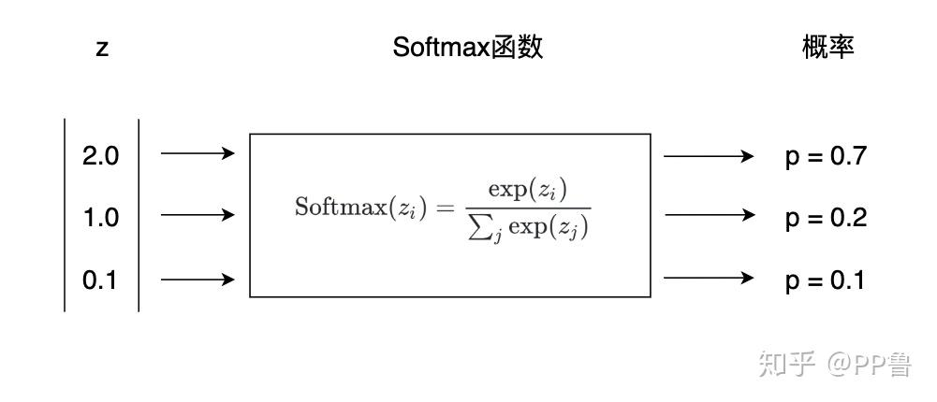
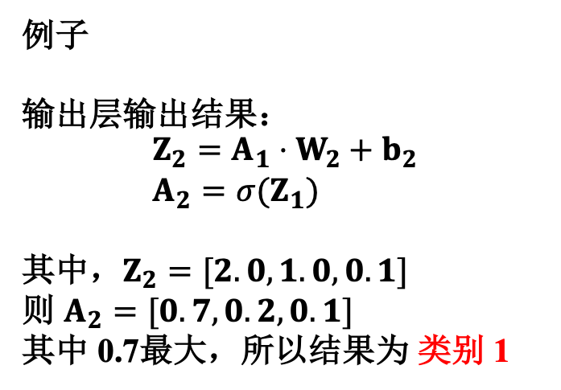
逻辑回归
激活函数
Softmax 函数将输入值映射为0-1之间的概率实数，适用于多分类任务
例子
输出层输出结果：
$$\begin{aligned}&Z_{2}=A_{1}⋅W_{2}+b_{2} \\ &A_{2}=σ(Z_{1})\end{aligned}$$
其中，$Z_{2}=[2.0, 1.0, 0.1]$
则 $A_{2}=[0.7, 0.2, 0.1]$
其中 0.7最大，所以结果为 类别 1
Notes:
Chongqing, located in the southwest of China.
Chongqing is famous for its mountain city. Because urban roads rises and falls, People travel mostly by private cars, taxis or public transit
. Bike and walk are relatively rare.
In addition, Changjiang River and jialingjiang River divide the city, there are many bridges and tunnels.
So, complex road system bring Chongqing more congestions, especially in rush hours.

Slide 11
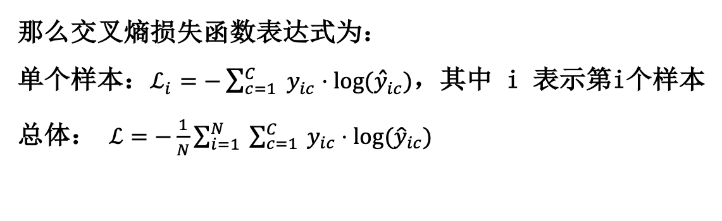
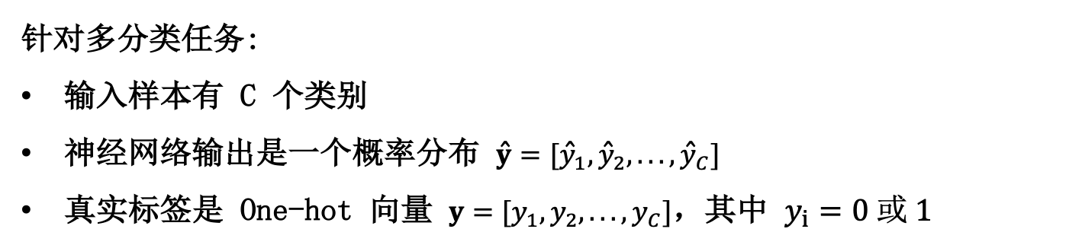
逻辑回归
交叉熵损失函数
针对多分类任务:
输入样本有 C 个类别
神经网络输出是一个概率分布 $\hat{y}=[{\hat{y}}_{1},{\hat{y}}_{2},...,{\hat{y}}_{C}]$
真实标签是 One-hot 向量 $y=[y_{1},y_{2},...,y_{C}]$，其中 $y_{i}=0 或 1$
那么交叉熵损失函数表达式为：
单个样本：$ℒ_{i}=−\sum_{c=1}^{C}{ }y_{ic}⋅log⁡({\hat{y}}_{ic})$，其中 i 表示第i个样本
总体： $ℒ=−\frac{1}{N}\sum_{i=1}^{N}{ }\sum_{c=1}^{C}{ }y_{ic}⋅log⁡({\hat{y}}_{ic})$
loss = -np.mean(np.sum(y * np.log(self.a2 + 1e-9), axis=1))
Notes:
Chongqing, located in the southwest of China.
Chongqing is famous for its mountain city. Because urban roads rises and falls, People travel mostly by private cars, taxis or public transit
. Bike and walk are relatively rare.
In addition, Changjiang River and jialingjiang River divide the city, there are many bridges and tunnels.
So, complex road system bring Chongqing more congestions, especially in rush hours.

Slide 12
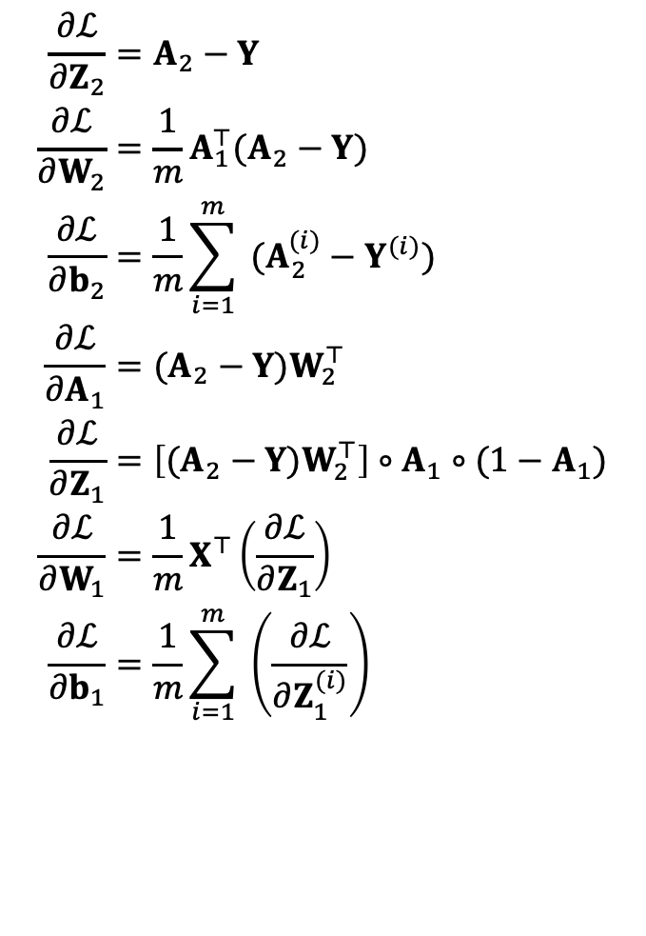
逻辑回归
最优化算法
梯度下降+反向传播
偏导数计算-链式法则
首先对输出层参数 W2，b2 求偏导
然后对隐藏层参数 W1，b1 求偏导
Softmax + Cross-Entropy的联合梯度简化形式
不需要计算损失值也能求梯度
$$\begin{aligned}\frac{∂ℒ}{∂Z_{2}}&=A_{2}−Y \\ \frac{∂ℒ}{∂W_{2}}&=\frac{1}{m}A_{1}^{⊤}(A_{2}−Y) \\ \frac{∂ℒ}{∂b_{2}}&=\frac{1}{m}\sum_{i=1}^{m}{ }(A_{2}^{(i)}−Y^{(i)}) \\ \frac{∂ℒ}{∂A_{1}}&=(A_{2}−Y)W_{2}^{⊤} \\ \frac{∂ℒ}{∂Z_{1}}&=\left[(A_{2}−Y)W_{2}^{⊤}\right]∘A_{1}∘(1−A_{1}) \\ \frac{∂ℒ}{∂W_{1}}&=\frac{1}{m}X^{⊤}\left(\frac{∂ℒ}{∂Z_{1}}\right) \\ \frac{∂ℒ}{∂b_{1}}&=\frac{1}{m}\sum_{i=1}^{m}{ }\left(\frac{∂ℒ}{∂Z_{1}^{(i)}}\right)\end{aligned}$$
Notes:
Chongqing, located in the southwest of China.
Chongqing is famous for its mountain city. Because urban roads rises and falls, People travel mostly by private cars, taxis or public transit
. Bike and walk are relatively rare.
In addition, Changjiang River and jialingjiang River divide the city, there are many bridges and tunnels.
So, complex road system bring Chongqing more congestions, especially in rush hours.

Slide 13
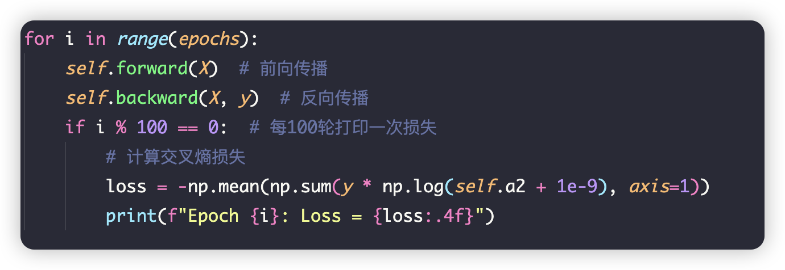
逻辑回归
训练
计算输出层输出 Z₂
超参数：
LR
轮数
Bachsize
………
更新模型参数
Notes:
Chongqing, located in the southwest of China.
Chongqing is famous for its mountain city. Because urban roads rises and falls, People travel mostly by private cars, taxis or public transit
. Bike and walk are relatively rare.
In addition, Changjiang River and jialingjiang River divide the city, there are many bridges and tunnels.
So, complex road system bring Chongqing more congestions, especially in rush hours.

Slide 14
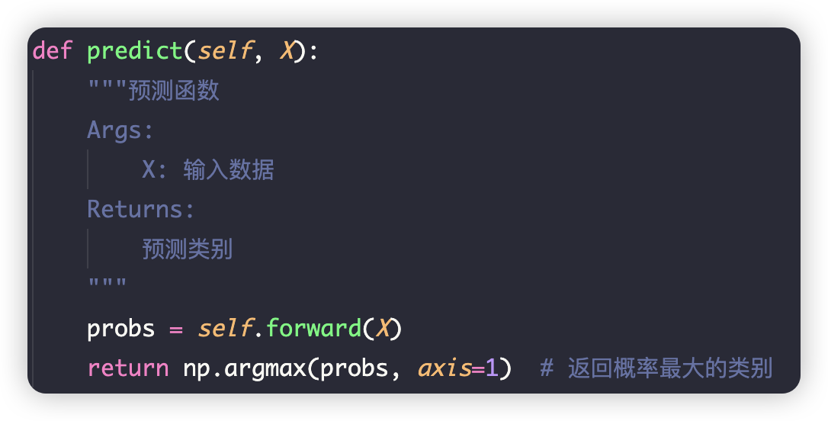
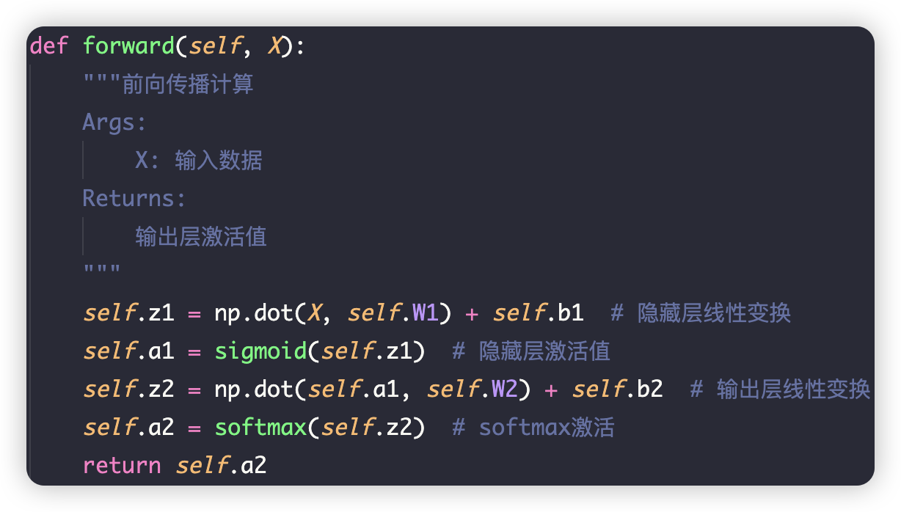
逻辑回归
推理
超参数：
LR
轮数
Bachsize
………
Notes:
Chongqing, located in the southwest of China.
Chongqing is famous for its mountain city. Because urban roads rises and falls, People travel mostly by private cars, taxis or public transit
. Bike and walk are relatively rare.
In addition, Changjiang River and jialingjiang River divide the city, there are many bridges and tunnels.
So, complex road system bring Chongqing more congestions, especially in rush hours.

Slide 15
逻辑回归
调试
加断点
观察
控制台
Notes:
Chongqing, located in the southwest of China.
Chongqing is famous for its mountain city. Because urban roads rises and falls, People travel mostly by private cars, taxis or public transit
. Bike and walk are relatively rare.
In addition, Changjiang River and jialingjiang River divide the city, there are many bridges and tunnels.
So, complex road system bring Chongqing more congestions, especially in rush hours.

