Slide 1
MapReduce : Simplified Data Processing on Large Cluster
Jeffrey Dean and Sanjay Ghemawat
OSDI 2004
Presented by Long Kai and Philbert Lin

Slide 2
Problem
Companies have huge amounts of data now
Conceptually straightforward problems being complicated by being performed on massive amounts of data
Grep
Sorting
How to deal with this in a distributed setting?
What could go wrong?

Slide 3
Solution
Restrict programming model so that framework can abstract away details of distributed computing
MapReduce
Two user defined functions, map and reduce
Provides
Automatic parallelization and distribution
Fault-tolerance
I/O Scheduling
Status and Monitoring
Library improvements helps all users of library
Interface can be many things, database etc.

Slide 4
Programming Model
Input key/value pairs → output a set of key/value pairs
Map
Input pair → intermediate key/value pair
(k1, v1) → list(k2, v2)
Reduce
One key all associated intermediate values
(k2, list(v2)) → list(v3)

Slide 5
MapReduce Examples
Word Count
Distributed Grep
URL Access Frequencies
Inverted Index
Rendering Map Tiles
PageRank

Slide 6
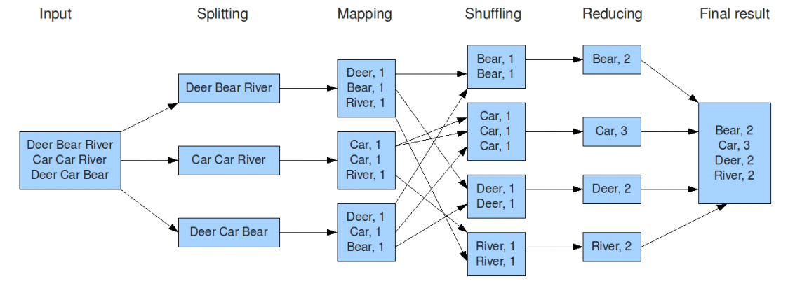
Word Count
http://hci.stanford.edu/courses/cs448g/a2/files/map_reduce_tutorial.pdf

Slide 7
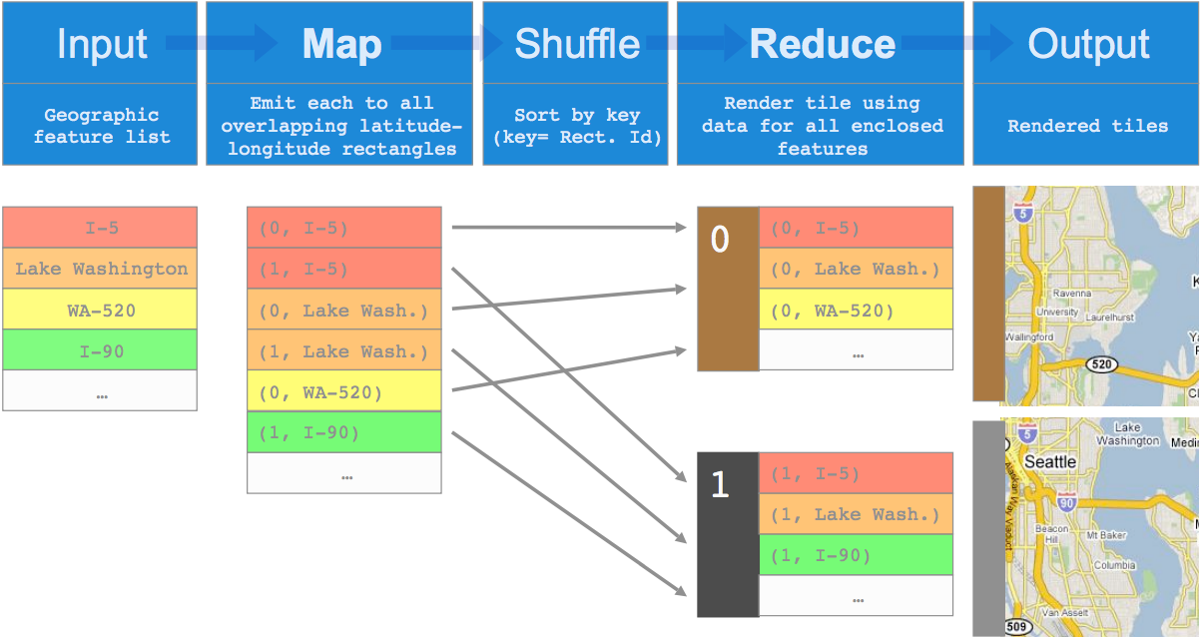
Rendering Map Tiles

Slide 8
Discussion
What kind of applications would be hard to be expressed as a MapReduce job?
Is it possible to modify the MapReduce model to make it more suitable for those applications?

Slide 9
Infrastructure Architecture
Interface applicable to many implementations
Focus on Internet and Data Center deployment
Master controls workers
Often 200,000 map tasks, 4,000 reduce tasks with 2,000 workers and only 1 master
Assigns idle workers a map or reduce task
Coordinate information globally, such as where to have reducers fetch data from

Slide 10
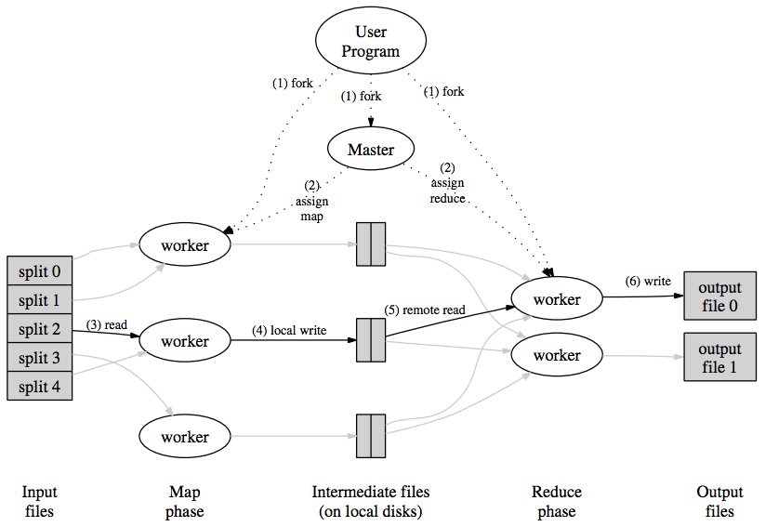
Execution Example

Slide 11
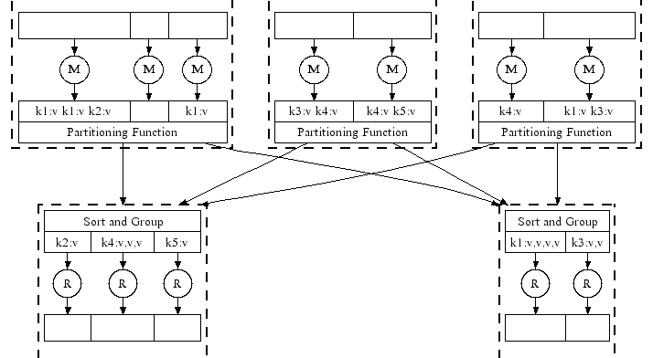
Parallel Execution

Slide 12
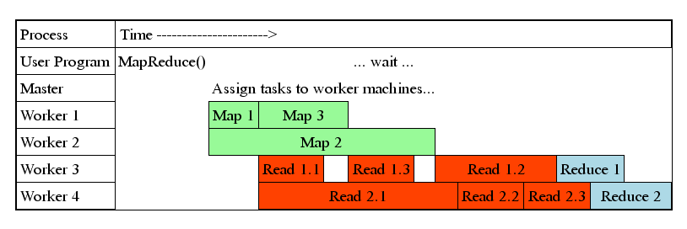
Task Granularity and Pipelining
Many tasks means
Minimal time for fault recovery
Better pipeline shuffling with map execution
Better load balancing

Slide 13
Performance
Sorted ≈1 TB in 891 seconds with 1800 nodes
1TB in 68 seconds on 1000 nodes (2008)
1 PB in 33 minutes on 8000 nodes (2011)
Fault-Tolerance
200 killed machines, only ≈5% increase in time
Lost 1600 once, but still able to finish the job
Notes:
Not all advances in sorting time is from improvements to MapReduce library (hardware, cluster management system, storage)

Slide 14
Discussion
What happens if the underlying cluster is not homogenous? (Rajashekhar Arasanal)
Can we go further with the locality? In an application where reduce tasks don't always read from all of the map tasks, could the reduce tasks be scheduled to save bandwidth? (Fred Douglas)

Slide 15
Bottlenecks
Reduce stage starts when final map task is done
Long startup latency
Not the best tool for every job
Or just make everything a nail?
Leads to Mesos
Not designed for iterative algorithms (Spark)
Unnecessary movement of intermediate data
Move computation to data
Not good for sorting when you need to move data
“If you have two big data sets and you want to join them, you have to move the data somehow.” – Microsoft Research
Notes:
Microsoft Sort: http://research.microsoft.com/en-us/news/features/minutesort-052112.aspx

Slide 16
Related Work
Parallel Processing
MPI (1999)
Bulk Synchronous Programming (1997)
Iterative
Spark (2011)
Stream
S4 (2010)
Storm (2011)

Slide 17
Conclusions
Useful programming model and abstraction that has changed the way industry processes massive amounts of data
Still heavily in use at Google today
And many companies using Hadoop MapReduce
Shows the need for frameworks which deal with the intricacies of distributed computing

Slide 18
Mesos: A Platform for Fine-Grained Resource Sharing in the Data Center
Benjamin Hindman, Andy Konwinski, Matei Zaharia,
Ali Ghodsi, Anthony D. Joseph, Randy Katz, Scott Shenker, Ion Stoica

Slide 19
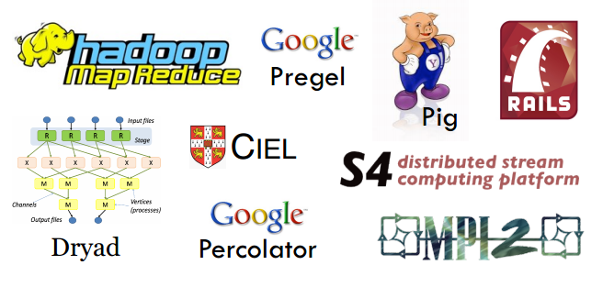
Diversified Computation Frameworks
No single framework optimal for all applications.

Slide 20
Questions
Should we share a cluster between multiple computation jobs?
More specifically, what kind of resources do we want to share?
If we have different frameworks for different applications, why would we expect to share data among them? (Fred)
If so, should we partition resources statically or dynamically?

Slide 21
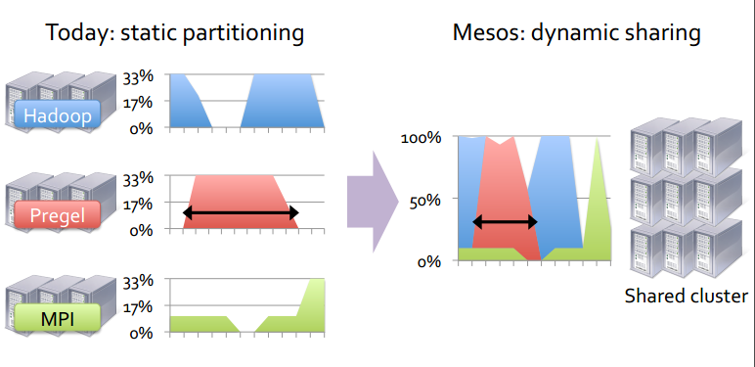
Motivation

Slide 22
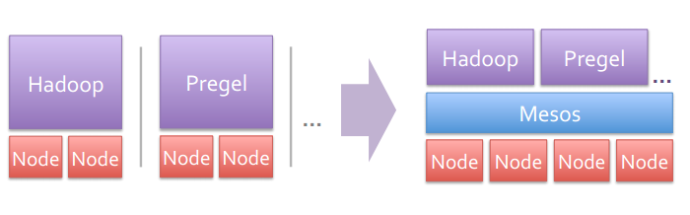
Moses
Mesos is a common resource sharing layer over which diverse frameworks can run

Slide 23
Other Benefits
Run multiple instances of the same framework
Isolate production and experimental jobs
Run multiple versions of the framework concurrently
Build specialized frameworks targeting particular problem domains
Better performance than general-purpose abstractions

Slide 24
Requirements
High utilization of resources
Support diverse frameworks
Scalability
Reliability (failure tolerance)
What does it need to do?
Scheduling of computation tasks

Slide 25
Design Choices
Fine-grained sharing:
Allocation at the level of tasks within a job
Improves utilization, latency, and data locality
Resource offers:
Pushes the scheduling logic to frameworks
Simple, scalable application-controlled scheduling mechanism

Slide 26
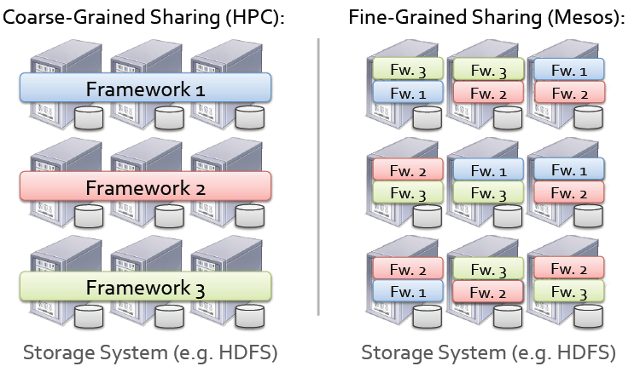
Fine-Grained Sharing
Improves utilization and responsiveness

Slide 27
Resource Offers
Negotiates with frameworks to reach an agreement:
Mesos only performs inter-framework scheduling (e.g. fair sharing), which is easier than intra-framework scheduling
Offer available resources to frameworks, let them pick which resources to use and which tasks to launch

Slide 28
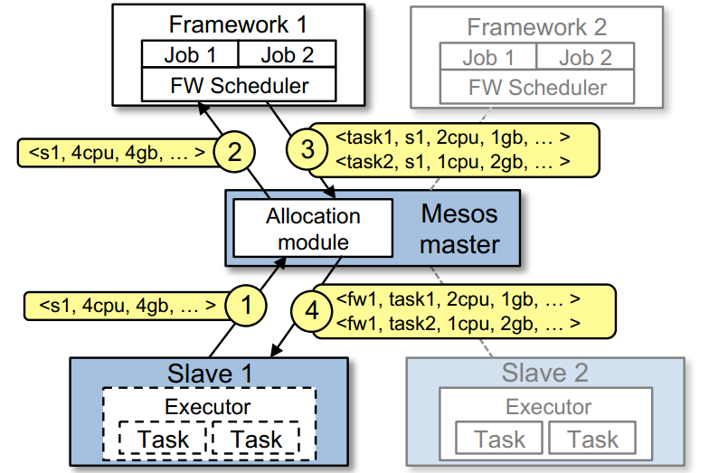
Resource Offers

Slide 29
Questions
Mesos separates inter-framework scheduling and intra-framework scheduling. Problems?
Is it better to let Mesos be aware of intra-framework scheduling policy and do it as well?
Can multiple frameworks coordinate with each other for scheduling without resorting to a centralized inter-framework scheduler?
Rajashekhar Arasanal
Steven Dalton

Slide 30
Reliability: Fault Tolerance
Mesos master has only soft state: list of currently running frameworks and tasks
Rebuild when frameworks and slaves re-register with new master after a failure

Slide 31
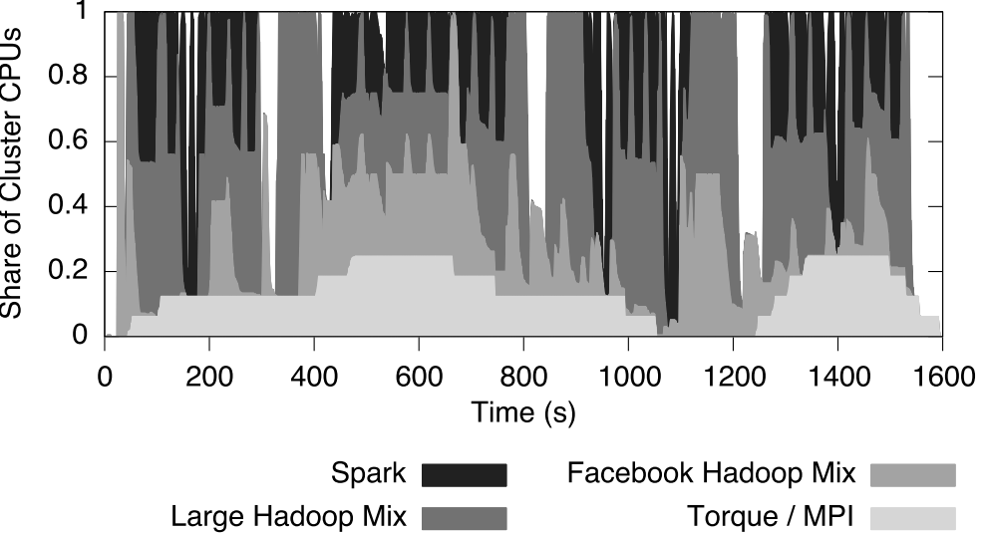
Evaluation

Slide 32
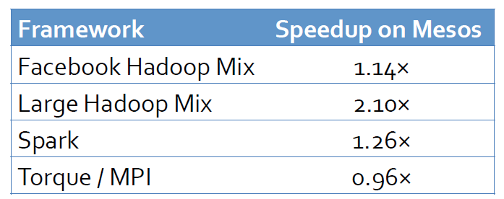
Mesos vs. Static Partitioning
Compared performance with statically partitioned cluster where each framework gets 25% of nodes

Slide 33
Questions
Is Mesos a general solution for sharing cluster among multiple computation frameworks?
Matt Sinclair
Holly Decker
Steven Dalton

Slide 34
Conclusion
Mesos is a platform for sharing commodity clusters between multiple cluster computing frameworks
Fine-grained sharing and resource offers have been shown to achieve better utilization

