Slide 1
Symmetry-Breaking for Grid-based Multi-Agent Path Finding
Jiaoyang Li, Daniel Harabor, Peter J. Stuckey, Hang Ma and Sven Koenig
University of Southern California
Monash University

Slide 2




Multi-Agent Path Finding (MAPF)
Notes:
Define MAPF

Slide 3
Multi-Agent Path Finding (MAPF)

Slide 4
Multi-Agent Path Finding (MAPF)

Slide 5
Multi-Agent Path Finding (MAPF)

Slide 6
Multi-Agent Path Finding (MAPF)

Slide 7
Multi-Agent Path Finding (MAPF)

Slide 8
Multi-Agent Path Finding (MAPF)

Slide 9
Multi-Agent Path Finding (MAPF)

Slide 10
Multi-Agent Path Finding (MAPF)

Slide 11

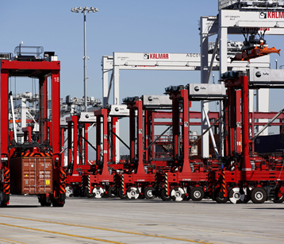
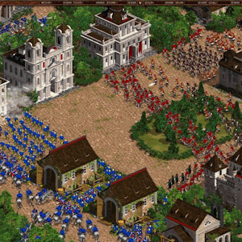
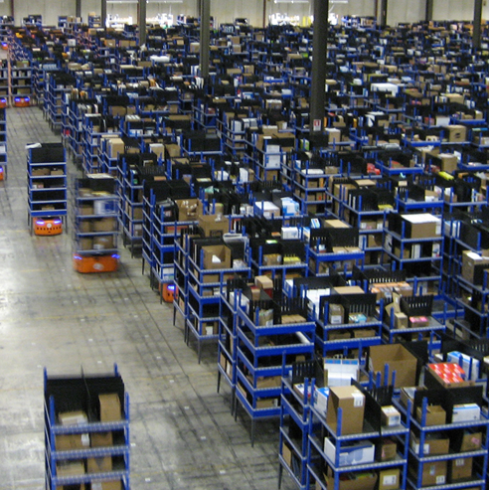
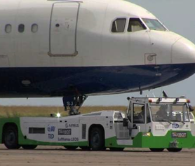
Motivation
Video games
Automated ports
Warehouse Robots
Towing vehicles
…

Slide 12
Conflict-Based Search (CBS)
Find paths for every agent independently
Check conflicts in paths
If there is a conflict <agent A, agent B, location u, location v, timestep t>:
Option 1: agent A cannot stay at location u at timestep t;
Option 2: agent B cannot stay at location v at timestep t.
constraint
<agent, location, timestep>
Constraint Set C

Slide 13
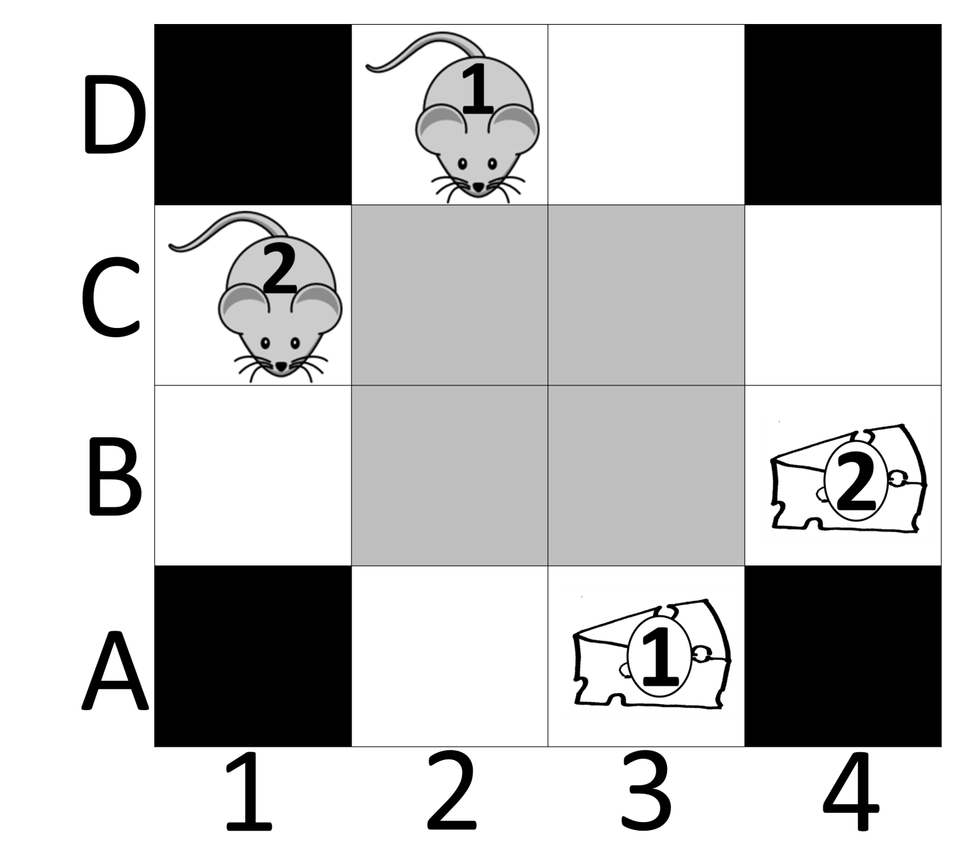
Con={}
Cost = 4 + 4
D
C
B
A
 | 1 | 2 | 3 | 4
Con={<1,C2,1>}
Cost = 4 + 4
D
C
B
A
 | 1 | 2 | 3 | 4
D
C
B
A
 | 1 | 2 | 3 | 4
Con={<2,C2,1>}
Cost = 4 + 4
D
C
B
A
 | 1 | 2 | 3 | 4
D
C
B
A
 | 1 | 2 | 3 | 4
…
…
Con={<1,C2,1>,
<1,B3,3>}
Cost = 5 + 4
Con={<1,C2,1>,
<2,B3,3>}
Cost = 4 + 4

Slide 14
Symmetries in grid-based MAPF
Symmetric conflicts:
 | A | B | C | D | E
1 |  | S2
2 | S1
3 |  |  |  |  | G1
4 |  |  |  | G2
 | A | B | C | D | E
1 |  | S2
2 | S1
3 |  |  |  |  | G1
4 |  |  |  | G2
 | A | B | C | D | E
1 |  | S2
2 | S1
3 |  |  |  |  | G1
4 |  |  |  | G2
We call this a rectangle conflict.

Slide 15
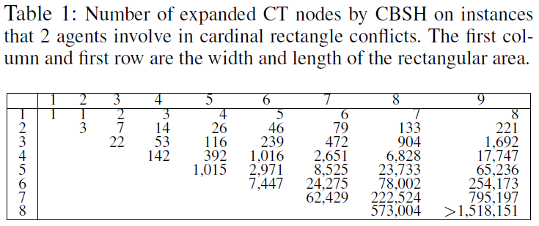
Symmetries in grid-based MAPF
 | A | B | C | D | E
1 |  | S2
2 | S1
3 |  |  |  |  | G1
4 |  |  |  | G2
Inefficiency of CBS:

Slide 16
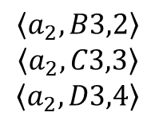
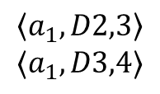
Resolve rectangle conflicts
 | A | B | C | D | E
1 |  | S2
2 | S1
3 |  |  |  |  | G1
4 |  |  |  | G2
$$\left\langle a_{2},B3,2\right\rangle$$
$$\left\langle a_{2},C3,3\right\rangle$$
$$\left\langle a_{2},D3,4\right\rangle$$
$$\left\langle a_{1},D2,3\right\rangle$$
$$⟨a_{1},D3,4⟩$$
 | A | B | C | D | E
1 |  | S2
2 | S1
3 |  |  |  |  | G1
4 |  |  |  | G2
 | A | B | C | D | E
1 |  | S2
2 | S1
3 |  |  |  |  | G1
4 |  |  |  | G2
Barrier constraints

Slide 17
Different types of rectangle conflicts
 | A | B | C | D | E
1 |  | S2
2 | S1
3 |  |  |  |  | G1
4 |  |  |  | G2
 | A | B | C | D | E
1 |  | S2
2 | S1
3 |  |  |  | G1
4 |  |  |  |  | G2
 | A | B | C | D | E
1 |  | S2
2 | S1
3 |  |  |  |  | G2
4 |  |  |  | G1
Cardinal
Semi-cardinal
Non-cardinal

Slide 18
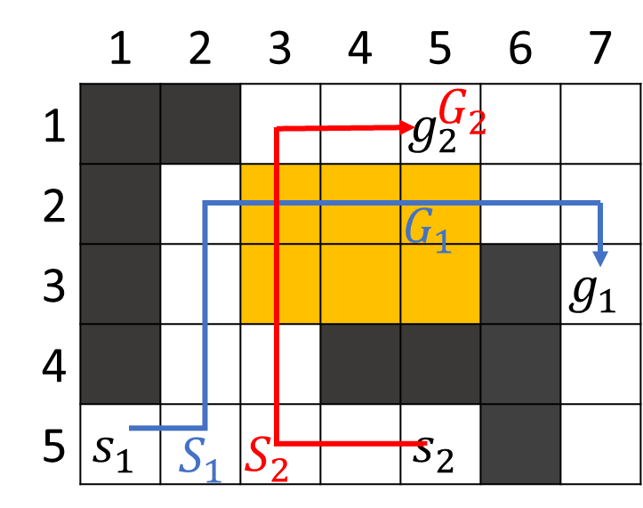
Identify rectangle conflicts
Rectangle conflicts for entire paths
Reason about the relative locations of starts and goals.
Rectangle conflicts for path segments
Find critical locations along the paths;
Treat these critical locations as starts and goals.
Reason about the relative locations of starts and goals.
 | A | B | C | D | E
1 |  | S2
2 | S1
3 |  |  |  |  | G1
4 |  |  |  | G2

Slide 19
Three algorithms
CBSH-CR
Reason about cardinal rectangle conflicts for entire paths.
CBSH-R
Reason about rectangle conflicts for entire paths.
CBSH-RM
Reason about rectangle conflicts for path segments.
CBSH: a state-of-the-art CBS version.

Slide 20
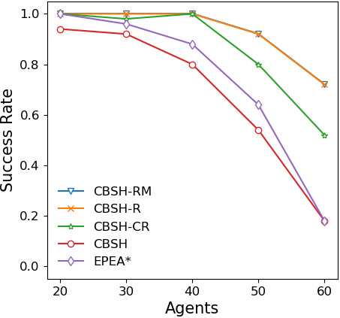
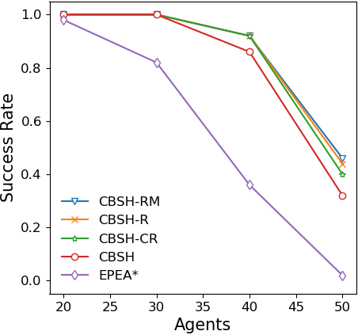
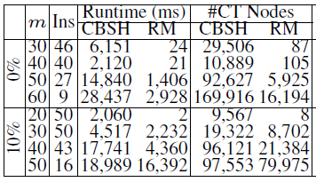
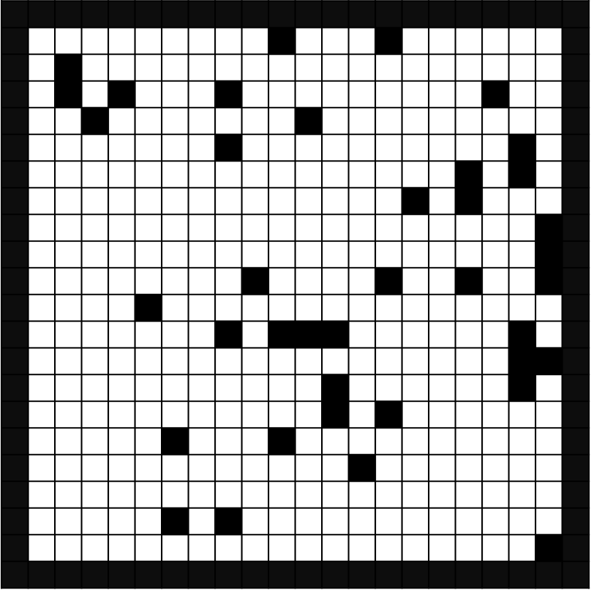
Experimental Results: 20x20 grids
No blocked cells
10% randomly blocked cells
Rectangle
Reasoning
Rectangle
Reasoning
CBSH
EPEA*
CBSH
EPEA*

Slide 21
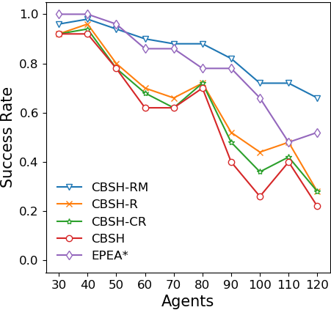
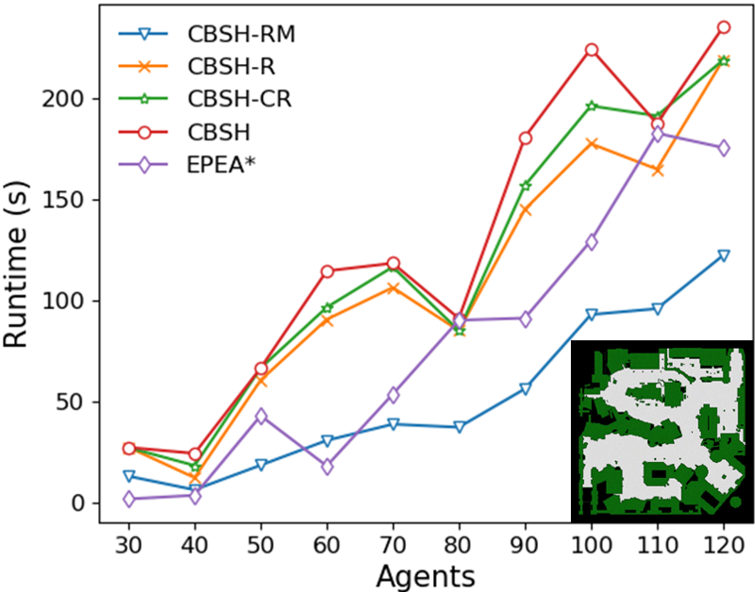
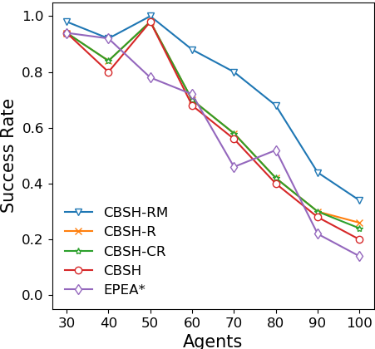
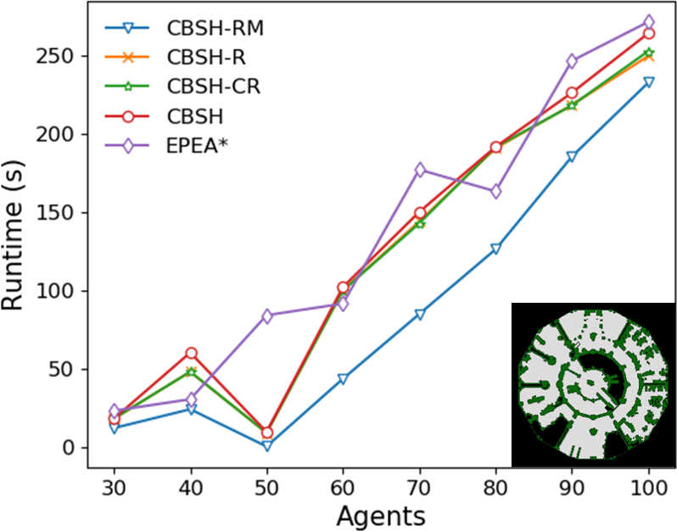
Experimental Results: large game grids

Slide 22
Summary
A special class of symmetric conflicts
- rectangle conflicts;
Symmetry-breaking constraints
- barrier constraints;
Three methods to identify rectangle conflicts
- CBSH-CR, CBSH-R and CBSH-RM.
Future work
Symmetry reasoning for MAPF on general graphs;
Symmetric conflicts among multiple agents;
Symmetry reasoning for MAPF sub-optimal solvers.

