Slide 1



Memory-Tracker
Group member:
Jiapeng Pei 11810127, Muyang Zhang 11810119,
Hao Chen 11812802

Slide 2

Task2
Goals:
1. Monitoring memory allocation
2. File handle info

Slide 3
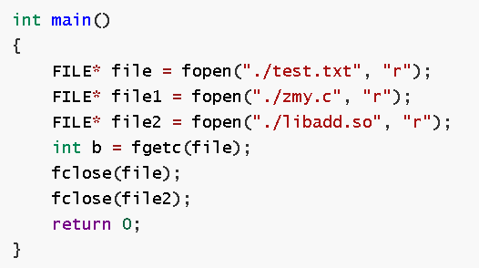
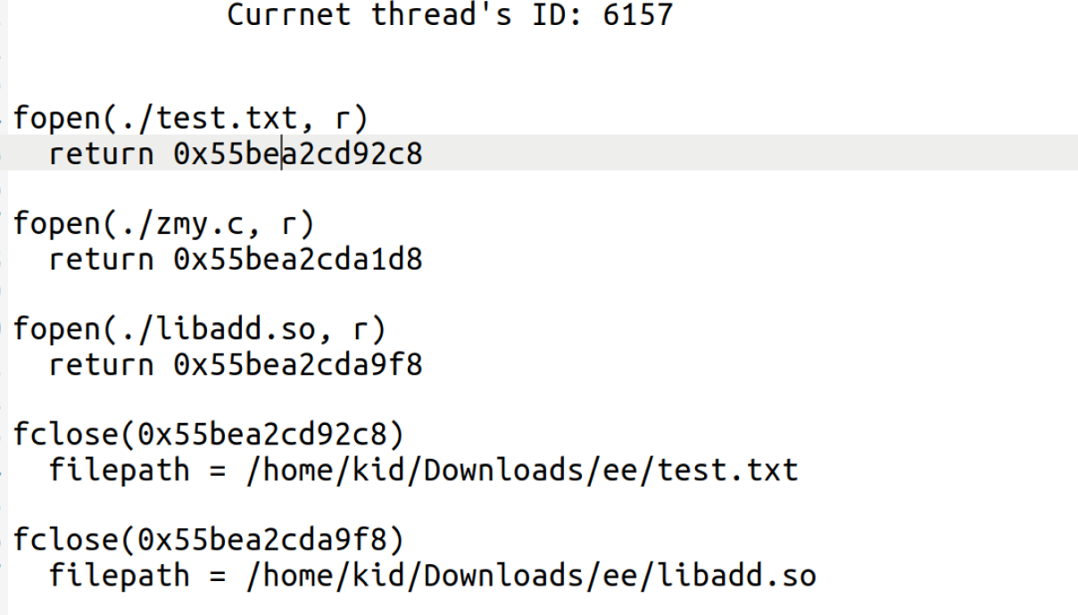
Result

Slide 4
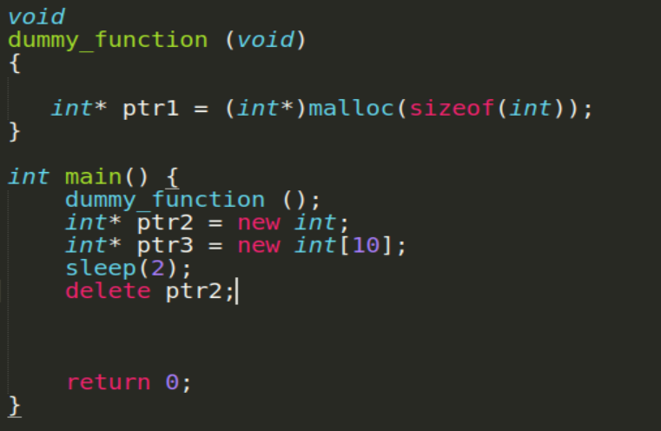
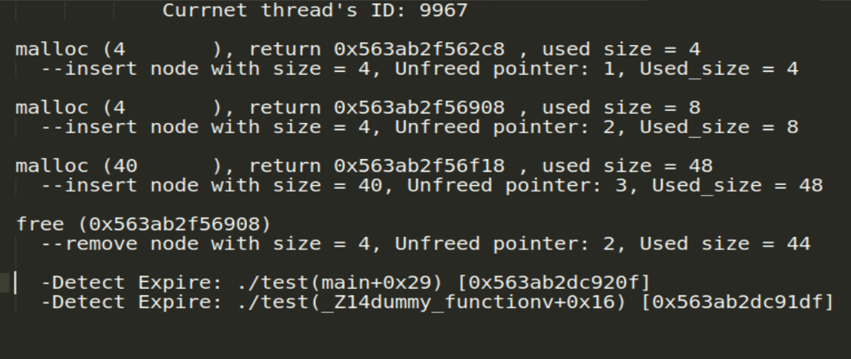
Result

Slide 5
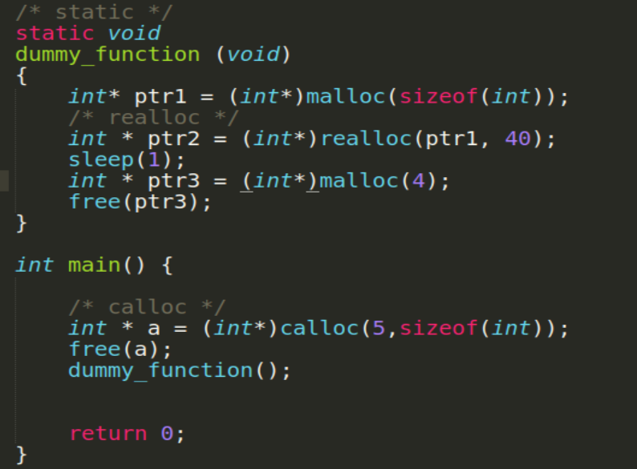
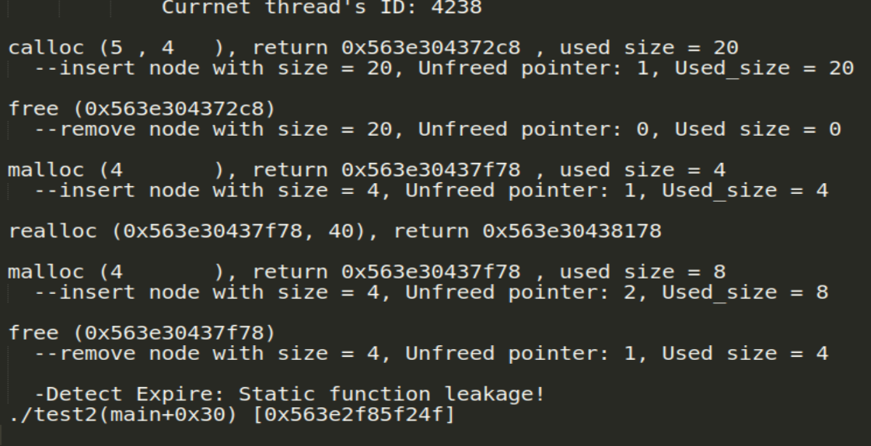
Result
Also works in complicated system files, like ssh

Slide 6
Implementation
Override malloc, calloc, e.t.c.
Provide temporary and simple memory allocation buffer
Import the real function call
overriden functions in __ attribute __ ((constructor))
Handle fclose

Slide 7
Thank you！

