Slide 1
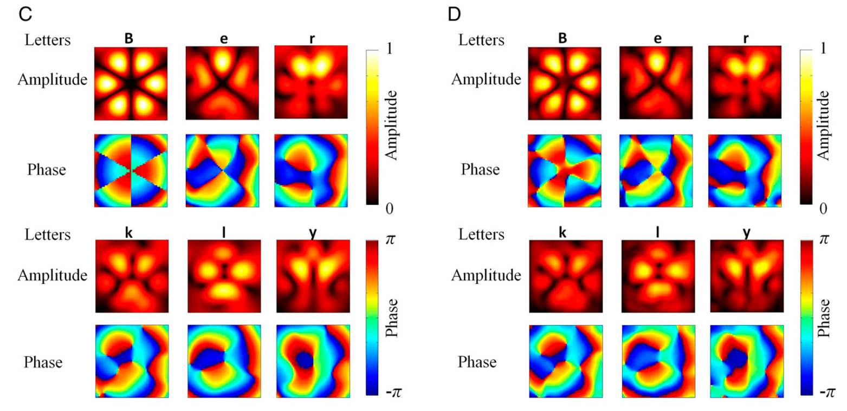
High-speed acoustic communication by multiplexing
orbital angular momentum
完全就是将波数成像+管道模态结合在一块

Slide 2











