Slide 1
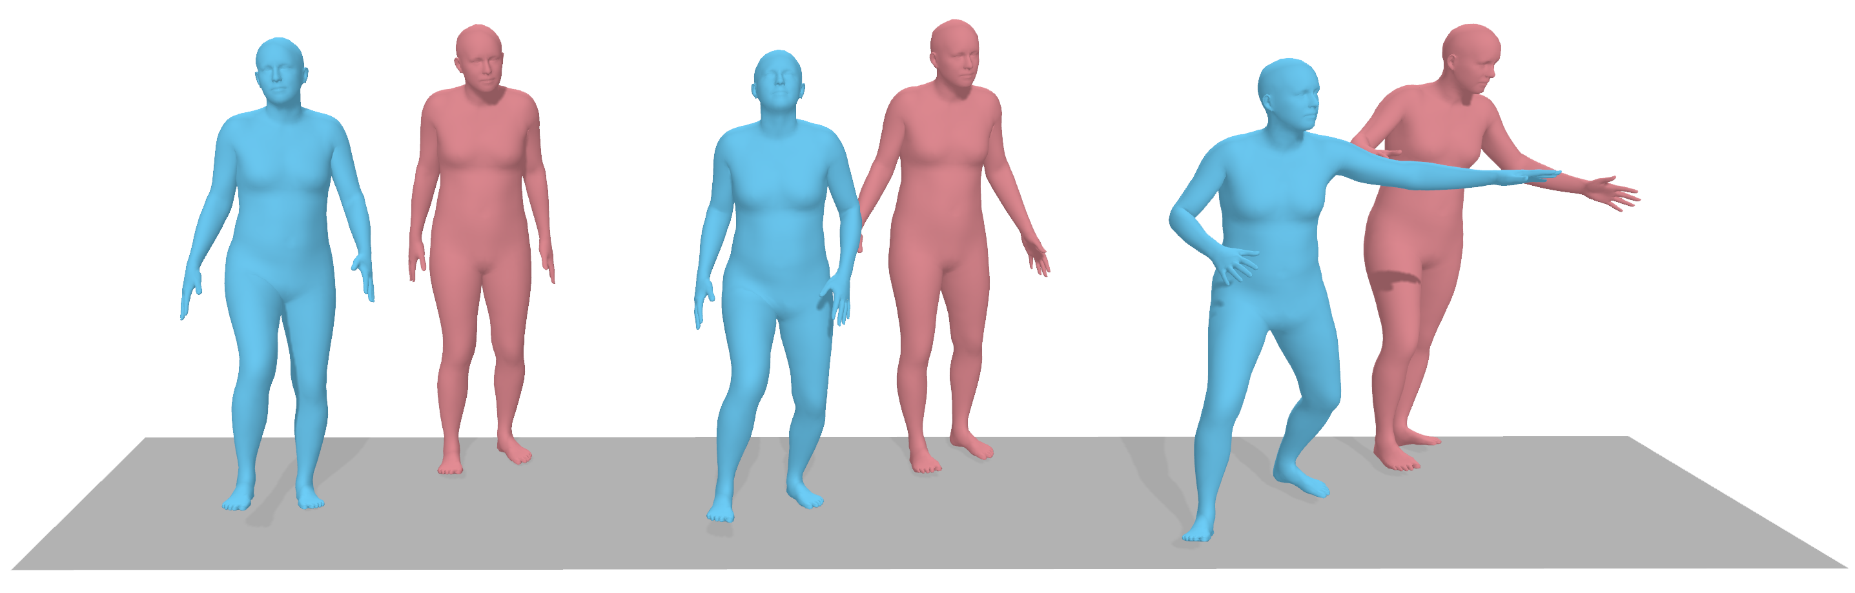
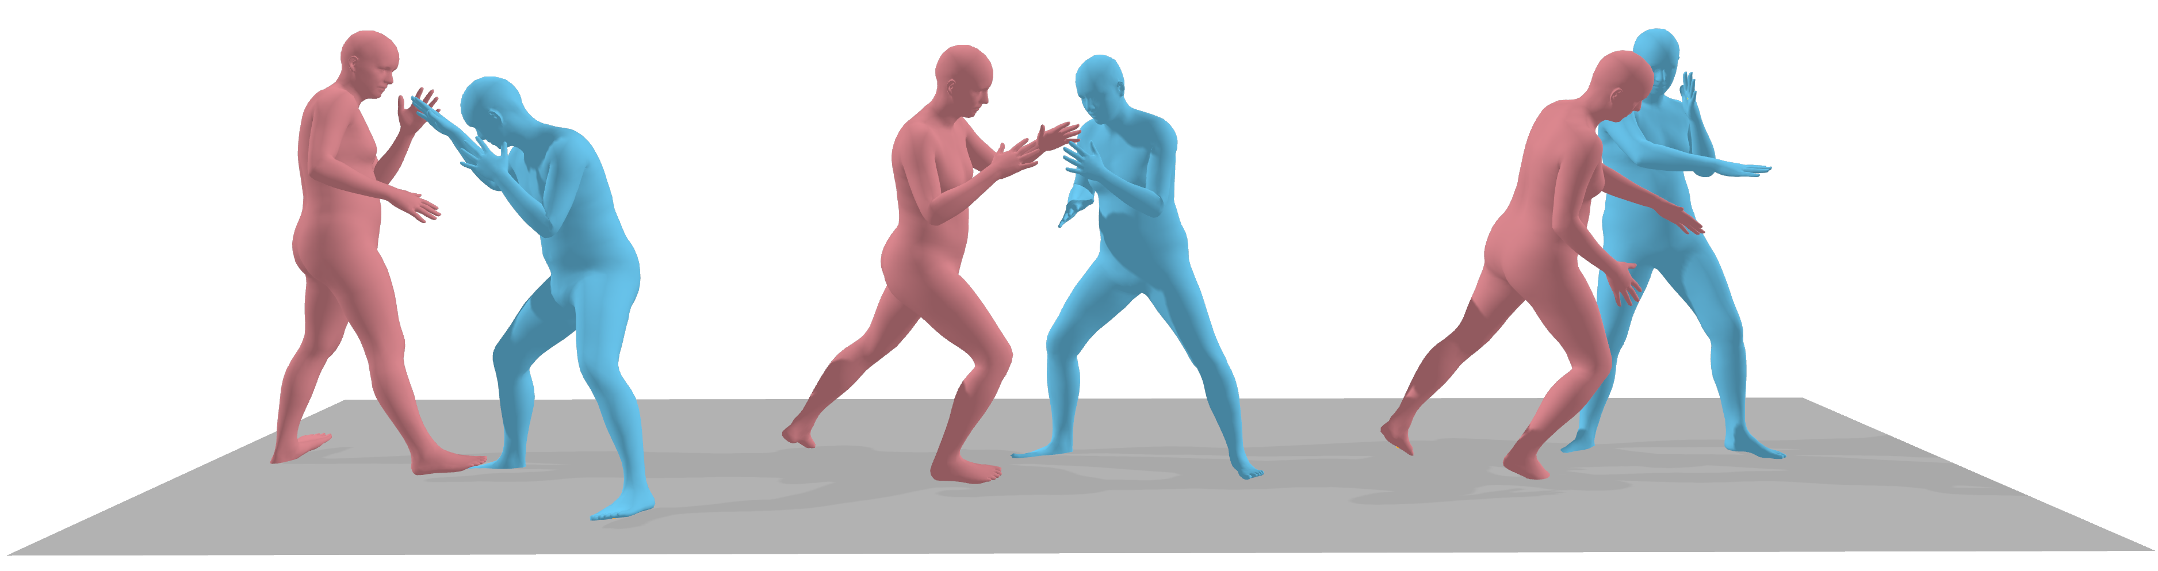
Text to Human-Human
The first person steps forward with the right foot while the second takes
one step back with the
left foot and
raises both hands.
Reaction Generation
Two people are throwing punches at each other.
Reference
Motion
Reaction
Motion

Slide 2
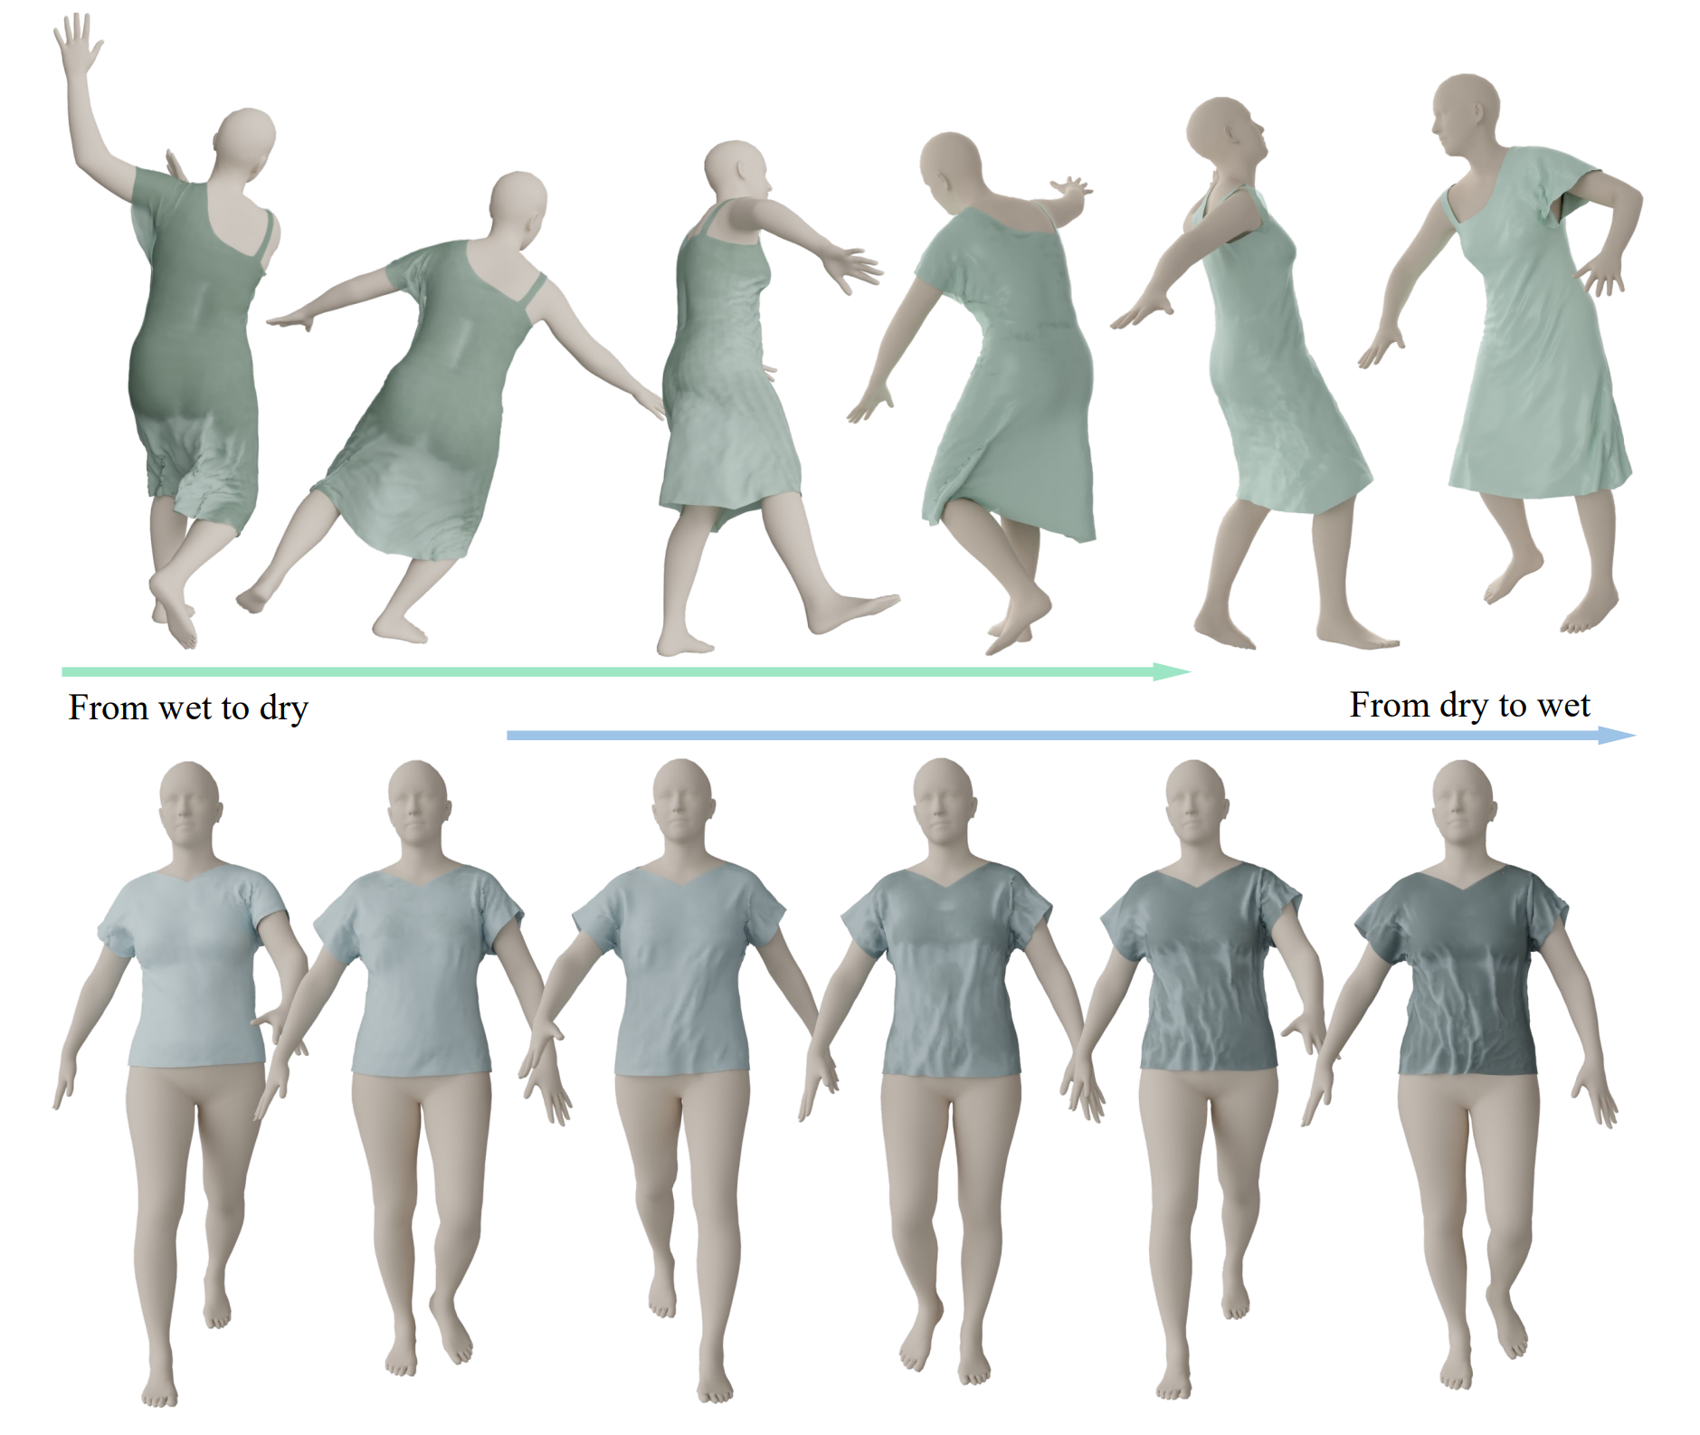
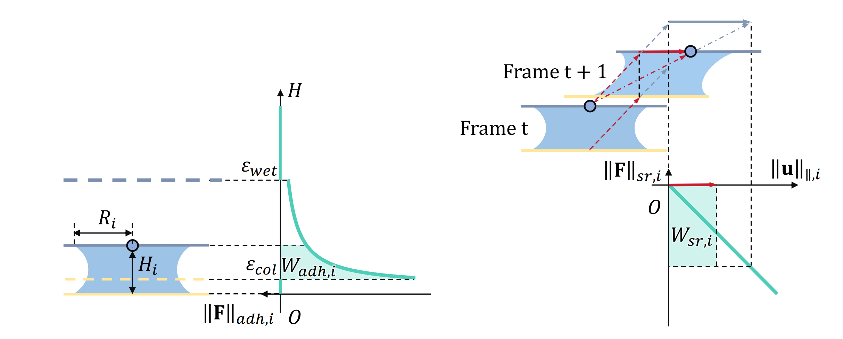

Slide 3
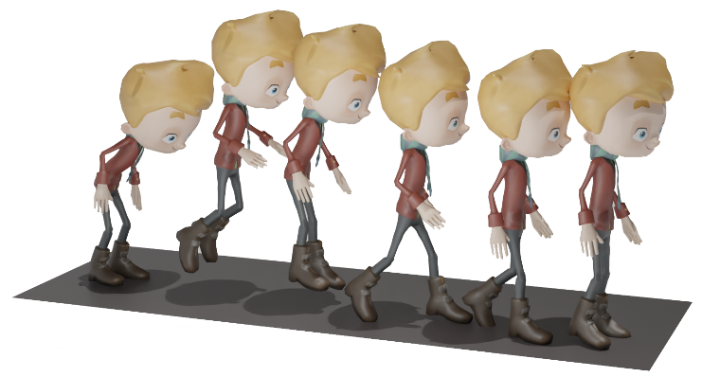
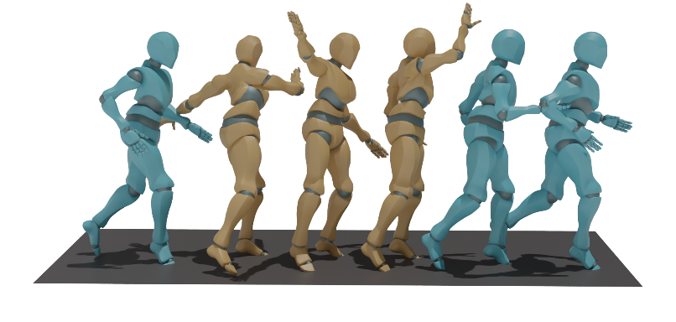
The figure does a quick small jump, then walks forwards and stops.
The person is running forward at a normal speed.
A person swings his right arm over head.

Slide 4
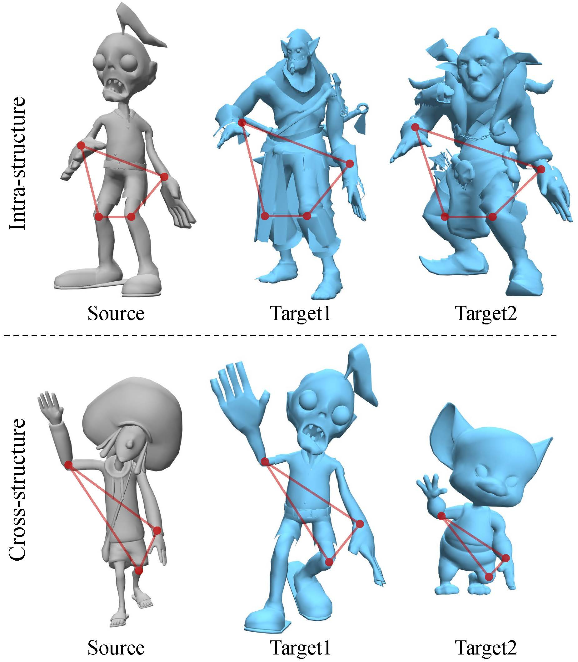
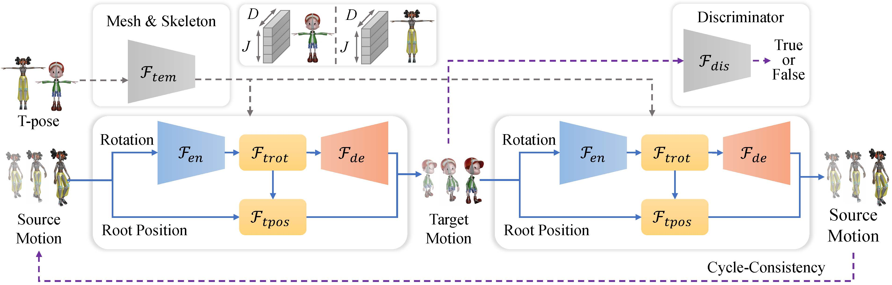

Slide 5
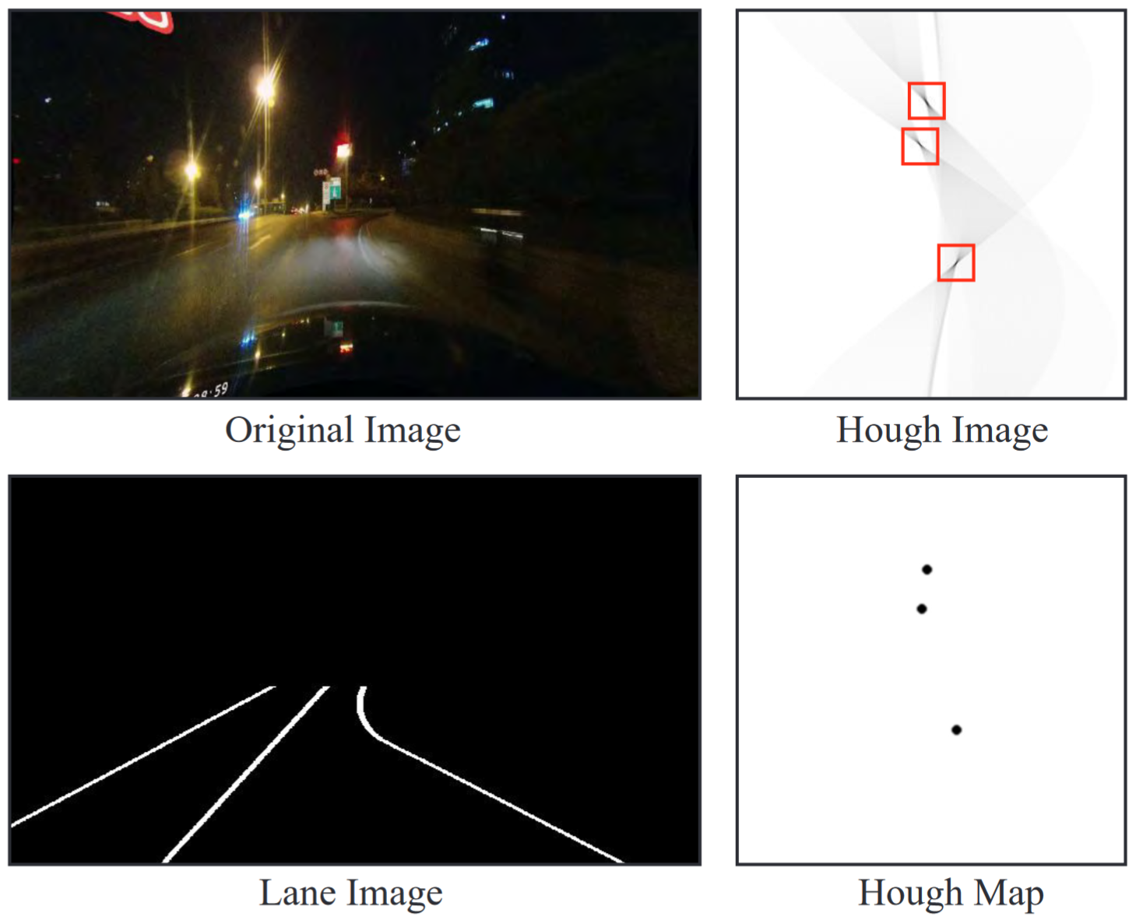
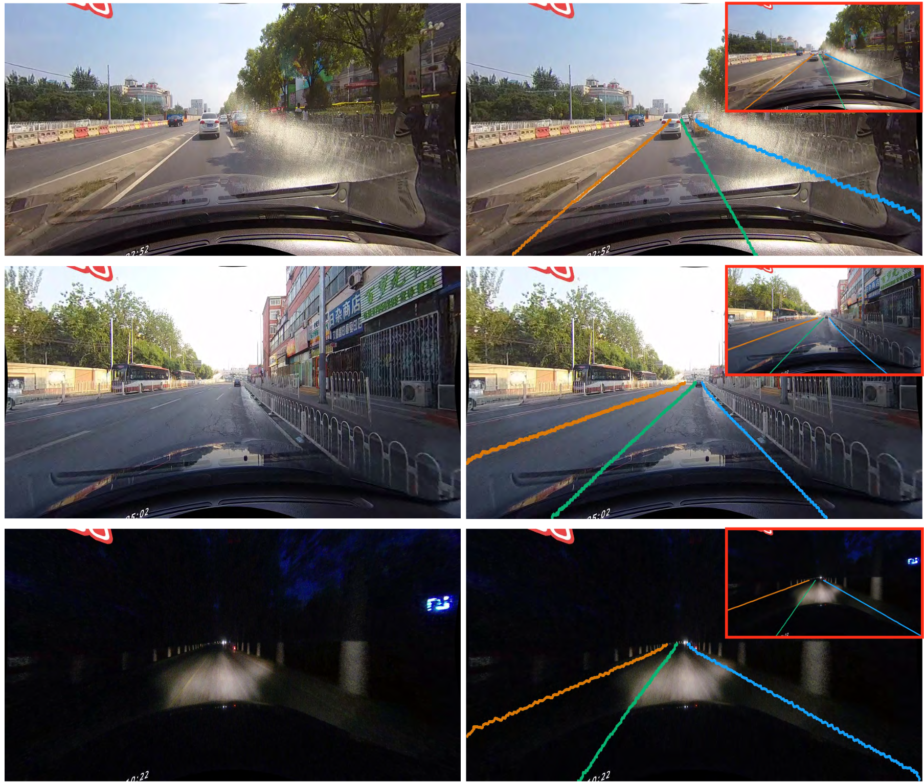

Slide 6
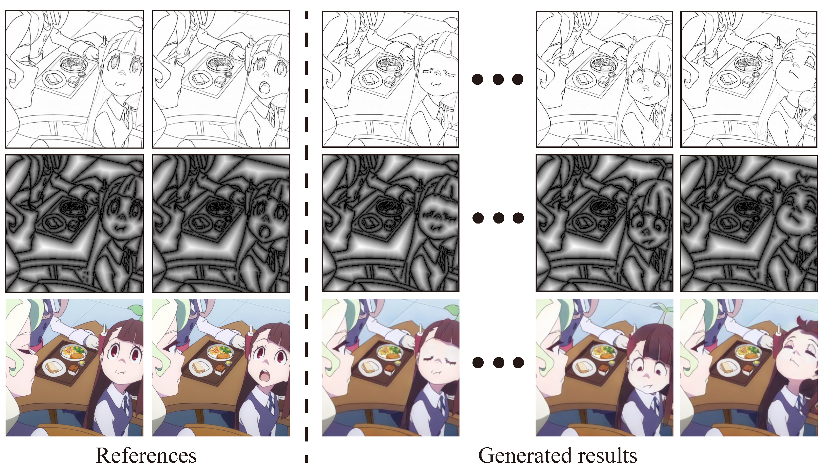

Slide 7
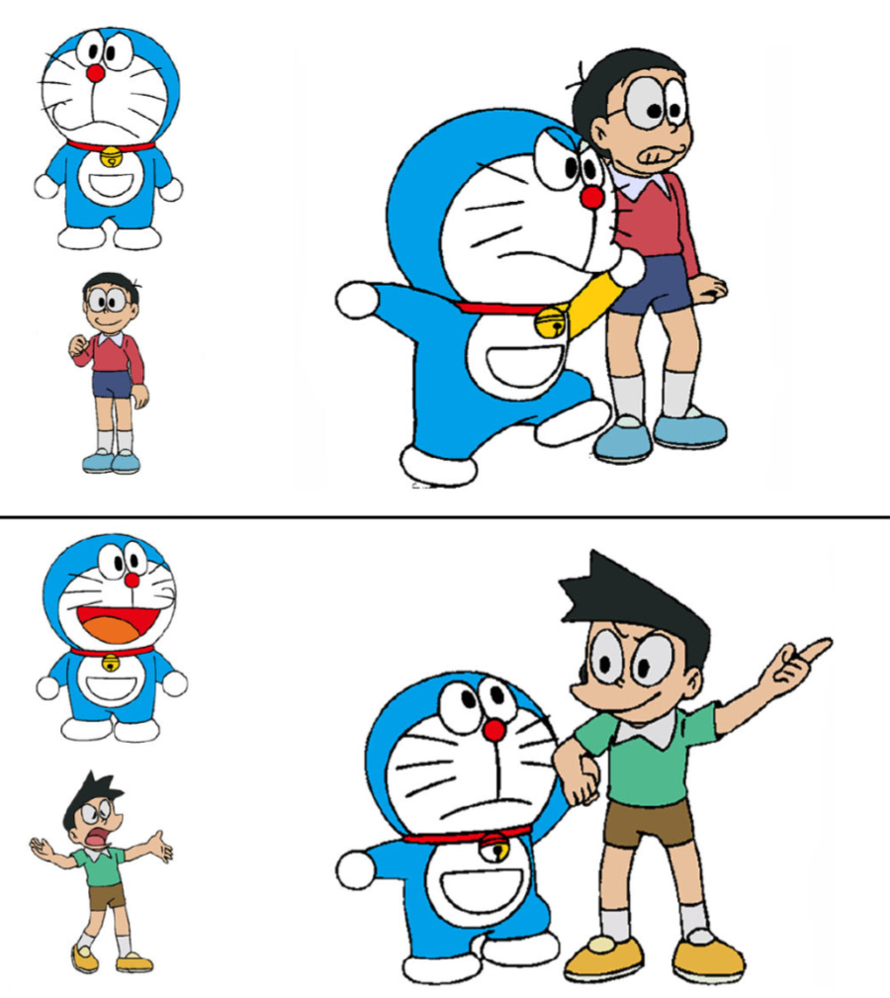
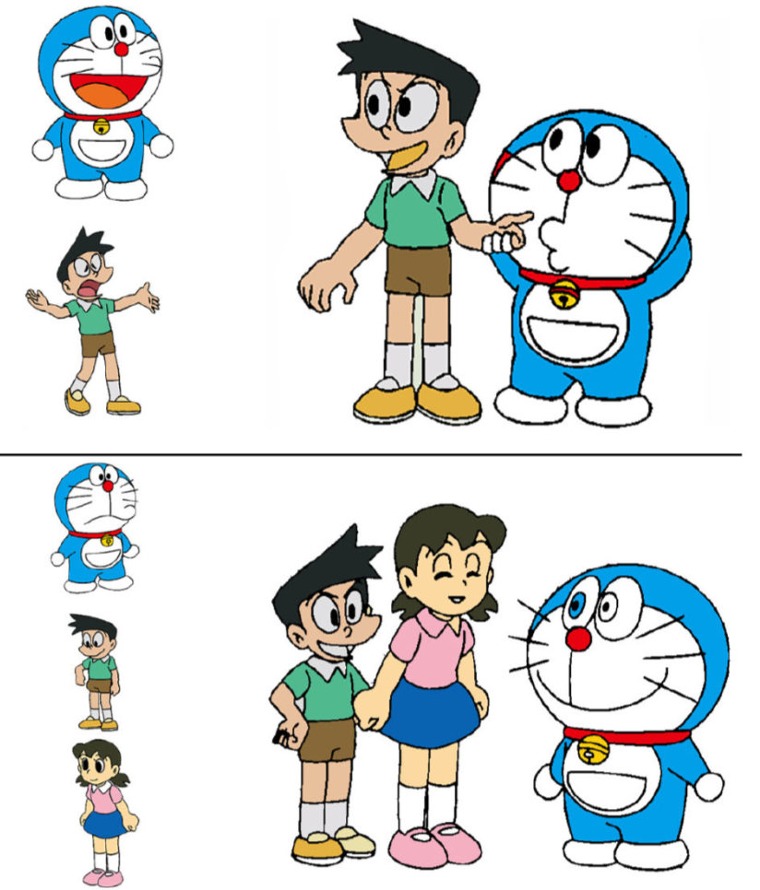

Slide 8
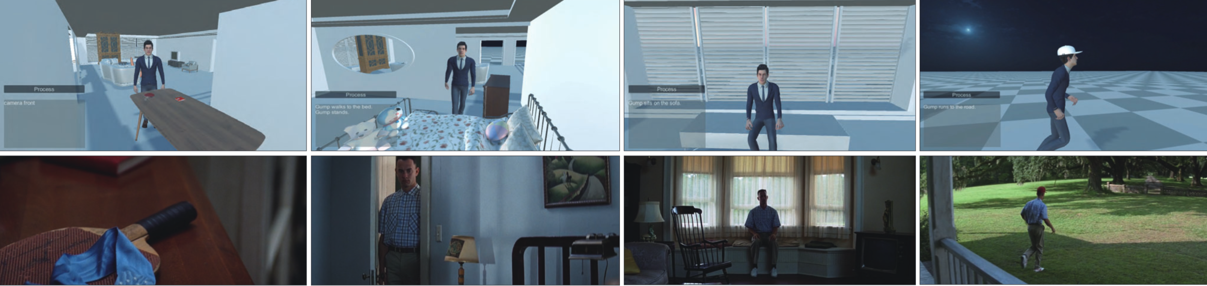
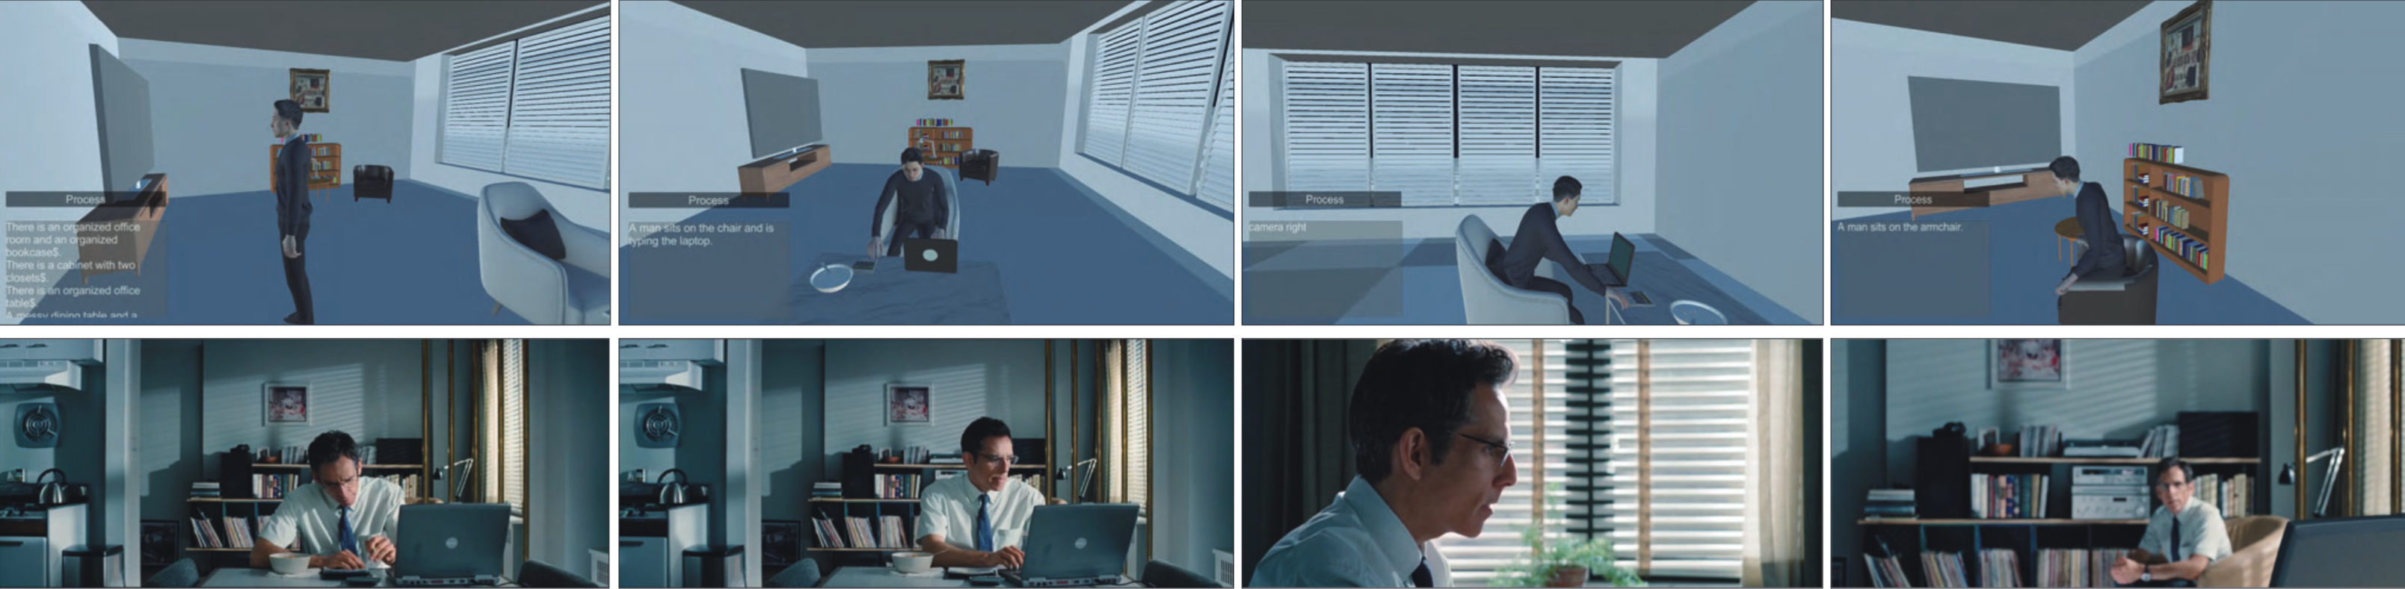
Camera front
Gump walks to the bed. Gump stands.
Gump sits on the sofa.
Gump runs to the road.
There is an organized office room$...
A man sits on the chair and is typing the laptop.
Camera right
A man sits on the armchair.

Slide 9
